Slide 1
In Vitro Fertilization
Informed Consent

Slide 2
Overview
In Vitro Fertilization (IVF) has become an established treatment for many forms of infertility. The main goal of IVF is to allow a patient the opportunity to become pregnant using her own eggs and sperm from her partner or from a donor. This is an elective procedure designed to result in the patient’s pregnancy when other treatments have failed or are not appropriate.
This consent reviews the IVF process from start to finish, including the risks that this treatment might pose to you and your offspring. While best efforts have been made to disclose all known risks, there may be risks of IVF which are not yet clarified or even suspected at the time of this writing.

Slide 3
IVF Cycle
An IVF cycle typically includes the following steps or procedures:
Medications to grow multiple eggs
Retrieval of eggs from the ovary or ovaries
Insemination of eggs with sperm
Culture of any resulting fertilized eggs (embryo)
Placement (“transfer”) of one or more embryo(s) into the uterus
Support of the uterine lining with hormones to permit and sustain pregnancy

Slide 4
Additional procedures
In certain cases, these additional procedures can be employed:
Intracytoplasmic sperm injection (ICSI) to increase chance for fertilization
Assisted hatching of embryos to increase the chance of embryo attachment (“implantation”)
Embryo Cryopreservation (freezing)
Notes:
Justin: Add to technique in IVF

Slide 5
Medications for IVF Treatment
The success of IVF largely depends on growing multiple eggs at once
Injections of the natural hormones FSH and/or LH (gonadotropins) are used for this purpose
Additional medications are used to prevent premature ovulation
An overly vigorous ovarian response can occur, or conversely an inadequate response
Medications may include (but not limited to) the following:
Gonadotropins (injectable “fertility drugs”)
GnRH-agonists (Leuprolide acetate)
GnRH-antagonists (Ganirelix Acetate or Cetrorelix Acetate)
Human chorionic gonadotropin (hCG)
Progesterone and Estradiol
Oral contraceptive pills/estradiol
Other: Antibiotics, antianxiety, steroids, heparin, aspirin
Notes:
Justin: Please place in core elements
Include medications that may be used?
Technique of IVF -→ core elements and their risk

Slide 6
Gonadotropins (injectable “fertility drugs”)
These hormones stimulate the ovary in hopes of inducing the simultaneous growth of several oocytes (eggs) over the span of 8 or more days. All injectable fertility drugs have FSH (follicle stimulating hormone), a hormone that will stimulate the growth of your ovarian follicles (which contain the eggs). Some of them also contain LH (luteinizing hormone) or LH like activity. LH is a hormone that may work with FSH to increase the production of estrogen and growth of the follicles. Luveris®, recombinant LH, can also be given as a separate injection in addition to FSH or alternatively, low-dose hCG can be used. These medications are given by subcutaneous or intramuscular injection. Proper dosage of these drugs and the appropriate timing of triggering ovulation require monitoring of the ovarian response, usually by way of blood tests and ultrasound examinations during the ovarian stimulation.
As with all injectable medications, bruising, redness, swelling, or discomfort can occur at the injection site. Rarely, there can be there an allergic reaction to these drugs. The intent of giving these medications is to mature multiple follicles, and many women experience some bloating and minor discomfort as the follicles grow and the ovaries become temporarily enlarged. Up to 2.0 % of women will develop Ovarian Hyperstimulation Syndrome (OHSS). Other risks and side effects of gonadotropins include, but are not limited to, fatigue, headaches, weight gain, mood swings, nausea, and clots in blood vessels.
Even with pre-treatment attempts to assess ovarian response including abnormal pre-treatment evaluations of ovarian reserve, the stimulation may result in very few follicles developing where the end result may be few or no eggs obtained at egg retrieval or even cancellation of the treatment cycle prior to egg retrieval.
Some research has suggested that the risk of ovarian tumors may increase in women who take any fertility drugs over a long period of time. These studies had significant flaws which limited the strength of the conclusions. More recent studies have not confirmed this risk. A major risk factor for ovarian cancer is infertility per se, suggesting that early reports may have falsely attributed the risk resulting from infertility to the use of medications to overcome it. In these studies, conception lowered the risk of ovarian tumors to that of fertile women.
Notes:
Justin: press next to get to different medications and Justin: tab under medication
Question 10 in OHSS section about gonadotropin side effects

Slide 7
GnRH-agonists (Leuprolide acetate)
Notes:
Justin: tab under medication

Slide 8
GnRH-antagonists
Notes:
Justin: tab under medication

Slide 9
Human chorionic gonadotropin
Notes:
Justin: tab under medication

Slide 10
Progesterone and estradiol
Progesterone and estradiol are hormones normally produced by the ovaries after ovulation. After egg retrieval in some women, the ovaries will not produce adequate amounts of these hormones for long enough to fully support a pregnancy. Accordingly, supplemental progesterone, and in some cases estradiol, are given to ensure adequate hormonal support of the uterine lining. Progesterone is usually given by injection or by the vaginal route after egg retrieval. Progesterone is often continued for some weeks after a pregnancy has been confirmed. Progesterone has not been associated with an increase in fetal abnormalities. Side effects of progesterone include depression, sleepiness, allergic reaction and if given by intra-muscular injection includes the additional risk of infection or pain at the application site. Estradiol, if given, can be by oral, trans-dermal, intramuscular, or vaginal administration. Side effects of estradiol include nausea, irritation at the injection site if given by the trans-dermal route and the risk of blood clots or stroke.
Notes:
Justin: tab under medication
9. Which of the following is responsible for supporting the uterine lining?
Answer: D
Estrogens
b) Human Chorionic Gonadotropins
c) Leuprolides
d) Progesterones

Slide 11
Oral contraceptive pills/estradiol
Notes:
Justin: tab under medication

Slide 12
Other medications
Antibiotics given for short period of time
Notes:
Justin: tab under medication

Slide 13
Transvaginal Oocyte Retrieval
Eggs are removed from the ovary with a needle under ultrasound guidance
Anesthesia is provided to make this comfortable
Injury and infection are rare

Slide 14
IVF and Embryo Culture
Sperm and eggs are placed together in specialized conditions (culture media, controlled temperature, humidity and light) in hopes of fertilization
Culture medium is designed to permit normal fertilization and early embryo development, but the content of the medium is not standardized
Embryo development in the lab helps distinguish embryos with more potential from those with less or none

Slide 15
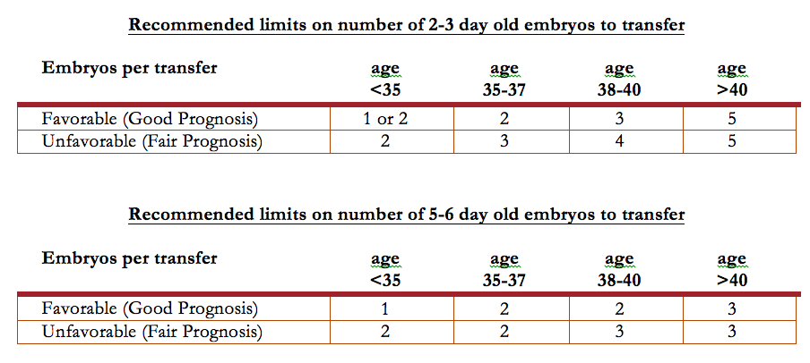
Embryo Transfer
After a few days of development, the best appearing embryos are selected for transfer
The number chose influences the pregnancy rate and the multiple pregnancy rate
A women’s age and the appearance of the developing embryo have the greatest influences on pregnancy outcome
Embryos are placed in the uterine cavity with a thin tube
Excess embryos of sufficient quality that are not transferred can be frozen
Notes:
8. What is the maximum number of embryos that will be transferred to a woman under 35 years of age at one time?
Answer: B
1
b) 2
c) 3
d) 4
e) 5

Slide 16
Hormonal Support of the Uterine Lining
Successful attachment of embryo(s) to the uterine lining depends on adequate hormonal support
Progesterone, given by the intramuscular or vaginal route, is routinely given for this purpose

Slide 17
Intracytoplasmic Sperm Injections (ICSI)
ICSI is used to increase the chance of fertilization when fertilization rates are anticipated to be lower than normal
An increased risk of genetic defects in offspring is reported
ICSI will not improve oocyte defects

Slide 18
Assisted Hatching
Assisted Hatching involves making a hole in the outer shell (zona pellucid) that surrounds the embryo
Hatching may make it easier for embryos to escape from the shell which surrounds them

Slide 19
Embryo Disposition
Freezing of viable embryos not transferred after egg retrieval provides additional chances for pregnancy
Frozen embryos do not always survive the process of freezing and thawing
Freezing of eggs before fertilization is currently much less successful than freezing of fertilized eggs (embryos)
Ethical and legal dilemmas can arise when couples separate or divorce; disposition agreements are essential
It is the responsibility of each couple with frozen embryos to remain in contact with WSP on quarterly basis

Slide 20
Cryopreserved Embryo Storage
WSP will only maintain cryopreserved embryos for a period of five years. After that time, any cryopreserved embryos must be:
Thawed for Frozen Embryo Transfer
Donated to another couple
Donated to research
Discarded
Transferred to a long-term storage facility
There are fees associated with freezing and maintaining cryopreserved embryo(s).
Patients/couples must remain in contact with WSP on a quarterly basis in order to inform the clinic of their wishes as well as to pay the fees associated with the storage of their embryo(s).
In situations where there is no contact with WSP for a period of one year or fees associated with embryo storage have not been paid for a period of one year and WSP is unable to contact me/us at the last given address and phone number, the embryo(s) will be considered to be abandoned and may be discarded by WSP in accordance with normal laboratory procedures and applicable law.
Notes:
Not from bold box

Slide 21
Donated or Research Embryo Fate
In certain situations, donating embryo(s) may not be possible or may be restricted by law. While efforts will be made to abide by your wishes, no guarantees can be given that embryo(s) will be used to donate to another couple. In these instances, if after two years no recipient can be found, or your embryos are not eligible, your embryo(s) will be discarded by the lab in accordance with laboratory procedures and applicable laws.
In certain situations, donating embryo(s) for research may not be possible or may be restricted by law. It will be your responsibility to identify a research group willing to accept your embryos for donation to research. If you identify a research program, it is our/my responsibility to arrange for transfer of our/my embryos to the research facility. We/I also understand that we/I will be responsible for storage fees until the transfer of our/my embryos has been completed.
Notes:
Not from bold box

Slide 22
Ovarian Hyperstimulation Syndrome
To increase the number of eggs that develop, a series of hormone shots are given over two to four weeks. The hormones used in this regimen are known to have, or suspected of having a variety of side effects, some minor and some potentially major.
The most serious side effect of ovarian stimulation is ovarian hyperstimulation syndrome (OHSS).
Symptoms can include: increased ovarian size, nausea and vomiting, accumulation of fluid in the abdomen, breathing difficulties, an increasing concentration of red blood cells, kidney and liver problems, and in the most severe cases, blood cots, kidney failure, or death.
Severe cases affect only a very small percentage of women who undergo OI-IUI – 0.2% or less of all treatment cycles – very severe are even a smaller percentage.
Only about 1.4 in 100,000 cycles has lead to kidney failure, or death.
OHSS occurs at 2 stages:
Early, 1 to 5 days after your hCG-Ovidrel trigger
Late, 10 to 15 days after your hCG-Ovidrel trigger
Notes:
Risk to the Woman
Must check – consent form says OI-IUI
Answer: C
6. Medicines that recruit eggs, help them to mature, and induce ovulation can lead to which of the following?
a) Cardiac Arrhythmias
b) Hypothyroidism
c) Ovarian Hyperstimulation Syndrome
d) Parathyroid Cancer
10. Which of the following types of drugs can lead to increased ovarian size, nausea and vomiting, accumulation of fluid in the abdomen, and in severe cases kidney failure?
Answer: C
Antibiotics
b) GnRH antagonists
c) Gonadotropins
d) Oral contraceptives

Slide 23
Cancer
Many have worried that the use of fertility drugs could lead to an increased risk of cancer – in particular, breast, ovarian and uterine cancers.
One must be careful in interpreting epidemiological studies of women taking fertility drugs, because all of these cancers are more common in women with infertility.
Therefore, comparing women taking fertility drugs with women in the general populations inevitably shoes an increased incidence of cancer.
When the analysis is takes into account the increased cancer risk due to infertility per se, the evidence does not support a relationship between fertility drugs and an increased prevalence of breast or ovarian cancer.
More research is required to examine what the long-term impact fertility drugs may be on breast and ovarian cancer prevalence rates.
For uterine cancer, while numbers are too small to achieve statistical significance, it is at least possible that use of fertility drugs may indeed cause some increased risk.
Notes:
12. Which of the following is a potential reason ART treatments have been suspected of causing cancer?
Drugs used in the past caused ovarian cancer, but we use different drugs today
b) Infertility is a risk factor for gynecologic cancer
c) Ovarian cancer has been shown to be a risk of drugs still used today
d) Today we use medicines that prevent cancer

Slide 24
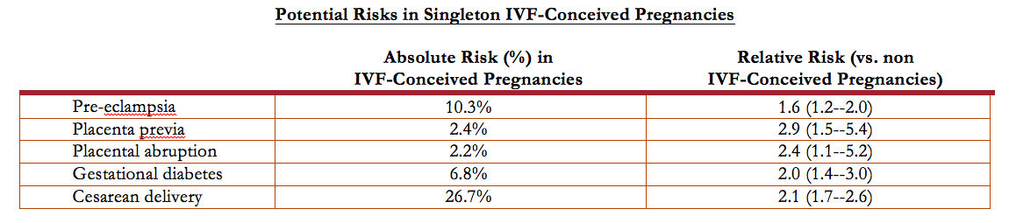
Risks of Pregnancy
Pregnancies that occur with IVF are associated risks with increased risks of certain conditions
Some of these risks stem from the higher average age of women pregnant by IVF and the fact that underlying cause of infertility may be the cause of the increased risk of pregnancy complications
Absolute risk = % IVF Pregnancies in which risk occurred
Relative risk = risk in IVF versus risk in non-IVF pregnancies (ex: Relative risk of 2.0 indicates that twice as many IVF pregnancies experience this risk as compared to non-IVF pregnancies.
Notes:
13. Which of the following maternal conditions is most likely to occur in an IVF-conceived pregnancy?
Answer: D
Gestational diabetes
b) Placenta previa
c) Placental abruption
d) Preeclampsia

Slide 25
Risks of Pregnancy
Currently more than 30% of IVF pregnancies are twins or higher-order multiple gestations (triplets or greater)
Half IVF babies are a result of multiple gestations
Identical twinning occurs in 1.5% - 4.5% of IVF pregnancies
IVF twins deliver on average 3 weeks earlier and weight 1,000 gm less than IVF singletons
IVF twins do as well as spontaneously conceived twins
Triplet (and greater pregnancies delivery before 32 weeks (7 months) in almost half of cases
Abnormal intra-uterine pregnancies have occurred either alone or concurrently with normal intra-

Slide 26
Risk to Offspring
IVF babies may be at a slight increased risk for birth defects
The risk for a multiple pregnancy is higher for patients undergoing IVF, even when only one embryo is transferred
Multiple pregnancies are the greatest risk for babies following IVF
Some risk may also stem from the underlying infertile state, or from IVF techniques, or both
Notes:
4. Which of the following poses the greatest risk for babies following IVF?
Preterm Delivery
b) Gestational Diabetes
c) Multiple Fetuses
d) Previous IVF Cycles

Slide 27
Overall Risks
Since the first birth of an IVF baby in 1978, more than 3 million children have been born worldwide following IVF treatments. Numerous studies have been conducted to assess the overall health of IVF children and the majority of studies on the safety of IVF have been reassuring. As more time has passed and the dataset has enlarged, some studies have raised doubts about the equivalence of risks for IVF babies as compared to naturally conceived babies.
A major problem in interpreting the data arises from the fact that comparing a group of infertile couples to a group of normally fertile couples is not the proper comparison to make if one wants to assess the risk that IVF technology engenders. Infertile couples, by definition, do not have normal reproductive function and might be expected to have babies with more abnormalities than a group of normally fertile couples. This said, even if the studies suggesting an increased risk to babies born after IVF prove to be true, the absolute risk of any abnormal outcome appears to be small.
Singletons conceived with IVF tend to be born slightly earlier than naturally conceived babies (39.1 weeks as compared to 39.5 weeks).
IVF twins are not born earlier or later than naturally conceived twins.
The risk of a singleton IVF conceived baby being born with a birth weight under 5 pounds nine ounces (2500 grams) is 12.5% vs. 7% in naturally conceived singletons.
Notes:
Risks to the Offspring

Slide 28
Birth Defects
The risk of birth defects in the normal population is 2-3 %.
In IVF babies the birth defect rate may be 2.6-3.9%. The difference is seen predominately in singleton males.
Studies to date have not been large enough to prove a link between IVF treatment and specific types of birth defects.

Slide 29
Birth Defects
Imprinting Disorders. These are rare disorders having to do with whether a maternal or paternal gene is inappropriately expressed. In two studies approximately 4% of children with the imprinting disorder called Beckwith-Weidemann Syndrome were born after IVF, which is more than expected. A large Danish study however found no increased risk of imprinting disorders in children conceived with the assistance of IVF. Since the incidence of this syndrome in the general population is 1/15,000, even if there is a 2 to 5-fold increase to 2-5/15,000, this absolute risk is very low.
Childhood Cancers. Most studies have not reported an increased risk with the exception of retinoblastoma: In one study in the Netherlands, five cases were reported after IVF treatment which is 5 to 7 times more than expected.
Infant Development. In general, studies of long-term developmental outcomes have been reassuring so far; most children are doing well. However, these studies are difficult to do and suffer from limitations. A more recent study with better methodology reported an increased risk of cerebral palsy (3.7 fold) and developmental delay (4 fold), but most of this stemmed from the prematurity and low birth weight that was a consequence of multiple pregnancy.

Slide 30
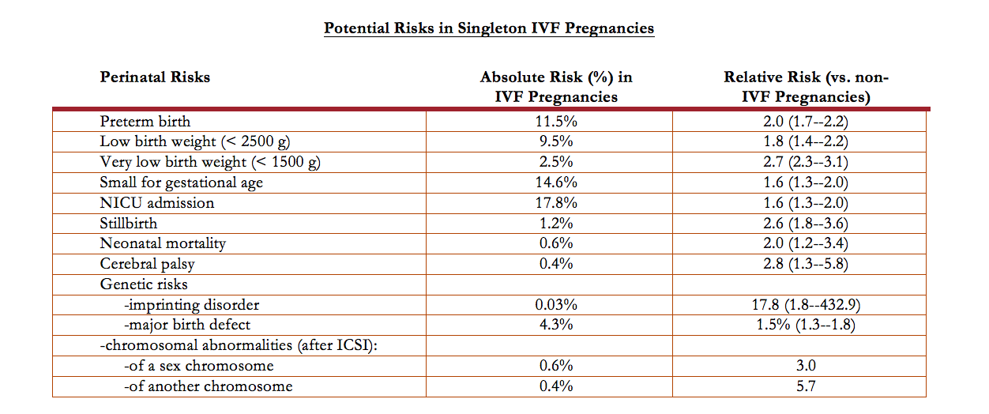
Potential Risks in Singleton IVF Pregnancies
Notes:
Justin: tab under birth defects
16. Which of the following fetal outcomes is most likely to occur in an IVF-conceived pregnancy?
Answer: C
Cerebral palsy
b) Major birth defect
c) Preterm birth
d) Stillbirth

Slide 31
Risks of Multiple Pregnancy
Multiple fetuses (including twins) that share the same placenta have additional risks. Twin-twin transfusion syndrome in which there is an imbalance of circulation between the fetuses may occur in up to 20% of twins sharing a placenta. Excess or insufficient amniotic fluid may result from twin-to-twin transfusion syndrome. Twins sharing the same placenta have a higher frequency of birth defects compared to pregnancies having two placentas. Twins sharing the same placenta appear to occur more frequently after blastocyst transfer.
Placenta previa and vasa previa are more common complications in multiple gestations. Abruptio placenta also is more common and postpartum hemorrhage may complicate 12% of multifetal deliveries. Consequences of multiple gestations include the major sequelae of prematurity (cerebral palsy, retinopathy of prematurity, and chronic lung disease) as well as those of fetal growth restriction (polycythemia, hypoglycemia, necrotizing enterocolitis). It is unclear to what extent multiple gestations themselves affect neuro-behavioral development in the absence of these complications. Rearing of twins and high-order multiples may generate physical, emotional, and financial stresses, and the incidence of maternal depression and anxiety is increased in women raising multiples. At mid-childhood, prematurely born offspring from multiple gestations have lower IQ scores, and multiple birth children have an increase in behavioral problems compared with singletons. It is not clear to what extent these risks are affected by IVF.
Notes:
5. Multiple gestations (twins, triplets, etc.) that result in live birth may result in which of the following factors?
I. Maternal Anxiety and Depression
II. Decreased IQ of the Children
III. Decreased Chance of Behavioral Problems
IV. Financial and Emotional Stress
Answer: D
I and II only
b) II and III only
c) III and IV only
d) I, II, and IV only
e) I, III, and IV only
f) I, II, III, and IV
14. When two fetuses share the same placenta, there is an increased risk of adverse outcomes. Which of the following is a unique problem for fetuses sharing the same placenta?
Answer: E
Cerebral palsy
b) Heart defects
c) Lower IQ scores
d) Premature birth
e) Twin-twin transfusion syndrome

Slide 32
The Option of Selective Reduction
Pregnancies that have more than 2 fetuses are considered an adverse outcome of infertility treatment. The greater the number of fetuses within the uterus, the greater is the risk for adverse perinatal and maternal outcomes. Patients with more than twins are faced with the options of continuing the pregnancy with all risks previously described, terminating the entire pregnancy, or reducing the number of fetuses in an effort to decrease the risk of maternal and perinatal morbidity and mortality. Multifetal pregnancy reduction (MFPR) decreases risks associated with preterm delivery, but often creates profound ethical dilemmas. Pregnancy loss is the main risk of MFPR. However, current data suggest that such complications have decreased as experience with the procedure has grown. The risk of loss of the entire pregnancy after MFPR is approximately 1% to 5%.
Notes:
Justin: tab under multiple pregnancy
7. Multifetal selective reduction can result in loss of pregnancy in what percentage of cases?
Answer: B
0%
b) 1-5%
c) 6-10%
d) 11-20%

Slide 33
Ethical and Religious Considerations in Infertility Treatment
Infertility treatment can raise concerns and questions of an ethical or religious nature for some patients. The technique of in vitro fertilization (IVF) involves the creation of human embryos outside the body, and can involve the production of excess embryos and/or “high-order” multiple pregnancy (triplets or more).
We encourage patients and their spouses or partners who so desire to consult with trusted members of their religious or ethics community for guidance on their infertility treatment.

Slide 34
Psychosocial Effects of Infertility Treatment
A diagnosis of infertility can be a devastating and life-altering event that impacts many aspects of a patient’s life. Infertility and its treatment can affect a patient and her spouse or partner medically, financially, socially, emotionally and psychologically. Feelings of anxiousness, depression, isolation, and helplessness are not uncommon among patients undergoing infertility treatment. Strained and stressful relations with spouses, partners and other loved ones are not uncommon as treatment gets underway and progresses.
Our health care team is available to address the emotional, as well as physical symptoms that can accompany infertility. In addition to working with our health care team to minimize the emotional impacts of infertility treatments, patients may also consider working with mental health professionals who are specially trained in the area of infertility care.
Our health care team can assist you in locating a qualified mental health professional who is familiar with the emotional experience of infertility, or you can contact a national support group such as RESOLVE, (www.resolve.org, Tel. 1-888-623-0744) or The American Fertility Association (AFA), (www.theafa.org, Tel: 1-888-917-3777).

Slide 35
While it is normal to experience emotional ups and downs when pursuing infertility treatment, it is important to recognize when these feelings are of a severe nature. If you experience any of the following symptoms over a prolonged period of time, you may benefit from working with a mental health professional:
loss of interest in usual activities
depression that doesn't lift
strained interpersonal relationships (with partner, family, friends and/or colleagues)
difficulty thinking of anything other than your infertility
high levels of anxiety
diminished ability to accomplish tasks
difficulty with concentration
change in your sleep patterns (difficulty falling asleep or staying asleep, early morning awakening, sleeping more than usual for you)
change in your appetite or weight (increase or decrease)
increased use of drugs or alcohol
thoughts about death or suicide
social isolation
persistent feelings of pessimism, guilt, or worthlessness
persistent feelings of bitterness or anger
Notes:
Justin: tab under psychosocial

Slide 36
Legal Considerations to Offspring
The law regarding embryo cryopreservation, subsequent thaw and use, and parent-child status of any resulting child(ren) is, or may be, unsettled in the state in which either the patient, spouse, partner, or any donor currently or in the future lives, or the state in which the ART Program is located. We/I acknowledge that the ART Program has not given us legal advice, that we are not relying on the ART Program to give us any legal advice, and that we have been informed that we may wish to consult a lawyer who is experienced in the areas of reproductive law and embryo cryopreservation and disposition. If we/I have any questions or concerns about the present or future status of our embryos, our/my individual or joint access to them, our/my individual or joint parental status as to any resulting child, or about any other aspect of this consent and agreement.
Notes:
With respect to areas of reproductive law, the consent form...
a) provides guidance on the storage of embryos
b) suggests consulting a lawyer experienced in reproductive law
c) is a legal document in a court of law
d) can be relied on for legal advice

Slide 37
Alternatives to IVF
There are alternatives to IVF treatment including gamete Intrafallopian transfer (GIFT), zygote intrafallopian transfer (ZIFT) or tubal embryo transfer (TET) where eggs and sperm, fertilized eggs (ZIFT) or developing embryos, respectively, are placed into the fallopian tube(s). Using donor sperm, donor eggs, adoption or not pursuing treatment are also options. Gametes (sperm and/or eggs), instead of embryos may be frozen for future attempts at pregnancy in an effort to avoid potential future legal issues relating to disposition of any cryopreserved embryos. Sperm freezing, but not egg freezing, has been an established procedure for many decades. Egg freezing is currently available, but is considered an experimental procedure at this time (January 2009).

Slide 38
Reporting Outcomes
The 1992 Fertility Clinic Success Rate and Certification Act requires the Centers for Disease Control and Prevention (CDC) to collect cycle-specific data as well as pregnancy outcome on all assisted reproductive technology cycles performed in the United States each year and requires them to report success rates using these data.
Consequently, data from my/our IVF procedure will be provided to the CDC, and to the Society of Assisted Reproductive Technologies (SART) of the American Society of Reproductive Medicine (ASRM) (if my/our clinic is a member of this organization).
The CDC may request additional information from the treatment center or contact me/us directly for additional follow-up.
Additionally, my/our information may be used and disclosed in accordance with HIPAA guidelines in order to perform research or quality control. All information used for research will be de-identified prior to publication. De-identification is a process intended to prevent the data associated with my/our treatment being used to identify me/us as individuals.
In addition, ARI physicians and scientists may include information about IVF procedures in medical publications and professional presentations. In these publications and presentations the identities of the patients involved in the IVF procedure remain confidential. ARI keeps patient medical records and information confidential through standard procedures for the protection of patient identities.
Notes:
2. In compliance with The 1992 Fertility Clinic Success Rate and Certification Act, this clinic will report the following data to the Centers for Disease Control (CDC) in a de-identified manner...
a) Drugs used in cycle stimulation
b) Pregnancy outcomes
c) Number of cycles
d) Number of live births
e) all of the above
f) none of the above

Slide 39
Financial
I/We have had a financial consult and have been given a copy of our benefits from the insurance cards we provided to ARI. I/We have been encouraged to check our own benefits. I/We are personally financially responsible for the expense of this treatment and any additional expenses for the medical problems or those for a child. Expenses for IVF treatment consist of the cost of the medications, laboratory, facility and professional fees. All questions have been answered to my/our satisfaction prior to starting treatment.

