Slide 1
Example: Human Resource data
Data to Decisions

Slide 2
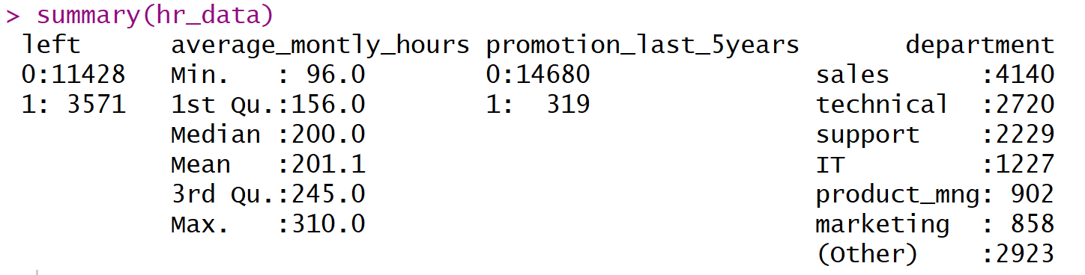
Human Resource Data: Summary
Raw R code and some explanations are in your R file:
summary(hr_data) (line 20-24)
Run line 1 – 19 before run line 24

Slide 3
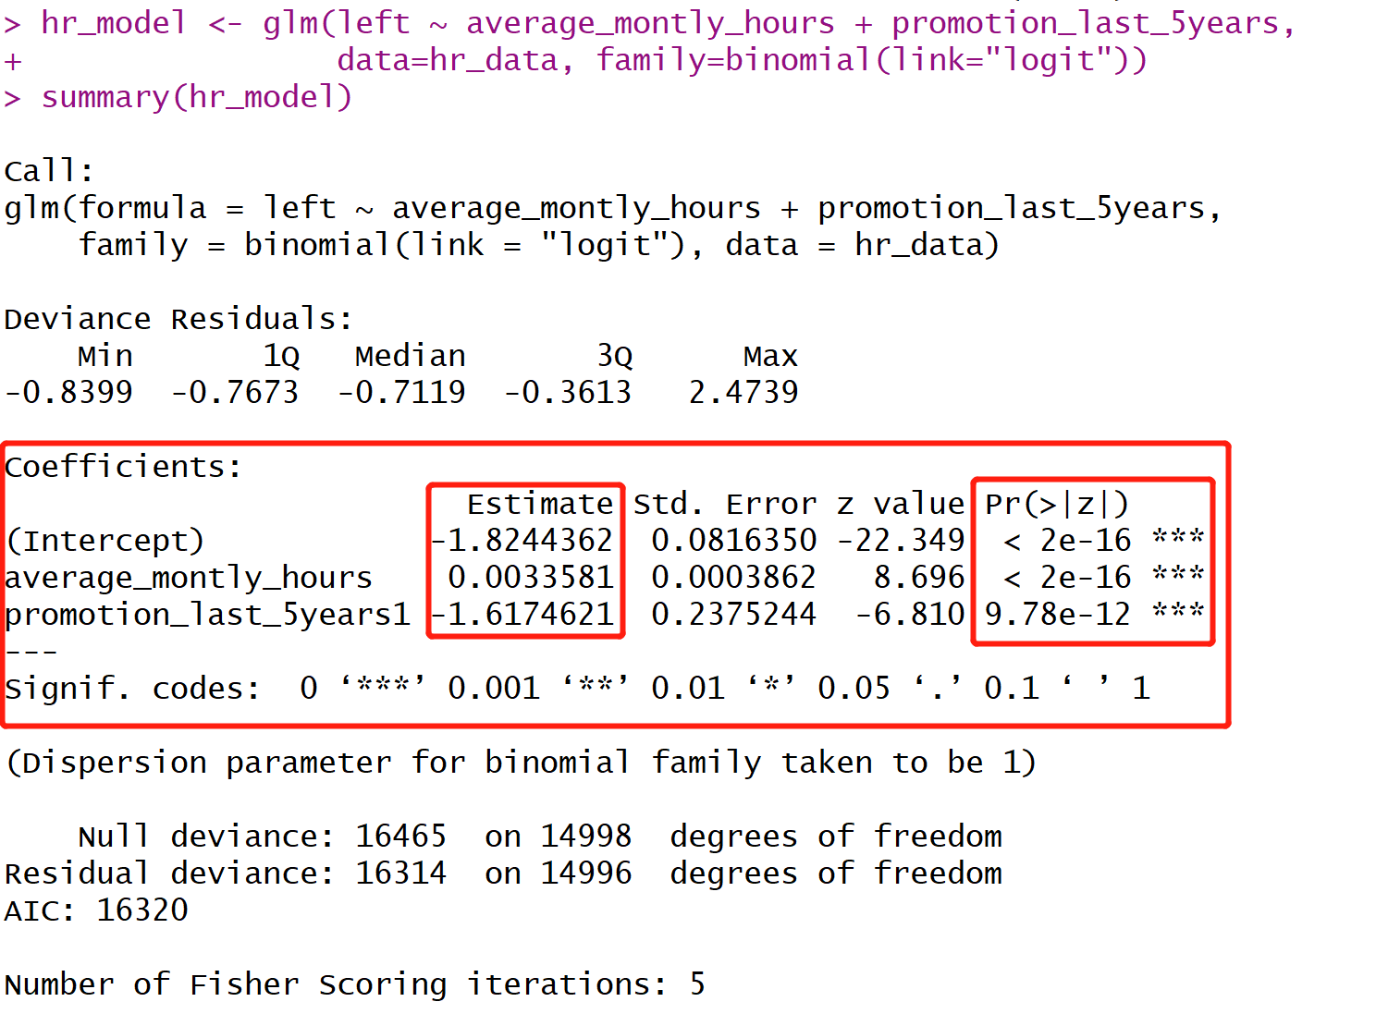
Human Resource Data: Model results
Raw R code and some explanations are in your R file:
hr_model <- glm(left ~ average_montly_hours + promotion_last_5years,
data=hr_data, family=binomial(link="logit"))
summary(hr_model)
(line 26-29)

Slide 4
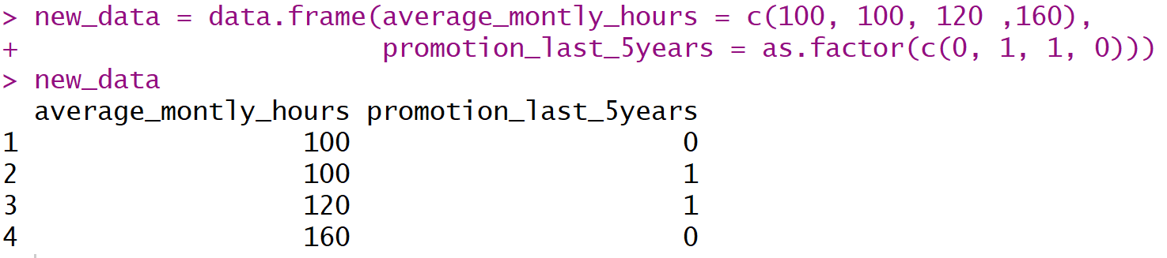
Some example of new data
Questions:
Who do you think is the one that is the most likely to leave?
Who do you think is the one that is the least likely to leave?
Raw R code and some explanations are in your R file:
new_data = data.frame(average_montly_hours = c(100, 100, 120 ,160),
promotion_last_5years = as.factor(c(0, 1, 1, 0)))
new_data
(line 30-33)

Slide 5
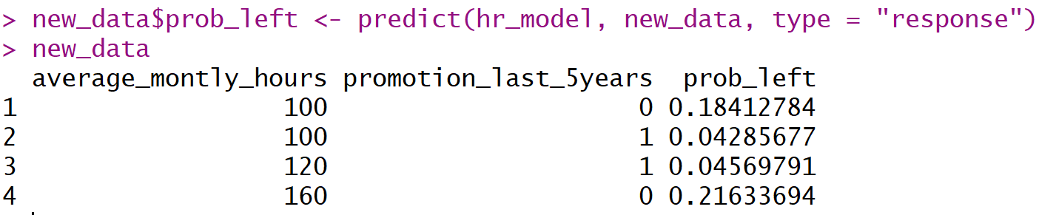
Prediction of new data
Answers:
The last person is the one that is the most likely to leave.
The second person is the one that is the least likely to leave.
Raw R code and some explanations are in your R file:
new_data$prob_left <- predict(hr_model, new_data, type = "response")
new_data
(line 37-38)

Slide 6
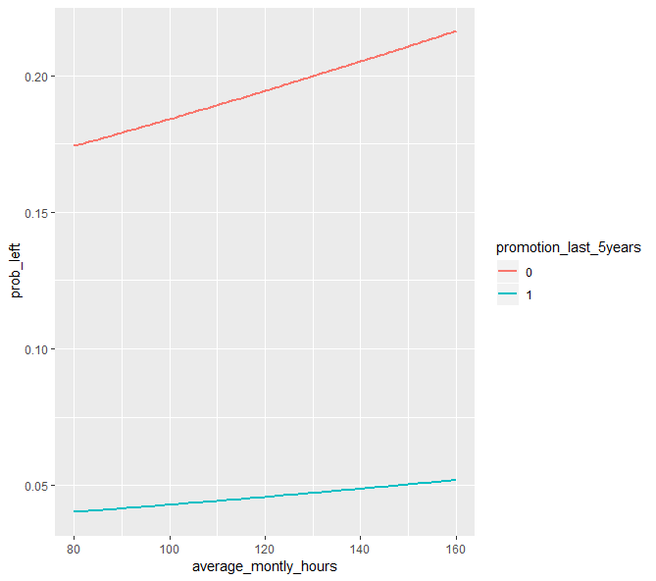
Some data visualization
Raw R code and some explanations are in your R file:
line 39-45

Slide 7
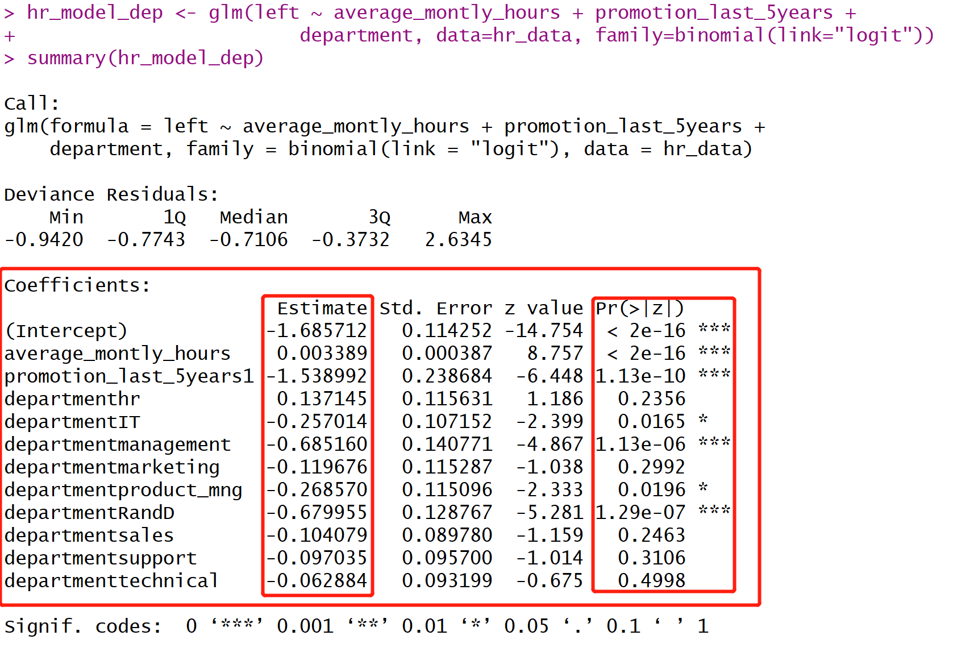
Model with department information
Raw R code and some explanations are in your R file:
line 37 - 55

Slide 8
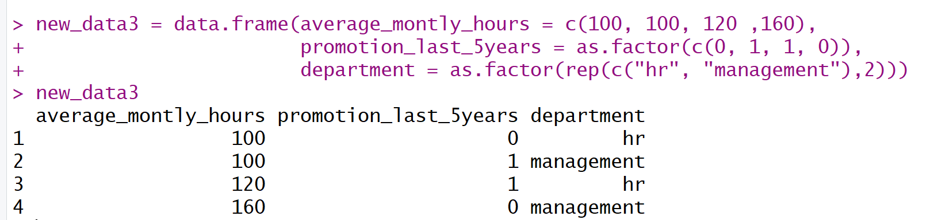
New data with department information
Questions:
Who do you think is the one that is the most likely to leave?
Who do you think is the one that is the least likely to leave?
Raw R code and some explanations are in your R file:
line 56-62

Slide 9
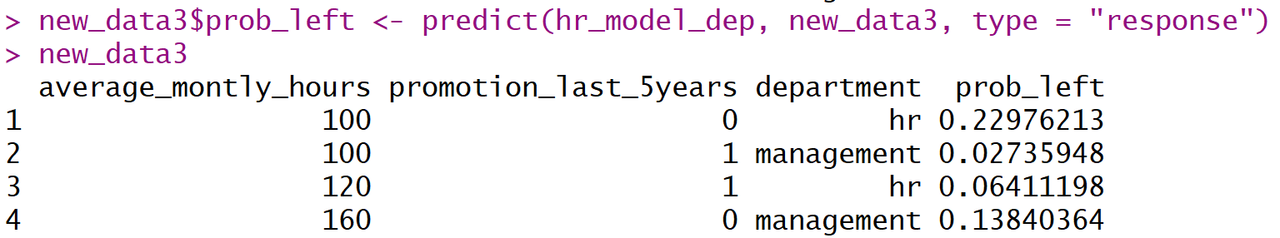
Prediction
Answers:
The first person is the one that is the most likely to leave.
The second person is the one that is the least likely to leave.
Raw R code and some explanations are in your R file:
new_data3$prob_left <- predict(hr_model_dep, new_data3, type = "response")
new_data3
line 64-65

Slide 10
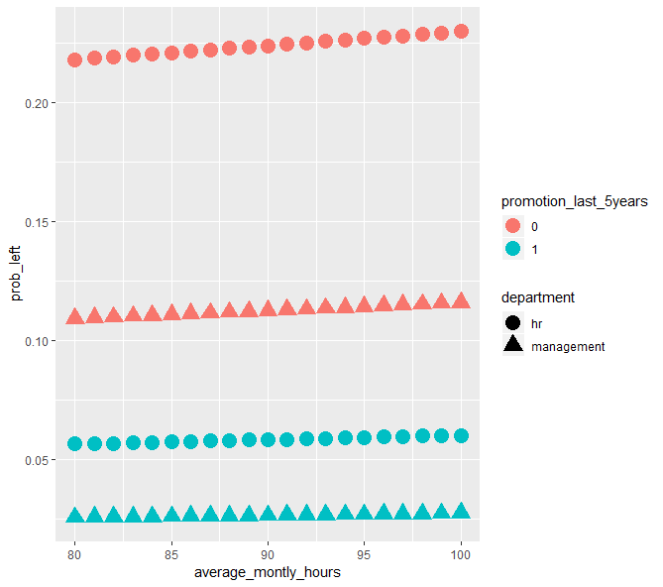
Some data visualization
Raw R code and some explanations are in your R file:
line 68-78

