Slide 1
Example: Advertising data
Data to Decisions

Slide 2
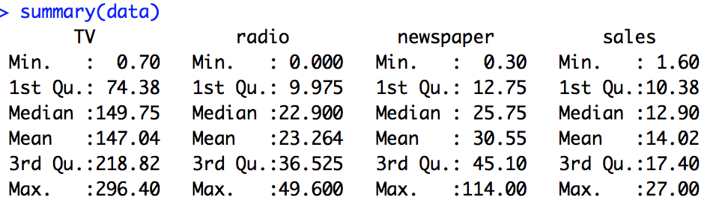
Advertising Data: Summary
Raw R code in your R file:
summary(ad_data) (line 19)

Slide 3
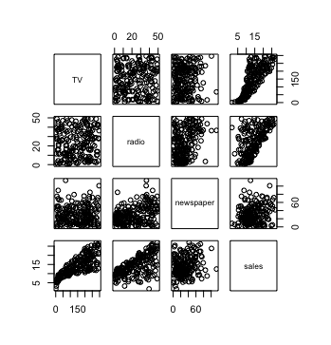
Advertising Data: Visualization
Raw R code in your R file:
plot(ad_data) (line 20)

Slide 4
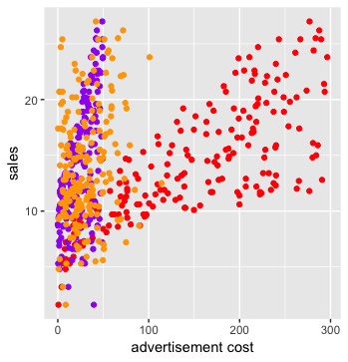
Advertising Data: Visualization
Raw R code in your R file:
ggplot(ad_data) +
geom_point(aes(x = TV, y=sales), color = "red") +
geom_point(aes(x = radio, y=sales), color = "purple") +
geom_point(aes(x = newspaper, y=sales), color = "orange") +
labs(x = "advertisement cost")
(line 32-36)

Slide 5
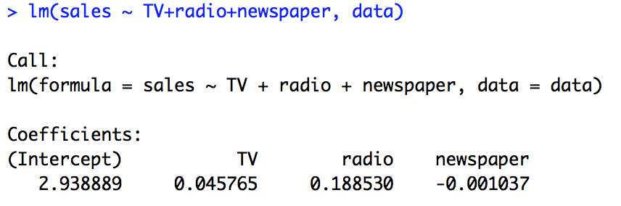
Model
Raw R code in your R file:
Lm1 (line 22)

Slide 6
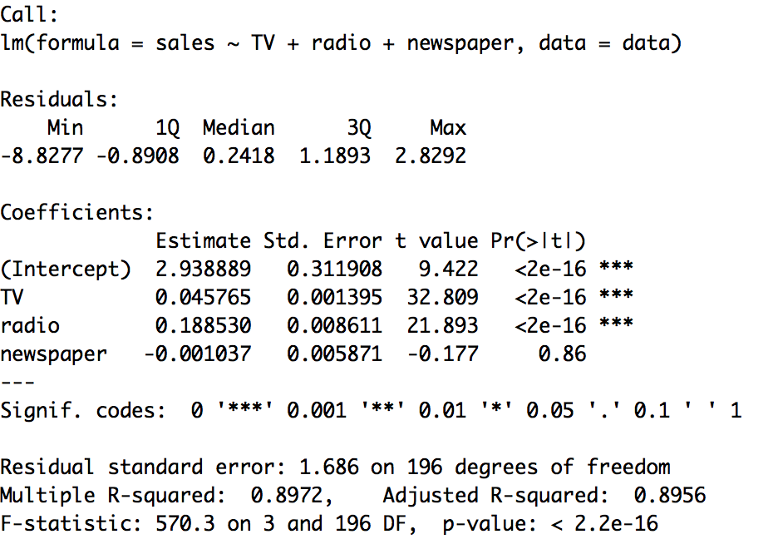
Model
Raw R code in your R file:
summary(lm1) (line 24)

Slide 7
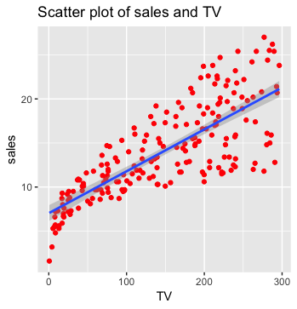
Simple Linear Regression:
Raw R code in your R file:
ggplot(ad_data, aes(x = TV, y=sales)) +
geom_point(color = "red") +
geom_smooth(method="lm") +
labs(title = "Scatter plot of sales and TV")
(line 45-48)

Slide 8
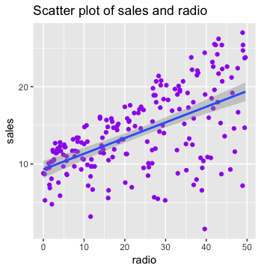
Simple Linear Regression:
Raw R code in your R file:
ggplot(ad_data, aes(x = radio, y=sales)) +
geom_point(color = "purple") +
geom_smooth(method="lm") +
labs(title = "Scatter plot of sales and radio")
(line 49-52)

Slide 9
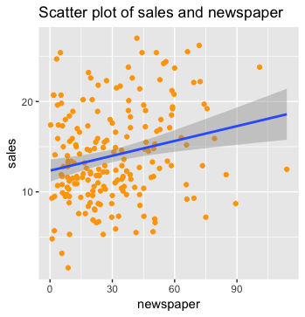
Simple Linear Regression:
Raw R code in your R file:
ggplot(ad_data, aes(x = newspaper, y=sales)) +
geom_point(color = "orange") +
geom_smooth(method="lm") +
labs(title = "Scatter plot of sales and newspaper")
(line 53-56)

