Slide 1
Comparison of 5 time-series forecasting models on Credit Default Swap rates during the start of the Covid-19 pandemic
– Joel Shefer, Michael van den Broek & David Kraakman

Slide 2
Table of Contents
01
02
03
Introduction
Preprocessing
Models
04
05
Results
Conclusion
CDS-rates; Focus on early Covid-19 period
Training and test time frame;
ARIMA, AR, GARCH, ARCH, GJR-GARCH
RMSE, PIS, Bootstrap
Is there a best model?

Slide 3
01
Introduction
Notes:
Project is to determine if financial models can work despite rare events (covid).

Slide 4




Credit Default Swap (CDS) rates
Periodical agreed upon payments (rates)
Buying Company
Issuing Company
Obligation to pay off buyers remaining outstanding debt when defaulting
Notes:
CDS is for people who have loaned money; insurance, depends on the risk of a company

Slide 5
Why CDS-rates are interesting
Higher CDS-rates
Perception
Higher perceived risk of defaulting
Behavior in unpredictable times?
Notes:
The higher the CDS rates, the higher the perceived risk of a company defaulting.

Slide 6
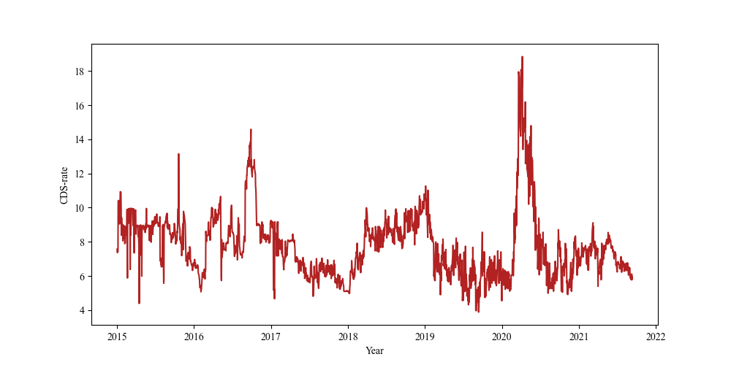
Covid-19
Frequently observed spike in CDS-rates
CDS-rates for McDonalds
Notes:
McDonalds risky in covid

Slide 7
02
Preprocessing
Notes:
From kraggle dataset to our dataset

Slide 8
Original number of companies in dataset
Filtering Companies with less than 1747 observations
Filtering
1747 observations was maximum and most frequent amount of observations amongst the companies
Filtering Companies with less than 1000 unique observations
Above 1000 we found acceptable to include
661
565
540
Notes:
Maybe a remark on the somewhat arbitrary cut off lines for 1747 and especially 1000

Slide 9
Training and Test range for models
Training
Test
Every observation up until 2020
Every observation
in 2020
2015
2020
2021

Slide 10
03
Models

Slide 11
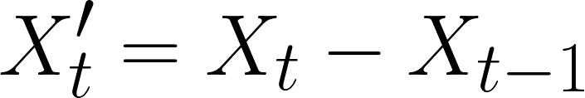
Autoregressive Integrated Moving Average (ARIMA) model
AR-model
MA-model
Forecast only depends on its own previous values (lags)
Forecast only depends on the error terms of previous forecasts (lags)
Integration
Both AR-part and MA-part require time-series to be stationary
Differencing:

Slide 12





Autoregressive (AR) model
Formula:
Intercept which helps adjust for non-zero baseline level of time-series
The fitted coefficient for the n-th lag, capturing relationship between
and
The error term, which is not explained by the lags

Slide 13


Moving Average (MA) model
Formula:
Intercept which helps adjust for non-zero baseline level of time-series
The fitted coefficient for the n-th lag, capturing relationship between current value and
The current error term, which is not explained by the lags

Slide 14



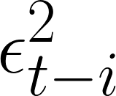

ARCH(1) Volatility Model
AutoRegressive Conditional Heteroskedasticity
Formula:
With returns modelled as:
Intercept which helps adjust for non-zero baseline variance of time-series (mean reversion)
Squared residual errors of lags, indicating the magnitude of past shocks
Fitted parameter for controlling influence of past (squared) shocks on volatility

Slide 15

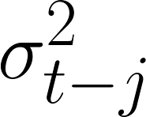

GARCH(1,1) Volatility Model
Generalized AutoRegressive Conditional Heteroskedasticity
Formula:
Intercept which helps adjust for non-zero baseline variance of time-series
Squared residual errors of lags, indicating the magnitude of past shocks
Conditional variances of lags, capturing volatility persistence
Fitted parameters for controlling influence of past volatility on current volatility

Slide 16


GJR-GARCH(1, 1, 1) Volatility Model
Formula:
Intercept which helps adjust for non-zero baseline variance of time-series
Squared residual errors of lags, indicating the magnitude of past shocks
Conditional variances of lags, capturing volatility persistence
Leverage effect: negative past shocks contribute more to volatility than positive shocks
Fitted parameters for controlling influence of past volatility on current volatility

Slide 17
Number of Lags
AR: 1
ARIMA: 1,1,1
ARCH: 1,1
Level Playing Field
GARCH: 1,1
GJR-GARCH: 1,1

Slide 18
04
Results

Slide 19
General Comparisons
1
2
Significancy

Slide 20
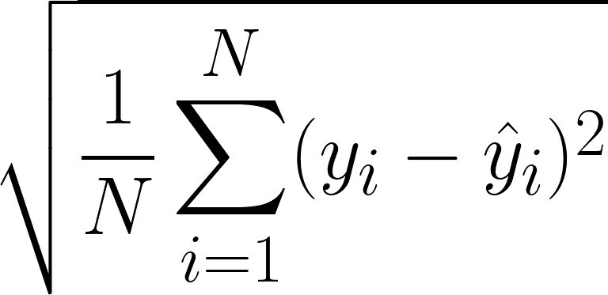
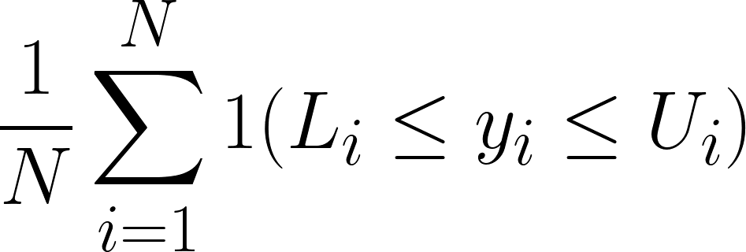
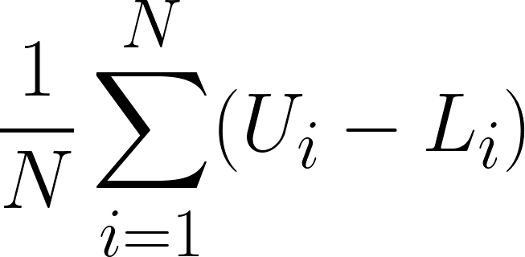
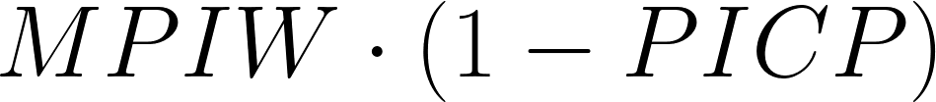
1
General Comparisons
Average Score over all companies
Root Mean Squared Error (RMSE)
RMSE
PIS
AR
5.333
0.961
Prediction Interval Sharpness (PIS)
ARIMA
5.393
0.979
1. Prediction Interval Coverage Probability (PICP)
ARCH
5.281
0.970
GARCH
5.278
0.924
2. Mean Prediction Interval Width (MPIW)
GJR-GARCH
5.278
0.940
3. Combined for PIS

Slide 21
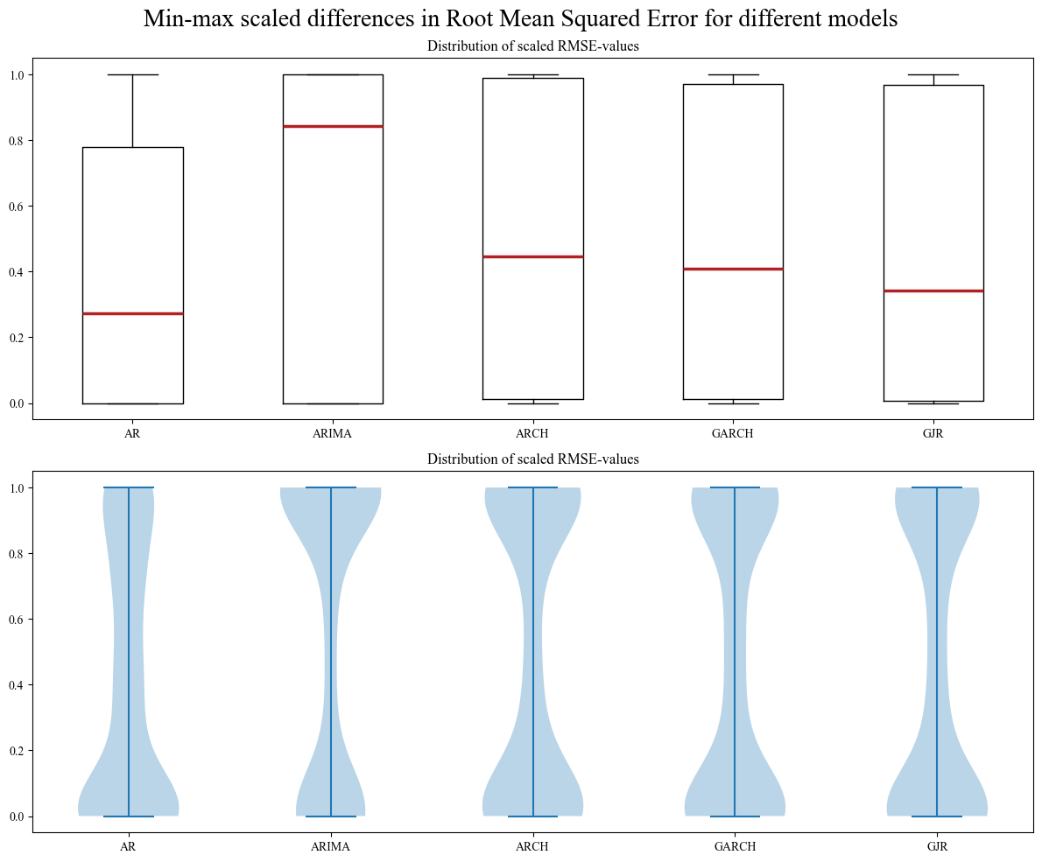
1
General Comparisons
RMSE

Slide 22
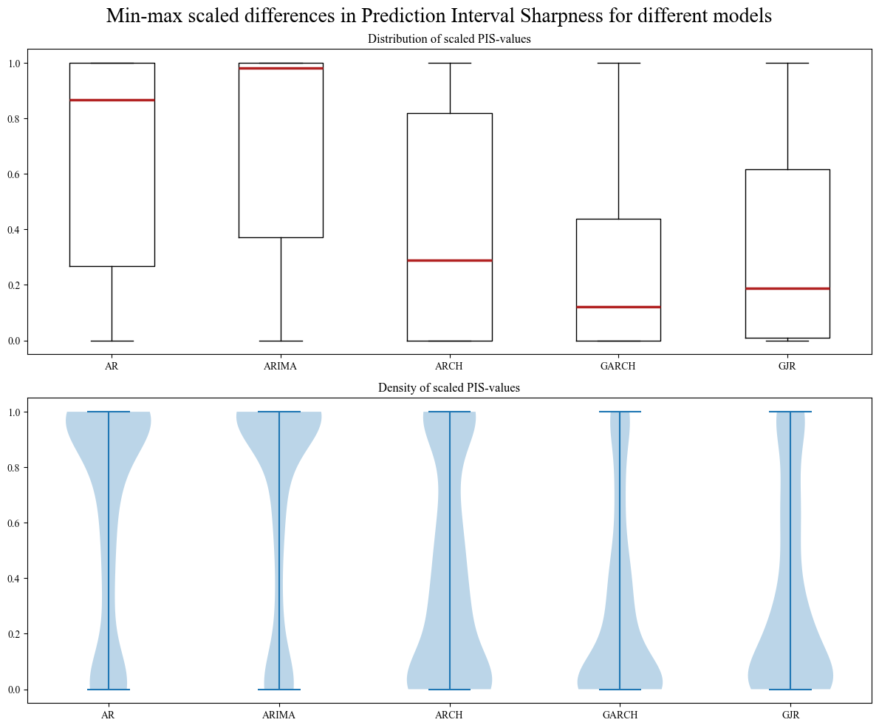
1
General Comparisons
PIS

Slide 23
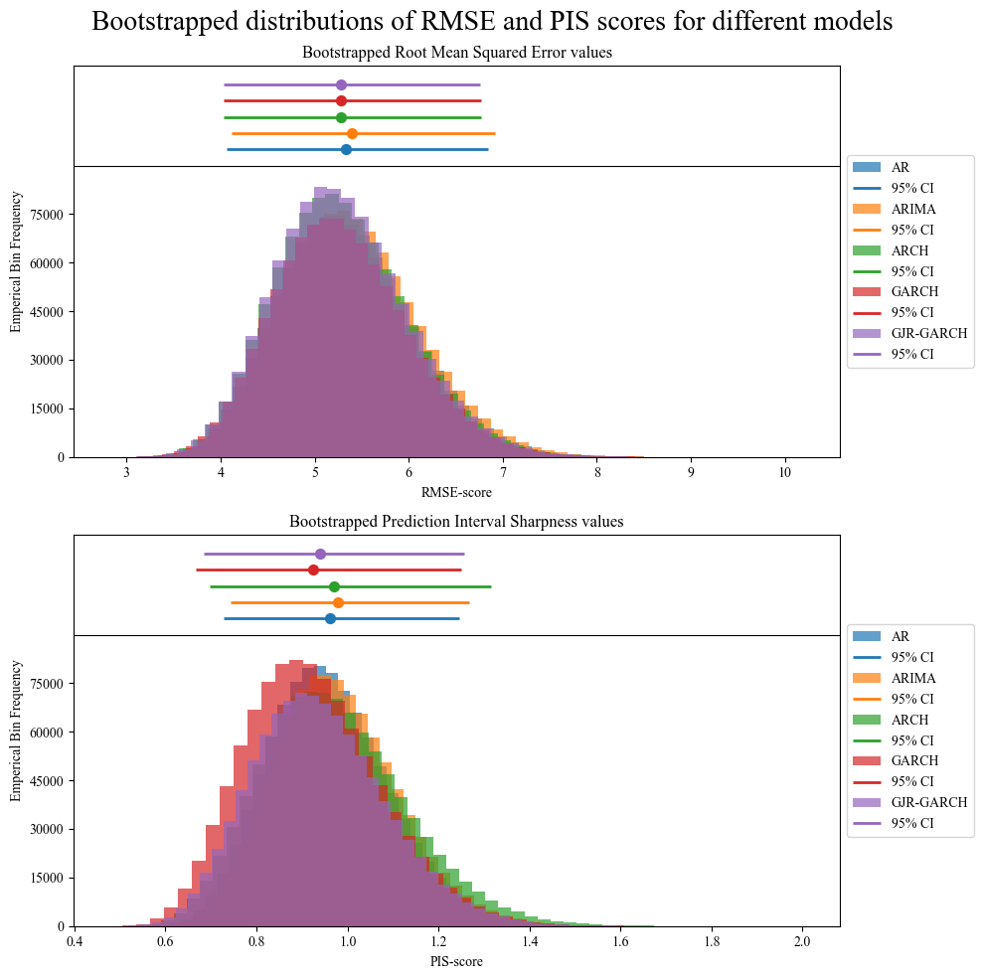
2
Significancy
Skewed
Nonparametric
Mann–Whitney U test

Slide 24
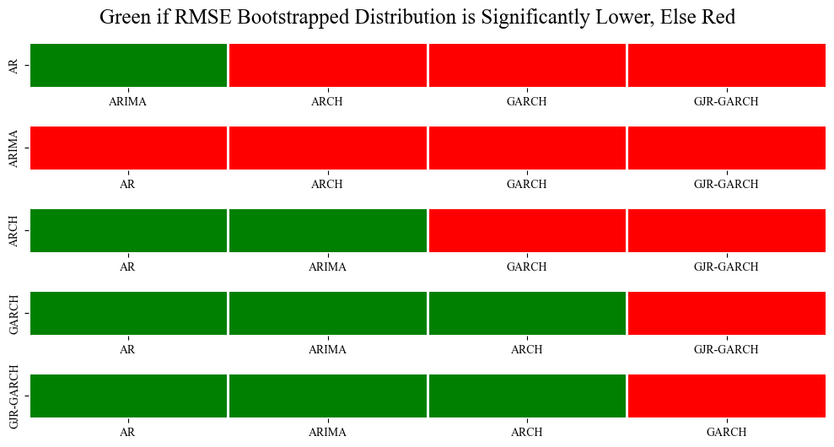
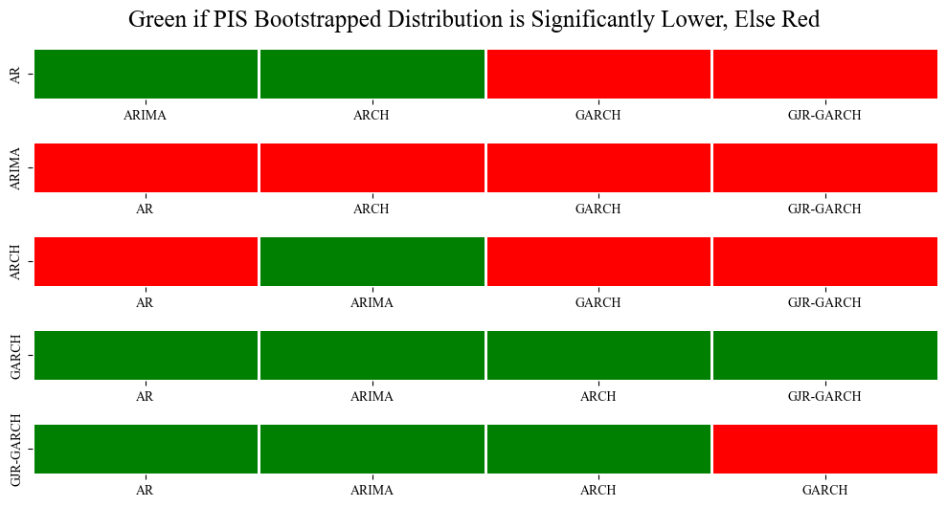
Mann–Whitney U test
2
Significancy
RMSE
PIS

Slide 25
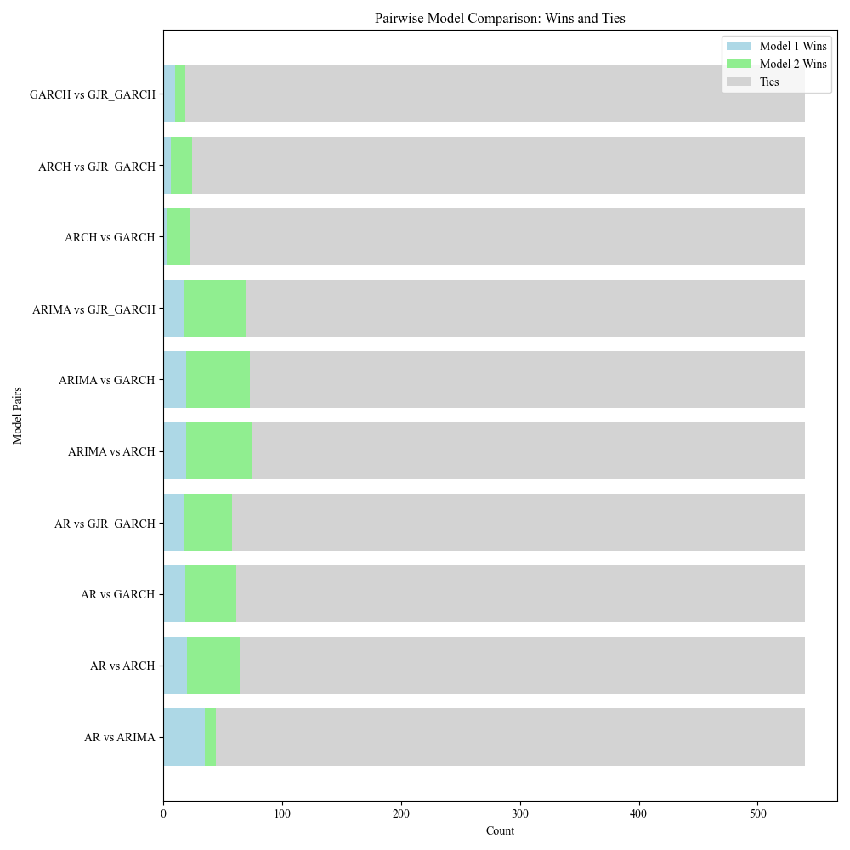
2
One test to rule them all
Diebold-Mariano Test
Total wins by model:
AR: 1
ARIMA: 4
ARCH: 0
GARCH: 0
GJR-GARCH: 1

Slide 26
05
Conclusion

Slide 27
Conclusions
Limitations
ARCH-models
Simple Models
01
Generally outperformed AR(IMA)-models
Used (possibly suboptimal) amount of lags for models
AR versus ARIMA
No Refitting
02
AR-model generally performed better than ARIMA-model
Ignores the real-world application of refitting models

