Slide 1

Future of React

Slide 2

О себе
В прошлом – PHP разработчик
Ушёл на фронт – с 2015
Vue.js ==> React
Senior Frontend Developer @ DINS

Slide 3
Present and Future of React
React Fiber
lazy / Suspence
Hooks
Concurrent mode
  scheduler
  react-cache
Event API / react-events

Slide 4
lazy / Suspence
import BigComponent from './MyBigComponent';
const BigComponent = lazy(
() => import('./MyBigComponent')
);

Slide 5
lazy / Suspence
const App = () => (
<BigComponent/>
);
const App = () => (
<Suspence fallback={<div>Loading</div>}>
<BigComponent/>
</Suspence>
);

Slide 6
lazy / Suspence – prior art
react-async-component
@loadable/component
react-async-import-component
+ 30 more…
native implementation (React-16.6.0, Oct 2018)

Slide 7
Concurrent Mode
<ConcurrentMode>
ReactDOM.unstable_createRoot(domNode)
“scheduler” package (cooperative multitasking)
“react-cache” package

Slide 8

Concurrent Mode Demo
https://codesandbox.io/s/r019y9l04n

Slide 9
How React works?
React
Element
React
Fiber
<BigComponent/>
Browser DOM

Slide 10
lazy
const BigComponent = lazy(
() => import('./MyBigComponent')
);
export function lazy(ctor) {
return {
$$typeof: REACT_LAZY_TYPE,
_ctor: ctor,
_status: -1,
_result: null,
};
}

Slide 11
lazy
const BigComponent = lazy(
() => import('./MyBigComponent')
);
export function lazy(ctor) {
return {
$$typeof: REACT_LAZY_TYPE,
_ctor: ctor,
_status: -1,
_result: null,
};
}

Slide 12
lazy
const status = lazyComponent._status;
const result = lazyComponent._result;
switch (status) {
case Resolved: return result;
case Rejected: throw result; // Error
case Pending: throw result;
default: {
lazyComponent._status = Pending;
const ctor = lazyComponent._ctor;
const thenable = ctor();
thenable.then(...);
lazyComponent._result = thenable;
throw thenable;
}
}

Slide 13
react-cache
const resource = {
read(input) {
const result = accessResult(...);
switch (result.status) {
case Pending: throw result.value;
case Resolved: return result.value;
case Rejected: throw result.value; // Error
}
}
};

Slide 14
Suspence
const App = () => (
<Suspence fallback={<div>Loading</div>}>
<BigComponent/>
</Suspence>
);
const React = {
Fragment: REACT_FRAGMENT_TYPE,
Suspense: REACT_SUSPENSE_TYPE,
// ...
};
export default React;

Slide 15
Suspence → Fiber structure
function createFiberFromTypeAndProps(type, /* ... */) {
switch (type) {
case REACT_FRAGMENT_TYPE:
return createFiberFromFragment(/* ... */);
// ...
case REACT_SUSPENSE_TYPE:
return createFiberFromSuspense(/* ... */);
// ...
}
}

Slide 16
React Fiber structure
Foo
return
{
...
return: null,
child: null,
sibling: null,
updateQueue: null,
memoizedState: null,
effectTag: null,
nextEffect: null,
...
}
child
const Foo = () => (
<Fragment>
<b>abc</b>
<p>
<i>cde</i>
</p>
</Fragment>
);
return
b
sibling
p
child
return
i

Slide 17
Suspence processing
renderRoot → workLoop → performUnitOfWork → beginWork = выбрасывает исключение “как есть” для thenable
RenderRoot → throwException = обработка выброшенного
Для thenable – поиск обрабатывающего Suspence
Прикрепляем его в Set внутри updateQueue
Навешиваем на корень текущего обрабатываемого дерева pingListener – который запросит ре-рендер дерева по resolve/reject внутри thenable

Slide 18

Suspence
Error Boundary на новый лад
componentDidCatch
getDerivedStateFromError

Slide 19
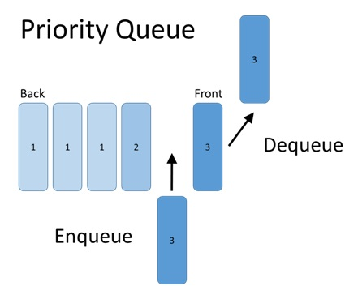
Scheduler Queue
scheduleCallback(priority, callback)
  Immediate (-1)
  UserBlocking (250)
  Normal (5000)
  Low (10000)
  Idle (never)

Slide 20
Scheduler API
scheduleCallback(priority, callback)
  Immediate (-1)
  UserBlocking (250)
  Normal (5000)
  Low (10000)
  Idle (never)
unstable_scheduleCallback(
unstable_NormalPriority,
() => {
this.setState({value});
}
);

Slide 21

Links
https://github.com/JSmith01/react-future-speech

Slide 22
Вопросы?

