Slide 1
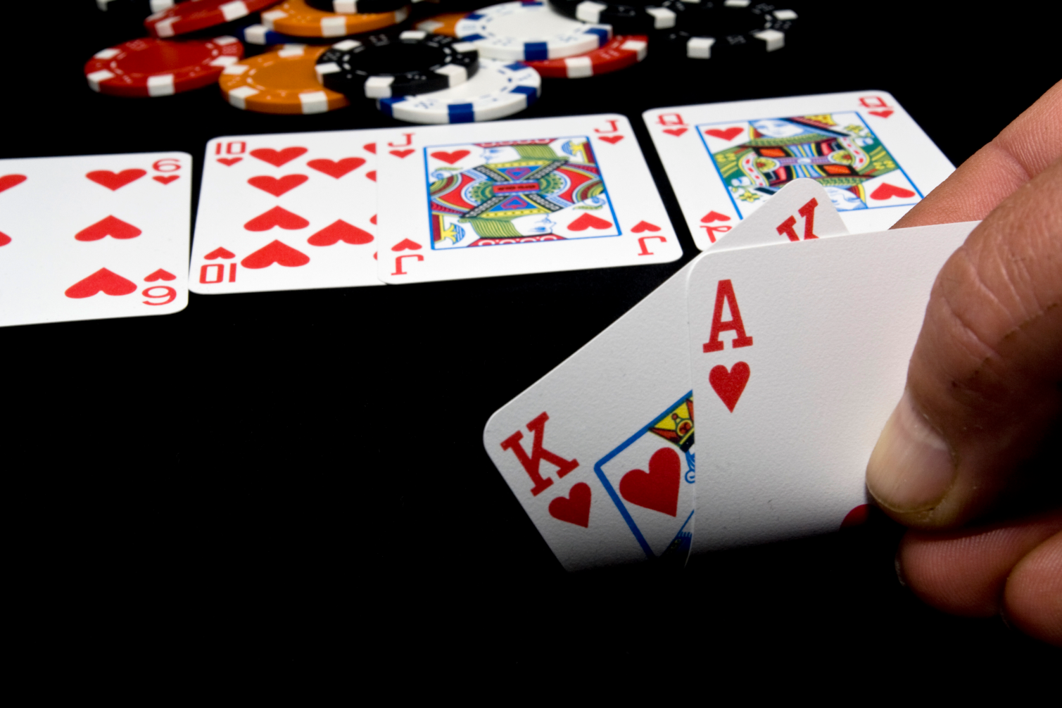
Poker Hands Investigations $$$$James & Tao$$$$

Slide 2
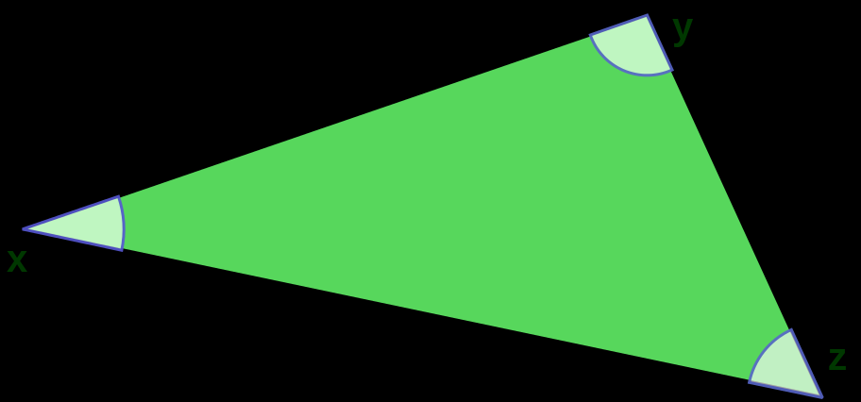
Analysis Premises
A comparison needs a metric, when there are more than two points in comparison.

Slide 3
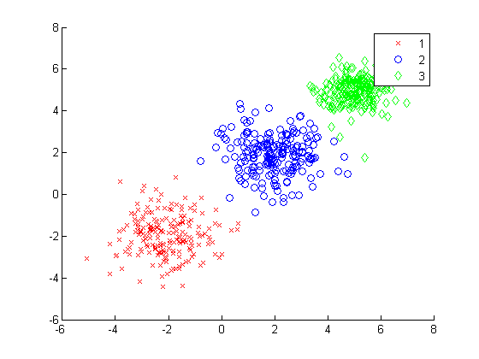
Stable or Stabilized Data

Slide 4
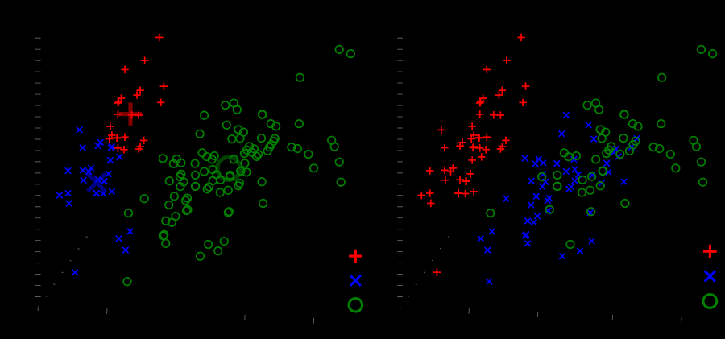
Somebody is Somebody

Slide 5
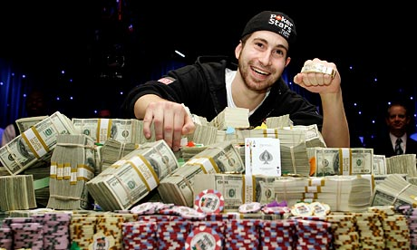
This is about plays’ style
This is not about if the player is greedy or not, it’s about…

Slide 6
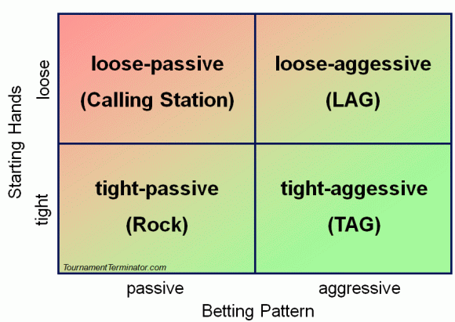
There’s some theory about their styles..

Slide 7
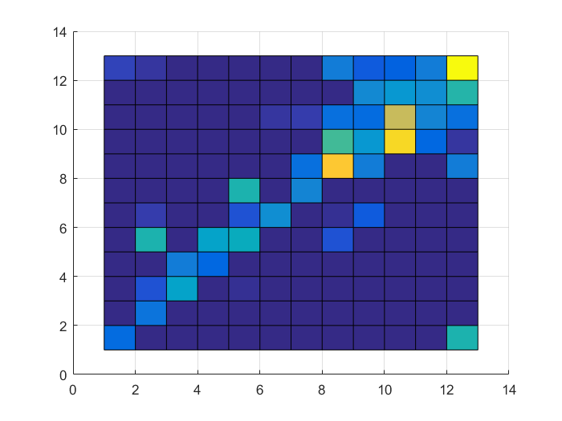
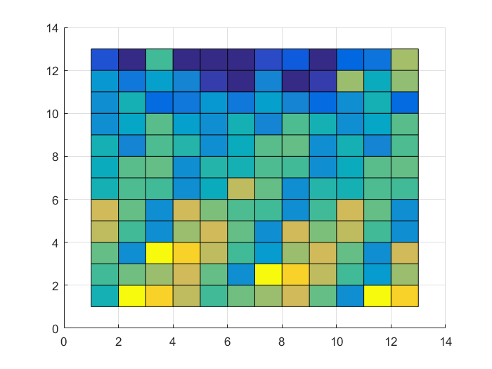
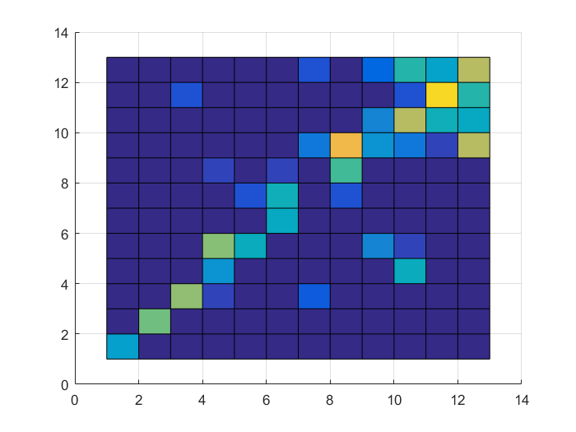
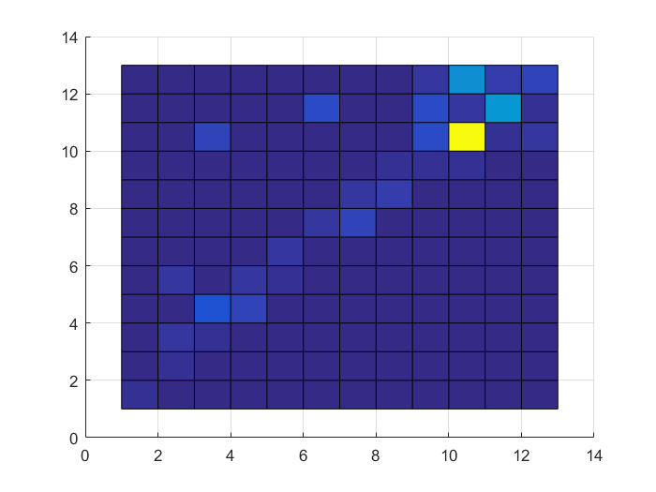
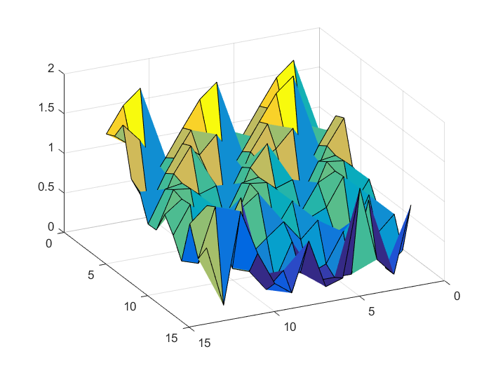
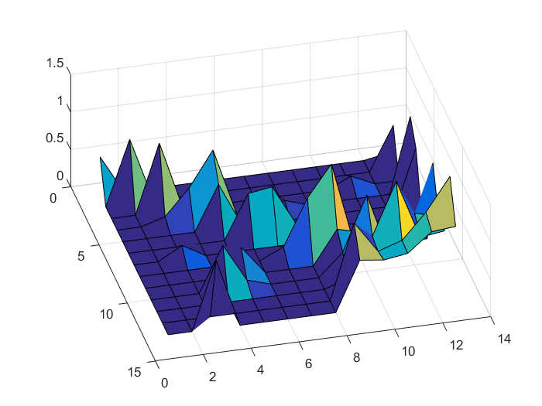
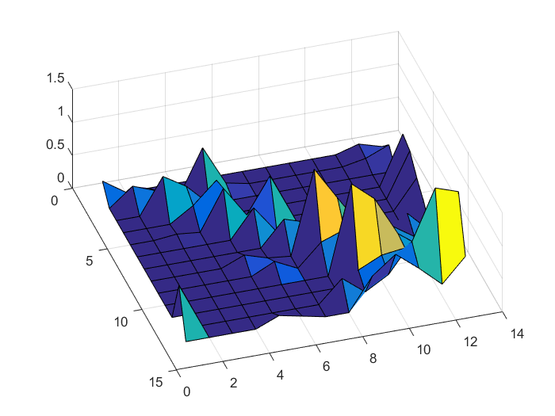
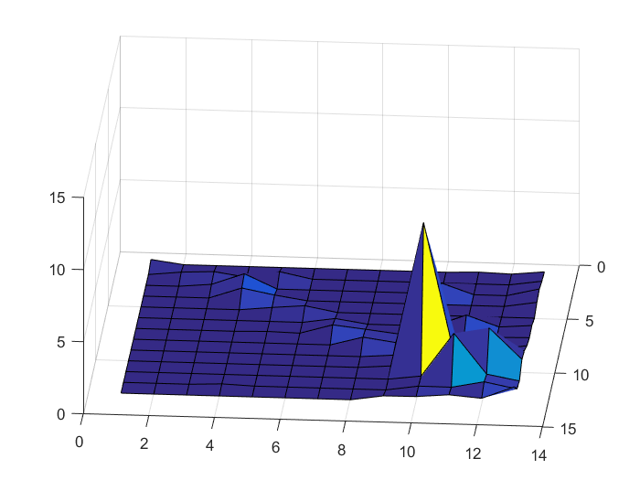
About Hausdorff Distance
ddddfdfdfdfgfgfdgfd
HD:1.1667 and 8.9096

Slide 8
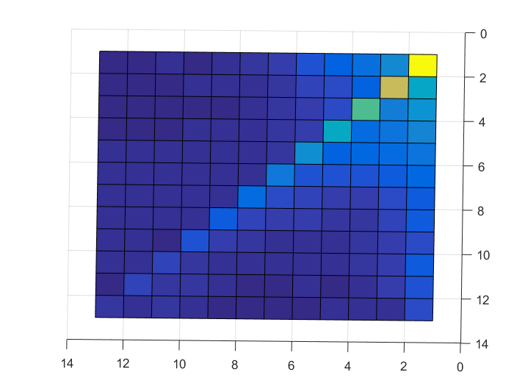
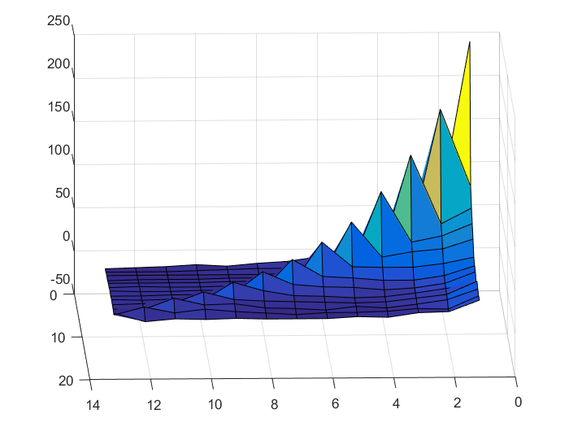
Logic scores v.s. actual games

Slide 9
Creating a Metric
We succeeded in creating a metric space where there’s no violation of requirements of a metric space.
In other words, we can put the data points on a map for visualization.

Slide 10
Tricks to Play
Choosing a good parameter to produce what we want to see from the data, disregarding the interpretation of such a parameter choice for the moment.
Getting rid of some unwanted data points in light of some experience in the game.
Transformation of the data to emphasize what we want to see.

Slide 11
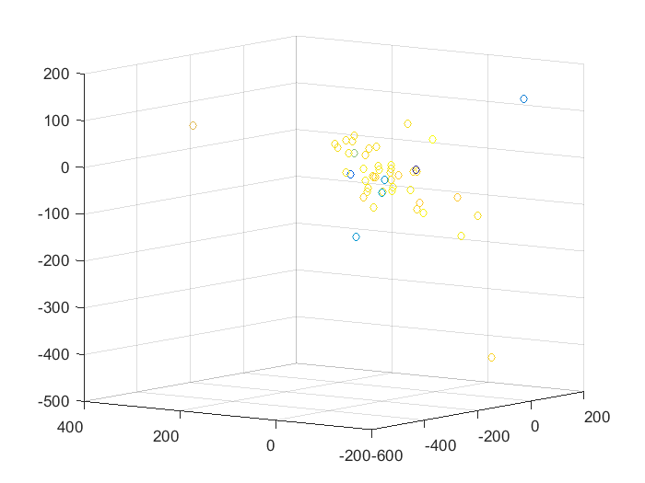
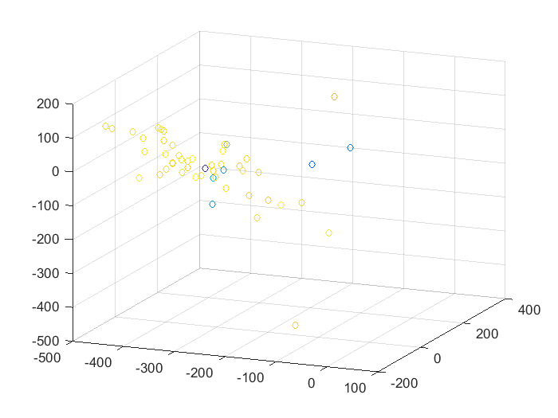
3D Display

Slide 12
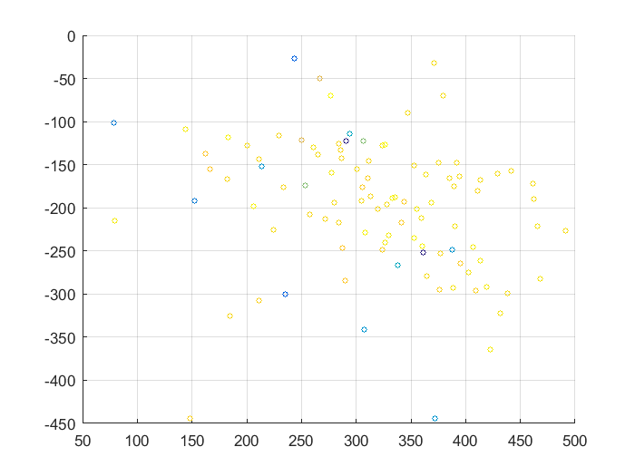
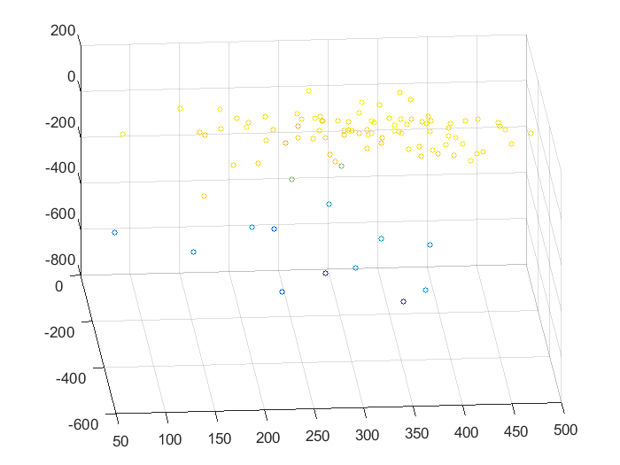
2D Display

Slide 13
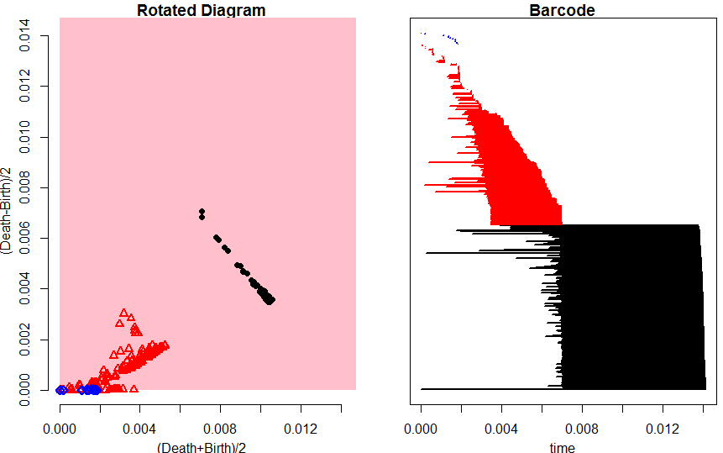
Persistence Diagram Tried

Slide 14
Conclusions
The hands data are either too noisy or to small in size for analysis.
Human decisions depend on many factors such as others’ decisions. It’s like there’s no solid ground to stand on.

Slide 15

Question?

Slide 16


