Slide 1
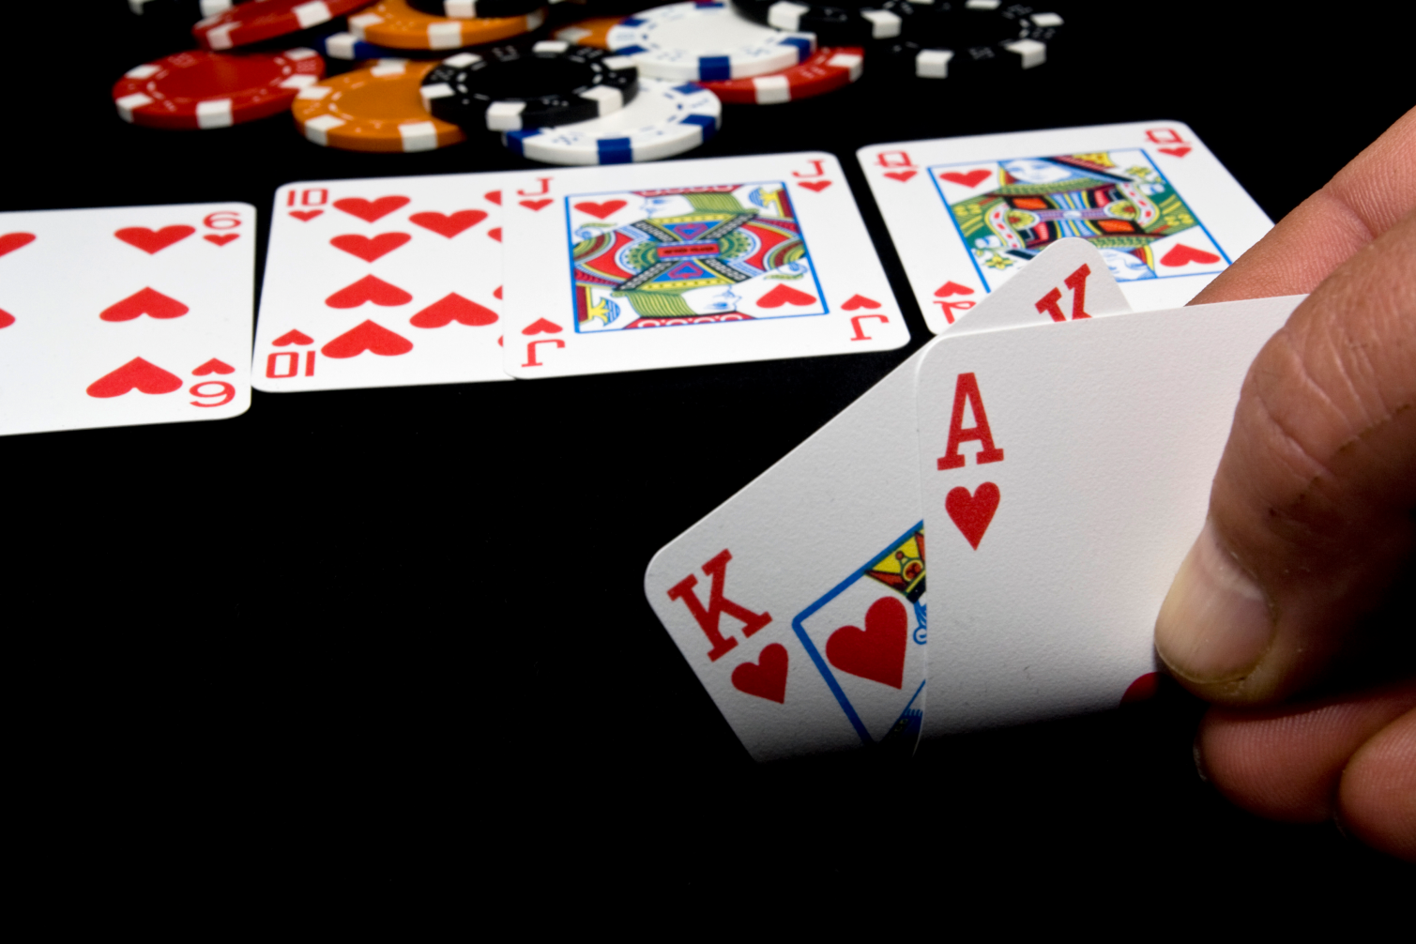
Poker Hands Investigations $$$$James & Tao$$$$

Slide 2
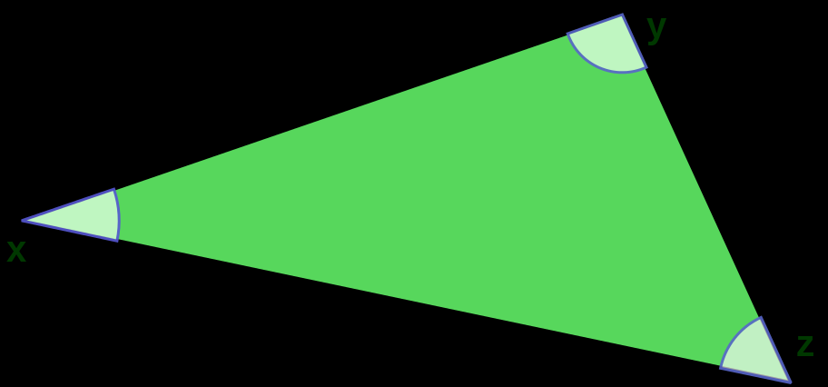
Analysis Premises
A comparison needs a metric, when there are more than two points in comparison.

Slide 3
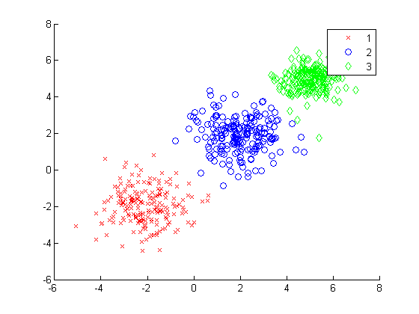
Stable or Stabilized Data

Slide 4
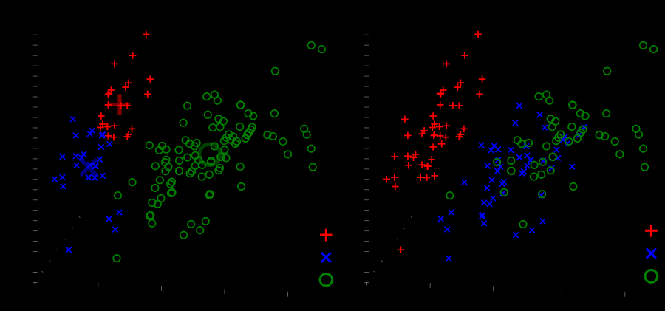
Somebody is Somebody

Slide 5
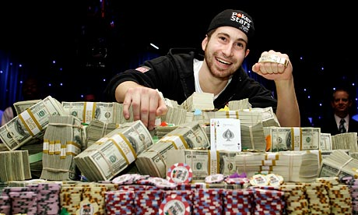
This is about plays’ style
This is not about if the player is greedy or not, it’s about…

Slide 6
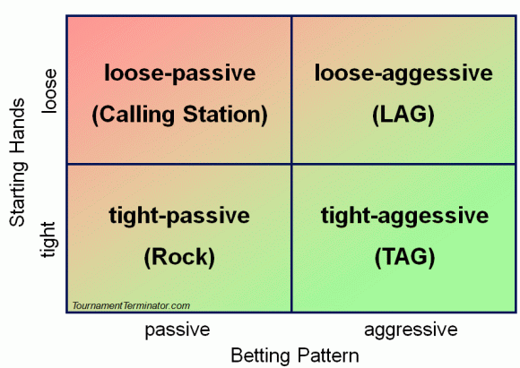
There’s some theory about their styles..

Slide 7
About the landscape
It’s possible that the way they play the game is the combination of their style and logic reasoning, because humans are emotional and logical beings.
Though, there are tons of data available, the space of rounds played is almost infinite…We can’t have all the data points.

Slide 8
But, potential benefits are tempting
Gaming can be representative of human social behaviors.
One more aspect about players->practically useful
Understanding and hence making use of a messy data set is very helpful.

Slide 9
Possible approaches
Using the data of the beginning stage to limit human interaction and dimensionality.
The strength of the first two cards dealt is kind of fixed logically.
Hausdorff distance can be a summary of how similar players are to each other, if they have a relatively stable and tangible pattern.

Slide 10
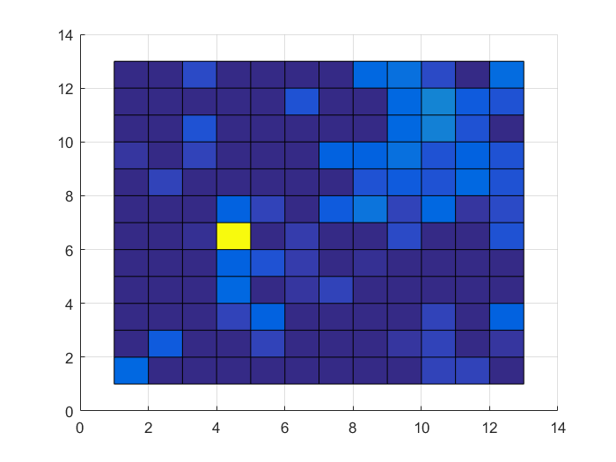
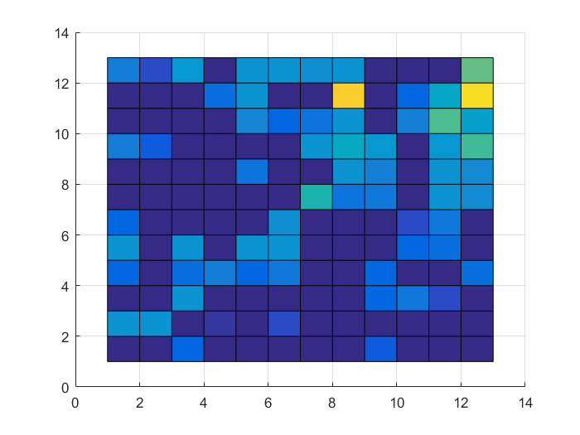
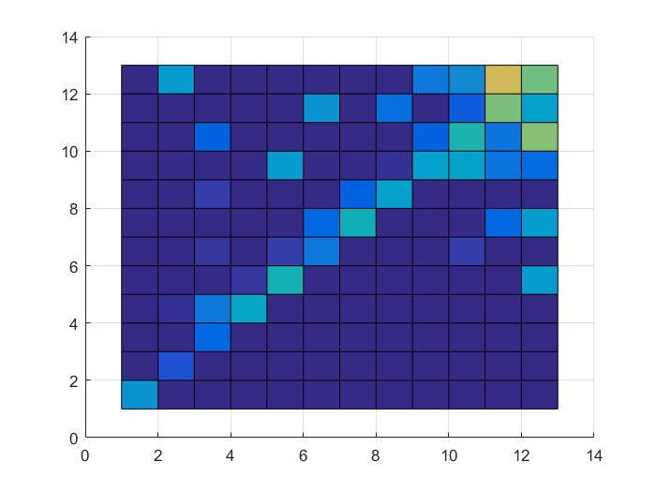
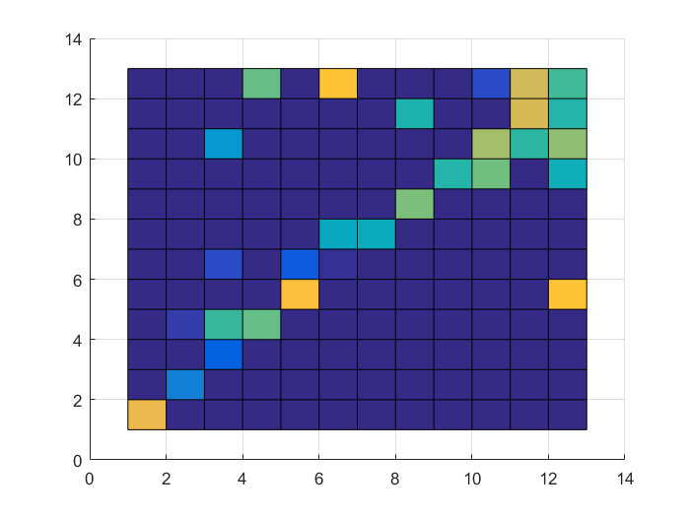
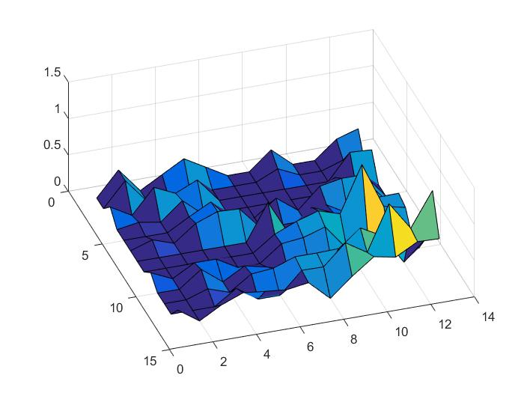
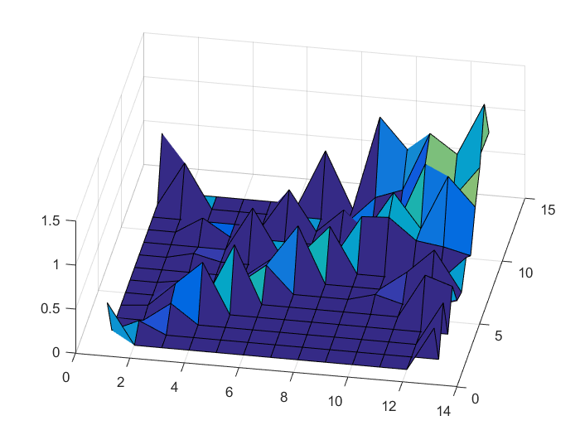
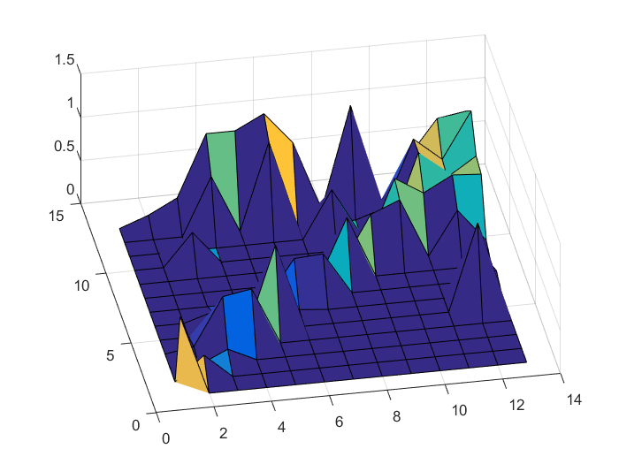
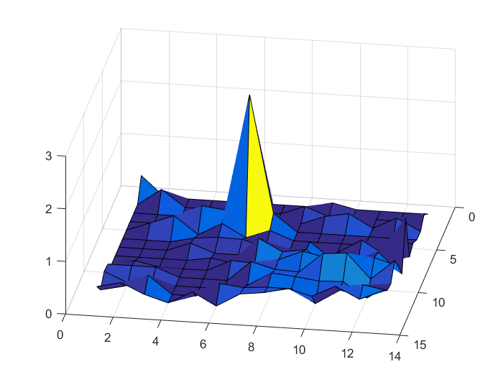
Sets A and B from two players
HD:2.5583 and 1.1667

Slide 11
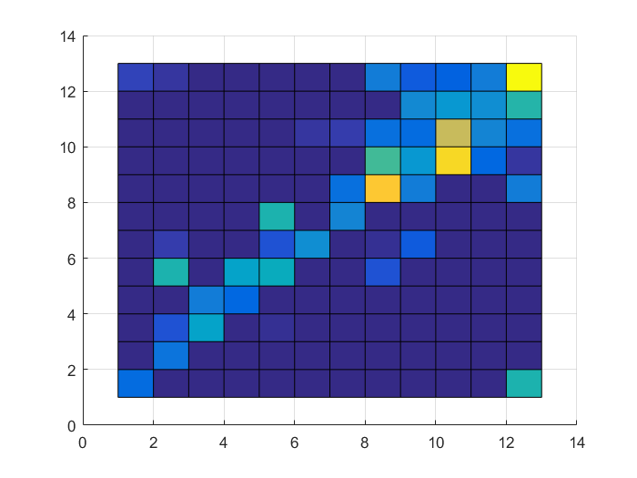
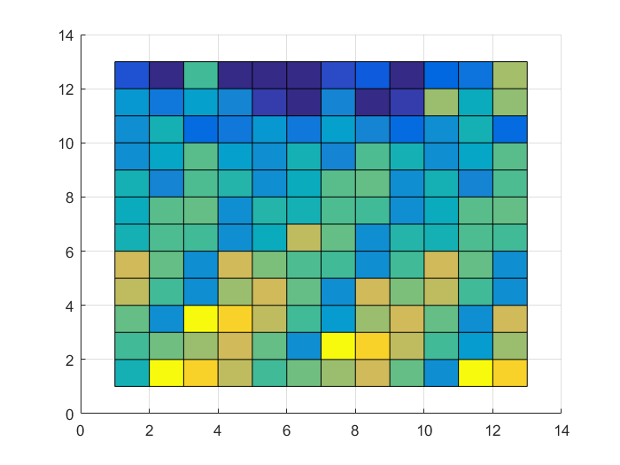
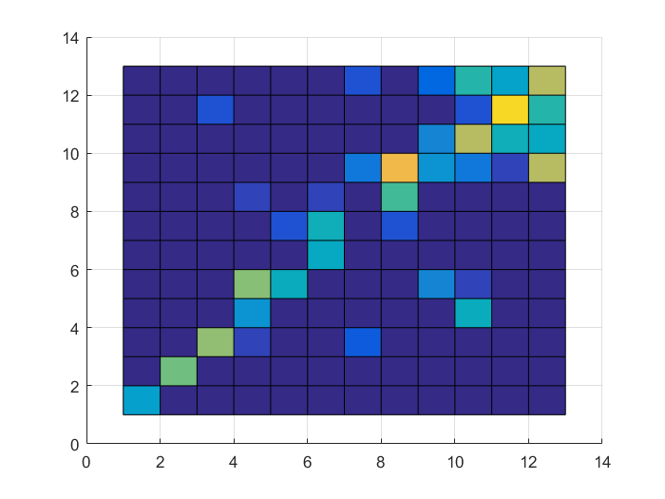
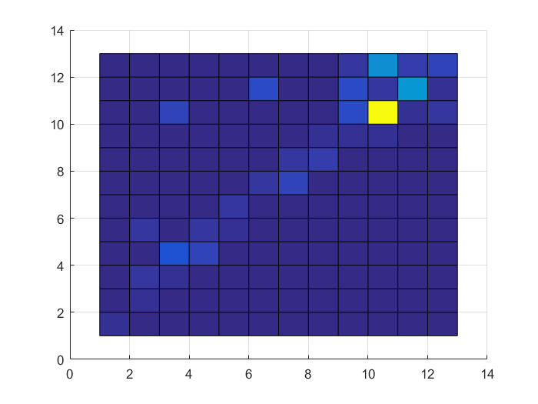
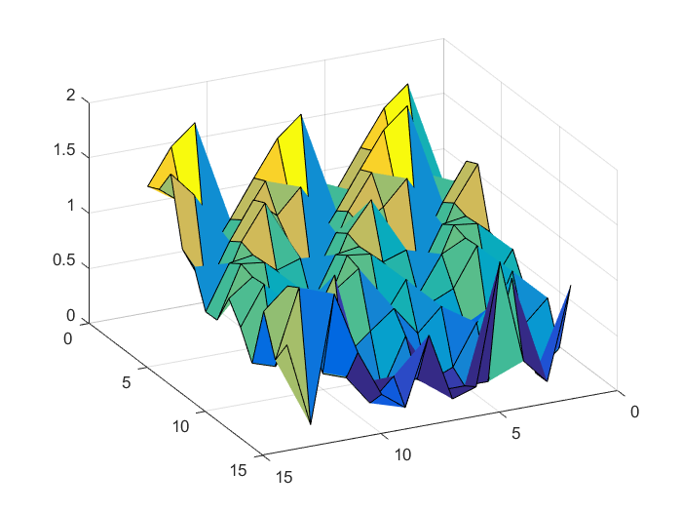
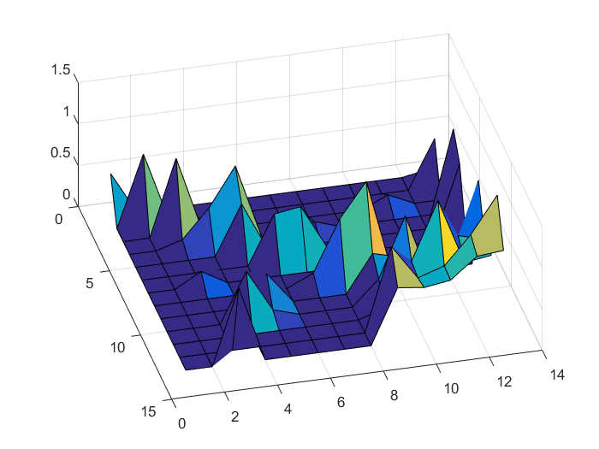
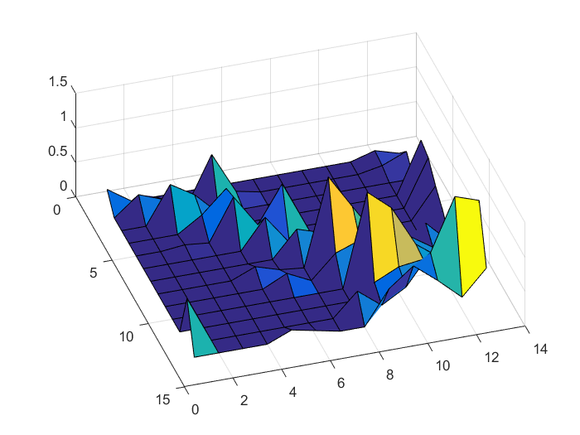
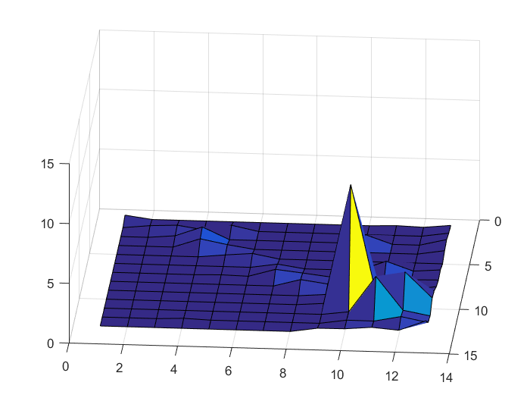
ddddfdfdfdfgfgfdgfd
HD:1.1667 and 8.9096

Slide 12
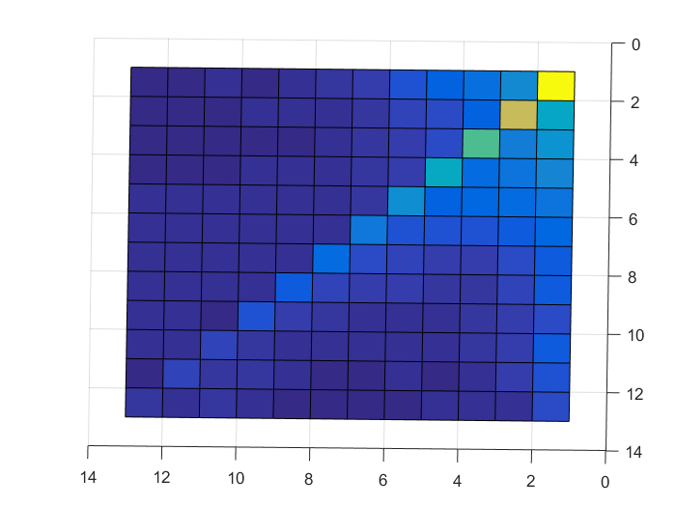
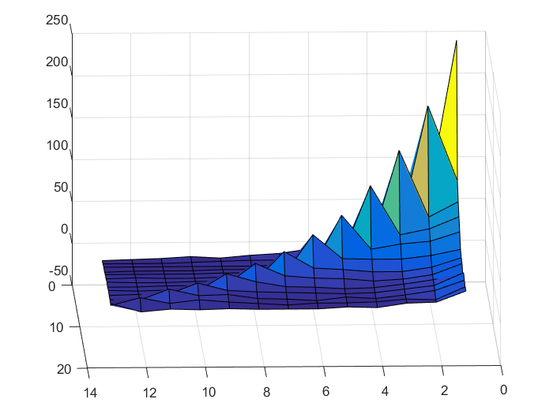
Logic scores v.s. actual games

