Slide 1
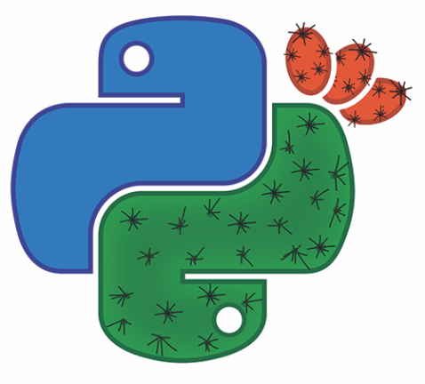
How to Study Evolution Using Scientific Python
Yoav Ram
PyCon Israel 2016

Slide 2
Who I am
PhD in Evolutionary Theory at TAU
Using Python since 2002
Using Scientific Python since 2011
Teaching Python since 2011
Python training for engineers & scientists

Slide 3
Why Scientific Python (why not MATLAB?)
Python is…
Free as in beer
Free as in speech
General purpose
Large, diverse, active community
Beautiful design
Portable
Easy to learn, fast to develop
Fast enough
Many libraries
I used Matlab. Now I use Python. by Steve Tjoa
Why use Python for scientific computing?
Introduction to Python for MATLAB users

Slide 4
Mathematical Evolution Formally: Population genetics
Study changes in frequency of gene variants within populations
The four forces of evolution:
Natural selection
Random genetic drift
Gene flow & recombination
Mutation
Focus on adaptation, speciation, population subdivision, and population structure
Population genetics

Slide 5
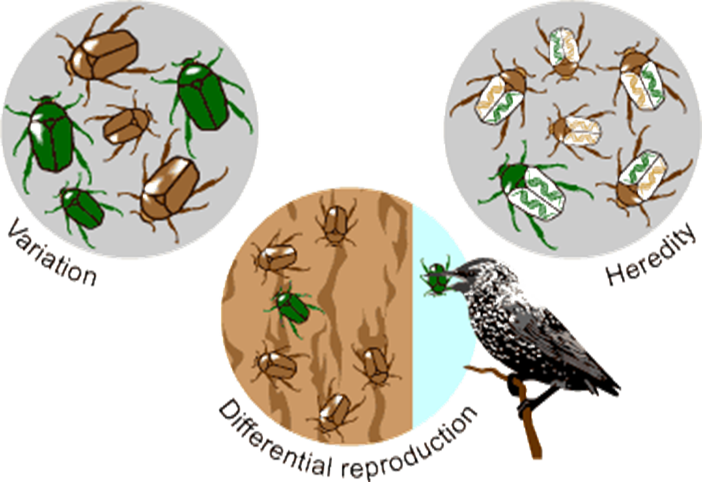
Evolution
University of California Museum of Paleontology's Understanding Evolution

Slide 6

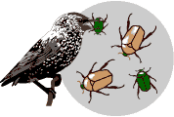


Natural Selection

Slide 7

Random Genetic Drift

Slide 8
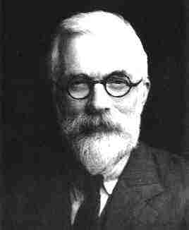
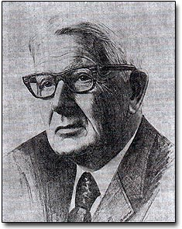
The Wright-Fisher Model
Standard model for change in frequency of gene variants.
R.A. Fisher
1890-1962, UK & Australia
Sewall Wright
1889-1988, USA

Slide 9
The Wright-Fisher Model
Standard model for change in frequency of gene variants.
Two gene variants: 0 and 1.
Number of individuals with each variant is n₀ and n₁.
Total population size is N = n₀ + n₁.
Frequency of each variant is p₀=n₀/N and p₁=n₁/N.

Slide 10
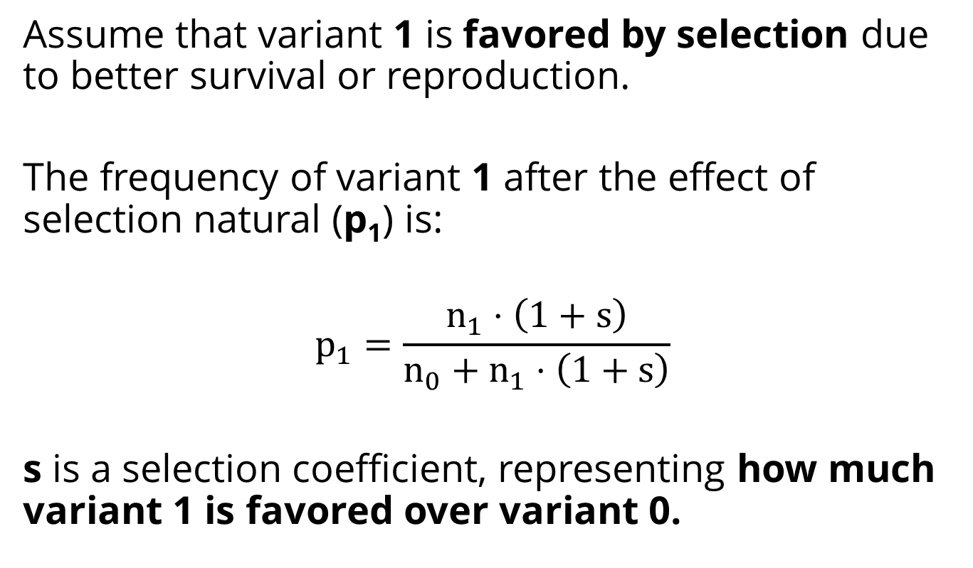
The Wright-Fisher Model
Assume that variant 1 is favored by selection due to better survival or reproduction.
The frequency of variant 1 after the effect of selection natural (p₁) is:
$$p_{1}=\frac{n_{1}⋅\left(1+s\right)}{n_{0}+n_{1}⋅\left(1+s\right)}$$
s is a selection coefficient, representing how much variant 1 is favored over variant 0.

Slide 11
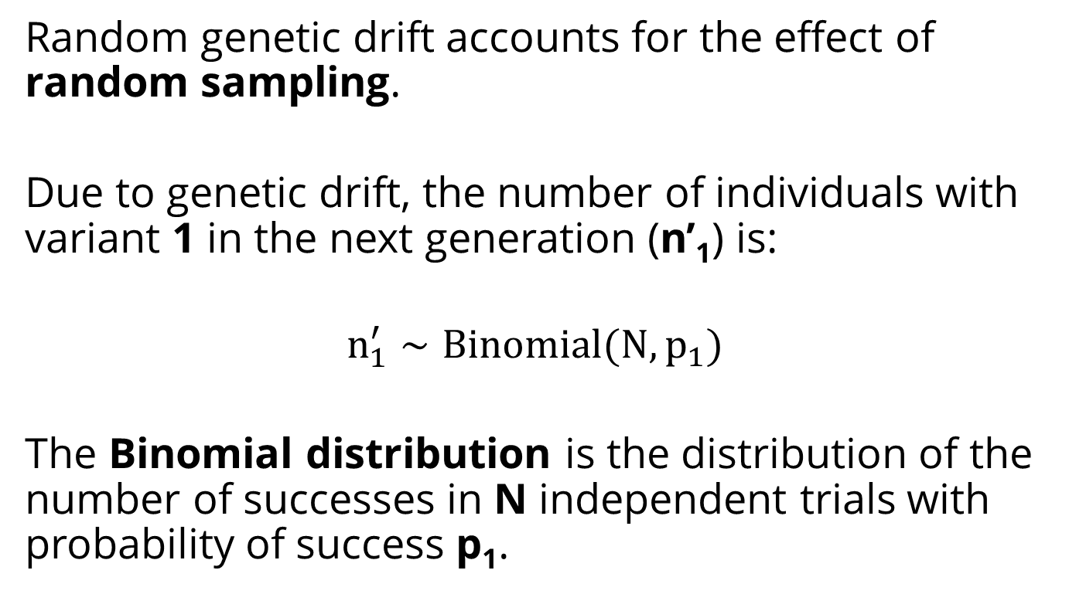
The Wright-Fisher Model
Random genetic drift accounts for the effect of random sampling.
Due to genetic drift, the number of individuals with variant 1 in the next generation (n’₁) is:
$$n_{1}^{′}∼Binomial(N, p_{1})$$
The Binomial distribution is the distribution of the number of successes in N independent trials with probability of success p₁.

Slide 12
Fixation Probability
Assume a single copy variant 1 in a population of size N.
What is the probability that variant 1 will fix rather than go extinct?

Slide 13
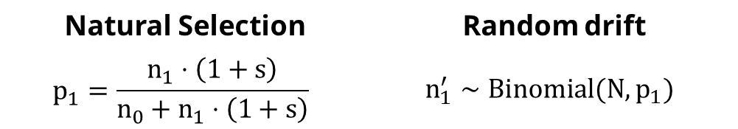
Random drift | Natural Selection
$$n_{1}^{′}∼Binomial(N, p_{1})$$ | $$p_{1}=\frac{n_{1}⋅\left(1+s\right)}{n_{0}+n_{1}⋅\left(1+s\right)}$$
from numpy.random import binomial
n1 = 1
while 0 < n1 < N:
n0 = N - n1
p1 = n1*(1+s) / (n0 + n1*(1+s))
n1 = binomial(N, p1)
result = n1 == N
Import a binomial random number generator from NumPy

Slide 14
NumPy
The fundamental package for scientific computing with Python:
Powerful N-dimensional array object
Sophisticated (broadcasting) functions
Random number generators
Tools for integrating C/C++ and Fortran code
Linear algebra
Fourier transform
numpy.org
from numpy.random import binomial
Loosing your loops

Slide 15
Random drift | Natural Selection
$$n_{1}^{′}∼Binomial(N, p_{1})$$ | $$p_{1}=\frac{n_{1}⋅\left(1+s\right)}{n_{0}+n_{1}⋅\left(1+s\right)}$$
from numpy.random import binomial
n1 = 1
while 0 < n1 < N:
n0 = N - n1
p1 = n1*(1+s) / (n0 + n1*(1+s))
n1 = binomial(N, p1)
result = n1 == N
Start with a single copy of variant 1

Slide 16
Random drift | Natural Selection
$$n_{1}^{′}∼Binomial(N, p_{1})$$ | $$p_{1}=\frac{n_{1}⋅\left(1+s\right)}{n_{0}+n_{1}⋅\left(1+s\right)}$$
from numpy.random import binomial
n1 = 1
while 0 < n1 < N:
n0 = N - n1
p1 = n1*(1+s) / (n0 + n1*(1+s))
n1 = binomial(N, p1)
result = n1 == N
Until number of individuals with variant 1 is 0 or N: extinction or fixation

Slide 17
Random drift | Natural Selection
$$n_{1}^{′}∼Binomial(N, p_{1})$$ | $$p_{1}=\frac{n_{1}⋅\left(1+s\right)}{n_{0}+n_{1}⋅\left(1+s\right)}$$
from numpy.random import binomial
n1 = 1
while 0 < n1 < N:
n0 = N - n1
p1 = n1*(1+s) / (n0 + n1*(1+s))
n1 = binomial(N, p1)
result = n1 == N
The frequency of variant 1 after selection is p1

Slide 18
Random drift | Natural Selection
$$n_{1}^{′}∼Binomial(N, p_{1})$$ | $$p_{1}=\frac{n_{1}⋅\left(1+s\right)}{n_{0}+n_{1}⋅\left(1+s\right)}$$
from numpy.random import binomial
n1 = 1
while 0 < n1 < N:
n0 = N - n1
p1 = n1*(1+s) / (n0 + n1*(1+s))
n1 = binomial(N, p1)
result = n1 == N
Due to genetic drift, the number of individuals with variant 1 in the next generation is n1

Slide 19
Random drift | Natural Selection
$$n_{1}^{′}∼Binomial(N, p_{1})$$ | $$p_{1}=\frac{n_{1}⋅\left(1+s\right)}{n_{0}+n_{1}⋅\left(1+s\right)}$$
from numpy.random import binomial
n1 = 1
while 0 < n1 < N:
n0 = N - n1
p1 = n1*(1+s) / (n0 + n1*(1+s))
n1 = binomial(N, p1)
result = n1 == N
Fixation: n1 equals N
Extinction: n1 equals 0

Slide 20
NumPy vs. Pure Python
Here, NumPy is useful for random number generation:
n1 = binomial(N, p1)
Pure Python version would replace this with:
from random import random
n1 = sum(
1
for _ in range(N)
if random.random() < p1
)
random is a standard library module

Slide 21
NumPy vs. Pure Python
%timeit simulation(N=1000, s=0.1)
%timeit simulation(N=1000000, s=0.01)
Pure Python version:
100 loops, best of 3: 6.42 ms per loop
1 loop, best of 3: 528 ms per loop
NumPy version:
10000 loops, best of 3: 150 µs per loop x42 faster
1000 loops, best of 3: 313 µs per loop
x1680 faster!

Slide 22
Can we do it better faster?

Slide 23

Optimizing compiler
Makes writing C extensions for Python as easy as Python itself
Declare the static type of variables
Foreign function interface for invoking C/C++ routines
http://cython.org

Slide 24

Numba
Optimizing compiler
Uses LLVM to compile Python syntax to machine code
Array-oriented and math-heavy Python code can be just-in-time compiled to native machine instructions, similar in performance to C, C++ and Fortran
Sponsored by Continuum Analytics
http://numba.pydata.org

Slide 25
def simulation(np.uint64_t N, np.float64_t s):
cdef np.uint64_t n1 = 1
cdef np.uint64_t n0
cdef np.float64_t p
while 0 < n1 < N:
n0 = N - n1
p1 = n1 * (1 + s) / (n0 + n1 * (1 + s))
n1 = np.random.binomial(N, p1)
return n1 == N

Slide 26
Cython
%timeit simulation(N=1000, s=0.1)
%timeit simulation(N=1000000, s=0.01)
Cython vs. NumPy:
10000 loops, best of 3: 87.8 µs per loop x2 faster
10000 loops, best of 3: 177 µs per loop x1.75 faster

Slide 27
Numba
@numba.jit(locals=dict(
s=numba.float64, N=numba.uint64,
n0=numba.uint64, n1=numba.uint64,
p=numba.float64))
def simulation(N, s):
n1 = 1
while 0 < n1 < N:
n0 = N - n1
p1 = n1 * (1 + s) / (n0 + n1 * (1 + s))
n1 = np.random.binomial(N, p1)
return n1 == N

Slide 28
Numba
%timeit simulation(N=1000, s=0.1)
%timeit simulation(N=1000000, s=0.01)
Numba vs. NumPy:
1000 loops, best of 1: 50.1 µs per loop x3 faster
1000 loops, best of 1: 70.3 ms per loop much slower…

Slide 29
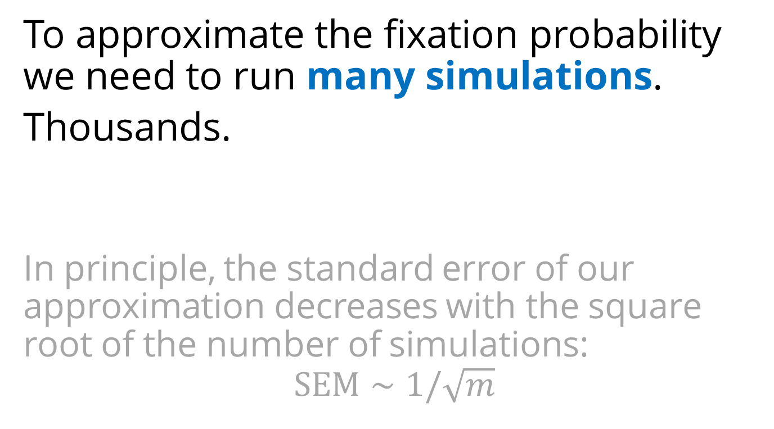
One simulation is not enough
To approximate the fixation probability we need to run many simulations.
Thousands.
In principle, the standard error of our approximation decreases with the square root of the number of simulations:
$$SEM∼1/\sqrt{m}$$

Slide 30
Multiple simulations: for loop
fixations = [
simulation(N, s)
for _ in range(1000)
]
sum(fixations) / len(fixations)
> 0.195
%timeit [simulation(…) for … range(1000)]
1 loop, best of 3: 8.05 s per loop

Slide 31
Multiple simulations: NumPy
def simulation(N, s, repetitions):
n1 = np.ones(repetitions)
update = np.array([True] * repetitions)
while update.any():
p1 = n1 * (1 + s) / (N + n1 * s)
n1[update] = binomial(N, p1[update])
update = (n1 > 0) & (n1 < N)
return n1 == N
Initialize multiple simulations

Slide 32
Multiple simulations: NumPy
def simulation(N, s, repetitions):
n1 = np.ones(repetitions)
update = np.array([True] * repetitions)
while update.any():
p1 = n1 * (1 + s) / (N + n1 * s)
n1[update] = binomial(N, p1[update])
update = (n1 > 0) & (n1 < N)
return n1 == N
Natural selection:
n1 is an array so operations are element-wise

Slide 33
Multiple simulations: NumPy
def simulation(N, s, repetitions):
n1 = np.ones(repetitions)
update = np.array([True] * repetitions)
while update.any():
p1 = n1 * (1 + s) / (N + n1 * s)
n1[update] = binomial(N, p1[update])
update = (n1 > 0) & (n1 < N)
return n1 == N
Genetic drift:
p1 is an array so binomial(N, p1) draws from multiple distributions

Slide 34
Multiple simulations: NumPy
def simulation(N, s, repetitions):
n1 = np.ones(repetitions)
update = np.array([True] * repetitions)
while update.any():
p1 = n1 * (1 + s) / (N + n1 * s)
n1[update] = binomial(N, p1[update])
update = (n1 > 0) & (n1 < N)
return n1 == N
update follows the simulations that didn’t finish yet

Slide 35
Multiple simulations: NumPy
def simulation(N, s, repetitions):
n1 = np.ones(repetitions)
update = np.array([True] * repetitions)
while update.any():
p1 = n1 * (1 + s) / (N + n1 * s)
n1[update] = binomial(N, p1[update])
update = (n1 > 0) & (n1 < N)
return n1 == N
result is array of Booleans: for each simulation, did variant 1 fix?

Slide 36
Multiple simulations: NumPy
%timeit simulation(N=1000, s=0.1)
10 loops, best of 3: 25.2 ms per loop
x320 faster

Slide 37
Fixation probability as a function of N
Nrange = np.logspace(1, 6, 20, dtype=np.uint64)
N must be an integer for this to evaluate to True:
(n1 > 0) & (n1 < N)

Slide 38
Fixation probability as a function of N
fix_prob = [
simulation(
N,
s, repetitions
) for N in Nrange
]

Slide 39
Fixation probability as a function of N
fix_prob = np.array(fix_prob)
mean = fix_prob.mean(axis=1)
sem = fix_prob.std(
axis=1,
ddof=1
) / np.sqrt(repetitions)

Slide 40
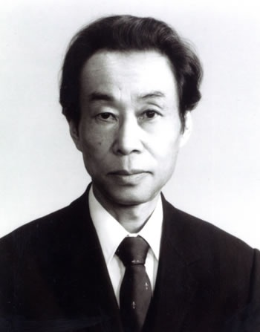
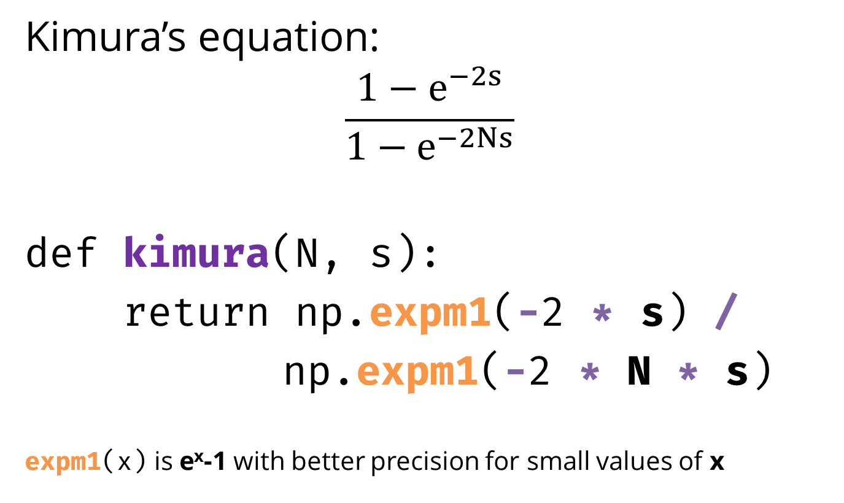
Approximation
Kimura’s equation:
$$\frac{1−e^{−2s}}{1−e^{−2Ns}}$$
def kimura(N, s):
return np.expm1(-2 * s) /
np.expm1(-2 * N * s)
expm1(x) is e^{x}-1 with better precision for small values of x
Motoo Kimura
1924-1994
Japan & USA

Slide 41
kimura is a ufunc out-of-the-box
%timeit [kimura(N=N, s=s)
for N in Nrange]
%timeit kimura(N=Nrange, s=s)
1 loop, best of 3: 752 ms per loop
1000 loops, best of 3: 3.91 ms per loop
X200 faster!

Slide 42
Numexpr
Fast evaluation of element-wise array expressions using a vector-based virtual machine.
def kimura(N, s):
return numexpr.evaluate(
"expm1(-2 * s) /
expm1(-2 * N * s)“)
%timeit kimura(N=Nrange, s=s)
1000 loops, best of 3: 803 µs per loop x5 faster
https://github.com/pydata/numexpr

Slide 43
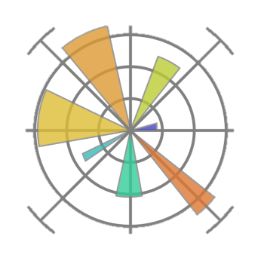
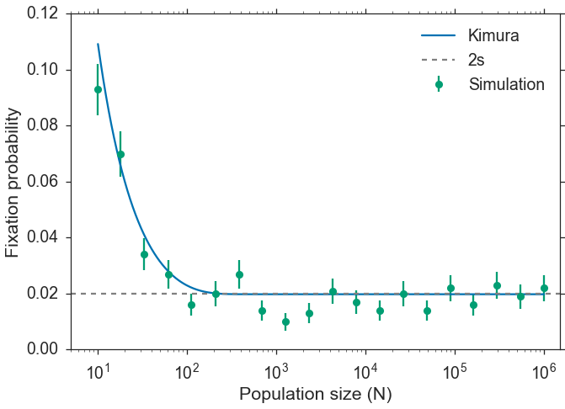
Plotting with matplotlib
http://matplotlib.org

Slide 44
Fixation time
How much time does it take variant 1 to go extinct or to fix?
We want to keep track of time*.
*time is measured in number of generations

Slide 45
def simulation(N, s, repetitions):
n1 = np.ones(repetitions)
T = np.empty_like(n1)
update = (n1 > 0) & (n1 < N)
t = 0
while update.any():
t += 1
p = n1 * (1 + s) / (N + n1 * s)
n1[update] = binomial(N, p[update])
T[update] = t
update = (n1 > 0) & (n1 < N)
return n1 == N, T
t keeps track of time

Slide 46
def simulation(N, s, repetitions):
n1 = np.ones(repetitions)
T = np.empty_like(n1)
update = (n1 > 0) & (n1 < N)
t = 0
while update.any():
t += 1
p = n1 * (1 + s) / (N + n1 * s)
n1[update] = binomial(N, p[update])
T[update] = t
update = (n1 > 0) & (n1 < N)
return n1 == N, T
T holds time for extinction/fixation

Slide 47
def simulation(N, s, repetitions):
n1 = np.ones(repetitions)
T = np.empty_like(n1)
update = (n1 > 0) & (n1 < N)
t = 0
while update.any():
t += 1
p = n1 * (1 + s) / (N + n1 * s)
n1[update] = binomial(N, p[update])
T[update] = t
update = (n1 > 0) & (n1 < N)
return n1 == N, T
Return both Booleans
and times (T)

Slide 48
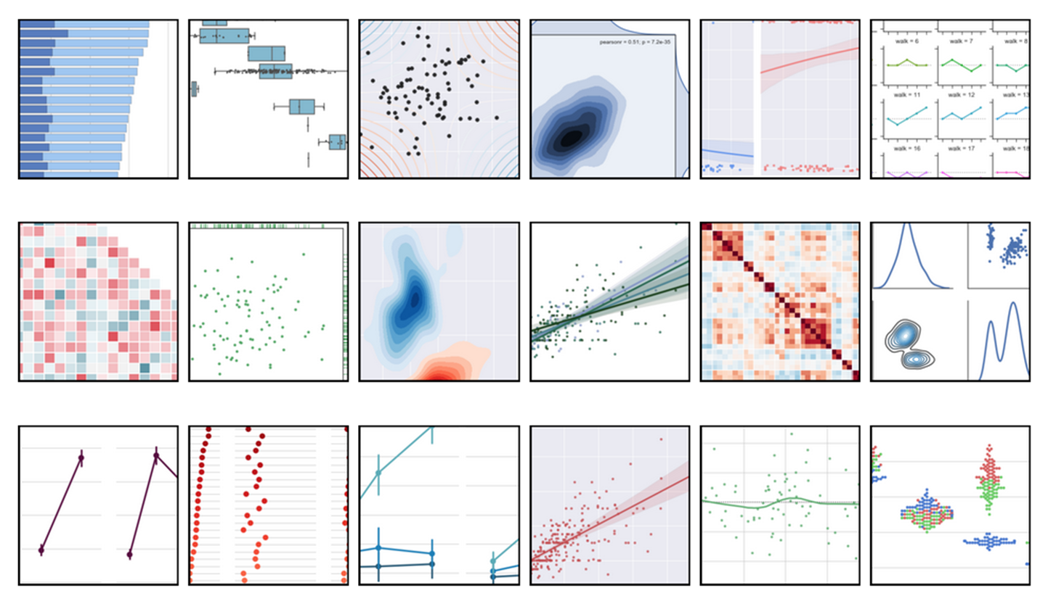
Statistical data visualization with Seaborn

Slide 49
Statistical data visualization with Seaborn
Visualization library based on matplotlib and Pandas
High-level interface for attractive statistical graphics
By Michael Waskom, Stanford Ph.D. student
http://stanford.edu/~mwaskom/software/seaborn

Slide 50
Plot with Seaborn
import seaborn as sns
fixations, times = simulation(…)
sns.distplot(times[fixations])
sns.distplot(times[~fixations])

Slide 51
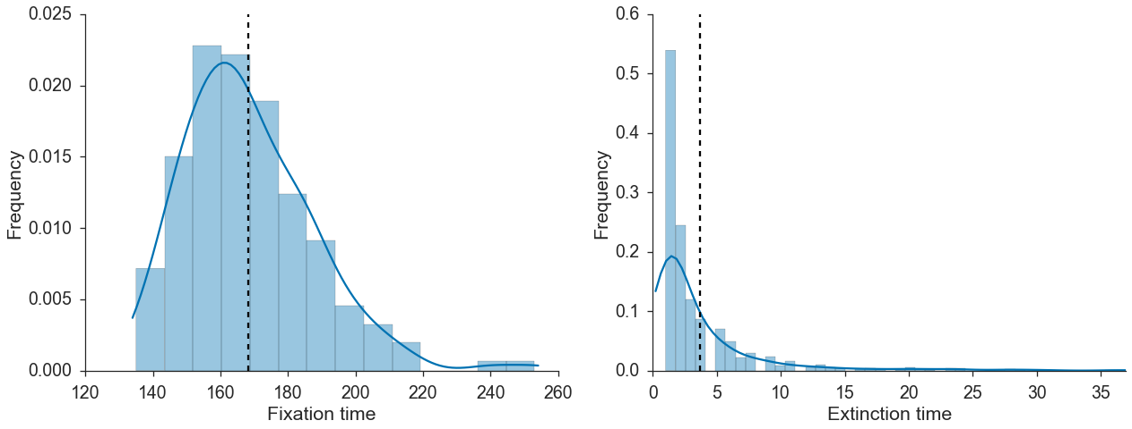
Plot with Seaborn
import seaborn as sns
fixations, times = simulation(…)
sns.distplot(times[fixations])
sns.distplot(times[~fixations])

Slide 52
Diffusion equation approximation
Motoo Kimura
1924-1994
Japan & USA

Slide 53
Diffusion equation approximation
Requires
integration…
Motoo Kimura
1924-1994
Japan & USA

Slide 54

from functools import partial
from scipy.integrate import quad
def integral(f, N, s, a, b):
f = partial(f, N, s)
return quad(f, a, b)[0]
Integral will calculate $\int_{a}^{b}{f\left(N,s,x\right)dx}$

Slide 55
from functools import partial
from scipy.integrate import quad
def integral(f, N, s, a, b):
f = partial(f, N, s)
return quad(f, a, b)[0]
partial freezes N and s
in f(N, s, x) to create f(x)

Slide 56
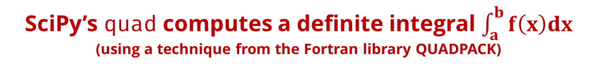
from functools import partial
from scipy.integrate import quad
def integral(f, N, s, a, b):
f = partial(f, N, s)
return quad(f, a, b)[0]
SciPy’s quad computes a definite integral $\int_{a}^{b}{f\left(x\right)dx}$
(using a technique from the Fortran library QUADPACK)

Slide 57
def I1(N, s, x):
…
def I2(N, s, x):
…
I1 and I2 are defined according to the equations

Slide 58
@np.vectorize
def T_kimura(N, s):
x = 1.0 / N
J1 = -1.0 / (s * expm1(-2 * N * s)) *
integral(I1, N, s, x, 1)
J2 = -1.0 / (s * expm1(-2 * N *s)) *
integral(I2, N, s, 0, x)
u = np.expm1(-2 * N * s * x) /
np.expm1(-2 * N * s)
return J1 + ((1 - u) / u) * J2
T_kimura is the fixation time given a single copy of variant 1: frequency x=1/N

Slide 59
@np.vectorize
def T_kimura(N, s):
x = 1.0 / N
J1 = -1.0 / (s * expm1(-2 * N * s)) *
integral(I1, N, s, x, 1)
J2 = -1.0 / (s * expm1(-2 * N *s)) *
integral(I2, N, s, 0, x)
u = np.expm1(-2 * N * s * x) /
np.expm1(-2 * N * s)
return J1 + ((1 - u) / u) * J2
J1 and J2 are calculated using integrals of I1 and I2

Slide 60
@np.vectorize
def T_kimura(N, s):
x = 1.0 / N
J1 = -1.0 / (s * expm1(-2 * N * s)) *
integral(I1, N, s, x, 1)
J2 = -1.0 / (s * expm1(-2 * N *s)) *
integral(I2, N, s, 0, x)
u = np.expm1(-2 * N * s * x) /
np.expm1(-2 * N * s)
return J1 + ((1 - u) / u) * J2
T_{fix} is the return value

Slide 61
@np.vectorize
def T_kimura(N, s):
x = 1.0 / N
J1 = -1.0 / (s * expm1(-2 * N * s)) *
integral(I1, N, s, x, 1)
J2 = -1.0 / (s * expm1(-2 * N *s)) *
integral(I2, N, s, 0, x)
u = np.expm1(-2 * N * s * x) /
np.expm1(-2 * N * s)
return J1 + ((1 - u) / u) * J2
np.vectorize creates a function that takes a sequence and returns an array - x2 faster

Slide 62
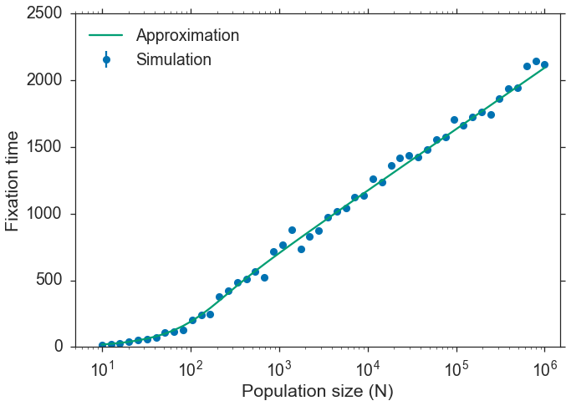

Slide 63
More in the online Jupyter notebook github.com/yoavram/PyConIL2016
More NumPy: multi-type simulation with matrix multiplication and broadcasting
Pandas: high-performance, easy-to-use data structures and data analysis tools
Numba: JIT compiler, array-oriented and math-heavy Python syntax to machine code
IPyParallel: IPython’s sophisticated and powerful architecture for parallel and distributed computing.
IPyWidgets: Interactive HTML Widgets for Jupyter notebooks and the IPython kernel

Slide 64
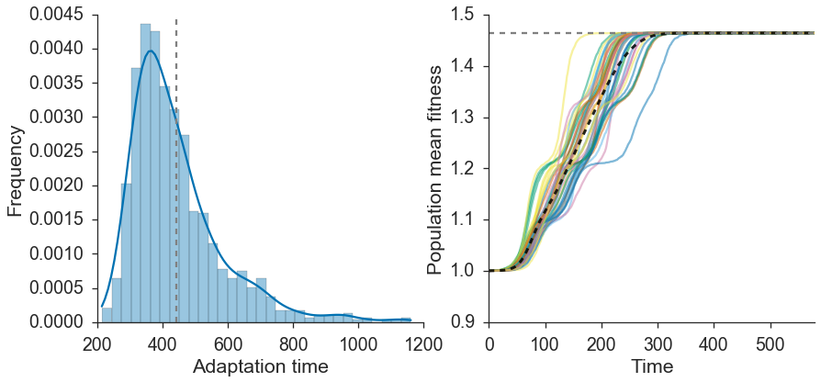
More in the online Jupyter notebook github.com/yoavram/PyConIL2016
Multi-type simulation:
Includes L variants, with mutation.
Follow n₀, n₁, …, n_{L} until n_{L}=N.

Slide 65





Thank You!
Presentation, Jupyter notebook, and more at
github.com/yoavram/PyConIL2016
yoav@yoavram.com
@yoavram
github.com/yoavram
www.yoavram.com
python.yoavram.com
a

