Slide 1
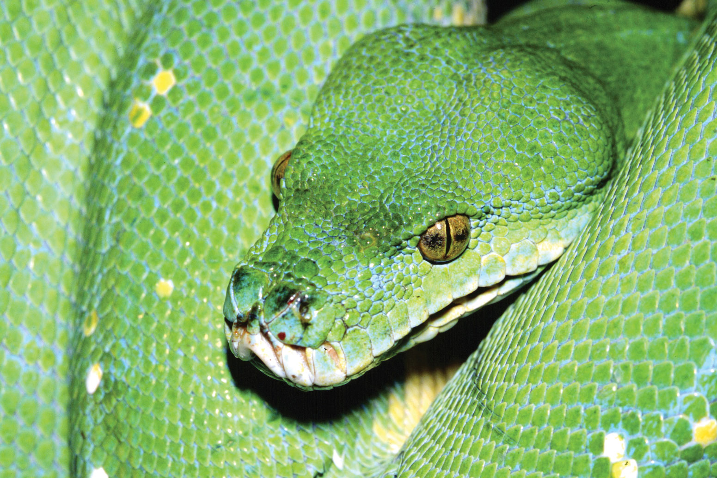
How to Study Evolution Using Scientific Python: Appendix
Yoav Ram
PyCon Israel 2016
Encyclopædia Britannica Online

Slide 2
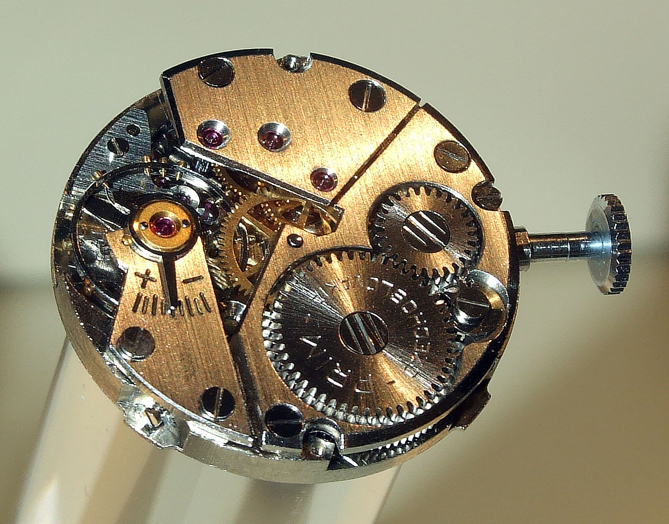
Fixation time
How much time does it take variant 1 to go extinct or to fix?
We want to keep track of time*.
time is measured in number of generations
https://commons.wikimedia.org/wiki/File:Prim_clockwork.jpg

Slide 3
def simulation(N, s, repetitions):
n1 = np.ones(repetitions)
T = np.empty_like(n1)
update = (n1 > 0) & (n1 < N)
t = 0
while update.any():
t += 1
p = n1 * (1 + s) / (N + n1 * s)
n1[update] = binomial(N, p[update])
T[update] = t
update = (n1 > 0) & (n1 < N)
return n1 == N, T
t keeps track of time

Slide 4
def simulation(N, s, repetitions):
n1 = np.ones(repetitions)
T = np.empty_like(n1)
update = (n1 > 0) & (n1 < N)
t = 0
while update.any():
t += 1
p = n1 * (1 + s) / (N + n1 * s)
n1[update] = binomial(N, p[update])
T[update] = t
update = (n1 > 0) & (n1 < N)
return n1 == N, T
T holds time for extinction/fixation

Slide 5
def simulation(N, s, repetitions):
n1 = np.ones(repetitions)
T = np.empty_like(n1)
update = (n1 > 0) & (n1 < N)
t = 0
while update.any():
t += 1
p = n1 * (1 + s) / (N + n1 * s)
n1[update] = binomial(N, p[update])
T[update] = t
update = (n1 > 0) & (n1 < N)
return n1 == N, T
Return both Booleans
and times (T)

Slide 6
Statistical data visualization with Seaborn
Visualization library based on matplotlib and Pandas
High-level interface for attractive statistical graphics
By Michael Waskom, Stanford Ph.D. student
http://stanford.edu/~mwaskom/software/seaborn

Slide 7
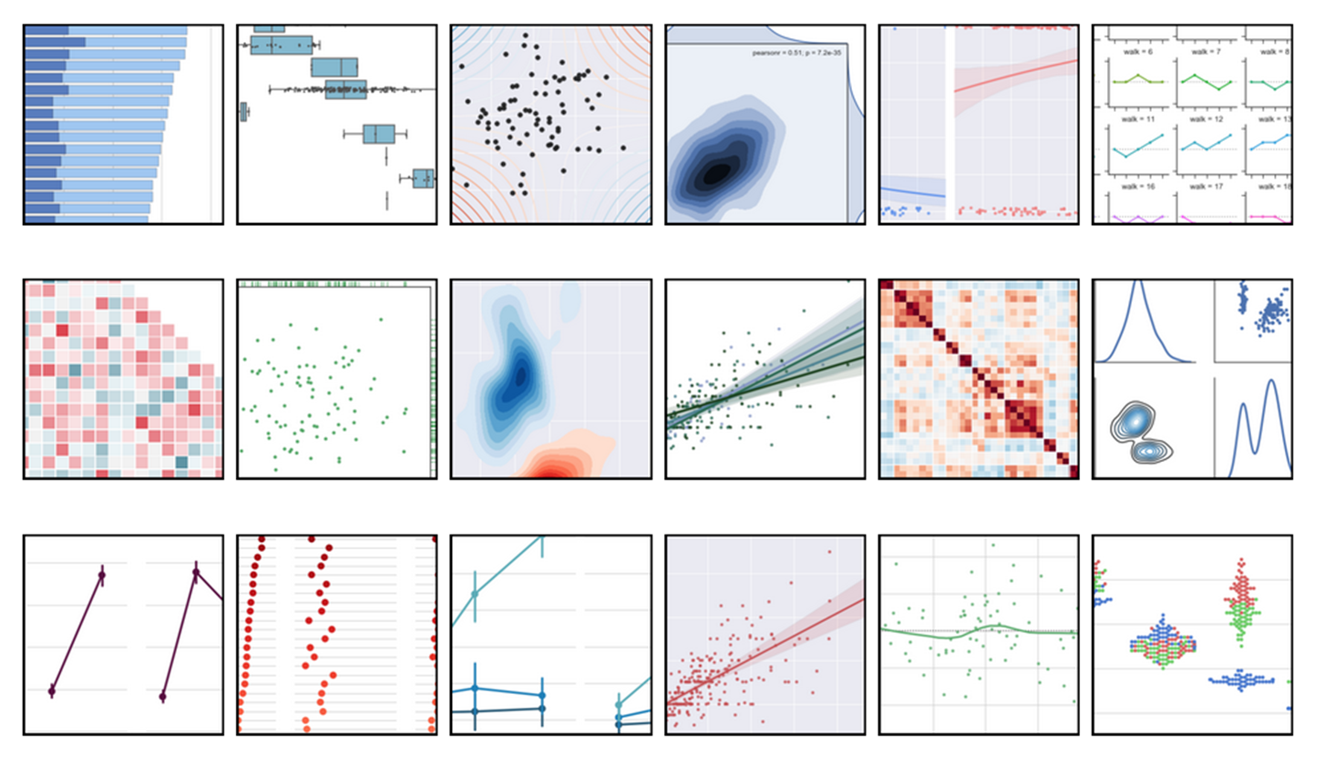
Statistical data visualization with Seaborn

Slide 8
Plot with Seaborn
from seaborn import distplot
fixations, times = simulation(…)
distplot(times[fixations])
distplot(times[~fixations])

Slide 9
Plot with Seaborn
from seaborn import distplot
fixations, times = simulation(…)
distplot(times[fixations])
distplot(times[~fixations])

Slide 10
Plot with Seaborn
from seaborn import distplot
fixations, times = simulation(…)
distplot(times[fixations])
distplot(times[~fixations])

Slide 11
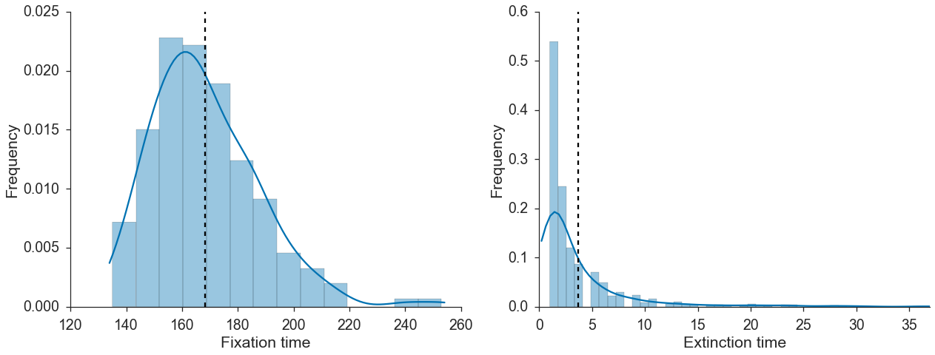
Plot with Seaborn
fixations, times = simulation(…)
distplot(times[fixations])
distplot(times[~fixations])

Slide 12
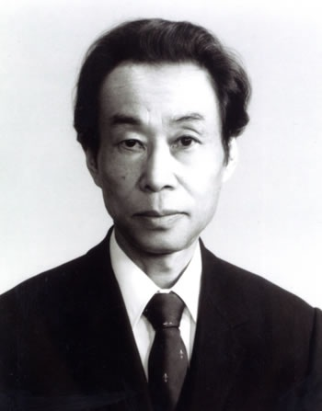
Diffusion equation approximation
Motoo Kimura
1924-1994
Japan & USA

Slide 13
Diffusion equation approximation
Requires
integration…
Motoo Kimura
1924-1994
Japan & USA

Slide 14

from functools import partial
from scipy.integrate import quad
def integral(f, N, s, a, b):
f = partial(f, N, s)
return quad(f, a, b)[0]
integral will calculate $\int_{a}^{b}{f\left(N,s,x\right)dx}$

Slide 15
from functools import partial
from scipy.integrate import quad
def integral(f, N, s, a, b):
f = partial(f, N, s)
return quad(f, a, b)[0]
partial freezes N and s
in f(N, s, x) to create f(x)

Slide 16
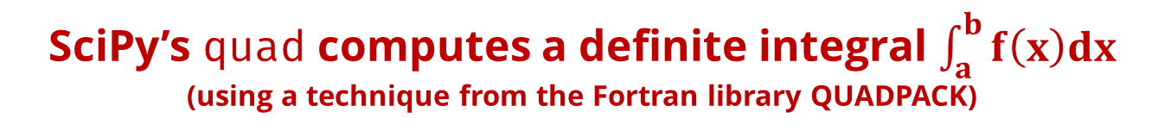
from functools import partial
from scipy.integrate import quad
def integral(f, N, s, a, b):
f = partial(f, N, s)
return quad(f, a, b)[0]
SciPy’s quad computes a definite integral $\int_{a}^{b}{f\left(x\right)dx}$
(using a technique from the Fortran library QUADPACK)

Slide 17
def I1(N, s, x):
…
def I2(N, s, x):
…
I1 and I2 are defined according to the equations

Slide 18
@np.vectorize
def T_kimura(N, s):
x = 1.0 / N
J1 = -1.0 / (s * expm1(-2 * N * s)) *
integral(I1, N, s, x, 1)
J2 = -1.0 / (s * expm1(-2 * N *s)) *
integral(I2, N, s, 0, x)
u = expm1(-2 * N * s * x) /
expm1(-2 * N * s)
return J1 + ((1 - u) / u) * J2
T_kimura is the fixation time given a single copy of variant 1: frequency x=1/N

Slide 19
@np.vectorize
def T_kimura(N, s):
x = 1.0 / N
J1 = -1.0 / (s * expm1(-2 * N * s)) *
integral(I1, N, s, x, 1)
J2 = -1.0 / (s * expm1(-2 * N *s)) *
integral(I2, N, s, 0, x)
u = expm1(-2 * N * s * x) /
expm1(-2 * N * s)
return J1 + ((1 - u) / u) * J2
J1 and J2 are calculated using integrals of I1 and I2

Slide 20
@np.vectorize
def T_kimura(N, s):
x = 1.0 / N
J1 = -1.0 / (s * expm1(-2 * N * s)) *
integral(I1, N, s, x, 1)
J2 = -1.0 / (s * expm1(-2 * N *s)) *
integral(I2, N, s, 0, x)
u = expm1(-2 * N * s * x) /
expm1(-2 * N * s)
return J1 + ((1 - u) / u) * J2
T_{fix} is the return value

Slide 21
@np.vectorize
def T_kimura(N, s):
x = 1.0 / N
J1 = -1.0 / (s * expm1(-2 * N * s)) *
integral(I1, N, s, x, 1)
J2 = -1.0 / (s * expm1(-2 * N *s)) *
integral(I2, N, s, 0, x)
u = expm1(-2 * N * s * x) /
expm1(-2 * N * s)
return J1 + ((1 - u) / u) * J2
np.vectorize creates a function that takes a sequence and returns an array - x2 faster

Slide 22
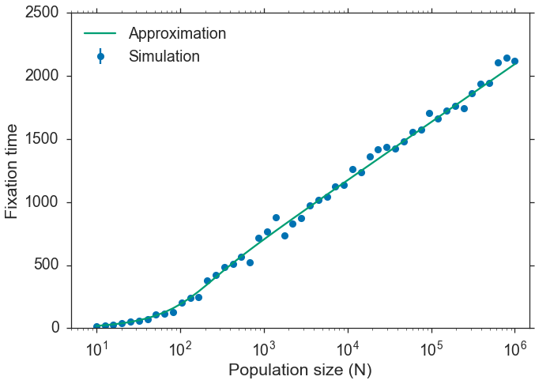

Slide 23





Presentation, Jupyter notebook, and more at
github.com/yoavram/PyConIL2016
yoav@yoavram.com
@yoavram
github.com/yoavram
www.yoavram.com
python.yoavram.com
a

