Slide 1

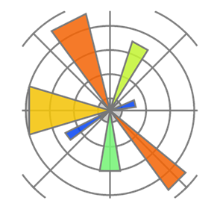

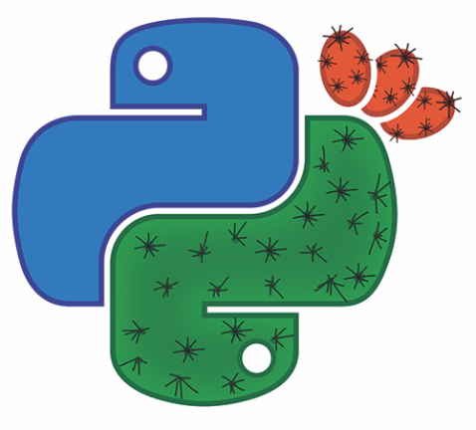

How to Study Evolution Using Scientific Python
Yoav Ram
PyCon Israel 2016
Tel Aviv, Israel
May 2-3

Slide 2
Who I am
PhD in Theoretical Evolutionary Biology
Using Python since 2002
Using Scientific Python since 2011
Teaching Python since 2011

Slide 3
Why Scientific Python (why not MATLAB?)
Python is…
Free as in beer
Free as in speech
General purpose
Portable
Beautiful
Everything is an object
Easy to learn, fast to develop
Fast enough
Large, diverse, active community
Many libraries
I used Matlab. Now I use Python. by Steve Tjoa
Why use Python for scientific computing?
Introduction to Python for MATLAB users

Slide 4
Mathematical Evolution Formally: Population genetics
Study change in frequency of gene variants within populations
The four forces of evolution:
Natural selection
Random genetic drift
Gene flow & recombination
Mutation
Focus on adaptation, speciation, population subdivision, and population structure
Population genetics

Slide 5
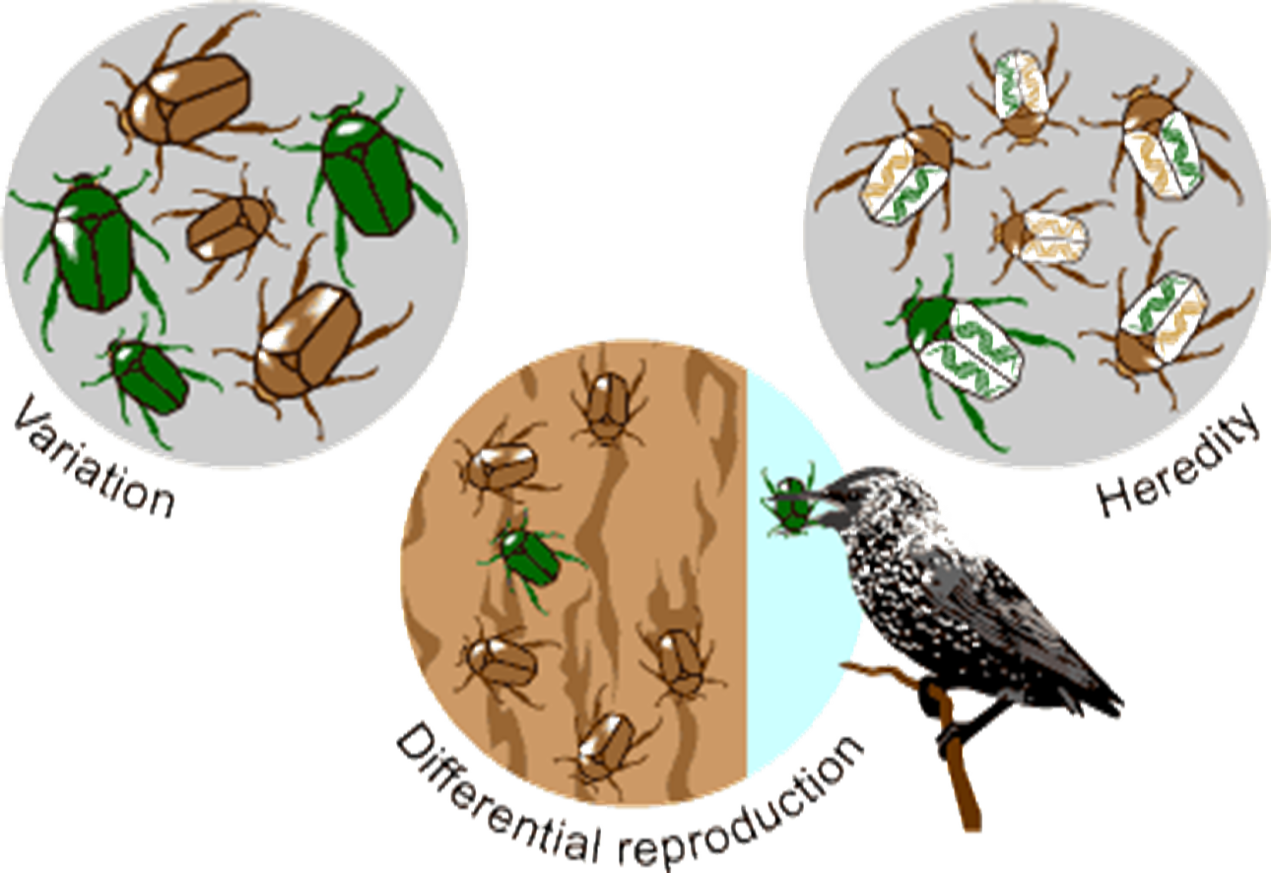
Evolution
University of California Museum of Paleontology's Understanding Evolution

Slide 6

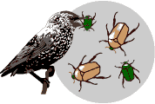


Natural Selection

Slide 7

Genetic Drift

Slide 8
The Wright-Fisher Model
Standard model for change in frequency of gene variants.
Two gene variants: 0 and 1.
Number of individuals with each variant is n₀ and n₁.
Total population size is N= n₀+n₁.
Frequency of each variant is p₀=n₀/N and p₁=n₁/N.

Slide 9
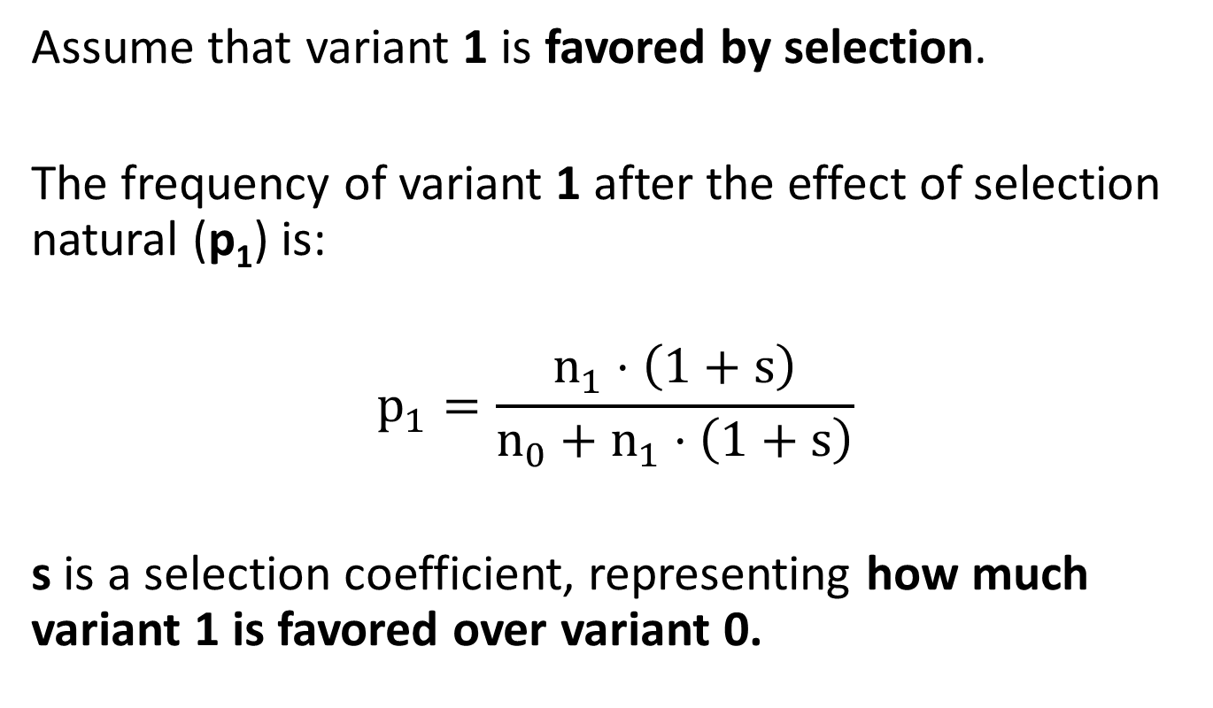
The Wright-Fisher Model
Assume that variant 1 is favored by selection.
The frequency of variant 1 after the effect of selection natural (p₁) is:
$$p_{1}=\frac{n_{1}⋅\left(1+s\right)}{n_{0}+n_{1}⋅\left(1+s\right)}$$
s is a selection coefficient, representing how much variant 1 is favored over variant 0.

Slide 10
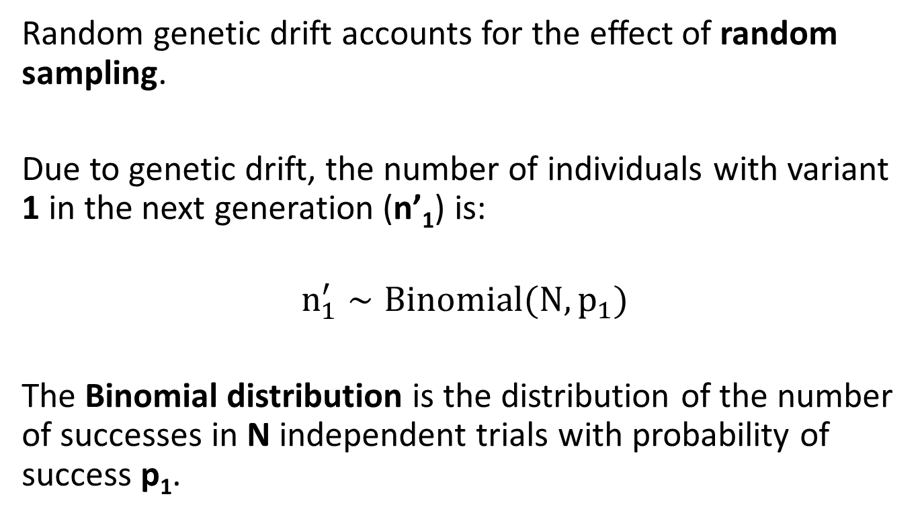
The Wright-Fisher Model
Random genetic drift accounts for the effect of random sampling.
Due to genetic drift, the number of individuals with variant 1 in the next generation (n’₁) is:
$$n_{1}^{′}∼Binomial(N, p_{1})$$
The Binomial distribution is the distribution of the number of successes in N independent trials with probability of success p₁.

Slide 11
Focus: Fixation Probability
Assume a single copy variant 1 in a population of size N.
What is the probability that variant 1 will fix rather than go extinct?

Slide 12
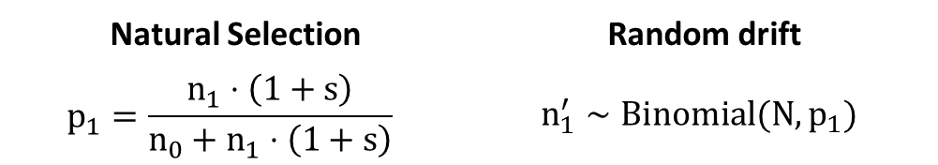
Random drift | Natural Selection
$$n_{1}^{′}∼Binomial(N, p_{1})$$ | $$p_{1}=\frac{n_{1}⋅\left(1+s\right)}{n_{0}+n_{1}⋅\left(1+s\right)}$$
from numpy.random import binomial
n1 = 1
while 0 < n1 < N:
n0 = N - n1
p1 = n1*(1+s) / (n0 + n1*(1+s))
n1 = binomial(N, p1)
result = n1 == N

Slide 13
Random drift | Natural Selection
$$n_{1}^{′}∼Binomial(N, p_{1})$$ | $$p_{1}=\frac{n_{1}⋅\left(1+s\right)}{n_{0}+n_{1}⋅\left(1+s\right)}$$
from numpy.random import binomial
n1 = 1
while 0 < n1 < N:
n0 = N - n1
p1 = n1*(1+s) / (n0 + n1*(1+s))
n1 = binomial(N, p1)
result = n1 == N
Import a binomial random number generator from NumPy

Slide 14
Random drift | Natural Selection
$$n_{1}^{′}∼Binomial(N, p_{1})$$ | $$p_{1}=\frac{n_{1}⋅\left(1+s\right)}{n_{0}+n_{1}⋅\left(1+s\right)}$$
from numpy.random import binomial
n1 = 1
while 0 < n1 < N:
n0 = N - n1
p1 = n1*(1+s) / (n0 + n1*(1+s))
n1 = binomial(N, p1)
result = n1 == N
Start with a single copy of variant 1

Slide 15
Random drift | Natural Selection
$$n_{1}^{′}∼Binomial(N, p_{1})$$ | $$p_{1}=\frac{n_{1}⋅\left(1+s\right)}{n_{0}+n_{1}⋅\left(1+s\right)}$$
from numpy.random import binomial
n1 = 1
while 0 < n1 < N:
n0 = N - n1
p1 = n1*(1+s) / (n0 + n1*(1+s))
n1 = binomial(N, p1)
result = n1 == N
Until number of individuals with variant 1 is 0 or N: extinction or fixation

Slide 16
Random drift | Natural Selection
$$n_{1}^{′}∼Binomial(N, p_{1})$$ | $$p_{1}=\frac{n_{1}⋅\left(1+s\right)}{n_{0}+n_{1}⋅\left(1+s\right)}$$
from numpy.random import binomial
n1 = 1
while 0 < n1 < N:
n0 = N - n1
p1 = n1*(1+s) / (n0 + n1*(1+s))
n1 = binomial(N, p1)
result = n1 == N
The frequency of variant 1 after the effect of selection natural is p1

Slide 17
Random drift | Natural Selection
$$n_{1}^{′}∼Binomial(N, p_{1})$$ | $$p_{1}=\frac{n_{1}⋅\left(1+s\right)}{n_{0}+n_{1}⋅\left(1+s\right)}$$
from numpy.random import binomial
n1 = 1
while 0 < n1 < N:
n0 = N - n1
p1 = n1*(1+s) / (n0 + n1*(1+s))
n1 = binomial(N, p1)
result = n1 == N
Due to genetic drift, the number of individuals with variant 1 in the next generation is n1

Slide 18
Random drift | Natural Selection
$$n_{1}^{′}∼Binomial(N, p_{1})$$ | $$p_{1}=\frac{n_{1}⋅\left(1+s\right)}{n_{0}+n_{1}⋅\left(1+s\right)}$$
from numpy.random import binomial
n1 = 1
while 0 < n1 < N:
n0 = N - n1
p1 = n1*(1+s) / (n0 + n1*(1+s))
n1 = binomial(N, p1)
result = n1 == N
Fixation: n1 equals N
Extinction: n1 equals 0

Slide 19
NumPy vs. Pure Python
Here, NumPy is useful for random number generation:
n1 = binomial(N, p1)
Pure Python version would replace this with:
from random import random
n1 = sum(
1
for _ in range(N)
if random () < p1
)
* random is the standard library random number generation module

Slide 20
NumPy vs. Pure Python
%timeit simulation(N=1000, s=0.1)
%timeit simulation(N=1000000, s=0.01)
Pure Python version:
100 loops, best of 3: 8.13 ms per loop
1 loop, best of 3: 319 ms per loop
NumPy version:
10000 loops, best of 3: 190 µs per loop (x42 faster)
1000 loops, best of 3: 249 µs per loop (x1280 faster)

Slide 21
Can we do it better faster?
Cython
a
Numba
b

Slide 22
Cython
def simulation(np.uint64_t N, np.float64_t s):
cdef np.uint64_t n1 = 1
cdef np.uint64_t n0
cdef np.float64_t p
while 0 < n1 < N:
n0 = N - n1
p1 = n1 * (1 + s) / (n0 + n1 * (1 + s))
n1 = np.random.binomial(N, p1)
return n1 == N

Slide 23
Cython
%timeit simulation(N=1000, s=0.1)
%timeit simulation(N=1000000, s=0.01)
NumPy version:
10000 loops, best of 3: 190 µs per loop (x42 faster)
1000 loops, best of 3: 249 µs per loop (x1280 faster)
Cython version:
10000 loops, best of 3: 97.7 µs per loop (x2 faster)
10000 loops, best of 3: 198 µs per loop (x1.25 faster)

Slide 24
Numba
@numba.jit(locals=dict(
s=numba.float64, N=numba.uint64,
n0=numba.uint64, n1=numba.uint64,
p=numba.float64))
def simulation(N, s):
n1 = 1
while 0 < n1 < N:
n0 = N - n1
p1 = n1 * (1 + s) / (n0 + n1 * (1 + s))
n1 = np.random.binomial(N, p1)
return n1 == N

Slide 25
Numba
%timeit simulation(N=1000, s=0.1)
%timeit simulation(N=1000000, s=0.01)
NumPy version:
10000 loops, best of 3: 190 µs per loop (x42 faster)
1000 loops, best of 3: 249 µs per loop (x1280 faster)
Numba version:
10000 loops, best of 3: 57.9 µs per loop (x2 faster)
100 loops, best of 3: 33.8 ms per loop (x20 slower?)

Slide 26
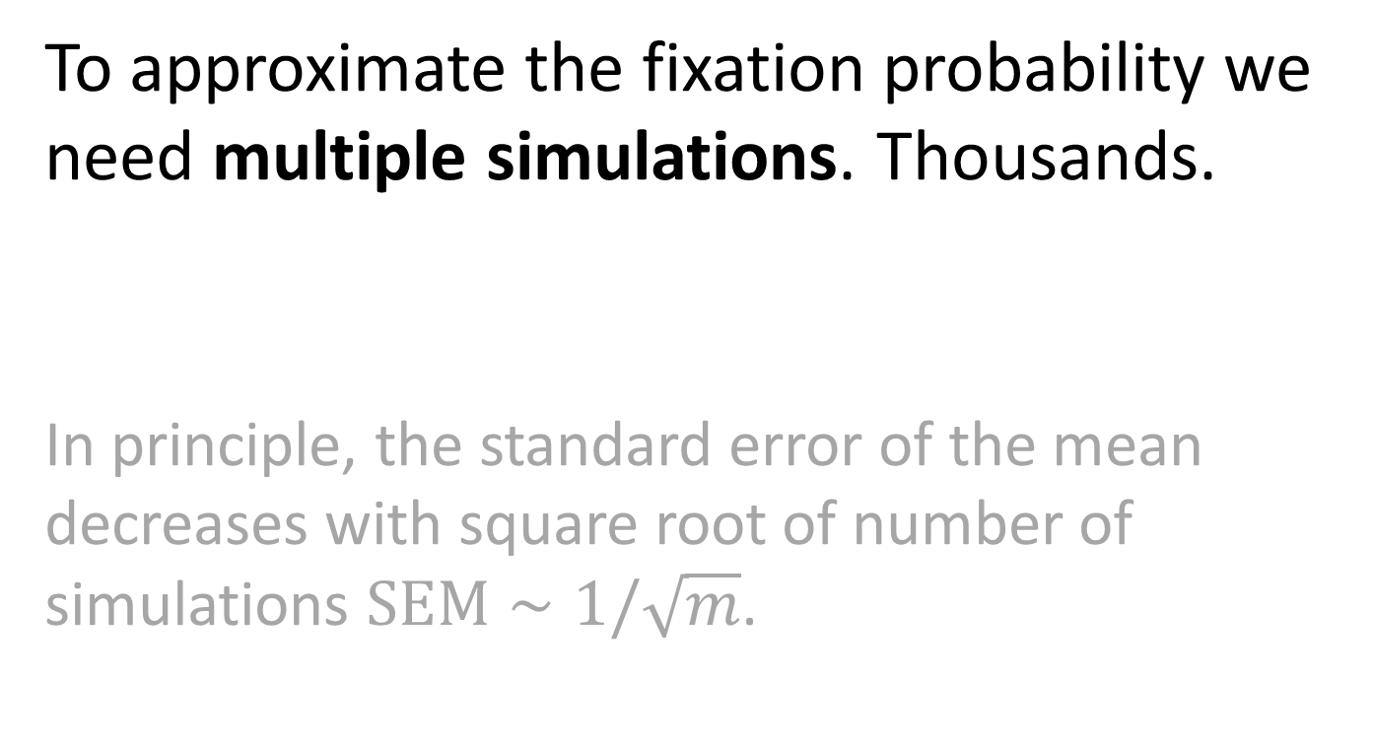
One simulation is not enough
To approximate the fixation probability we need multiple simulations. Thousands.
In principle, the standard error of the mean decreases with square root of number of simulations $SEM∼1/\sqrt{m}$.

Slide 27
Multiple simulations: for loop
fixations = [
simulation(N, s)
for _ in range(1000)
]
sum(fixations) / len(fixations)
-> 0.195
%timeit [simulation(…) for … range(1000)]
1 loop, best of 3: 8.05 s per loop

Slide 28
Multiple simulations: NumPy
def simulation(N, s, repetitions=1000):
n1 = np.ones(repetitions)
update = np.array([True] * repetitions)
while update.any():
p1 = n1 * (1 + s) / (N + n1 * s)
n1[update] = binomial(N, p1[update])
update = (n1 > 0) & (n1 < N)
return n1 == N

Slide 29
Multiple simulations: NumPy
def simulation(N, s, repetitions=1000):
n1 = np.ones(repetitions)
update = np.array([True] * repetitions)
while update.any():
p1 = n1 * (1 + s) / (N + n1 * s)
n1[update] = binomial(N, p1[update])
update = (n1 > 0) & (n1 < N)
return n1 == N
Initialize multiple simulations

Slide 30
Multiple simulations: NumPy
def simulation(N, s, repetitions=1000):
n1 = np.ones(repetitions)
update = np.array([True] * repetitions)
while update.any():
p1 = n1 * (1 + s) / (N + n1 * s)
n1[update] = binomial(N, p1[update])
update = (n1 > 0) & (n1 < N)
return n1 == N
Natural selection:
n1 is an array so operations are element-wise

Slide 31
Multiple simulations: NumPy
def simulation(N, s, repetitions=1000):
n1 = np.ones(repetitions)
update = np.array([True] * repetitions)
while update.any():
p1 = n1 * (1 + s) / (N + n1 * s)
n1[update] = binomial(N, p1[update])
update = (n1 > 0) & (n1 < N)
return n1 == N
Genetic drift:
binomial(N, p1) draws from multiple binomial distributions

Slide 32
Multiple simulations: NumPy
def simulation(N, s, repetitions=1000):
n1 = np.ones(repetitions)
update = np.array([True] * repetitions)
while update.any():
p1 = n1 * (1 + s) / (N + n1 * s)
n1[update] = binomial(N, p1[update])
update = (n1 > 0) & (n1 < N)
return n1 == N
update follows the simulations that didn’t finish yet

Slide 33
Multiple simulations: NumPy
def simulation(N, s, repetitions=1000):
n1 = np.ones(repetitions)
update = np.array([True] * repetitions)
while update.any():
p1 = n1 * (1 + s) / (N + n1 * s)
n1[update] = binomial(N, p1[update])
update = (n1 > 0) & (n1 < N)
return n1 == N
Return an array of Booleans: for each simulation, did variant 1 fix?

Slide 34
Multiple simulations: NumPy
%timeit simulation(N=1000, s=0.1)
10 loops, best of 3: 39.2 ms per loop (x200 faster)

Slide 35
Fixation probability as a function of N
Nrange = np.logspace(1, 6, 20, dtype=np.uint64)

Slide 36
Fixation probability as a function of N
fix_prob = [
simulation(
N,
s, repetitions
) for N in Nrange
]

Slide 37
Fixation probability as a function of N
fix_prob = np.array(fix_prob)
mean = fix_prob.mean(axis=1)
sem = fix_prob.std(
axis=1,
ddof=1
) / np.sqrt(repetitions)

Slide 38
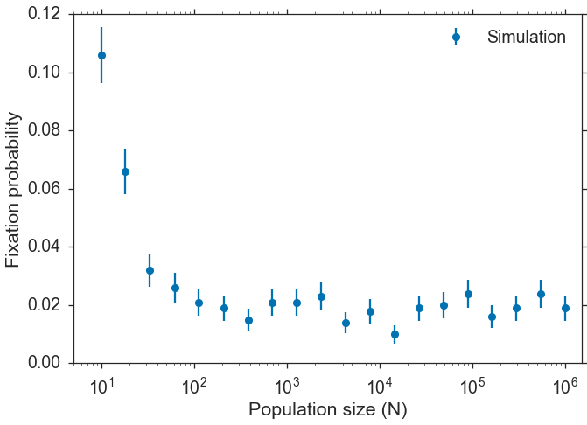

Slide 39
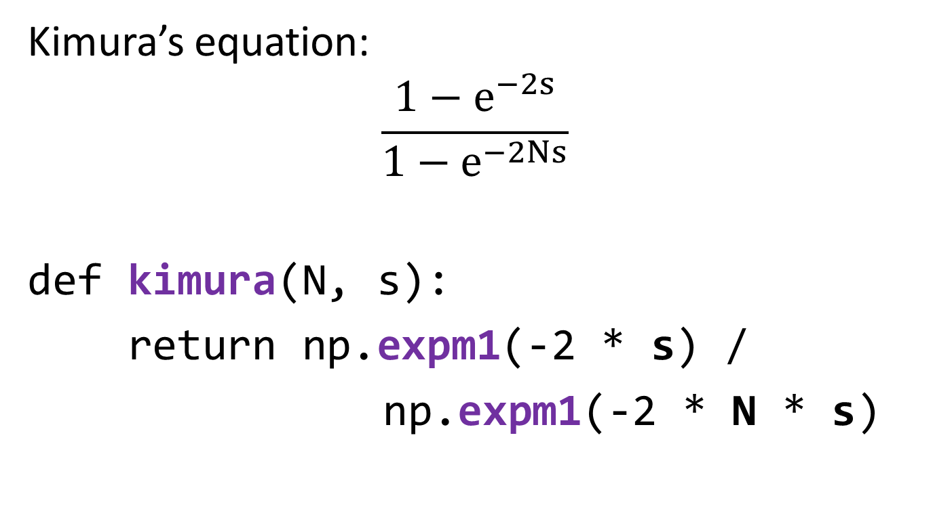
Approximation
Kimura’s equation:
$$\frac{1−e^{−2s}}{1−e^{−2Ns}}$$
def kimura(N, s):
return np.expm1(-2 * s) /
np.expm1(-2 * N * s)

Slide 40
kimura is a ufunc out-of-the-box
%timeit [kimura(N=N, s=s)
for N in Nrange]
%timeit kimura(N=Nrange, s=s)
1 loop, best of 3: 917 ms per loop 1000 loops, best of 3: 4.77 ms per loop
X200 faster!

Slide 41
Numexpr
fast evaluation of array expressions elementwise by using a vector-based virtual machine.
def kimura(N, s):
return ne.evaluate(
"expm1(-2 * s)
/ expm1(-2 * N * s)“)
%timeit kimura(N=Nrange, s=s)
1000 loops, best of 3: 1.18 ms per loop (x2 faster)
https://github.com/pydata/numexpr

Slide 42
Plot
import matplotlib.pyplot as plt
fig, ax = plt.subplots(1, 1)
ax.plot(Nrange, kimura(Nrange s), label='Kimura')
ax.axhline(2*s, color='gray', ls='--', label='2s')
ax.errorbar(x=Nrange, y=mean, yerr=sem,
fmt='o', capsize=5, label='Simulation')
ax.set(xlabel='Population size (N)', xscale='log',
xlim=(0.5 * Nrange.min(), 1.5 * Nrange.max()),
ylabel='Fixation probability')
ax.legend()

Slide 43
