Slide 1
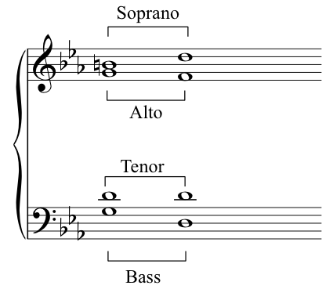
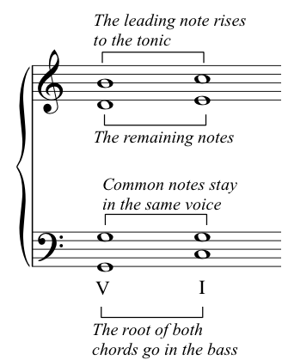
Four Part Harmony: A Pun on the word fux
Matthew Deutsch & Jarele Soyinka
Constructing The Notes & Relations
Evolution of the CSP
Introduction
  For Matt
Diagram of the class structure
Objective
  For our final project, we will produce a program that writes simple phrases of Baroque choral music via the theory of “First Species” four part harmony (FS4PH). First Species four part harmony is a set of rules for writing choral music first described by music theorist Johann Fux in 1725, in an attempt to codify the style of JS Bach and contemporaries. We will model this problem as a CSP.
Conclusion

