Slide 1
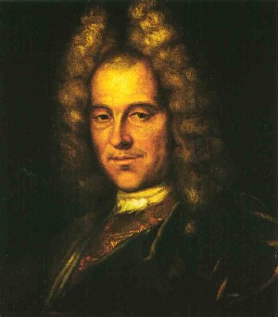
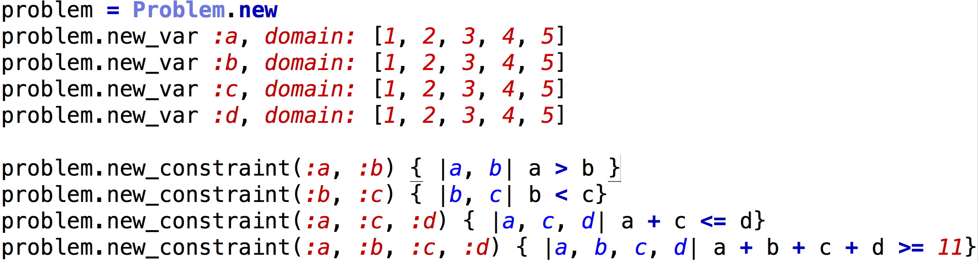
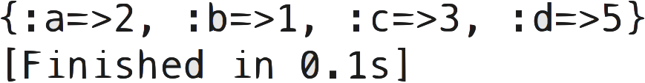
Four Part Harmony: A Pun on the word fux
Matthew Deutsch & Jarele Soyinka
Constructing The Notes & Relations
Evolution of the Solving Algorithm
  Many design decisions had to be made while determining how to best describe our problem as a CSP. First, what exactly is a variable? Is it a note? A chord? A phrase? Second, since many of the rules defined by Fux were never meant to be followed 100% of the time, how do we encode these constraints along with his more rigid ones?
  One of the great features of the ruby programming language is the ability to store executable codes of blocks as objects. This became the basis for initializing our constraints, in our initial implementation. The general outline would look something like this:
Introduction
  In 1725, a music theorist named Johann Fux codified the set of rules of thumb that Baroque composers used to create good-sounding harmonies. Fux’s theories are still taught in almost all introductory music theory courses, and a common assignment is to write music that follows Fux’s rules. Since many of these rules are quite objective, it is possible to codify his prescriptions as a CSP.
Class Hierarchy
FUX Problem
Solution:
  From there it was a matter of choosing the model that best suited our needs. Our implementation strategy proceeded as followed:
FUX Chord
Variable
Backtracking
+100% will find existing solution
- Very Slow
Forward Checking
+100% will find existing solution
- Slow
Alto Range, Tenor Range
Bass Range, Soprano Range
Variable.Domain
Min-Conflicts
- Not guaranteed solution
+ Very Fast
Most Constrained Value
+100% will find existing solution
- Slightly slow - Hard to implement
Objective
Voices Within Octave
Constraint
  We seek to produce output that matches or is indistinguishable from harmonies written by real Baroque composers. We attempt to do this by modeling Fux’s prescriptive rules as constraints in a CSP. In order to account for many of Fux’s rules which are explicitly meant to be occasionally ignored, we encode these as “soft constraints”, and seek to modify our familiar CSP algorithms to account for such soft constraints.
Min-Conflicts w/ Soft Constraints
- Not guaranteed solution
+ Fast + Better Solutions Found
  Taking a complete “musical phrase” as a variable would make the constraints easier, but the domain size of each variable would be so monstrous as to be completely unwieldy. Thus we settled on having each moment in time (each chord) be its own variable, which strikes a middle ground between having a relatively small domain size (about 700 possibilities per chord) while keeping the constraints still fairly simple.
??Weighted Soft Constraints??
- Not guaranteed solution
+ Fast + Best Solutions Found
Conclusion
  The problem at hand was solvable, we were able to produce music
  Class organization greatly affects implementation strategy
  The solver not only is important in finding the solution, but also in determining what solutions are best

