Slide 1
AR
Vendor Onboarding Analysis
Crypto.com Arena · Live Excel Dashboard
Analyst: Spoon Scope: 370 vendors · 7 onboarding coordinators
Tools: Excel (data cleaning, live formula engine, dashboard), Claude (AI assistant)
A designed sourcing & procurement scenario: onboard the full supplier base an arena runs on, from a raw 400-vendor list cleaned to 370.

Slide 2
Part 1
The Findings
What the data says about opening-day readiness, and where the exposure actually sits.

Slide 3
01
EXECUTIVE SUMMARY
Progress is healthy. The essential services are not yet secured.
38%
74%
97
32
fully onboarded
on track
red-flag vendors
critical suppliers at risk
140 of 370
273 complete or in progress
$8.71M annual spend
$5.55M not yet secured
TAKEAWAY
Of the 129 critical suppliers (the services an arena cannot open without: HVAC, electrical, security, fire and life safety, elevators), 32 are delayed or unresponsive, carrying $5.55M. That number, not the 38% headline, sets the agenda. The question is not "are we behind?" but "are the doors-open services locked down?"

Slide 4
02
PROGRESS OVERVIEW
The status mix across all 370 vendors
Status | Vendors | Share
Complete | 140 | 38%
Received (in progress) | 133 | 36%
Delayed | 62 | 17%
Delayed (EOD) | 12 | 3%
Poor Communication | 23 | 6%
370
vendors
TAKEAWAY
Three of every four vendors are moving through the pipeline as intended. The onboarding machine works. The open question is not whether it functions, but whether it is finishing the right vendors in time.

Slide 5
03
THE RISK VIEW
Critical-supplier readiness, the number that matters for an arena
Status | Critical suppliers | Share
Complete | 64 | 50%
Received | 33 | 26%
Delayed | 26 | 20%
Delayed (EOD) | 2 | 2%
Poor Communication | 4 | 3%
$5.55M
in essential-services spend not yet secured
32 of 129
critical suppliers delayed or unresponsive
TAKEAWAY
Half of critical suppliers are secured, but 32 (25%) are delayed or unresponsive across the exact categories an arena cannot open without. Completion percentage alone is a comfort metric: a delayed napkin vendor and a delayed fire-safety vendor are not the same risk.

Slide 6
04
THE ESCALATION LIST
Top critical suppliers at risk, highest-spend essential services not yet secured
Supplier | Coordinator | Status | Annual $
Monarch Mechanical Partners | Marisol Reyes | Delayed | $434,200
Precision Electrical Co. | Trevor Nguyen | Delayed | $408,600
Allied Guard Services Inc. | Damon Fields | Delayed (EOD) | $313,400
SoCal Fire Protection Services | Andre Boseman | Delayed | $286,000
Coastal Climate Control | Marisol Reyes | Delayed | $283,800
Guardian Fire Protection Solutions | Marisol Reyes | Delayed | $279,000
Union Security Contractors | Priya Kapoor | Poor Comms | $272,500
Sequoia Electrical Associates | Trevor Nguyen | Delayed | $259,000
Golden State Technologies Services | Andre Boseman | Poor Comms | $248,800
Sterling Electrical LLC | Trevor Nguyen | Delayed | $244,300
The ten highest-dollar at-risk suppliers fit on one screen. This is a targeting problem, not a scramble.

Slide 7
05
COORDINATOR PERFORMANCE
Completion rate, read the way an analyst should: weighted by what each book carries
Coordinator | Comp % | Crit. at-risk | Spend at-risk
Marisol Reyes | 57% | 11 | $1,843,300
Trevor Nguyen | 57% | 9 | $1,627,600
Damon Fields | 38% | 4 | $1,656,700
Andre Boseman | 38% | 3 | $1,180,400
Hannah Whitlock | 29% | 2 | $1,303,600
Priya Kapoor | 28% | 3 | $920,600
Yuki Tanaka | 19% | 0 | $179,200
TAKEAWAY
Marisol and Trevor lead at 57%, but they also carry the highest at-risk exposure because they were handed the heaviest critical, high-dollar books. Their 57% is more impressive, not less. The reverse holds for Yuki: lowest completion (19%) but zero critical at-risk and only $179K exposed. Low completion does not equal high risk.

Slide 8
06
RED FLAGS
Two concentration patterns a status average would hide
23
poor-communication flags,
all held by three coordinators
12
end-of-day (EOD) delays,
all on one coordinator
Priya Kapoor 8 Hannah Whitlock 8
Andre Boseman
7 Other four coordinators 0
Damon Fields 12 of 12 (100%)
A single coordinator holding 100% of the most time-sensitive delays signals a bottleneck. Reinforce or partially reassign his hard-deadline vendors before those deadlines pass.
When a problem clusters this cleanly it is rarely coincidence: workload, vendor quality, or a coaching gap. Diagnose before treating the symptom.
TAKEAWAY
The risk is concentrated and nameable, which makes it fixable. These two patterns point directly at where a manager should spend attention this week.

Slide 9
07
RECOMMENDATIONS
Ordered by risk to opening day
1
Triage the $5.55M in critical at-risk suppliers first
The only items that can stop the doors from opening. Escalate the top ten, starting with Monarch Mechanical ($434K) and Precision Electrical ($408K).
2
Diagnose the poor-communication cluster
Priya, Hannah, and Andre hold all 23 flags. Find the cause and provide escalation support or reassign the truly unresponsive vendors.
3
Break the end-of-day bottleneck on Damon’s book
All 12 EOD delays are his. Reinforce or partially reassign so no hard deadline lapses on a single point of contact.
4
Convert Yuki’s received backlog for a cheap completion bump
Low criticality, high volume, mid-process. A focused documentation push raises the overall rate quickly and safely.
5
Codify what Marisol and Trevor do
The two best performers carry the hardest books. Capture their approach as the standard operating procedure and lift the middle of the pack.

Slide 10
Part 2
How It Was Built
A fully live formula engine. The moment a coordinator updates a vendor, every number and chart re-ranks itself. Nothing is hardcoded.

Slide 11
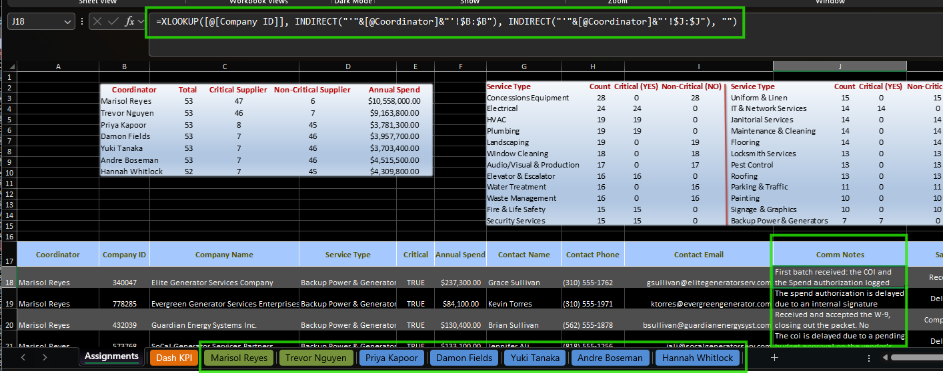
E1
THE ENGINE · STEP 1 OF 6
Roll up every coordinator’s notes into one sheet
TAKEAWAY
XLOOKUP finds each vendor by Company ID, and INDIRECT builds the sheet reference from the coordinator’s name (“’”&[@Coordinator]&“’!$J:$J”). One formula reads the right column on the right tab, so all seven coordinator sheets feed the central Assignments engine automatically.

Slide 12
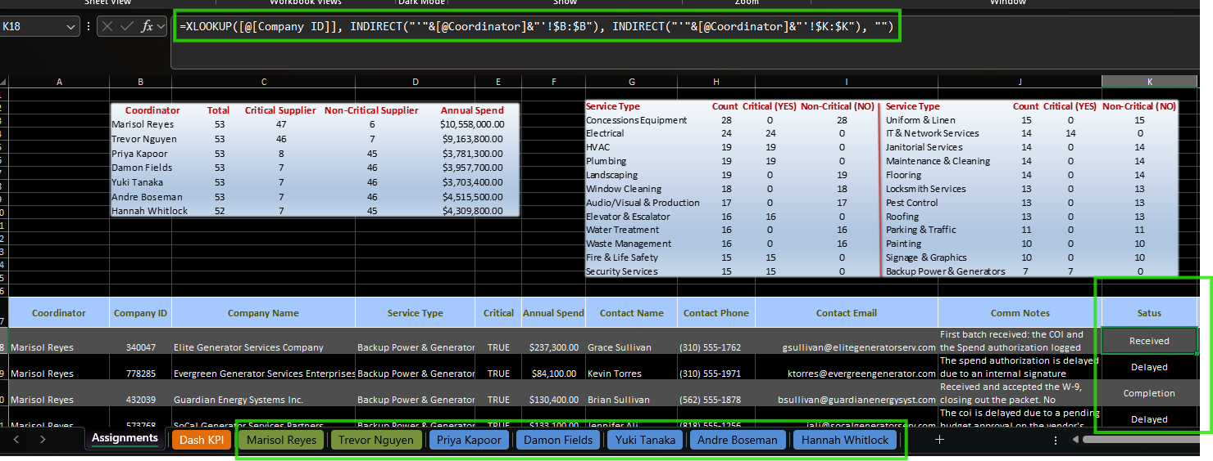
E2
THE ENGINE · STEP 2 OF 6
The same pattern rolls up onboarding Status
TAKEAWAY
Identical XLOOKUP + INDIRECT, pointed at the Status column ($K:$K). Because the sheet reference is built from the Coordinator field, adding or renaming a coordinator tab needs no formula edits, the roll-up just follows the name.

Slide 13
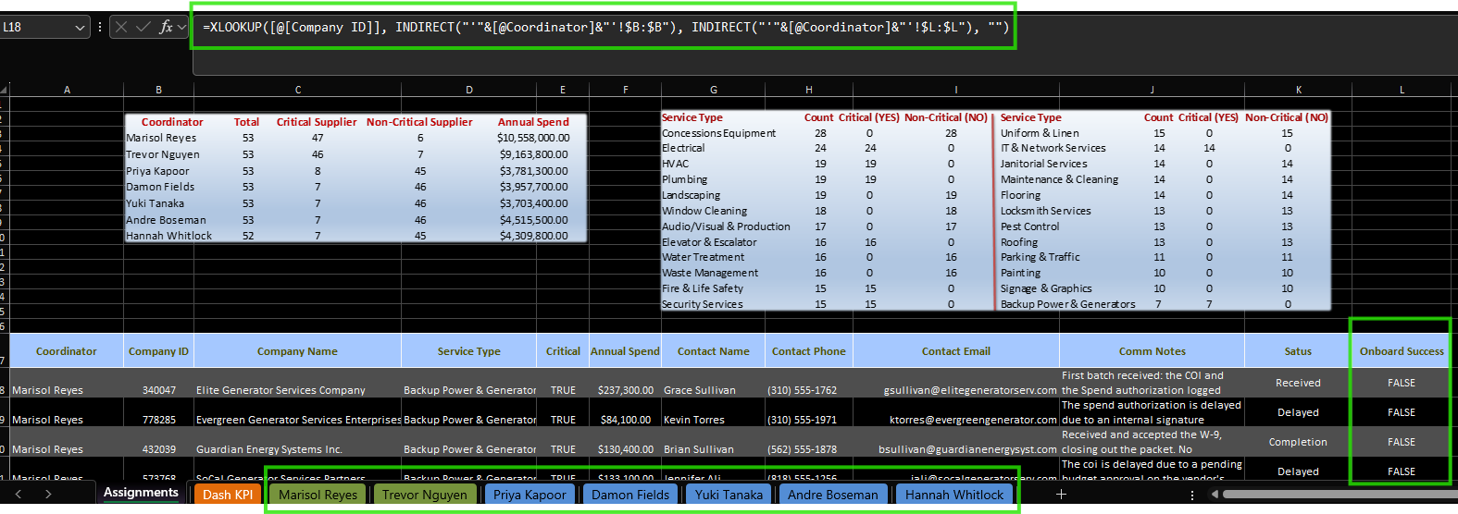
E3
THE ENGINE · STEP 3 OF 6
And rolls up Onboard Success the same way
TAKEAWAY
The third field, Onboard Success ($L:$L), completes the engine. Three columns, one reusable formula pattern, every vendor’s live state pulled into a single table that the KPI cards and charts read from.

Slide 14
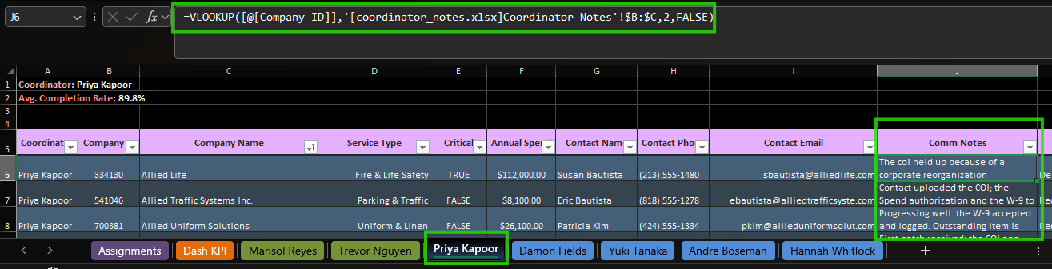
E4
THE SOURCE · STEP 4 OF 6
Where the notes come from: a separate notes workbook
TAKEAWAY
On each coordinator sheet, VLOOKUP pulls each vendor’s Comm Notes from a separate coordinator_notes.xlsx (AI-generated with Claude to represent realistic vendor communication: progress, poor comms, delays, or completion). Keeping notes in their own file keeps the working sheets clean.

Slide 15
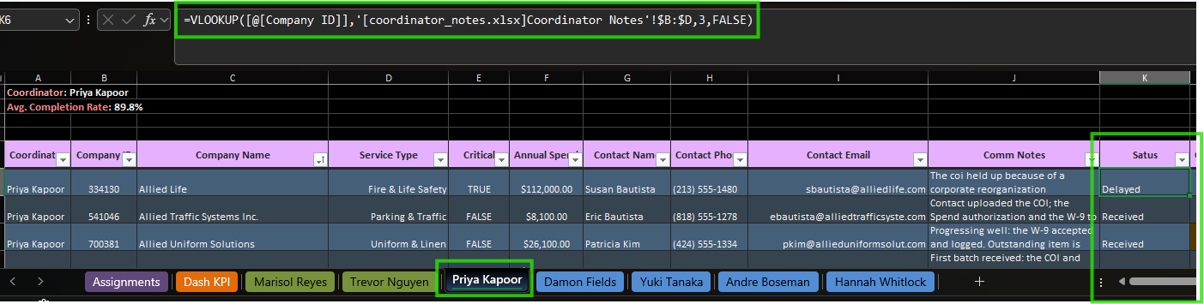
E5
THE SOURCE · STEP 5 OF 6
The same lookup drives each vendor’s Status
TAKEAWAY
A second VLOOKUP against coordinator_notes.xlsx returns the Status value that the engine then rolls up. Status and notes stay in sync because they resolve from the same source row, keyed on Company ID.

Slide 16
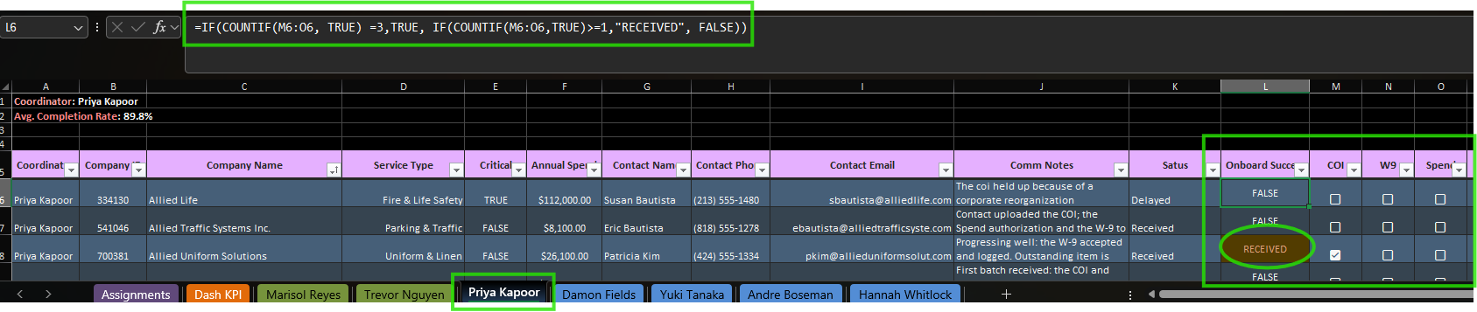
E6
THE LOGIC · STEP 6 OF 6
Onboard Success is earned, not typed
TAKEAWAY
IF(COUNTIF over the COI, W9, and Spend checkboxes) returns TRUE only when all three documents are in, RECEIVED when some are, and FALSE otherwise. Conditional formatting shades RECEIVED yellow and TRUE green, so readiness is visible at a glance and impossible to fake.

Slide 17
08
DATA QUALITY
Trustworthy numbers start with a clean list
400
370
Remove Duplicates + Fuzzy Lookup
raw rows
(exact duplicates + fuzzy name variants)
clean, unique vendors
(the analysis base)
TAKEAWAY
The same supplier had been entered under slightly different names. Remove Duplicates caught the exact copies; Fuzzy Lookup caught the near-matches. Every downstream number reads from this cleaned base through the live engine, which is what makes the dashboard trustworthy rather than merely impressive.

Slide 18
What opening-day readiness looks like
$5.55M
32
100%
critical spend to secure
critical suppliers to close
critical, not 100% of all vendors
Where to act first
Triage the 32 critical at-risk suppliers ($5.55M)
  the only items that can stop the doors from opening; start with Monarch Mechanical and Precision Electrical.
Clear the poor-comms cluster and Damon’s EOD bottleneck
  the softest, most fixable risk sits with four named coordinators.
Let completion climb on its own, and codify the top performers
  the 38% figure drains upward as the pipeline clears; make Marisol and Trevor’s approach the standard.

