Slide 1

terminal — zsh — 1280x720
$ init --system "vibe-coding-protocol"
DON'T Download AI Skills, BUILD Them
The 50+ Custom AI Operating System for Antigravity
MASTER
UTF-8
PAGE 01/12

Slide 2

the_hook.sh — zsh — 1280x720
$ grep --hook "random_skills"
"Everyone is downloading random AI skills and hoping they work."
➜
Pasting GitHub markdown files into Antigravity leads to "mid" results.
➜
It's not a skills problem; it's a systems problem.
MASTER
UTF-8
PAGE 02/12

Slide 3
reality_check.py — zsh — 1280x720
$ diagnose --target "default_antigravity"
ERROR: Workspace_Empty
RESULT: "Mid" Output
✖ No Context Files
✖ Unstyled & Basic
✖ No Coding Standards
✖ No Animations
✖ No Design System
✖ Bland SEO/Marketing
✖ No Security Checks
✖ Fragile Production Code
"The AI can do everything you want—you just haven't told it HOW."
MASTER
UTF-8
PAGE 03/12

Slide 4
vibe_suite_v1.0.0 — zsh — 1280x720
$ systemctl status "vibecoding-protocol-suite"
AUTO
Skills activate based on task context
64
CORE
Security, Design, SEO, & Code Review
Custom Skills
INFO
Don't download one skill and pray
26
GOAL
Install a complete ecosystem
Workflows
SYSTEM_ACTIVE
UTF-8
PAGE 04/12

Slide 5
loop_1_foundation.sh — zsh — 1280x720
$ invoke --workflow "genesis"
GENERATED ASSETS:
.agent/ ├── PRD.md (Full Blueprint) ├── ISSUES.json (26 Tasks) ├── STANDARDS.md (Strict TS) └── STRUCTURE.yaml (App Router) src/ ├── app/ ├── components/ └── lib/
/vibe-genesis --init
01
Analyze Project Requirements
02
Generate PRD & GitHub Issues
03
Scaffold Folder Structure
04
Inject Coding Guidelines
[COMPLETED IN 30 SECONDS]
"Stop typing prompts; start invoking workflows for professional scaffolds."
MASTER
UTF-8
PAGE 05/12

Slide 6
design_engine.json — zsh — 1280x720
$ invoke --workflow "design-engine"
// DESIGN_SYSTEM_CONFIG
// EXECUTION_LOG
Styles: 50+ Curated
[STITCH] Generating UI components...
Palettes: 97 Premium
[REACT] Converting to TypeScript components...
[AUTO] Refining color contrast ratios...
Pairings: 57 Typography
[AUTO] Injecting micro-animations (Framer Motion)...
Mode: "Vibe-Pro-Max"
[AUTO] Optimizing typography hierarchy...
✔ DESIGN ENGINE SYNC COMPLETE
MASTER
UTF-8
PAGE 06/12

Slide 7
algorithmic_art.ts — zsh — 1280x720
$ invoke --skill "algorithmic-art"
generator.ts
✦
Unique SVG Animations built from pure code.
// Generating unique brand assets const art = await generateSVG({ style: "morphing-blobs", complexity: "high", animate: true, colors: ["#00FF41", "#569CD6"] }); // No stock graphics needed renderToHero(art);
✦
Zero Stock Graphics or downloaded assets.
✦
Generative UI that adapts to your brand identity.
MASTER
UTF-8
PAGE 07/12

Slide 8
quality_gate.sh — zsh — 1280x720
$ run-audit --all-skills
SKILL: security-audit
SKILL: code-review (J-Star)
SCANNING for vulnerabilities...
ANALYZING codebase patterns...
[CRITICAL] XSS vector found in contact-form.tsx
[P0] Memory leak in useEffect cleanup
[CRITICAL] SSRF risk in API route handler
[P1] Prop drilling detected in Dashboard
[WARNING] Missing rate limiting on /api/auth
[RESOLVED] P0 issues auto-fixed via skill
[FIXED] Input validation applied to 4 fields
[PASSED] Pattern compliance: 98%
The difference between a demo project and a production app is a rigorous, automated quality gate.
MASTER
UTF-8
PAGE 08/12

Slide 9

seo_marketing.sh — zsh — 1280x720
$ invoke --layer "marketing-seo"
SKILL: seo-ready
SKILL: copywriting
INJECTING Meta Descriptions... DONE
BEFORE (Developer Copy):
GENERATING Open Graph Tags... DONE
"This is a SaaS product for managing your tasks efficiently."
BUILDING Structured Data... DONE
AUDITING Heading Hierarchy... PASSED
AFTER (Marketer Copy):
"Stop Wasting Tokens. Build a 50+ Skill AI Operating System in Seconds."
// 10 seconds to complete 1 hour of manual work
✔ Benefit-driven & Specific
A beautiful site is useless if Google can't find it or if the copy doesn't convert.
MASTER
UTF-8
PAGE 09/12

Slide 10
skill_creator.sh — zsh — 1280x720
$ invoke --skill "skill-creator"
USER_INPUT
GENERATED: .AGENT/SKILLS/VERCEL-DEPLOY/SKILL.MD
"Build me a skill that handles deployment to Vercel, checks for environment variables, and runs a Lighthouse audit automatically."
# Vercel Deployment Skill ## Description Automates Vercel deployments with safety checks. ## Triggers - "deploy to production" - "ship it" ## Instructions 1. Verify .env.production 2. Run 'vercel --prod' 3. Trigger Lighthouse Audit
[GENERATING SKILL.md...]
"Don't download skills—build them to match YOUR brain."
META_LAYER_ACTIVE
UTF-8
PAGE 10/12

Slide 11
the_reveal.sh — zsh — 1280x720
$ cat .agent/logs/youtube-pipeline.log
SYSTEM REVEAL: youtube-pipeline skill
✔
Competitor Analysis & Market Gap Identification
✔
VidIQ & Google Trends Data Scraping
✔
10 Title Options & Thumbnail Concept Design
✔
Full Script Structure Generation (This Video)
"This video was produced by a skill. That's the system."
MASTER
UTF-8
PAGE 11/12

Slide 12
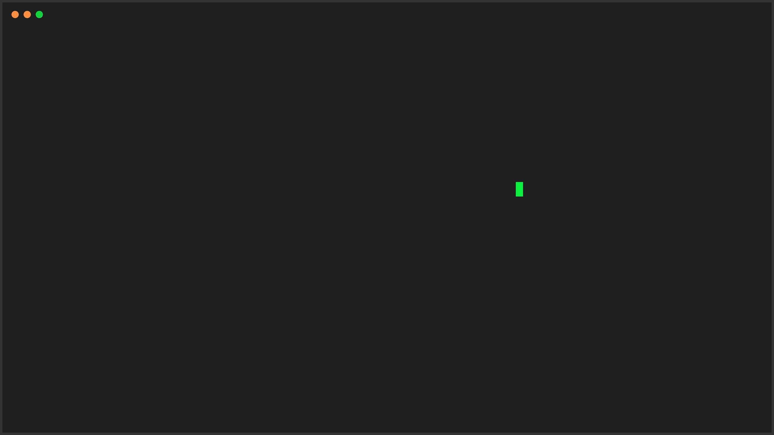
session_end.sh — zsh — 1280x720
Build Your Own Ecosystem
$
npx
vibesuite init
[FREE & OPEN SOURCE]
UP NEXT: "Agent.md Architecture" The context that connects 50+ skills into one brain. SUBSCRIBE & TURN ON NOTIFICATIONS
SESSION_COMPLETE
UTF-8
PAGE 12/12

