Slide 1
INTERNAL DEFENSE PRESENTATION
Development of a Secure Web-Based Medical Image Management System Using Steganography
Protecting patient diagnosis data inside medical images without visible distortion
LSB
Presenter
OMONIYI SAMSON DAMILARE | DEPARTMENT OF COMPUTER SCIENCE
June 2026
Secure Medical Image Management System using Steganography
01/13

Slide 2
Presentation Outline
Following the format supplied for the real/internal defense
1
Introduction
2
Review of Literature and Related Works
3
Motivation
4
Objectives
5
Methodology
6
Result and Discussion
7
Contribution to Knowledge
8
Conclusion and Recommendation
9
References
Secure Medical Image Management System using Steganography
02/13

Slide 3
Introduction
Why secure medical image handling matters
Context
Steganography
Project Focus
Medical images often move with supporting diagnosis notes, patient identifiers, and clinical comments. If shared carelessly, these details can expose confidential health information.
Steganography hides sensitive text inside an image file. Unlike visible encryption warnings, the image remains visually normal while carrying the embedded message.
This project implements a secure web-based system that embeds and retrieves patient diagnosis text from medical images while preserving image quality.
Confidentiality
Imperceptibility
Auditability
Web Access
Secure Medical Image Management System using Steganography
03/13

Slide 4
Review of Literature and Related Works
Client-supplied literature review format: Objective • Methodology • Result • Contribution
Author | Objective | Methodology | Result | Contribution
Cheddad et al. | Survey image steganography | Comparative review | Capacity, security, imperceptibility trade-offs | Guides algorithm selection
Morkel et al. | Explain steganography principles | Conceptual analysis | Hidden communication protects message presence | Supports use in sensitive data transfer
Sharma & Prabha (2025) | Fast clinical image embedding | LSB/client-side image processing | Efficient execution for real-time use | Supports browser-based workflow
Kouadri et al. (2025) | Medical image quality preservation | PSNR/MSE evaluation | High PSNR retains diagnostic value | Basis for quality validation
Gap addressed: a practical web system combining LSB steganography, authentication, and audit logging for medical image workflows.
Secure Medical Image Management System using Steganography
04/13

Slide 5
Motivation
The problem that led to the project
Data privacy risk
Image integrity
Accountability
Diagnosis notes can be exposed when images are transferred through general channels or unsecured storage.
Medical images must remain diagnostically useful; security must not visibly damage regions of interest.
Clinical systems need traceability, so encryption and decryption events should be logged with user and file context.
Secure Medical Image Management System using Steganography
05/13

Slide 6
Objectives
What the system was designed to achieve
Develop a secure web-based dashboard for authenticated users.
Success Criteria
Embed patient diagnosis text into medical images using LSB steganography.
• Hidden text recovered without corruption • Minimal visual difference between cover and stego-image • Responsive browser processing • Event logs stored through Prisma/SQLite
Recover hidden diagnosis text accurately during decryption.
Preserve visual quality so the stego-image remains medically usable.
Record encryption/decryption activities for audit and accountability.
Accuracy
Quality
Security
Logs
Secure Medical Image Management System using Steganography
06/13

Slide 7
Methodology
LSB embedding and recovery workflow
Cover image
LSB embedding
Stego PNG
Decryption
Recovered text
Diagnosis text
Embedding
Recovery
Audit
Text is converted to binary and placed in the least significant bits of RGB pixel channels.
Bits are extracted until the terminator is found, reconstructing the diagnosis text.
Each operation is logged with file context, user, status, and timestamp.
Secure Medical Image Management System using Steganography
07/13

Slide 8
System Architecture and Core Modules
Implementation stack and responsibilities
Authentication Dashboard
Steganography Engine
Audit Logging
Protected routes for dashboard, encryption lab, decryption lab, and settings using Better Auth.
HTML5 Canvas extracts pixel data; LSB algorithm embeds and retrieves diagnosis text from image pixels.
Prisma ORM stores encryption and decryption events in SQLite for accountability and later review.
Next.js 16
React 19
Tailwind CSS
Prisma ORM
SQLite
Canvas API
Secure Medical Image Management System using Steganography
08/13

Slide 9
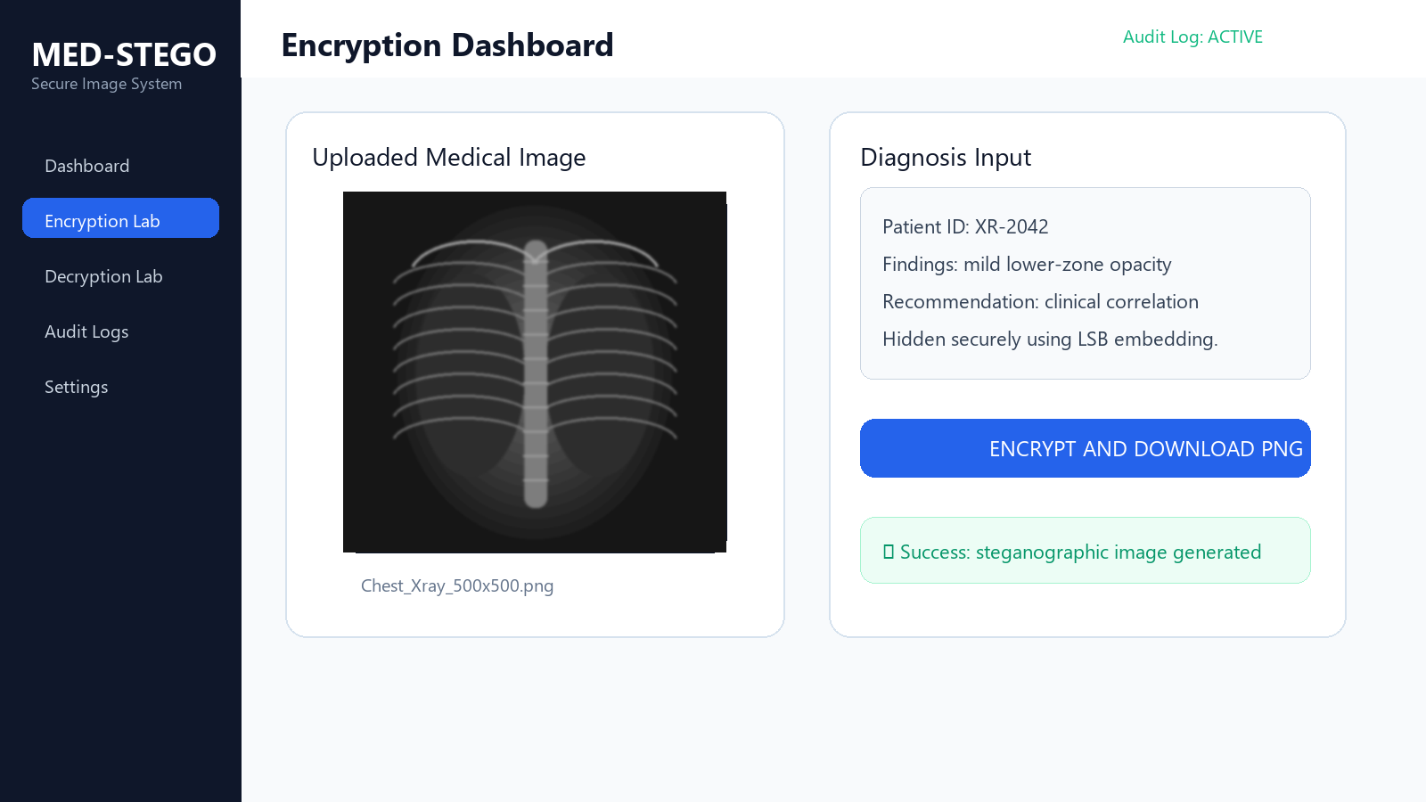
Result and Discussion
Encryption dashboard output
Test Case 1: Encryption
A standard chest X-ray image and diagnosis text were successfully processed into a downloadable stego PNG.
Visual Quality
The output image remained visually indistinguishable from the original cover image.
User Feedback
Real-time status indicators confirmed processing and success states.
Figure 4.1: Screenshot of the Encryption Dashboard showing the uploaded X-ray and the diagnosis input field
Secure Medical Image Management System using Steganography
09/13

Slide 10
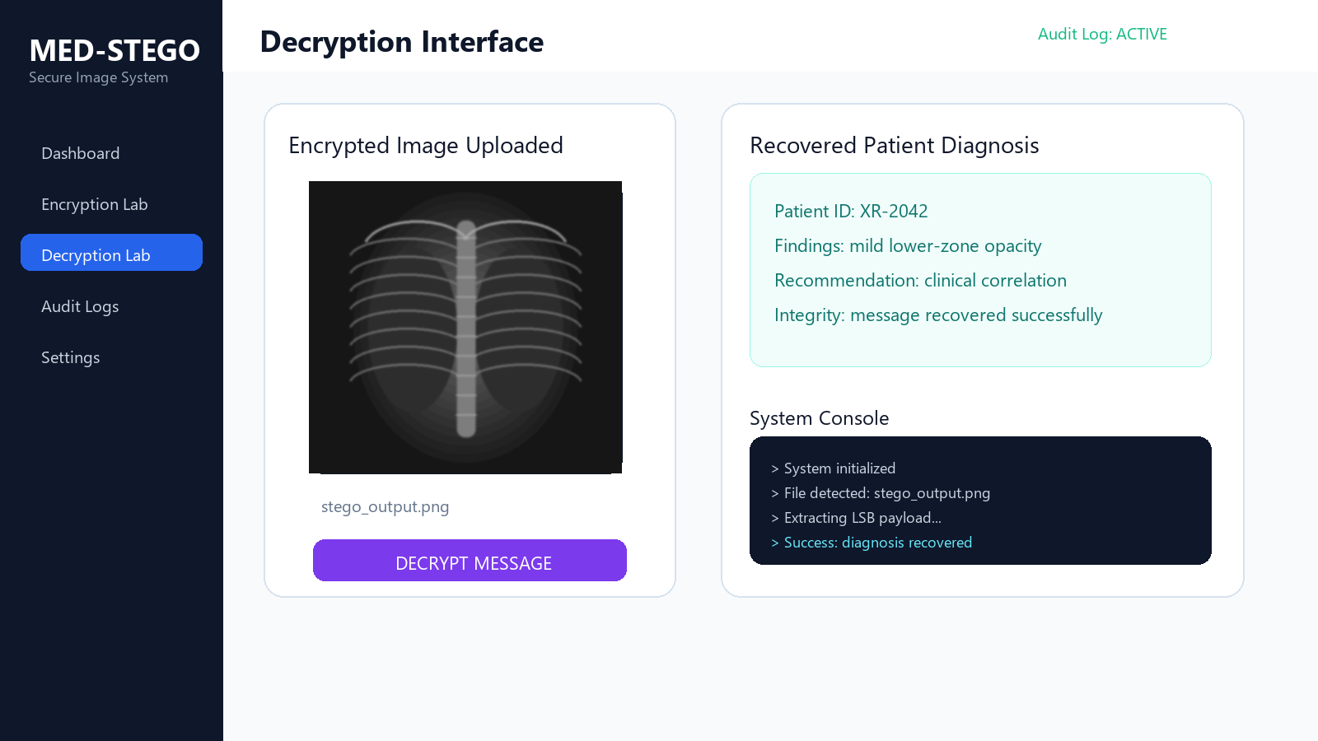
Functional Testing and Performance
Decryption, audit logging, and quality metrics
Recovered
PSNR
200-char diagnosis
> 55 dB
Speed
Audit
~150 ms / 1MB
Events logged
Discussion
The results indicate that the system balances security, usability, and image imperceptibility for medical image workflows.
Figure 4.2: Screenshot of the Decryption Interface displaying the recovered patient diagnosis
Secure Medical Image Management System using Steganography
10/13

Slide 11
Contribution to Knowledge
What this project adds
Medical-data hiding workflow
Browser-side processing
Demonstrates a usable path for pairing diagnosis text with medical image files without obvious external metadata.
Uses client-side Canvas processing, reducing the need to upload raw patient notes to a server before embedding.
Security + accountability
Quality-aware evaluation
Combines steganography with authenticated access and audit logging in one practical web prototype.
Uses imperceptibility, PSNR, speed, and functional recovery as defense-ready validation points.
Secure Medical Image Management System using Steganography
11/13

Slide 12
Conclusion and Recommendation
Summary and next steps
Conclusion
Recommendations
The developed system successfully embeds and retrieves diagnosis data inside medical images using LSB steganography. Testing showed accurate recovery, high visual imperceptibility, responsive processing, and traceable audit logs.
• Extend testing with larger DICOM datasets • Combine LSB with stronger cryptographic encryption • Add role-based clinical access controls • Deploy with PostgreSQL and secure cloud storage • Run usability testing with medical users
Secure Medical Image Management System using Steganography
12/13

Slide 13
References
Selected literature and project sources
Cheddad, A., Condell, J., Curran, K., & Mc Kevitt, P. (2010). Digital image steganography: Survey and analysis of current methods.
Morkel, T., Eloff, J. H. P., & Olivier, M. S. (2005). An overview of image steganography.
Provos, N., & Honeyman, P. (2003). Hide and seek: An introduction to steganography.
Sharma, R., & Prabha, S. (2025). Client-side image steganography for efficient clinical data protection.
Kouadri, A., et al. (2025). Quality evaluation of steganographic medical images using MSE and PSNR metrics.
Project source files: Chapter Four.docx, README.md, and implemented Next.js application modules.
Thank you
Secure Medical Image Management System using Steganography
13/13

