Slide 1
INTERNAL DEFENSE PRESENTATION
Development of a Secure Web-Based Medical Image Management System Using Steganography
Protecting patient diagnosis data inside medical images without visible distortion
Presenter
Presenter
OMONIYI SAMSON DAMILARE Department of Computer Science
OMONIYI SAMSON DAMILARE Department of Computer Science
Secure Web-Based Medical Image Management System using Steganography
01/12

Slide 2
Presentation Outline
Large-type version for dim projectors and back-row readability
1
Introduction
2
Literature Review
3
Motivation
4
Objectives
5
Methodology
6
Results & Discussion
7
Contribution
8
Conclusion & Recommendations
9
References
Secure Web-Based Medical Image Management System using Steganography
02/12

Slide 3
Introduction
Medical image security problem
Medical images carry context
Steganography hides presence
This project
X-rays and scans are usually shared with notes, findings, and patient identifiers.
Sensitive text is embedded inside the image itself, while the image still looks normal.
A secure web prototype for embedding and recovering patient diagnosis data from medical images.
Confidentiality
Image Quality
Audit Logging
Web Access
Secure Web-Based Medical Image Management System using Steganography
03/12

Slide 4
Review of Literature and Related Works
Objective • Methodology • Result • Contribution
Image steganography studies
Medical-image quality metrics
Gap addressed
Prior work shows the key trade-off: hiding capacity versus image imperceptibility and robustness.
Related works use MSE and PSNR to confirm that embedded images remain visually reliable.
This project combines LSB steganography with authentication, browser workflow, and audit logging.
Secure Web-Based Medical Image Management System using Steganography
04/12

Slide 5
Motivation
Why the system is needed
Patient diagnosis notes must remain confidential during image transfer.
Medical images should not be visibly degraded by the security process.
Users need a simple web interface rather than command-line tools.
Operations should be traceable through audit records.
Secure Web-Based Medical Image Management System using Steganography
05/12

Slide 6
Objectives
Project targets
Build authenticated access to the medical image system.
Embed patient diagnosis text into PNG/JPG/DICOM-style image workflows.
Recover hidden diagnosis text accurately during decryption.
Preserve visual quality of the steganographic output image.
Store encryption and decryption actions in an audit log.
Secure Web-Based Medical Image Management System using Steganography
06/12

Slide 7
Methodology
Least Significant Bit embedding workflow
1. Prepare inputs
2. Embed data
3. Recover & log
Upload the cover medical image and type the patient diagnosis payload.
Convert diagnosis text to bits and hide them in the least significant RGB pixel bits.
Upload the stego-image, extract the hidden text, and record the operation in the audit log.
Cover image
Diagnosis text
LSB algorithm
Stego PNG
Recovered text
Secure Web-Based Medical Image Management System using Steganography
07/12

Slide 8
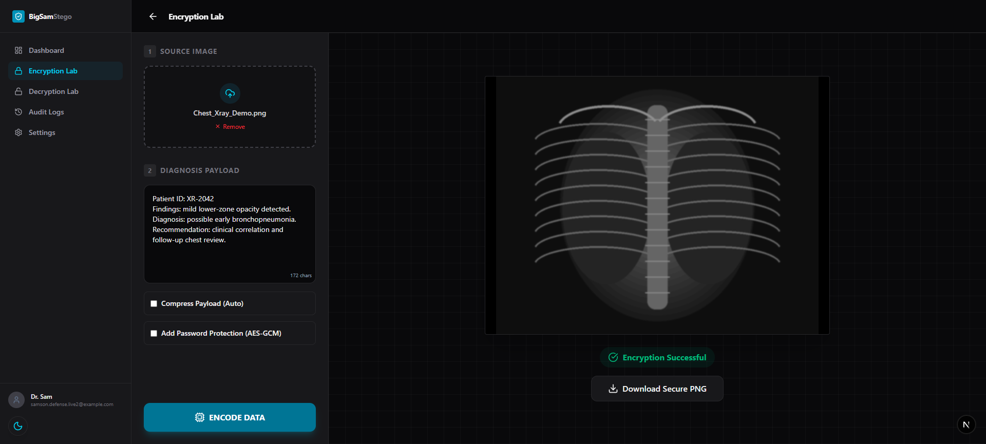
Result and Discussion
Live browser screenshot: Encryption Lab
Real test
Uploaded demo X-ray and entered patient diagnosis text.
Output
System produced a downloadable secure PNG.
Audit
Encryption event was recorded by the app.
Figure 4.1: Live Encryption Lab screenshot showing uploaded X-ray, diagnosis payload, and success state.
Secure Web-Based Medical Image Management System using Steganography
08/12

Slide 9
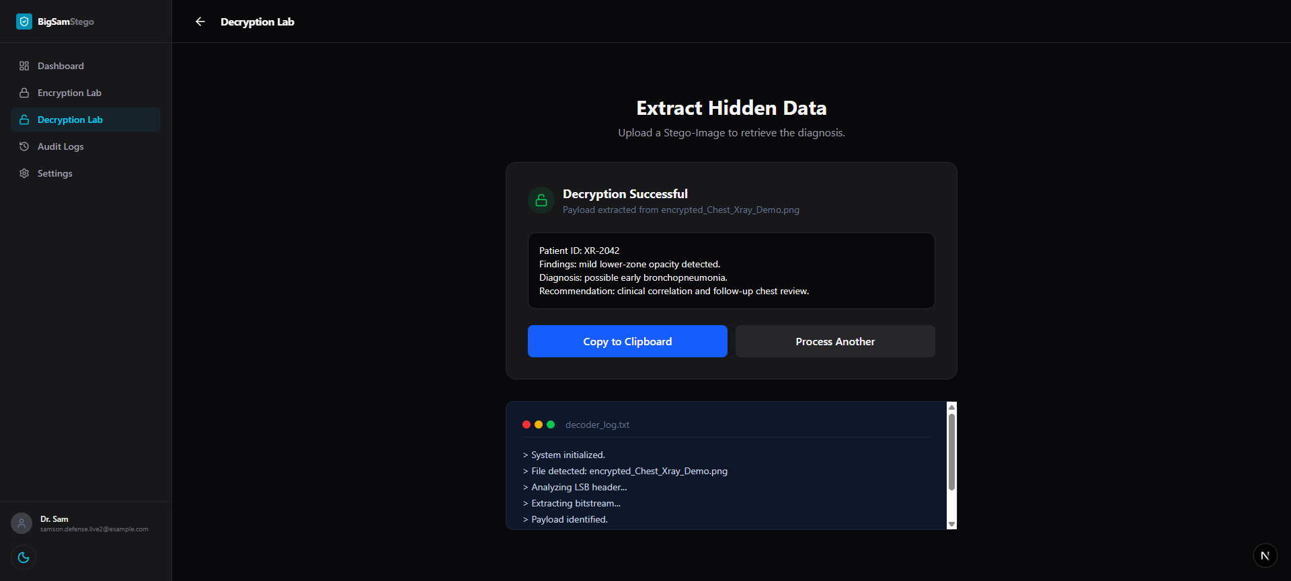
Result and Discussion
Live browser screenshot: Decryption Interface
Input
Uploaded the encrypted PNG generated by the browser test.
Recovered
Diagnosis text was extracted successfully.
Verification
Terminal log shows payload identified and data extracted.
Figure 4.2: Live Decryption Lab screenshot displaying successful recovery of hidden diagnosis data.
Secure Web-Based Medical Image Management System using Steganography
09/12

Slide 10
Contribution to Knowledge
What the project adds
Practical secure workflow
Browser-side prototype
Pairs medical images with diagnosis text without visible external metadata.
Demonstrates client-side Canvas processing for steganography in a web app.
Authentication + audit
Defense-ready evidence
Adds controlled access and activity records to the steganographic process.
Includes live screenshots, functional testing, and quality discussion.
Secure Web-Based Medical Image Management System using Steganography
10/12

Slide 11
Conclusion and Recommendation
Summary and future work
Conclusion
Recommendations
The system successfully embeds and retrieves patient diagnosis data from medical images. The live browser test confirmed encryption, decryption, recovery, and audit behavior.
• Test with larger DICOM datasets • Combine LSB with stronger encryption • Add role-based clinical access control • Deploy with PostgreSQL and secure cloud storage
Secure Web-Based Medical Image Management System using Steganography
11/12

Slide 12
References
Selected sources
Cheddad, A., Condell, J., Curran, K., & Mc Kevitt, P. (2010). Digital image steganography: survey and analysis.
Morkel, T., Eloff, J. H. P., & Olivier, M. S. (2005). An overview of image steganography.
Provos, N., & Honeyman, P. (2003). Hide and seek: an introduction to steganography.
Sharma, R., & Prabha, S. (2025). Client-side image steganography for clinical data protection.
Kouadri, A., et al. (2025). Quality evaluation of steganographic medical images using MSE and PSNR.
Project materials: Chapter Four.docx, Literature Review PDF, README, and implemented Next.js app.
Thank you
Secure Web-Based Medical Image Management System using Steganography
12/12

