Slide 1
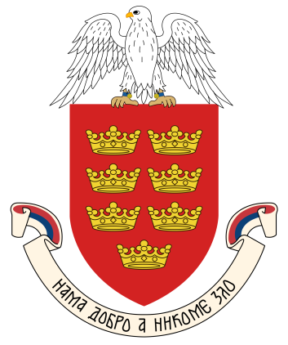
Kraljevo

Slide 2
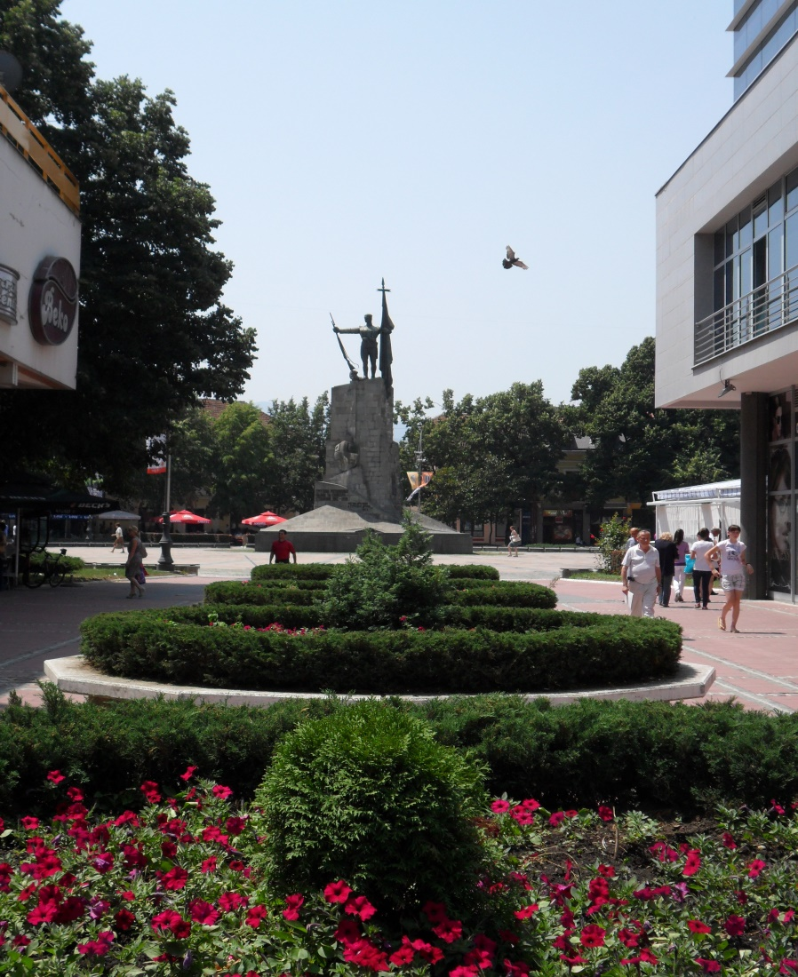
-Kraljevo has existed since the 14th century
-In 1882. Kraljevo gets its present name in honor of King Milan Obrenović
-Kraljevo has a population of 124 thousand
-It has the largest territory of all townships in Serbia

Slide 3
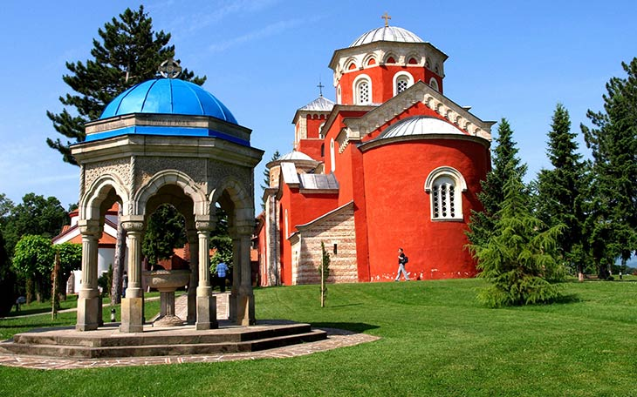
-The idea for the name came about because 7 kings were crowned at the Žiča Monastery
-Žiča is a Serbian monastery that was built in the first half of the 13th century

Slide 4
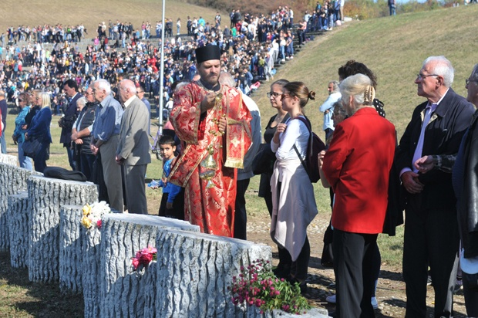
-Kraljevo suffered a lot during WW2
-The Germans killed between 3,000 and 6,000 civilians in revange for attacking their soldiers
-Each year, October 14th, marks the day of remembrance in their honor

Slide 5
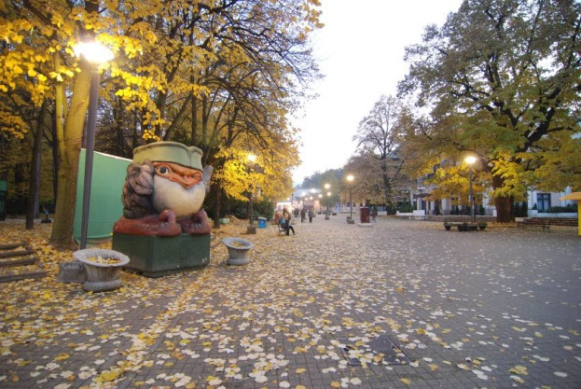
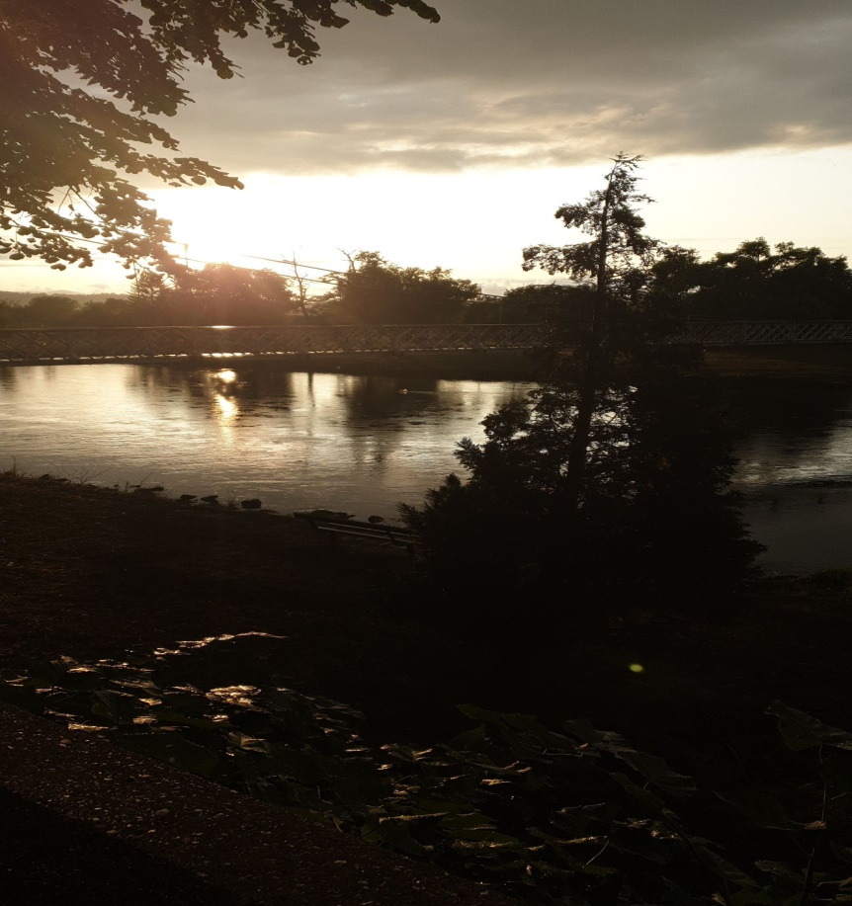
Kraljevo is located very close to 2 resorts
Vrnjačka Banja
Mataruška Banja

Slide 6
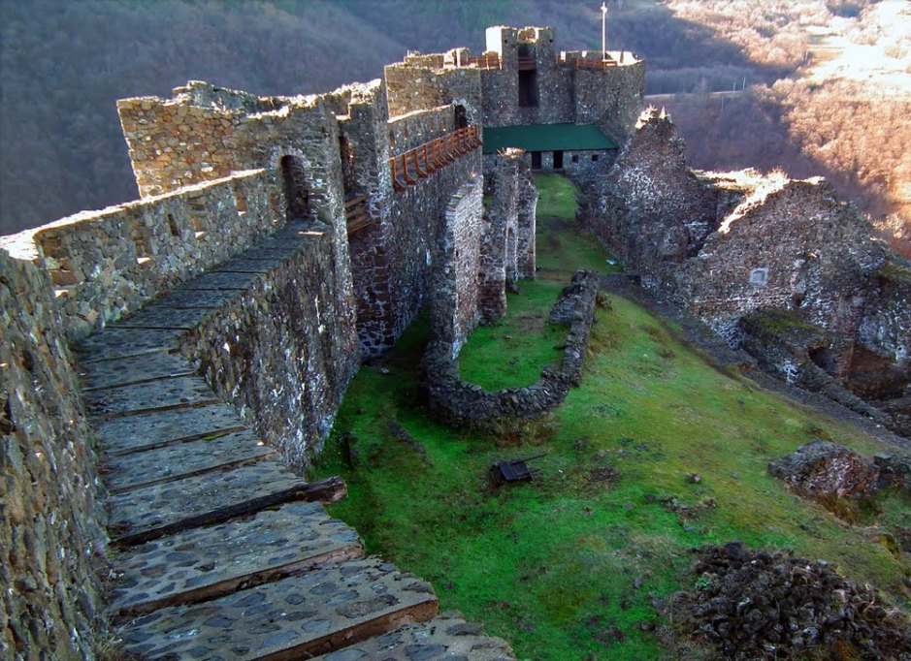
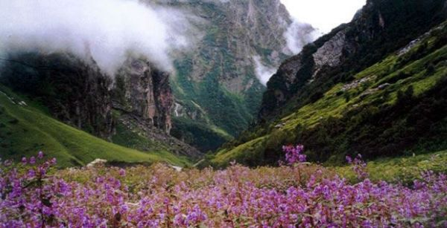
-Near the town of Kraljevo are the ruins of the medieval castle Maglič
-Below the Maglič is a Valley of Lilacs

Slide 7
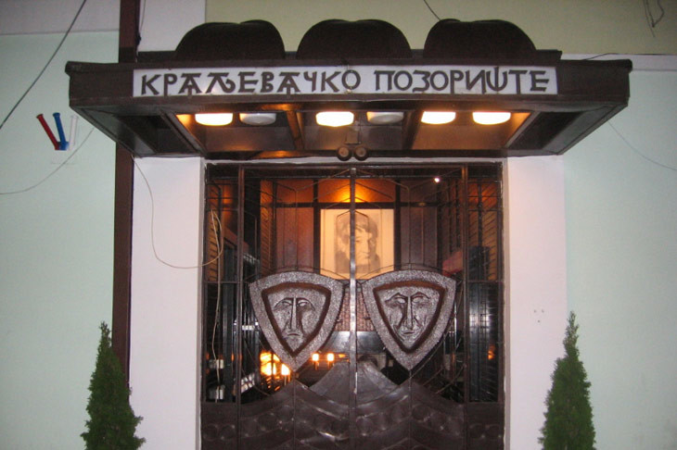
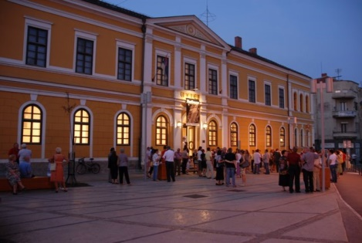
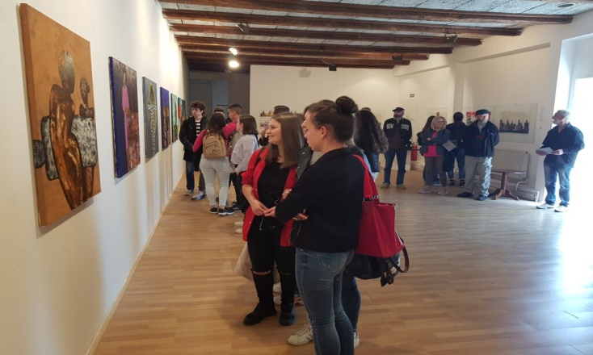
-Kraljevo has a large number of cultural institutions

Slide 8
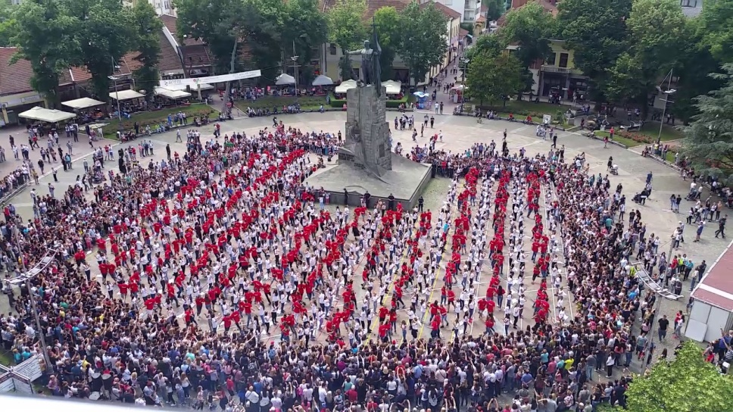
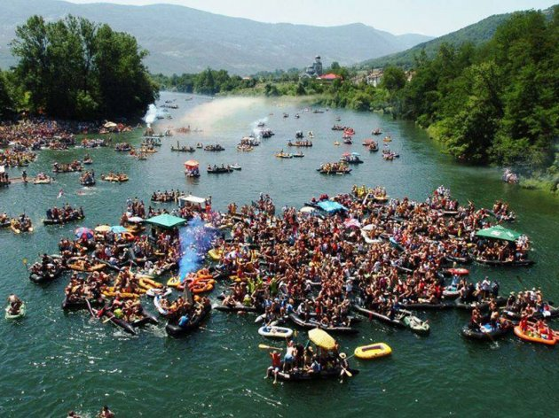
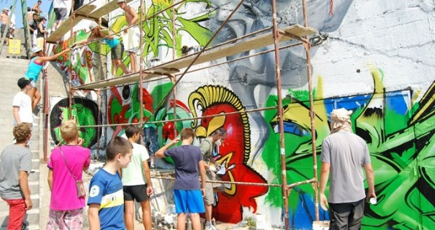
-Kraljevo organizes several unique events every year.
-The most famous of these are the Veseli Spust and Prom Dance

Slide 9
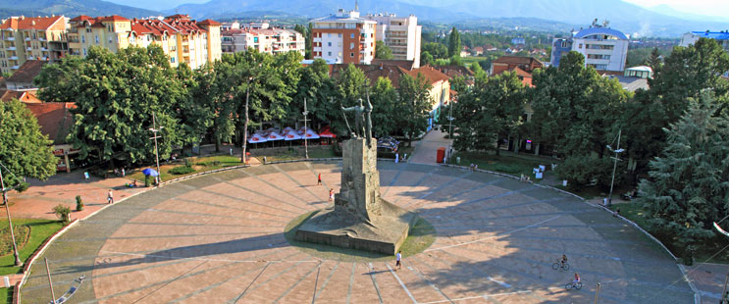
The downtown monument is unique because it is actually a huge sundial

Slide 10
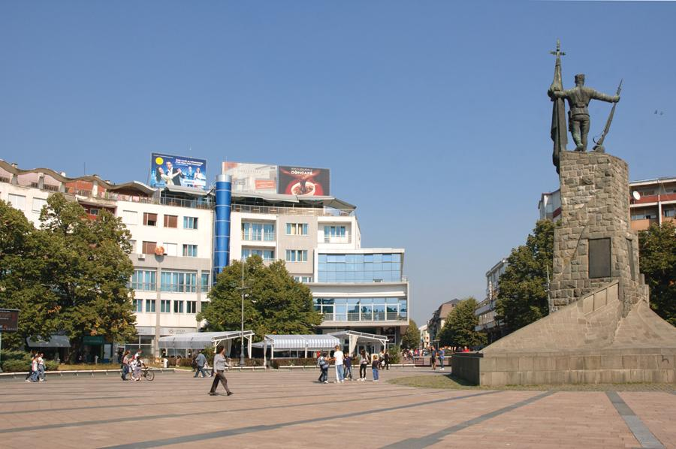
Kraljevo has a lot more to offer and it's worth a visit

Slide 11
Jovan Stankovic
RI 48/19

