Slide 1
PROCESS

Slide 2
private static ArrayList bucketSort(ArrayList arr, int index)
Single layered arraylist
Ex
[1,2,3,4,5,6]
Not
[[1,2,3], [4,5,6], 8 , 9]
Next page

Slide 3
INDEX
Tells the function where to look sa number
Ex index = 1
Ex index = 0
001
123

Slide 4
FLOW

Slide 5
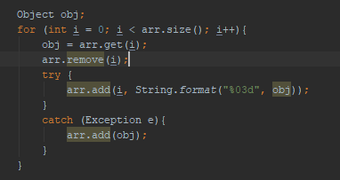
1
Translate the objects in the array into string with a format 0 0 0
Ex
93 - > 093

Slide 6
2
Translate the objects in the array into string with a format 0 0 0
Ex
93 - > 093

Slide 7
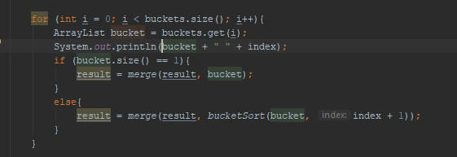
3
CASE 1 (BASE CASE)
The bucket has a size of 1
Meaning there exist an object in a bucket
Ex
Bucket = [123]
Not
[123,456,789]
CASE 2
The bucket has a size of 2 or more
Meaning there exist objects in a bucket but not 1
Ex
Bucket = [123,456,789]
Not
[123]

Slide 8
CASE 1
Merge the result with the bucket
Result = []
Bucket = [012]
Result = Merge(result, bucket)
- > result = [12]
Result = [012]
Bucket = [390]
Result = Merge(result, bucket)
- > result = [012, 390]

Slide 9
CASE 2
Merge the result with the result of the bucket passed to the same method
And
Look at the next index
Result = []
Bucket = [100,101,102]
Result = Merge(result, bucketSort(bucket, index + 1)
- > result = [result of bucketSorting[100,101,102]]
- > result = [123,456,789]
Result = [012]
Bucket = [390]
Result = Merge(result, bucket)
- > result = [012, 390]

