Slide 1
Flow Network
a directed graph where each edge has a capacity and a flow
Notes:
They are typically used to model problems involving the transport of items between locations, using a network of routes with limited capacity

Slide 2
Terminologies
SOURCE
SINK
CAPACITY

Slide 3
TBD
Composition of a Flow Network
Flow
Cuts
Maximum Flow
Minimum Cost Flow

Slide 4
S
T
Directed Graph On a Flow Network
5

Slide 5
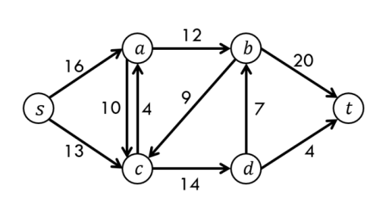
Src: brilliant.org

Slide 6
A flow network N is a tuple N=(G, c, s, t) where
G = (V, E) is a directed graph of vertices V and directed edges E c: E → R₀⁺ ​ is a mapping from the edges to the nonnegative reals, and c(e) is called the capacity of edge e s, t ∈ V are special vertices of G called the source and sink, respectively

Slide 7
b
20
10
a
d
30
c
10
20

Slide 8
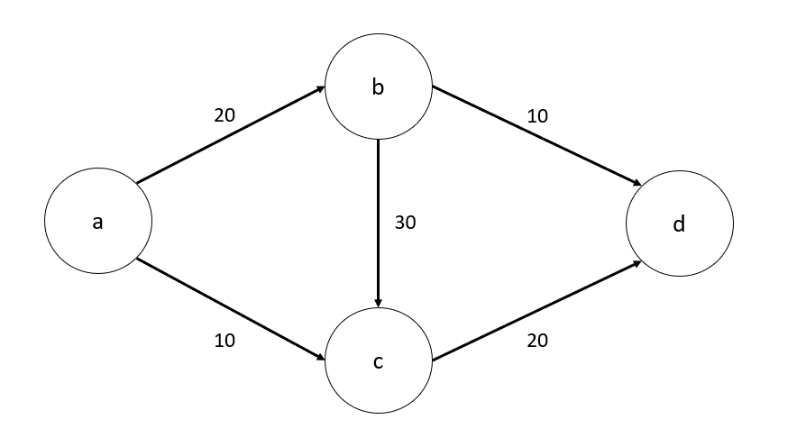
Flow – the amount going through the edges
8 /
15 /
23 /
1 /
18 /

Slide 9
Cuts – 1 side source, 1 side sink
A, B
C, D
8 /
S
T
15 /
23 /
1 /
18 /
CUT = 8+23+1 = 32

Slide 10
Cuts – 1 side source, 1 side sink
A, B, C
D
8 /
S
T
15 /
23 /
1 /
18 /
CUT = 8+18 = 26

Slide 11
A, B, C
D, E
C
S
T
4 / 8
4 / 4
0 / 5
A
6 / 6
B
E
6 / 6
3/ 3
9 / 9
D
CUT = 3+6+4 = 13

Slide 12
A, B, C, D
E
C
S
T
4 / 8
4 / 4
0 / 5
A
6 / 6
B
E
6 / 6
3/ 3
9 / 9
D
CUT = 4+9 = 13

Slide 13
A
B, C, D, E
C
S
T
4 / 8
4 / 4
0 / 5
A
6 / 6
B
E
6 / 6
3/ 3
9 / 9
D
CUT = 6+4+3 = 13

Slide 14
HEADCANNON ALERT

Slide 15
A, C, D
E, B
C
S
T
4 / 8
4 / 4
0 / 5
A
6 / 6
B
E
6 / 6
3/ 3
9 / 9
D
CUT = 6+9+4-6-0 = 13

Slide 16
Maximum Flow Algorithm
Ford-Fulkerson algorithm
Edmonds-Karp algorithm
Dinic's algorithm

Slide 17
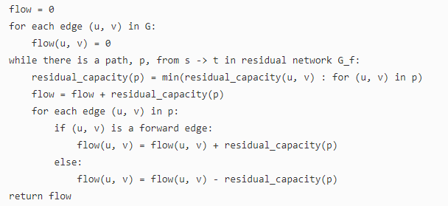
Ford-Fulkerson algorithm
This algorithm uses the concepts of
Residual Capacity
Augmenting Paths
<Non-Full> Forward Edges
<Non-Empty> Backward Edges
Maximum Flow – Ford-Fulkerson Algorithm

Slide 18
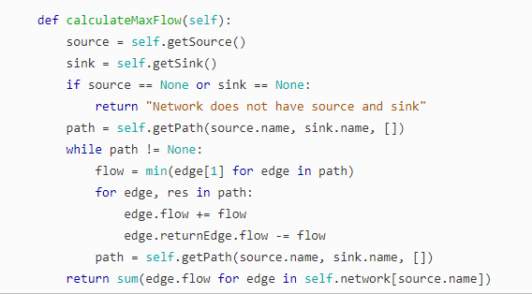
Maximum Flow – Ford-Fulkerson Algorithm

Slide 19
C
PATH | CAPACITY
1) A >B >C >E
4
0 / 8
4 / 4
0 / 4
0 / 5
4 / 5
A
B
E
4 / 6
0 / 6
0 / 6
0 / 3
0 / 9
D
FLOW
4
Maximum Flow – Ford-Fulkerson Algorithm

Slide 20
C
PATH | CAPACITY
A >B >C >E
A >D >E
4
3
0 / 8
4 / 4
4 / 5
A
B
E
4 / 6
0 / 6
0 / 3
3 / 3
0 / 9
3 / 9
D
FLOW
7
Maximum Flow – Ford-Fulkerson Algorithm

Slide 21
C
PATH | CAPACITY
A >B >C >E
A >D >E
A >C >B >D >E
4
3
4
4 / 8
0 / 8
4 / 4
4 / 5
0 / 5
A
B
E
4 / 6
0 / 6
4 / 6
3 / 3
7 / 9
3 / 9
D
FLOW
13
Maximum Flow – Ford-Fulkerson Algorithm

Slide 22
C
PATH | CAPACITY
A >B >C >E
A >D >E
A >C >B >D >E
A >B >D >E
4
3
4
2
4 / 8
4 / 4
0 / 5
A
B
E
4 / 6
6 / 6
6 / 6
4 / 6
3 / 3
9 / 9
7 / 9
D
FLOW
15
Maximum Flow – Ford-Fulkerson Algorithm

Slide 23
C
PATH | CAPACITY
A >B >C >E
A >D >E
A >C >B >D >E
A >B >D >E
4
3
4
2
4 / 8
4 / 4
0 / 5
A
B
E
6 / 6
6 / 6
3 / 3
9 / 9
D
FLOW
15
Maximum Flow – Ford-Fulkerson Algorithm

Slide 24
Minimum Cost Flow
Flow Network + Accompanying Cost
Example:
truck routes > greater capacity, higher cost (time)
plane routes > lesser capacity, lower cost
Minimum Cost Flow

Slide 25
Orinj = TRUCK cost = 1
Bloo = PLANE cost = 2
B
D
0 / 10
0 / 15
0 / 15
0 / 6
A
F
0 / 6
0 / 5
0 / 7
0 / 10
0 / 10
C
E
0 / 12
Minimum Cost Flow

Slide 26
(A, B) = 2x
0 ≤ x ≤ 15
(C, D) = x
0 ≤ x ≤ 7
(A, C) = x
0 ≤ x ≤ 10
(E, D) = x
0 ≤ x ≤ 5
(B, C) = x
0 ≤ x ≤ 6
(D, F) = 2x
0 ≤ x ≤ 15
(B, D) = 2x
0 ≤ x ≤ 10
(E, F) = x
0 ≤ x ≤ 10
(B, E) = x
0 ≤ x ≤ 6
Minimum Cost Flow

Slide 27
Baseball Elimination

