Slide 1

Network Flow and Matching

Slide 2

Matching Graph
A matching graph is a subgraph of a graph where there are no edges adjacent to each other. Simply, there should not be any common vertex between any two edges.

Slide 3
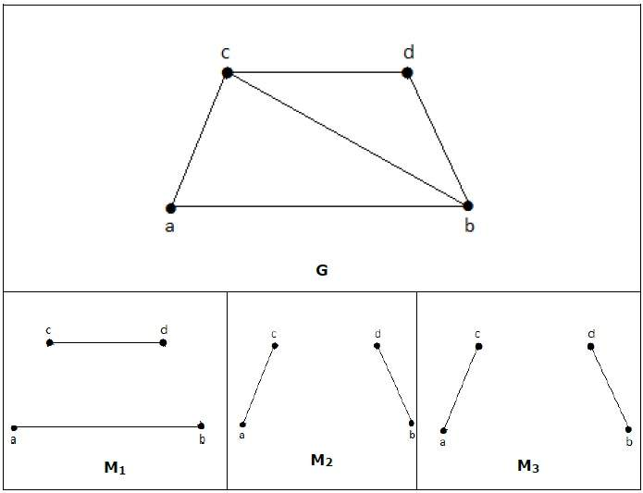
Examples

Slide 4
Matching
Let ‘G’ = (V, E) be a graph. A subgraph is called a matching M(G), if each vertex of G is incident with at most one edge in M, i.e.,
deg(V) ≤ 1 ∀ V ∈ G
which means in the matching graph M(G), the vertices should have a degree of 1 or 0, where the edges should be incident from the graph G.
Notation − M(G)
In a matching,
if deg(V) = 1, then (V) is said to be matched
if deg(V) = 0, then (V) is not matched.
In a matching, no two edges are adjacent. It is because if any two edges are adjacent, then the degree of the vertex which is joining those two edges will have a degree of 2 which violates the matching rule.

Slide 5

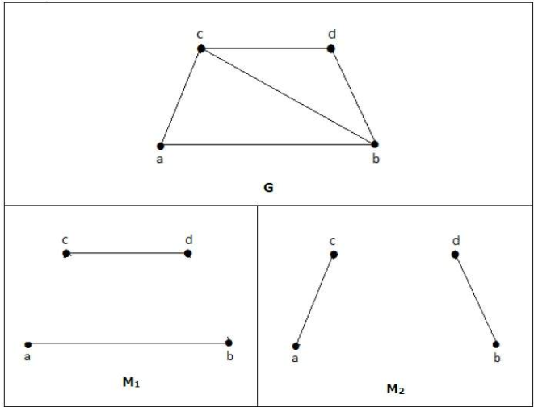
Example
For a graph given in the above example, M₁ and M₂ are the maximum matching of ‘G’ and its matching number is 2. Hence by using the graph G, we can form only the subgraphs with only 2 edges maximum. Hence we have the matching number as two.

Slide 6
Maximal Matching
maximal matching is a matching M of a graph G with the property that if any edge not in M is added to M, it is no longer a matching, that is, M is maximal if it is not a subset of any other matching in graph G. In other words, a matching M of a graph G is maximal if every edge in G has a non-empty intersection with at least one edge in M. The following figure shows examples of maximal matchings (red) in three graphs.

Slide 7
Maximum Matching
It is also known as largest maximal matching. Maximum matching is defined as the maximal matching with maximum number of edges.
The number of edges in the maximum matching of ‘G’ is called its matching number.

Slide 8
Maximum Bipartate Matching
A matching in a Bipartite Graph is a set of the edges chosen in such a way that no two edges share an endpoint. A maximum matching is a matching of maximum size (maximum number of edges). In a maximum matching, if any edge is added to it, it is no longer a matching. There can be more than one maximum matchings for a given Bipartite Graph.

Slide 9
Perfect Matching
A perfect matching (a.k.a. 1-factor) is a matching which matches all vertices of the graph. That is, every vertex of the graph is incident to exactly one edge of the matching. Every perfect matching is maximum and hence maximal. In some literature, the term complete matching is used. In the above figure, only part (b) shows a perfect matching. A perfect matching is also a minimum-size edge cover. Thus, ν(G) ≤ ρ(G) , that is, the size of a maximum matching is no larger than the size of a minimum edge cover. A perfect matching can only occur when the graph has an even number of vertices.

