Slide 1
Mostly review, some control flow
Taking a moment to make sure we’re all on the same page

Slide 2
Today’s menu
Announcement!
Review
  The DOM and why it matters
  Functions
  Objects
Data Types
Control Flow Introduction
P5.js demo (if we have time, probably Monday)

Slide 3

HTML, CSS, and Javascript - a ‘cheat sheet’
Notes:
HTML defines the structure of the content. CSS defines the look of it. Javascript (or another language) allow for dynamic actions.

Slide 4
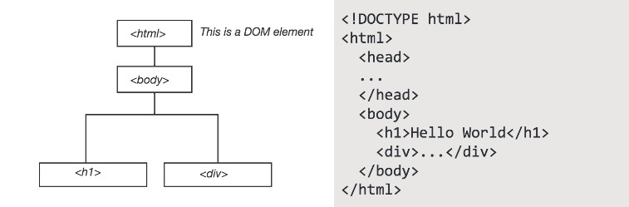
We reference objects through the DOM which allows for interactivity… and all web mapping… to take place

Slide 5
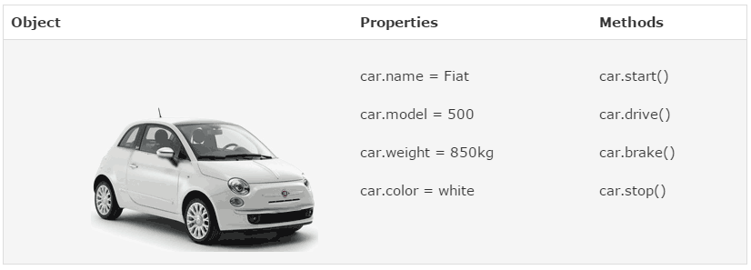

Slide 6
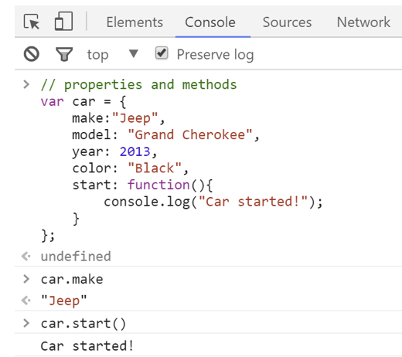

Slide 7
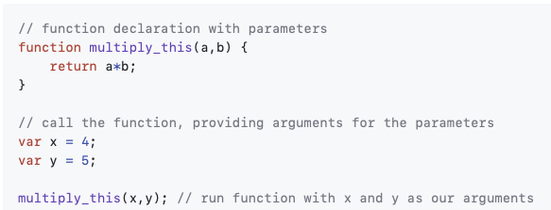
Functions
Pieces of code that run when called upon.
First you define a function (and give it a name)
Then you can call the function to execute

Slide 8
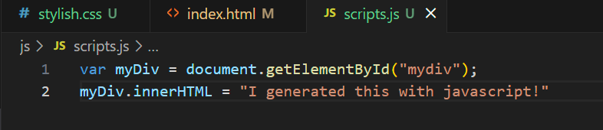
‘Dynamic’ Text

Slide 9
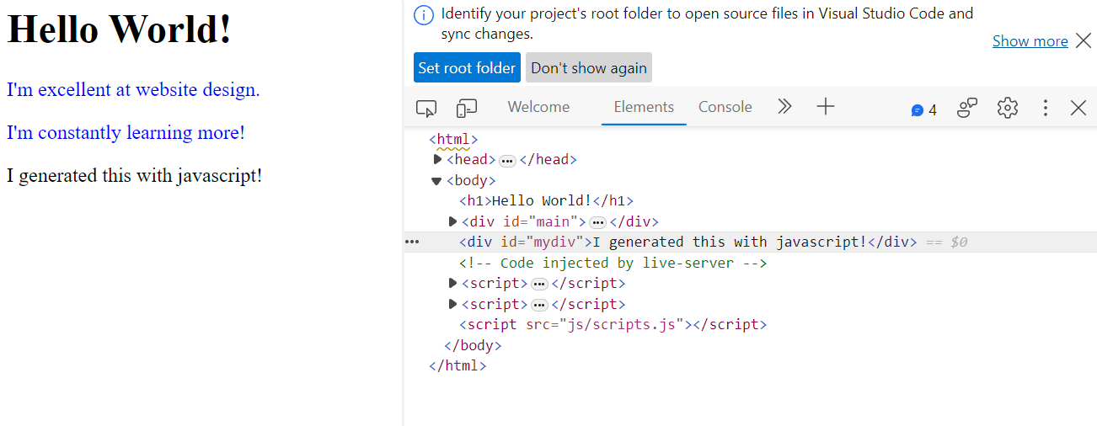

Slide 10
Data types vs. objects?
Variables are containers that hold data values (simple or complex!)
  Primitive data types - not objects, no methods
    Number - integer, floating point, etc.
    String - “Hello World!”
    Boolean - True or False
    Undefined - declared but not assigned a value yet
    Null - the intentional absence of a value
    Symbol - a unique identifier used to avoid naming issues (we can kind of ignore for now)
Notes:
This gets a little confusing.
You don’t really need to understand all of this.

Slide 11
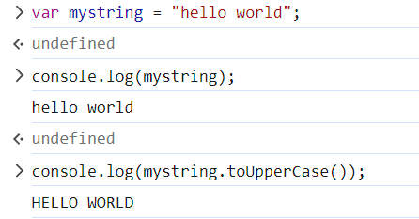
But wait…
Javascript is automatically converting the primitive type to the corresponding object wrapper that has methods…
Yes, that’s annoying. It’s a ‘sugar coating’ to make Object-Oriented Programming paradigms easier.

Slide 12
Data types vs. objects? (redux)
Reference Data Types can be thought of as ‘references’ to objects in your document:
  Arrays - [‘hello’, 1, 2.5, True]
  Object Literals - … literally objects (on the next slide)
  Functions - Yes, you can make functions as variables because… why not?
Notes:
This gets a little confusing.
You don’t really need to understand all of this.

Slide 13
Data types vs. objects? (penultimate)
Not a specific data type, but a data structure that can hold values, functions, other objects, hetods, and so on.
A class is a blueprint for creating objects. You use it to define a custom data type that specifies what properties and methods that object can have.
You can create an object on the fly, but if you know you’re going to need a lot of that type of object, you can use a class to define its properties (like ‘car’)
Notes:
This gets a little confusing.
You don’t really need to understand all of this.

Slide 15
DON’T PANIC!

Slide 16
You don’t need to know all of this right now.
Most (all?) of you do not want to be Computer Scientists
You need to know some key ideas, but not everything:
  Javascript allows you to create and manipulate objects
    To give them names/references
    To create, delete, and change them
  There are primitive data types that can only store certain forms of data
    An integer! A True or False value!
  You can create complex objects that can sort of store whatever you want
    A data structure that can hold values, functions, etc.
    A collection of key-value pairs where the key is typically a string (or symbol) and the values are any valid Javascript data type (including other objects and functions!)

Slide 17
Now for some Control Flow

Slide 18
Control Flow
Conditionals
  If …. Else if… else…
Loops
  While…
  For… (my favorite)
Notes:
DON’T FEEL BAD IF YOU SAY FLOW CONTROL, I ALWAYS WANT TO

Slide 19
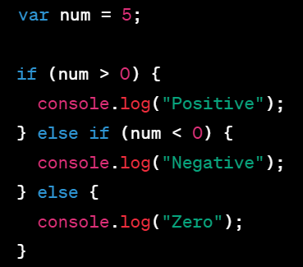
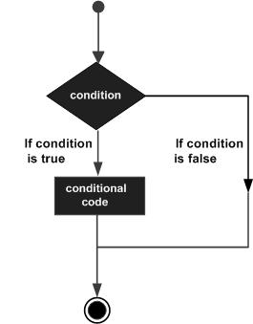
If… else if… else…

Slide 20
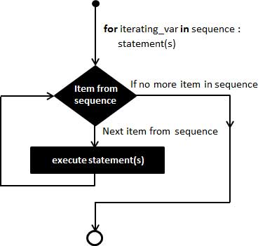
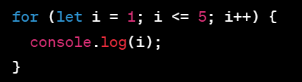
For…

Slide 21
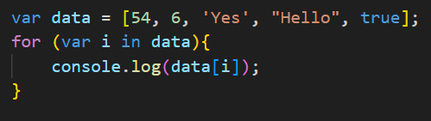
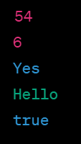
For… (why I like it)

Slide 22
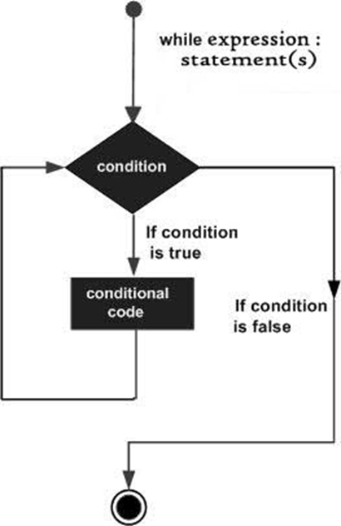
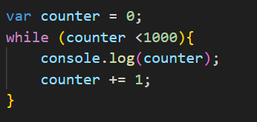
While…

Slide 23
When to use which?
Full disclosure: I often try to use ‘for’ loops when I can, I prefer them and I’m not an industry programmer
While loops are generally preferred when number of iterations are uncertain or conditions might change during the loop (While player’s score is under 100, keep playing)
For loops are generally preferred when the iterations are known (Manipulate every entry in a data set)

Slide 24
Let’s get started with p5.js
If we have time, let’s go here: https://p5js.org/get-started/
Work through the two examples.
What’s going on here?
  What is p5.js?
  Why are there different functions?
  How is it manipulating the dom??
  Think about these, we’ll talk about them more next week..

