Slide 1
Functions and Objects in javascript
Familiarizing ourselves with our basic building blocks…

Slide 2
Reminder
The goal here is not to be a perfect coder.
It is not to immediately understand every aspect of javascript (or to ever do so!).
We’re laying a foundation that will allow us to understand, build, and share interactive cartographic products digitally.
Things will click with time. Do the work and trust yourself.
Also… don’t get too upset about semi-colons (;)...

Slide 3
Today
Review
ChatGPT (and other tools)
A brief introduction to:
  Objects
  Functions

Slide 4
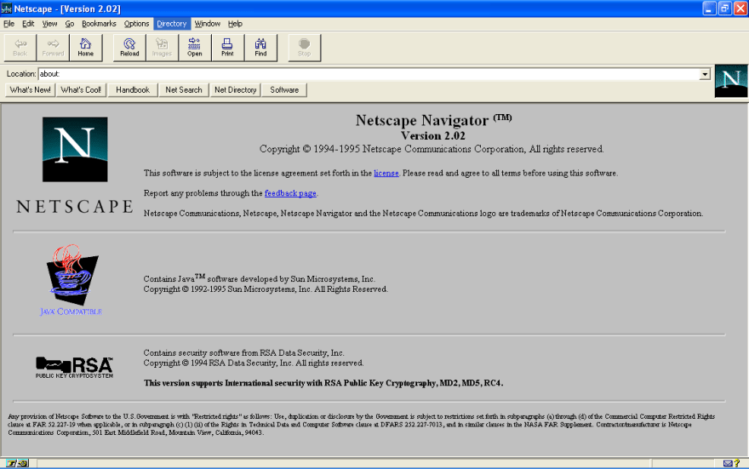
Javascript… not java…
Goal was for something lightweight and easy to grasp - for scripters, not programmers
  Java seen as too heavy, too ‘enterprise’ like
  Idea was originally a scripting companion to java (java for programs, javascript for web pages, etc.)
First called Mocha, then LiveScript, and eventually Javascript
  Allegedly developed in ten days
BUT IT’S NOT REALLY AT ALL LIKE JAVA
Notes:
This is where people often get confused. It kind of looks like java in some of its syntax. It shares a name with java. It even has a development history that’s tied to it…
But it’s really far more a lovechild of scheme and some other systems than it is something like java.

Slide 5


ECMAscipt vs. JScript vs…
“Browser Wars”
  Basically, each browser had its own specific scripting elements. They were similar but not the same.
  This was a nightmare and really stagnated web development for a few years
Google debuts Chrome with V8 Javascript engine in 2008
  Just-In-Time compilation makes it faster…
Finally, in 2009 they all agree to work together with ECMA standards
Notes:
ECMA was the European Computer Manufacturers Association, but has been renamed just Ecma International. It develops standards.

Slide 6
Allows for dynamic interactions on the web.
All modern browsers have dedicated engines to execute it.
Notes:
It’s CLIENT SIDE. which is what’s so important.
And that’s why we learn it.

Slide 7
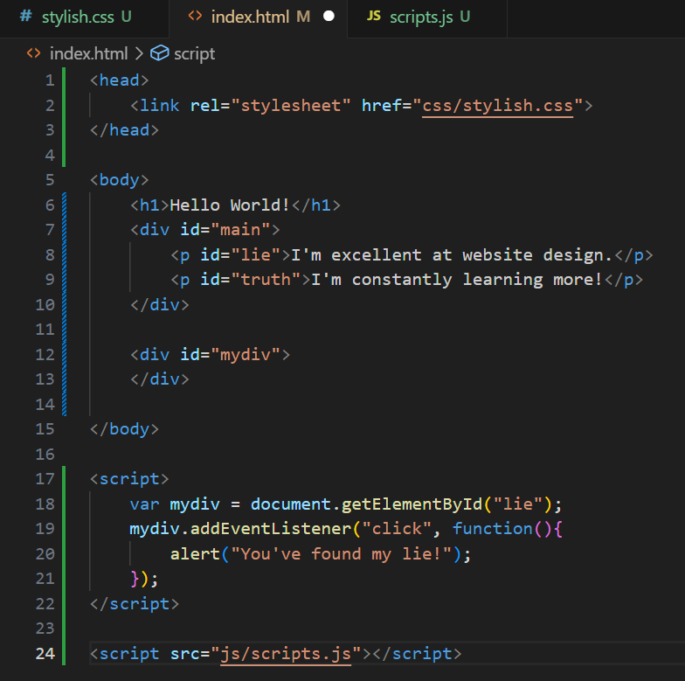
‘Dynamic’ Text
This is a bit canned, but let’s see how you can use javascript to manipulate the DOM and ‘create’ a web page.
In your /js/ directory, create a file called [whatever].js (I called mine scripts.js)
Now, let’s load and inspect it…
Notice I’m doing something very sloppy here, what is it?

Slide 8
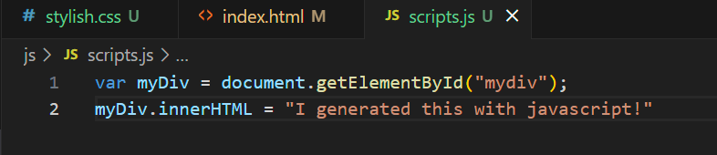
‘Dynamic’ Text

Slide 9
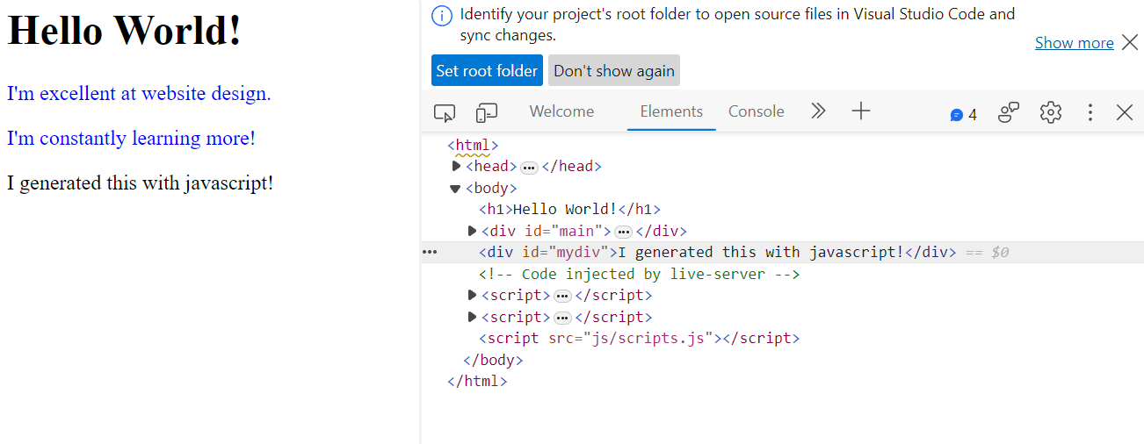

Slide 10
Pseudocode helps us think computationally
Start by writing down what you want your script to do.
Then, fill in each step you have to take to accomplish that goal.
It sounds simple, and can be, but it’s an important way to think through our goals.
Make a cup of tea
Gather ingredients
  Tea bag
  Cup
  Water
  Kettle
…. And so on… break it apart!

Slide 11
When stuck, try to write it out in pseudocode.

Slide 12
GPT-3 (or 4 or 5 or…)
GPT-whatever is a deep learning model that produces human like text…
  There are other models.
    Google has Gemini
    Microsoft has Copilot
    Etc.
Most, though not all, can write code
  Let’s look at OpenAI’s ChatGPT
Go to: chat.openai.com
Generative AI and coding

Slide 13
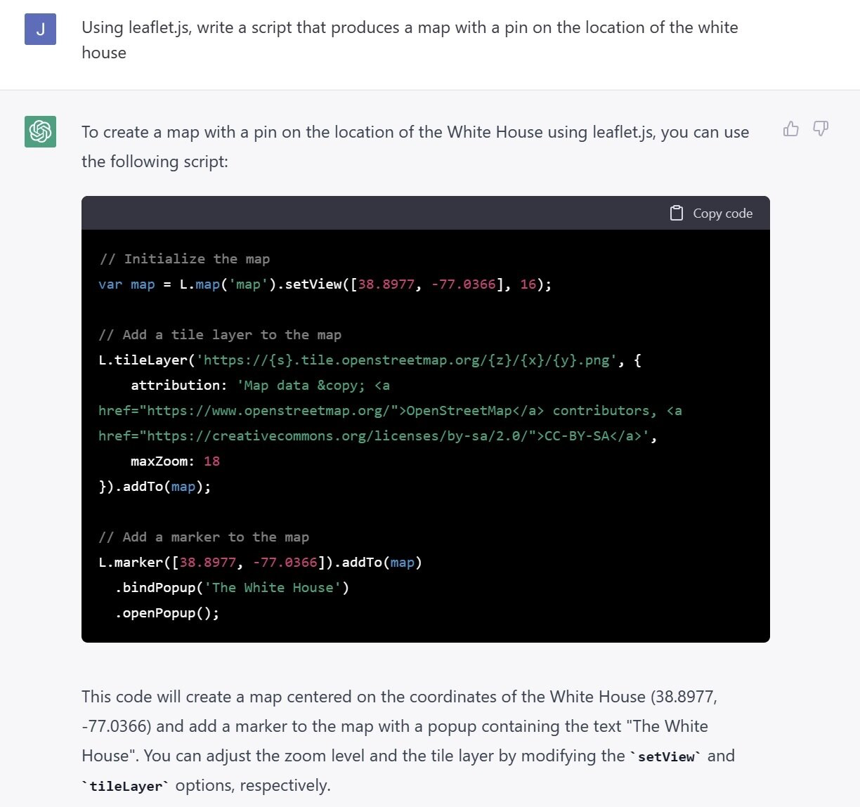

Slide 14
Know the fundamentals first!
Cite your usage!

Slide 15
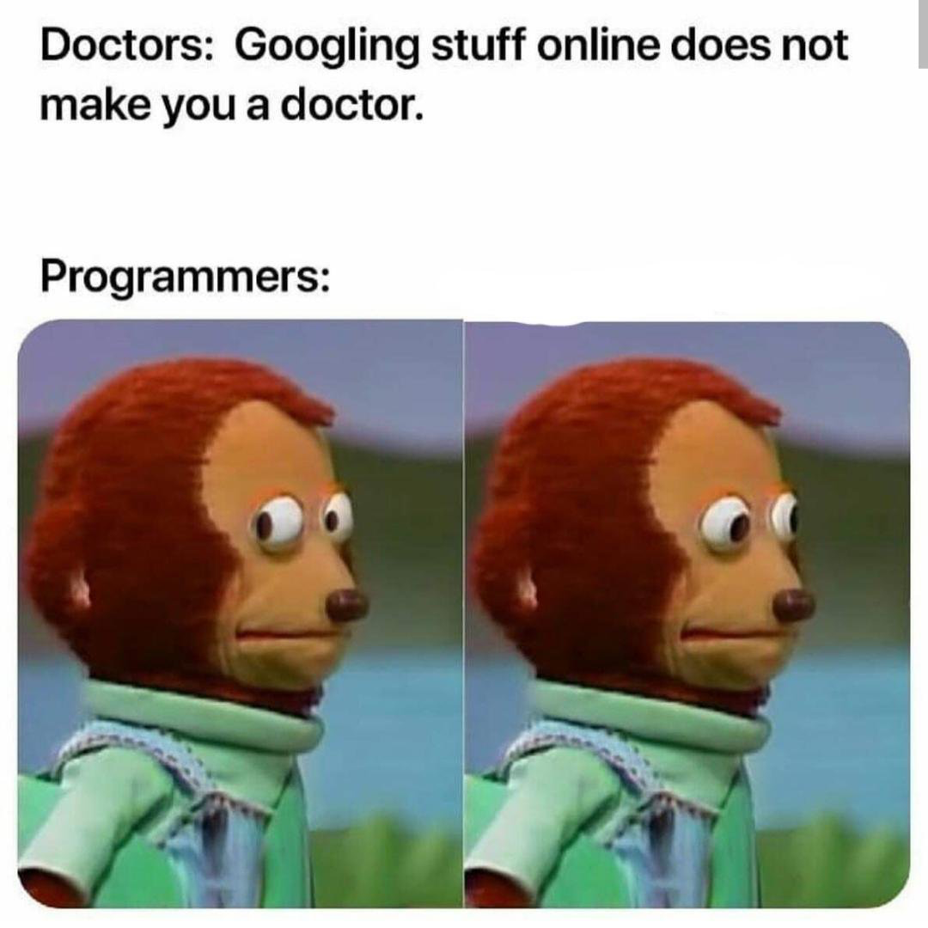
ChatGPT vs. Stack Overflow
A huge part of scripting is leveraging existing knowledge.
Whether it’s code generated by a GPT model or found on Stack Overflow (or from a classmate’s help!), make sure you understand what it is doing and why it works.
AND CITE YOUR SOURCES!

Slide 16

Objects
Remember our friend DOM?
  Document Object Model
Ultimately, an “object” is a region of memory that contain value and are referenced by identifiers

Slide 17
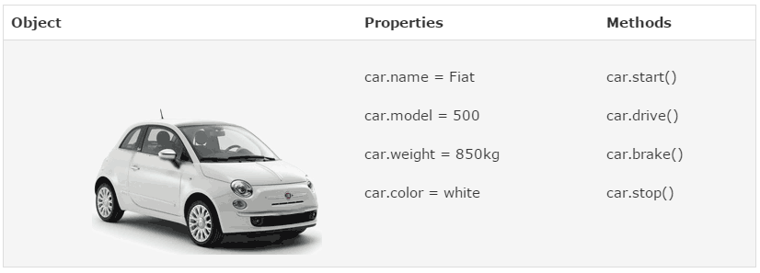

Slide 18
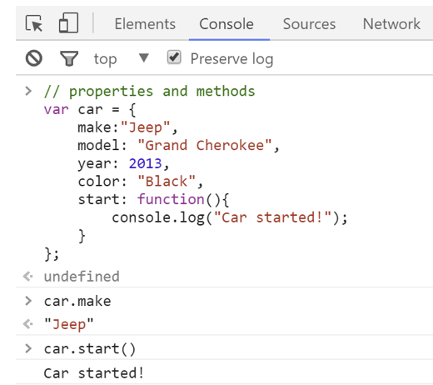

Slide 19
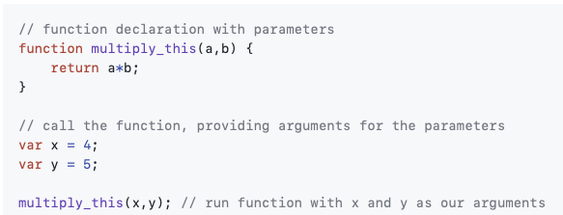
Functions
Pieces of code that run when called upon.
First you define a function (and give it a name)
Then you can call the function to execute

Slide 20
Let’s write a function that squares a number.

Slide 21
Common Data Formats
Geospatial data reference to a coordinate system that models the Earth’s surface
  Can be vector or raster
Geospatial data, when mapped, need to be projected from a 3-dimensional earth to a 2-dimensional representation thereof.
Shapefiles are a technically open data format popularized by ESRI since the early 1990s.
  They actually consist of upwards of six separate files (.prj, .dbf, etc.) with the ‘shapefile’ serving as a container
  This is not good for use in the DOM which needs to be able to read them as text.

Slide 22
Common Data Formats
KML
  Keyhole Markup Language
  An extension of XML (eXtensible Markup Language)
  Used by Google Earth and the Google Maps API
  Still popular, but moving towards JSON/GeoJSON (not tied to a single company, more easily parsible, etc.)

Slide 23
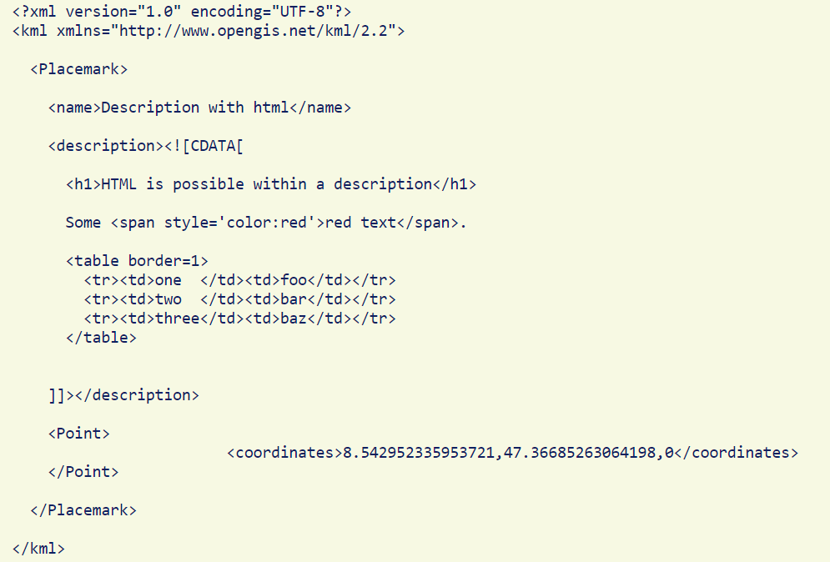
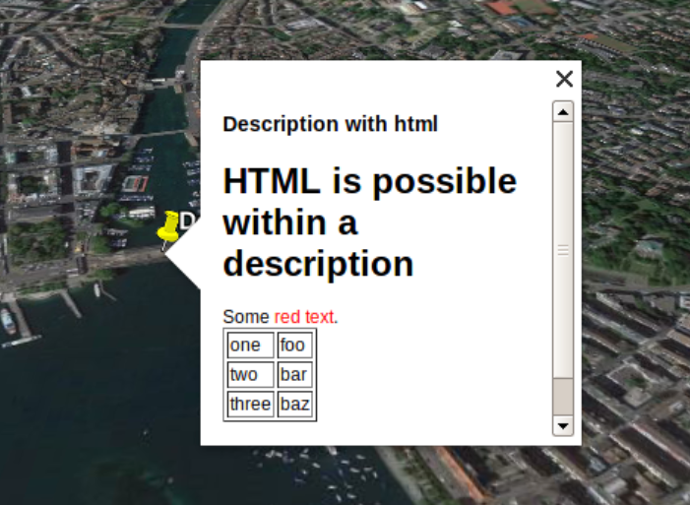
KML Example
Notes:
Source: Google Earth: kml examples (renenyffenegger.ch)

Slide 24
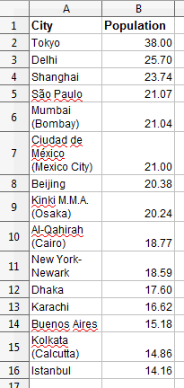
Common Data Formats
CSV
  Comma Separated Values
  A flat-file (meaning each file is a single table)
  A matrix of columns and rows with entries separated by files.
  Modern spreadsheet software can open and view .csv files…

Slide 25
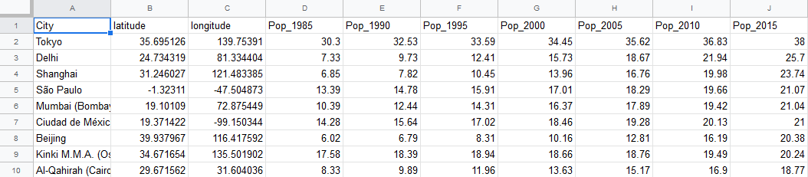
CSVs are good for point data…
Notes:
But we don’t always want to map points…

Slide 26
JSON and GeoJSON
JavaScript Object Notation
  Open standard
  ‘Human readable’ (lol)
  Language-independent, but derived from javascript’s object structure
  Developed due to need for real-time server-to-browser communication without plug-ins (Java, Flash, etc.).
    So, yes, JSON killed Flash (sort of, but not really)
geoJSON
  Added simple geographical features to JSON - points, lines, polygon, multipart collections thereof

Slide 27
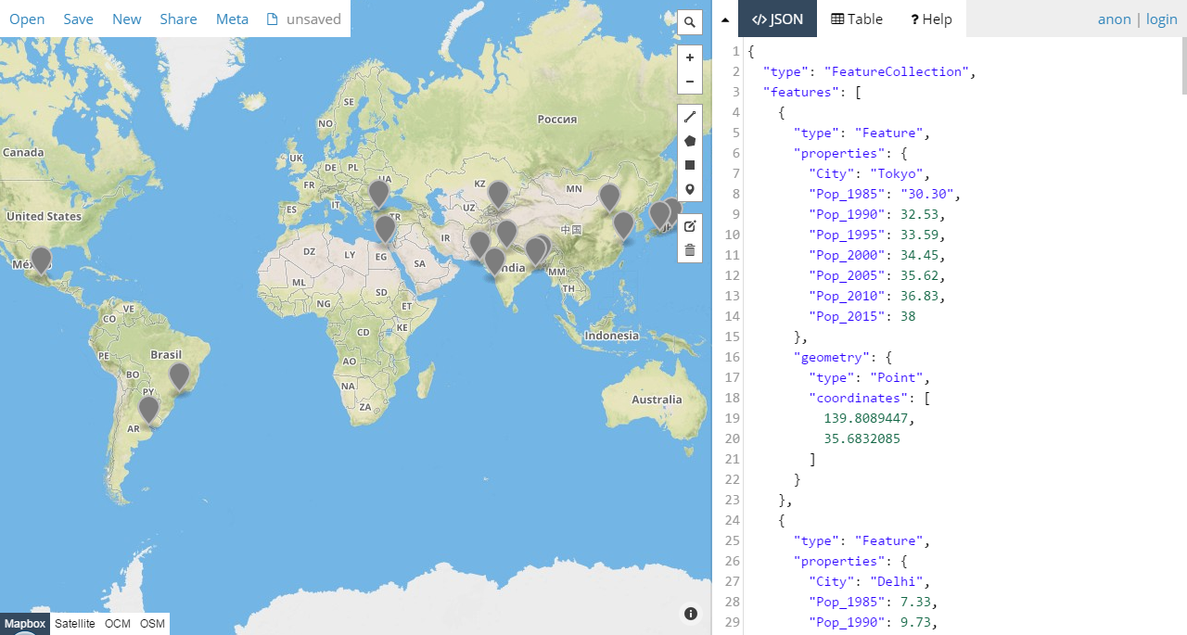
geoJSON

Slide 28
Let’s explore geoJSON
Grab a shapefile or csv that contains spatial information
  At a loss, you can just go back to the airports data we used in lab 1:
  https://www.naturalearthdata.com/downloads/10m-cultural-vectors/airports/
Convert it to geojson using QGIS, ArcGIS or the mapshaper tool:
  https://mapshaper.org/
Upload it to geojson.io and explore!
  https://geojson.io
  (If you’re feeling experimental or lazy, you can use the ‘meta’ tab to add and generate other content)
What do you see here? What does geoJSON look like?
  Finally, look at the ‘save’ tab… see how you can convert data between these various formats? Are there ones you don’t recognize?

