Slide 1
Review and Ajax
With special guest chatgpt

Slide 2
Today’s Outline
Loads of review!
AJAX
Debugging (time permitting)
  StackOverflow
  ChatGPT
  Other approaches…

Slide 3
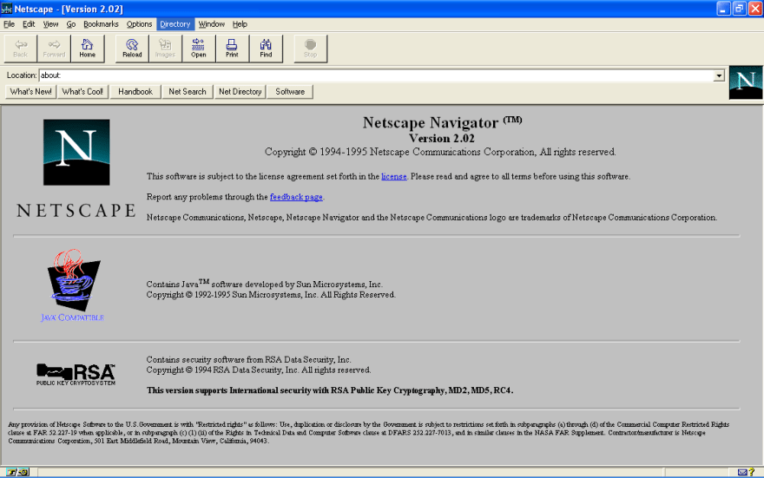
Javascript… not java…
Goal was for something lightweight and easy to grasp - for scripters, not programmers
  Java seen as too heavy, too ‘enterprise’ like
  Idea was originally a scripting companion to java (java for programs, javascript for web pages, etc.)
First called Mocha, then LiveScript, and eventually Javascript
  Allegedly developed in ten days
BUT IT’S NOT REALLY AT ALL LIKE JAVA
Notes:
This is where people often get confused. It kind of looks like java in some of its syntax. It shares a name with java. It even has a development history that’s tied to it…
But it’s really far more a lovechild of scheme and some other systems than it is something like java.

Slide 4


ECMAscipt vs. JScript vs…
“Browser Wars”
  Basically, each browser had its own specific scripting elements. They were similar but not the same.
  This was a nightmare and really stagnated web development for a few years
Google debuts Chrome with V8 Javascript engine in 2008
  Just-In-Time compilation makes it faster…
Finally, in 2009 they all agree to work together with ECMA standards
Notes:
ECMA was the European Computer Manufacturers Association, but has been renamed just Ecma International. It develops standards.

Slide 5
Pseudocode
Scripts are meant to accomplish something
  Update a file on click
  Load an image if they scroll here
You are very smart and an excellent communicator… your computer not so much.
Pseudocode helps us break apart big problems into smaller ones that are easier to convert into something a computer can understand.
Or why programming is kind of like cooking…

Slide 6
Pseudocode helps us think computationally
Start by writing down what you want your script to do.
Then, fill in each step you have to take to accomplish that goal.
It sounds simple, and can be, but it’s an important way to think through our goals.
Make a cup of tea
Gather ingredients
Boil water
Put teabag in cup
Add boiling water to cup
Wait
Remove teabag
Add milk and sugar
Serve

Slide 7
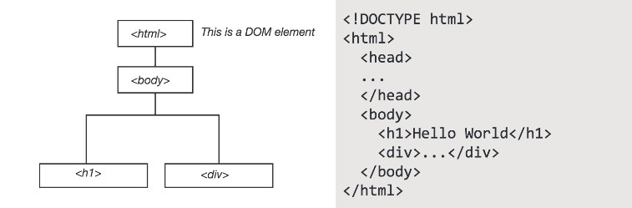
We reference objects through the DOM which allows for interactivity… and all web mapping… to take place

Slide 8
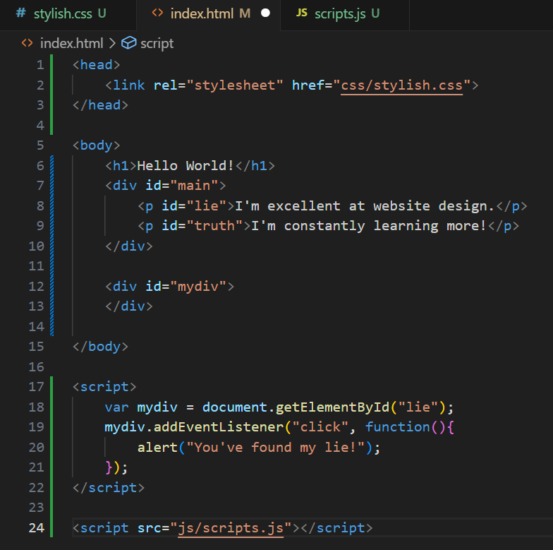
‘Dynamic’ Text
This is a bit canned, but let’s see how you can use javascript to manipulate the DOM and ‘create’ a web page.
In your /js/ directory, create a file called [whatever].js (I called mine scripts.js)
Now, let’s load and inspect it…
Notice I’m doing something very sloppy here, what is it?

Slide 9
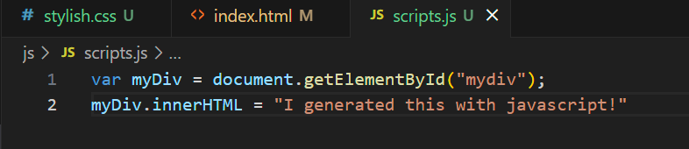
‘Dynamic’ Text

Slide 10
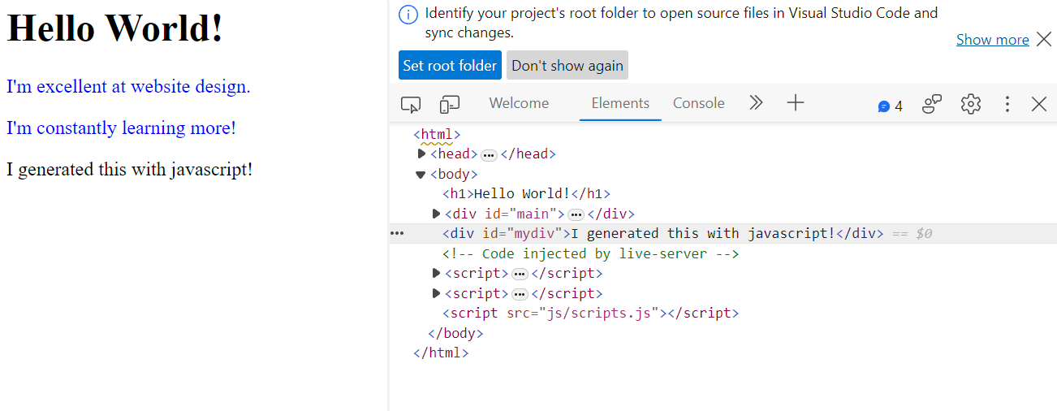

Slide 11
Data types vs. objects?
Variables are containers that hold data values (simple or complex!)
  Primitive data types - not objects, no methods
    Number - integer, floating point, etc.
    String - “Hello World!”
    Boolean - True or False
    Undefined - declared but not assigned a value yet
    Null - the intentional absence of a value
    Symbol - a unique identifier used to avoid naming issues (we can kind of ignore for now)
Notes:
This gets a little confusing.
You don’t really need to understand all of this.

Slide 12
Data types vs. objects? (redux)
Reference Data Types can be thought of as ‘references’ to objects in your document:
  Arrays - [‘hello’, 1, 2.5, True]
  Object Literals - … literally objects (on the next slide)
  Functions - Yes, you can make functions as variables because… why not?
Notes:
This gets a little confusing.
You don’t really need to understand all of this.

Slide 13
Data types vs. objects? (penultimate)
Not a specific data type, but a data structure that can hold values, functions, other objects, hetods, and so on.
A class is a blueprint for creating objects. You use it to define a custom data type that specifies what properties and methods that object can have.
You can create an object on the fly, but if you know you’re going to need a lot of that type of object, you can use a class to define its properties (like ‘car’)
We haven’t spent a ton of time with classes, but you’ll see them as we start using libraries.
Notes:
This gets a little confusing.
You don’t really need to understand all of this.

Slide 14
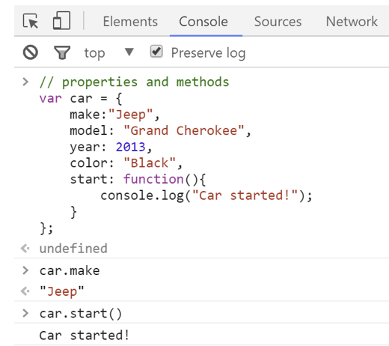

Slide 15
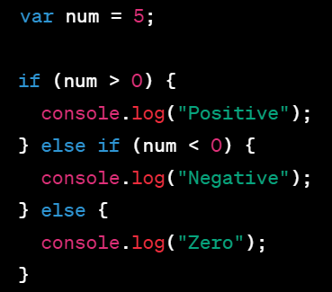
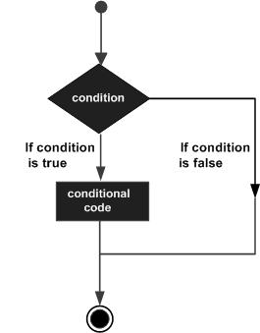
If… else if… else…

Slide 16
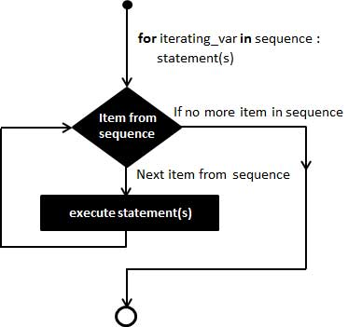
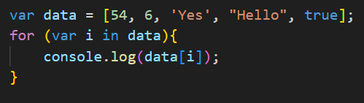
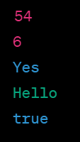
For… (why I like it)

Slide 17
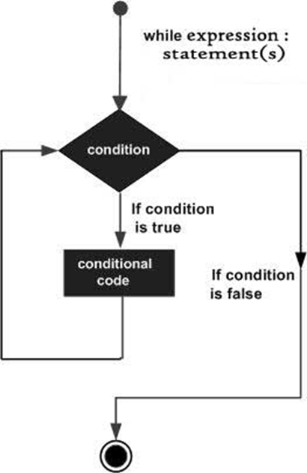
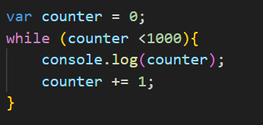
While…

Slide 18
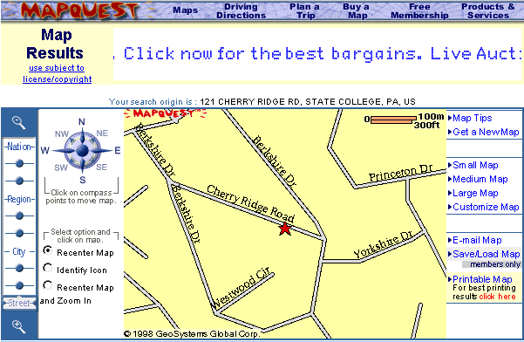
AJAX!
Asynchronous JavaScript and XML
  Early web pages were static. Any update required a complete reload of the page
  But… remember how the DOM made everything into an object?
  AJAX allows for data to be sent for and received from an outside resource without disrupting the entire page’s state
Notes:
From penn state’s online gis courses

Slide 19
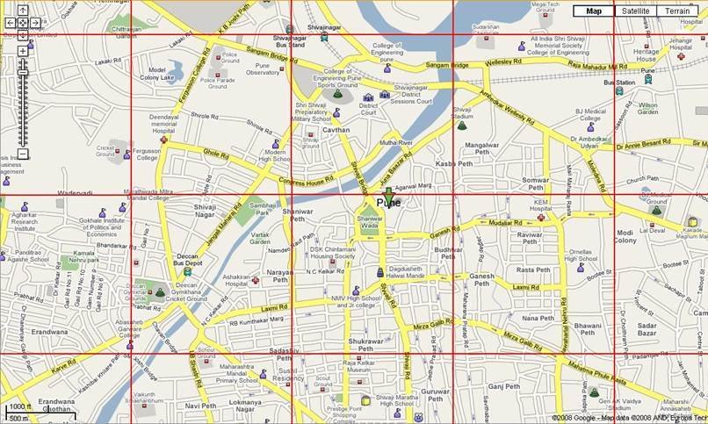
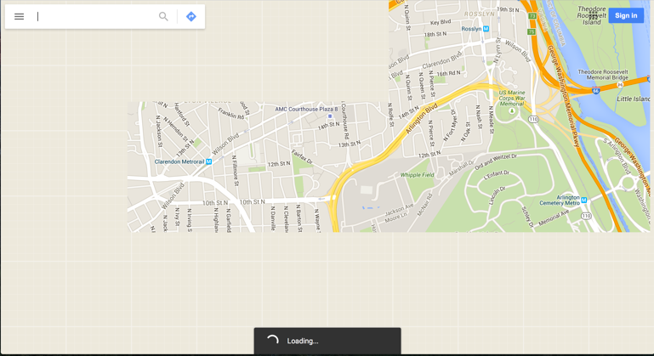
To this…

Slide 20
AJAX
There are A LOT of libraries to help you manage ajax requests
  Jquery, axios, superagent, etc. (you can google “javascript ajax libraries” to find more…)
The Fetch API is ‘native’ to javascript and supported by all modern web browsers. It does not require you to load anything external; so, we’ll focus on it.
Your workbook walks you through a full AJAX request (Lesson 2 of Chapter 3).
  It is assigned, but also highly recommended
  It does use a technique called window.onload… this is not necessary with modern scripts, and I recommend this StackOverflow thread for why: https://stackoverflow.com/questions/20180251/when-to-use-window-onload

Slide 21
With the remaining time… let’s build a fetch request
Let’s use our old friend airports.geojson!
What we’re going to do is use a fetch request to load it, convert it into json, and then print it out to the console.
On Wednesday, we’ll actually expand on this process to add it to a real-live web map!
  Hurrah! The syntax days are over, it’s web mapping time (almost)
Notes:
If we run out of time, we’ll finish this on Monday when we actually use this structure to load… our first map!

Slide 22

First…
Let’s add something to our script in our index.html document
Do you see the ‘defer’ there?
This should begin downloading the script immediately, but it won’t execute until the page is loaded!
Notes:
I say should, because sometimes this hasn’t worked for me.

Slide 23
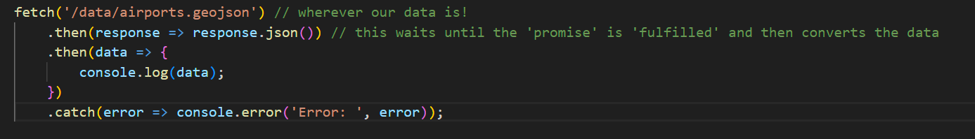
Second…
Let’s head over to our scripts page and add something like this:
Woah! That’s a lot! Let’s talk through it today and then use it to MAKE A MAP on Wednesday!
Notes:
If we have extra time, let’s load up leaflet’s tutorials and do the first one.

