Slide 1
Debugging and Leaflet
What is it, why we’re using it, and making our ‘first’ map (again)

Slide 2
Today’s Outline
A quick review
  “Where are we? Where are we headed?”
Debugging
What’s a library?
What’s Leaflet?
Let’s make a map

Slide 3
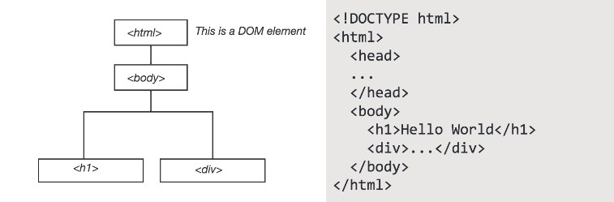
We reference objects through the DOM which allows for interactivity… and all web mapping… to take place

Slide 4
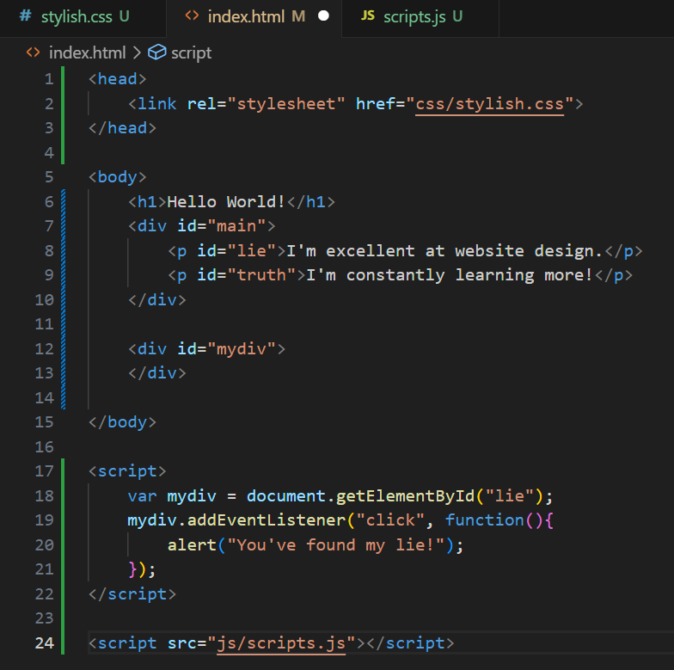
‘Dynamic’ Text
This is a bit canned, but let’s see how you can use javascript to manipulate the DOM and ‘create’ a web page.
In your /js/ directory, create a file called [whatever].js (I called mine scripts.js)
Now, let’s load and inspect it…
Notice I’m doing something very sloppy here, what is it?

Slide 5
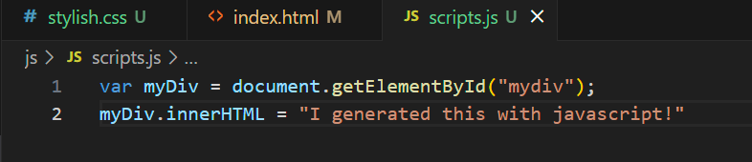
‘Dynamic’ Text

Slide 6
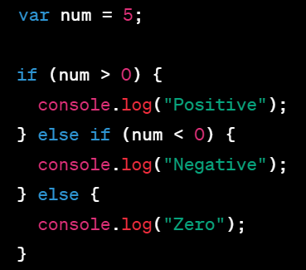
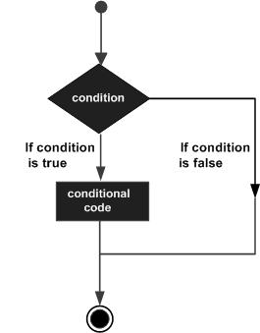
If… else if… else…

Slide 7
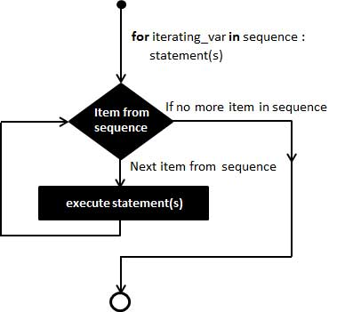
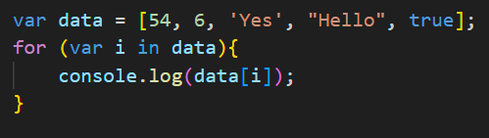
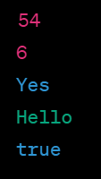
For… (why I like it)

Slide 8
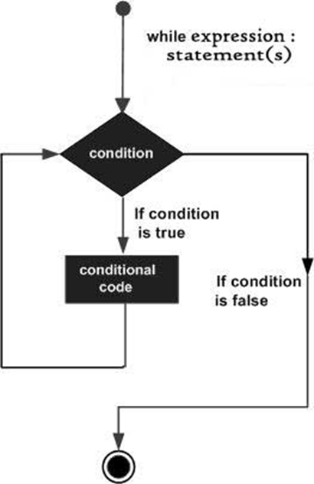
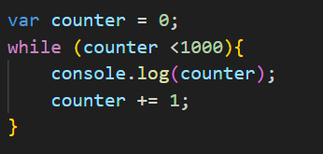
While…

Slide 9
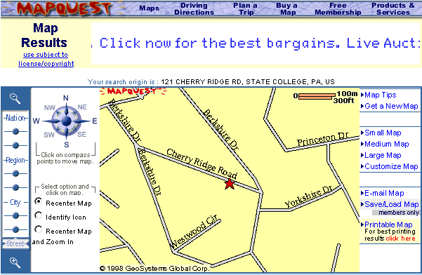
AJAX!
Asynchronous JavaScript and XML
  Early web pages were static. Any update required a complete reload of the page
  But… remember how the DOM made everything into an object?
  AJAX allows for data to be sent for and received from an outside resource without disrupting the entire page’s state
Notes:
From penn state’s online gis courses

Slide 10
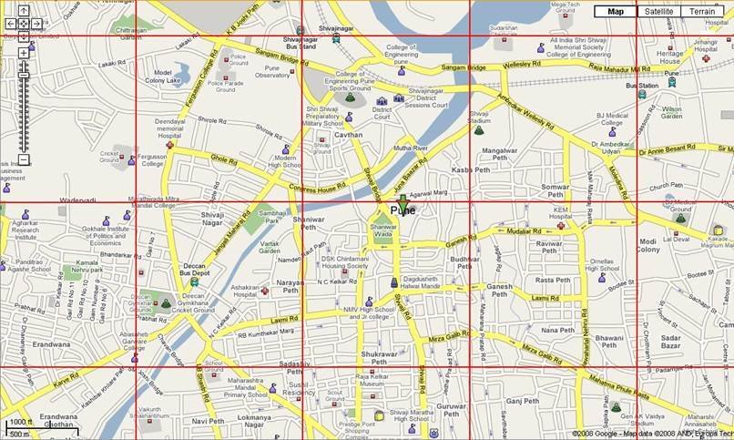
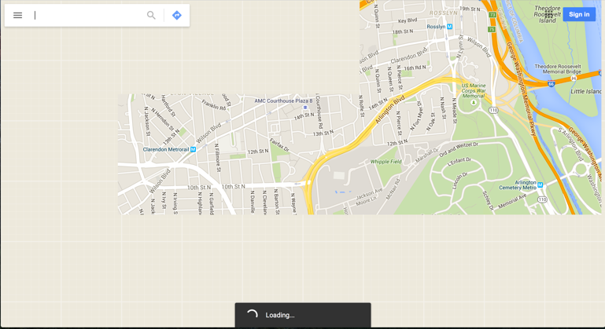
To this…

Slide 11

First…
Let’s add something to our script in our index.html document
Do you see the ‘defer’ there?
This should begin downloading the script immediately, but it won’t execute until the page is loaded!
Notes:
I say should, because sometimes this hasn’t worked for me.

Slide 12
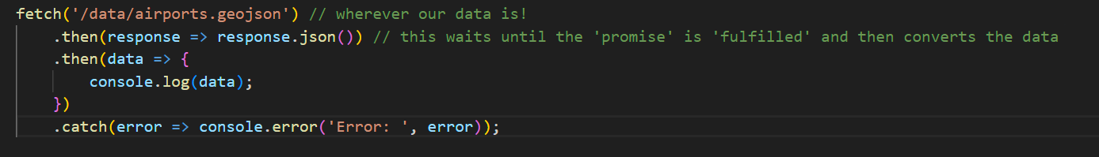
Second…
Let’s head over to our scripts page and add something like this:
Woah! That’s a lot! Let’s talk through it today and then use it to MAKE A MAP on Monday!
Notes:
Remember this slide! We’re going to build off of this.

Slide 13

Debugging
Sometimes it’s easy:

Slide 14
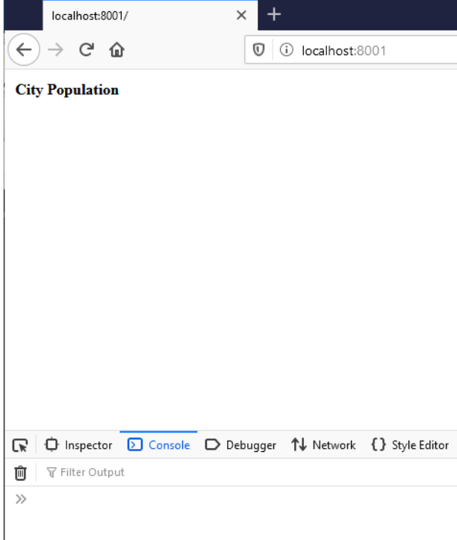
Debugging
Sometimes it’s not…

Slide 15
Debugging
Your console will often show errors.
When it doesn’t…
  console.log(“This is X part of the program!”)
    Insert into various levels of your code.
    Let’s you see if certain functions/variables/loops are or aren’t being called properly.
ChatGPT can also be used to spot errors in code.

Slide 16
Debugging takes time and patience.
Use the tools at your disposal.

Slide 17
Leaflet is a javascript mapping library
Libraries are pre-written bundles of code
  The contain… functions, methods, objects (classes), etc.
Javascript has many built in functions, methods, classes, and so on
  But, can’t contain everything that could be coded…
Libraries simplify and speed up development
  You don’t need to reinvent the wheel every time!
  They allow for people to specialize in areas that interest them!
In many ways, libraries are at the core of open-source development

Slide 18
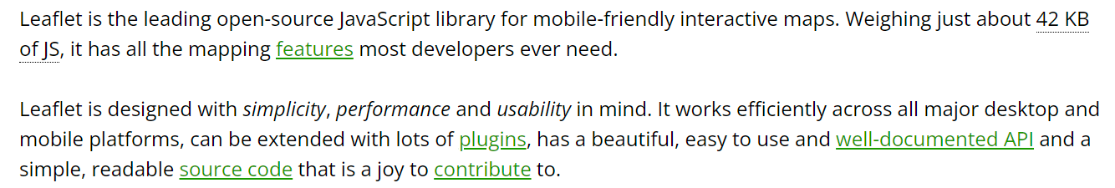
Leaflet is…
An open-source javascript web mapping library
Uses pre-rendered tilesets and includes methods for geospatial data overlays and other cartographic interactions

Slide 19

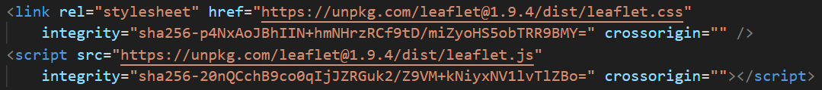
In Javascript, libraries can be local or remote…

Slide 20
Leaflet has its limitations…
Limited geospatial functions (is not a ‘gis’)
More advanced interactions require plugins (other libraries that work with leaflet in specific ways)
Custom projections are very difficult (Leaflet relies on Web Mercator mostly)
But, the plugin community is robust with many mapping platforms relying on parts of the leaflet code base (mapbox, carto, etc.)
For a good discussion of three of the most popular mapping libraries, see this blog post: The 3 best open source web mapping libraries - DEV Community

Slide 21
Let’s take Leaflet out for a spin…
First, follow the “Gettin Started” tutorial to add a map to a web page of your creation.
  Quick Start Guide - Leaflet - a JavaScript library for interactive maps (leafletjs.com)
Second, add your old friend airports.geojson to the map
  Using GeoJSON with Leaflet - Leaflet - a JavaScript library for interactive maps (leafletjs.com)
Feel free to explore styling or clustering or other tools you can use to change the look/presentation of the geojson file.
  You can create pop ups with information.
  You could change it so that different types of airports have different markers.

Slide 22
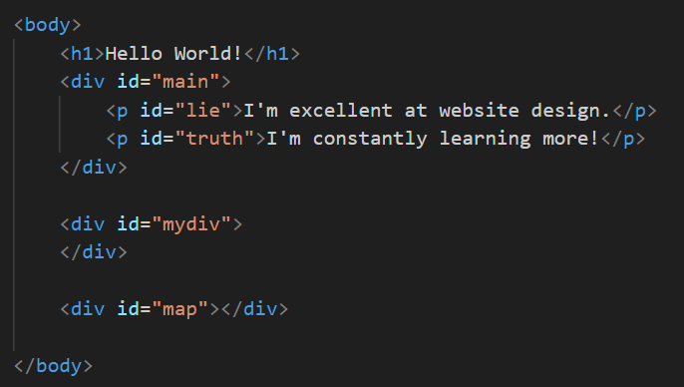

Slide 23
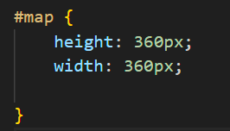

Slide 24
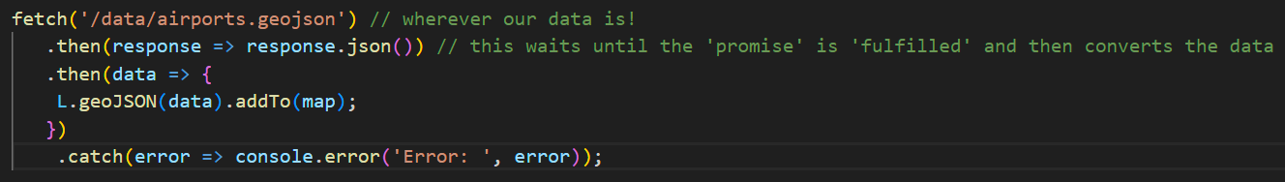

Slide 25
