Slide 1
ABDM Hackathon Series - Round 1: Kickstarting UHI – Innovation Challenges
Team from Global Value Web
Version No: 1.0 , Date: 17Jul2022
| © Copyright GVW

Slide 2
Innovation Challenges - Intelligent Search
Challenge 1: Intelligent Search: The objective of this challenge is to enable intelligent searches for better searchability via the UHI network
Mandatory Requirements Develop a software component that provides the following functionality on text input in English: ● Autocorrect ● Autosuggest ● Conversion of unstructured text into structured text (e.g.: Cardiologist near me – gets parsed on the EUA and search request is sent to the gateway for appropriate results) ● Location awareness
Optional Requirements ● Extend the support for language to any one of the following Indic languages - Hindi, Telugu, Tamil, Marathi, Gujarati, Bengali, Kannada, Urdu; ● Any additional feature developed will be considered in the evaluation

Slide 3

Find a Doctor - App Design
Description
Doctor name
Specialization
Location
Symptoms
Gender
Hospitals
Language
ABDM Server
Healthcare Professionals Registry
Search
Search
Display results
Response
Users
Rest API
What the users see & interacts with Kotlin
Frontend
Backend
Find a doctor is an application that quickly connects patients to their chosen doctors or healthcare professionals for consultations.

Slide 4






Intelligent search – Description based
The description search option is a text box that facilitates the user to search in a natural language
Examples of some descriptive search options
Best Cardiologist near me
Having stomach pain find a doctor near me
Insurance approved hospitals
near me
Which doctor shall I consult for my foot pain
Emergency services near me

Slide 5






Intelligent search – Attribute based
Doctor name
Toolbar that searches doctor’s name
Gender
Dr. Shreya
Toolbar that searches the doctor depending on the Gender
Specialization
Female doctor
Toolbar that searches the medical specialty
Hospitals
Gynaecologist
Toolbar that searches the doctor based on the hospital
Location
Prime Hospital
Toolbar that searches the Location by state and District
Language
Sholinganallur, Chennai & Tamil Nadu
Toolbar that searches the doctor based on the language preference
Symptoms
Telugu speaking
Toolbar that finds the doctor depending on the symptoms of the patient
Stomach pain

Slide 6
Intelligent Search Implementation
Description based Search
Semantic search supported by automated natural language processing programs
Using deep learning models (BERT)
Use case:
Search Parameter : Aged 65 Having Knee pain, unable to sit in for long duration
Solution : Here the key words are Symptoms like Knee pain, cannot sit for long duration, age. The algorithm should identify entities (Entity Recognition), link the same with relevant Keywords like “Orthopedic” and be able to search for professionals in the similar domain and present the user with the results.
Location based Search
searching for something based on yours and its relative physical locations
Using GeoCoding APIs
APIs like OpenCage, Google Geolocation API
Use cases:
Dentist near me
Keyword based Search
Search based on the attribute input values like Doctor Name, Specialty, Gender etc.
Searches the Registry by using simple queries and presents the results to the users.

Slide 7
Implementation
For demonstration we have created a simple UI with predefined fields/attributes and data set
Data source can be a registry however currently we are accessing the same in predefined array of data.
Business logics for the search are NOT created but hard coded to demonstrate the functionality at the UI level.

Slide 8
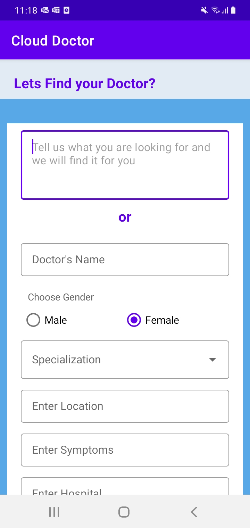
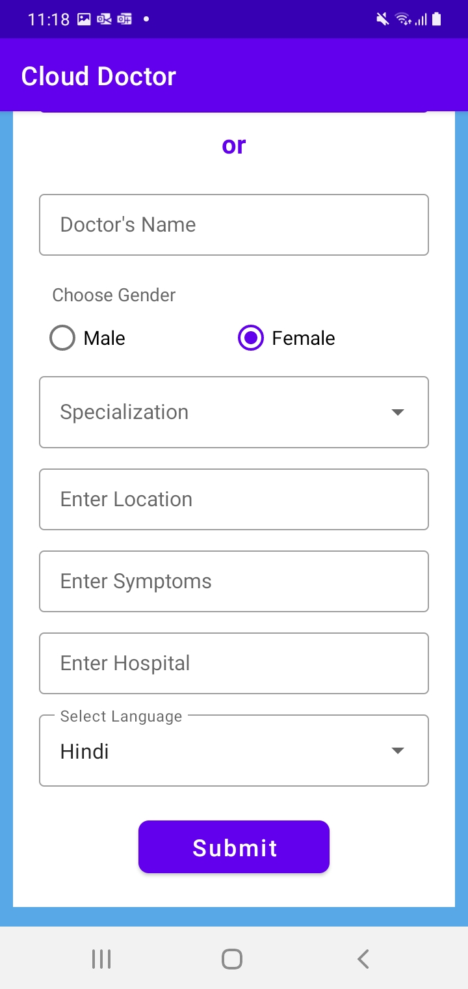
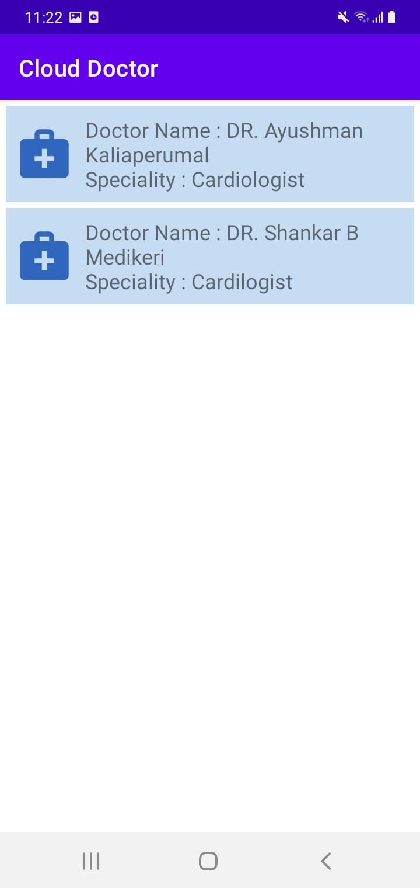
Find a doctor app - Screens
Screen 1
Screen 2
Screen 3

Slide 9
Our Team
Ananda Ramachandran – Director of Technology Services
Email: ananda.ramachandra@global-value-web.com
Mobile: 98450 24265
K Lakshmi – Project Manager
Email: klakshmi@global-value-web.com
Mobile: 9962923435
J Swetha – RWD Lead
Email : jswetha@global-value-web.com
Mobile: 9543870805
M Ragashree – Senior Android Developer
Email : mragashree@global-value-web.com
Mobile : 9943404721
K Giridhar – Data Engineer
Email : giridhar.kandey@global-value-web.com
Mobile : 9940253955
L Shyamli – Senior Marketing Specialist
Email: lshyamli@global-value-web.com
Mobile 9629897611

Slide 10
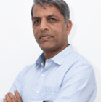


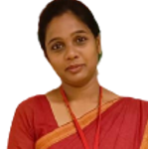
Thank You!
Ananda Ramachandra
Director – Technology Services
+91 98450 24265
ananda.ramachandra@global-value-web.com
Lakshmi K
Project Manager
+91 99629 23435
klakshmi@global-value-web.com

