Slide 1
The Trading Game
Seth Loew
Caelan Mayberry
Justin Sybrandt

Slide 2
The Game:
Sword
Armor
Tools
Iron
Leather
Common_Spices
Salt
Groceries
Wine
Rare_Spices
Paper
Oil
Wax
Perfume
Silk
Pearls
The Player buys and sells resources in a simulated economy.
The player travels between towns, each with their own wares and prices.
Towns adjust their prices for supply and demand.
The player attempts to make as much money as possible within a turn limit.

Slide 3
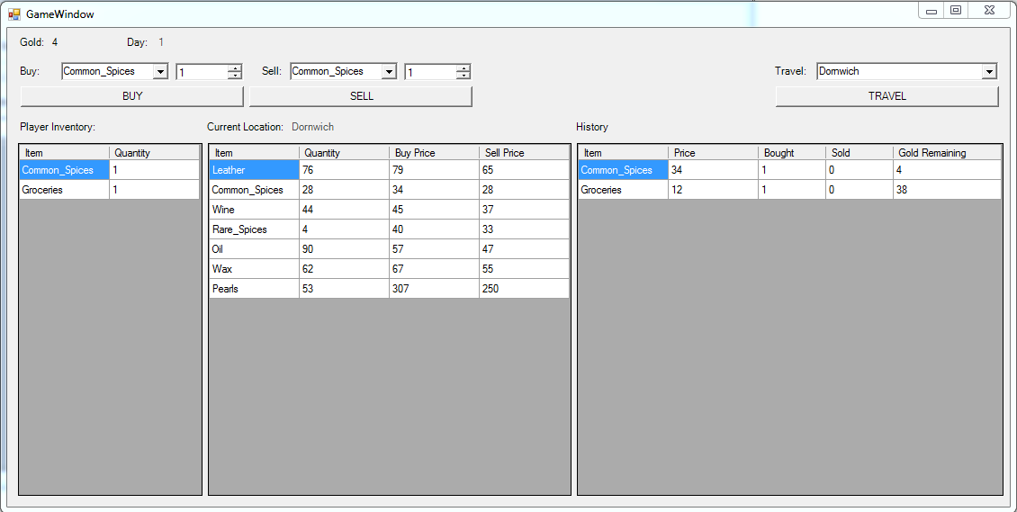
The GUI

Slide 4
Class Descriptions
Game : Stores all game related info. The client interfaces with this object.
Player : Stores the wealth and holdings of the player.
HistoryTuple : Used to record the transactions the player makes.
Town : Stores the towns holdings and defines an interface to buy and sell from. Also contains records of
TransactionTuple : Used to record the number of times an item in a town has been bought and sold.
Inventory : Used to store a count for each item. Provides an interface to keep these counts valid. Is the base class of Player and Town.
Item : Stores basic data such as name and default price.

Slide 5
Class Interactions
Game:
Has a Player
Has a collection of Items
Has a collection of Towns
Player:
Is an Inventory
Has a collection of HistoryTuples
Town:
Is an Inventory
Has a mapping from Item to TransactionTuple
Has a mapping from Item to price (int)

Slide 6
Basic Behavior
The player starts in a random town with a small amount of gold.
The player may buy and sell items at each town, attempting to make money.
The player only has enough time to travel thirty times before the end of the game.
Every travel causes the world to be simulated, and events occur during this time.

Slide 7
Simulation
When the player moves from one location to another, items move drastically around the world.
Ten-Thousand transactions are attempted by selecting random cities and products. The transactions that actually take place are most often money making, but not always. This provides a more interesting and variable player experience between towns.
After the simulation, prices are updated. If an item has been bought more than sold, it goes up in price, and vice versa.
This is calculated using the following metric: (#times bought - #times sold)/total # transactions

Slide 8
Events
Events are randomly chosen at the beginning of every day
Events:
War: The player cannot enter that town for two days
If a town has a war, that town is not an option in the drop down menu for travel
Famine: The current town’s supply of groceries are changed to 0
Birds Attack: The current town’s supplies of pearls, perfume, and silk are set to 0
Raid: The current town’s supplies of swords, armor, and tools are set to 0
When Famine, Birds Attack, or Raid occurs, the supplies that are set to 0 are not listed as options to buy from that town

Slide 9
DEMO:

