Slide 1
E-commerce
Csc 4402 final project
Josh bankston, patrick nguyen, reza namakian, christopher Duong

Slide 2

Goals and motivations
Motivation:
Being able to monitor specific store details to provide valuable statistics and analytics for the company to maximize the growth and longevity of the company.
Goal:
Streamline online shopping
Mimic real world shopping scenarios to ensure data consistency and customer experience

Slide 3

Assumptions
Each user has a unique user_id
Each product has a unique product_id
Only 1 payment type may be used
A product belongs to an order
Any number of products can exist in an inventory
A discount applies to specific products only

Slide 4
Constraints
A user must exist to shop from products
A user must contain relevant user information(user_address, and user_payment)
Order_items must contain products
Products must contain order_items, discount_code

Slide 5
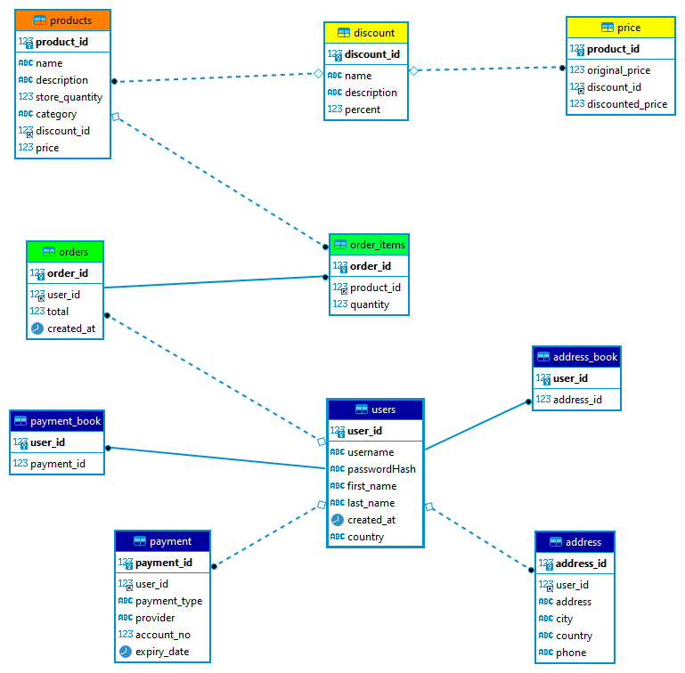
Er-diagram

Slide 6
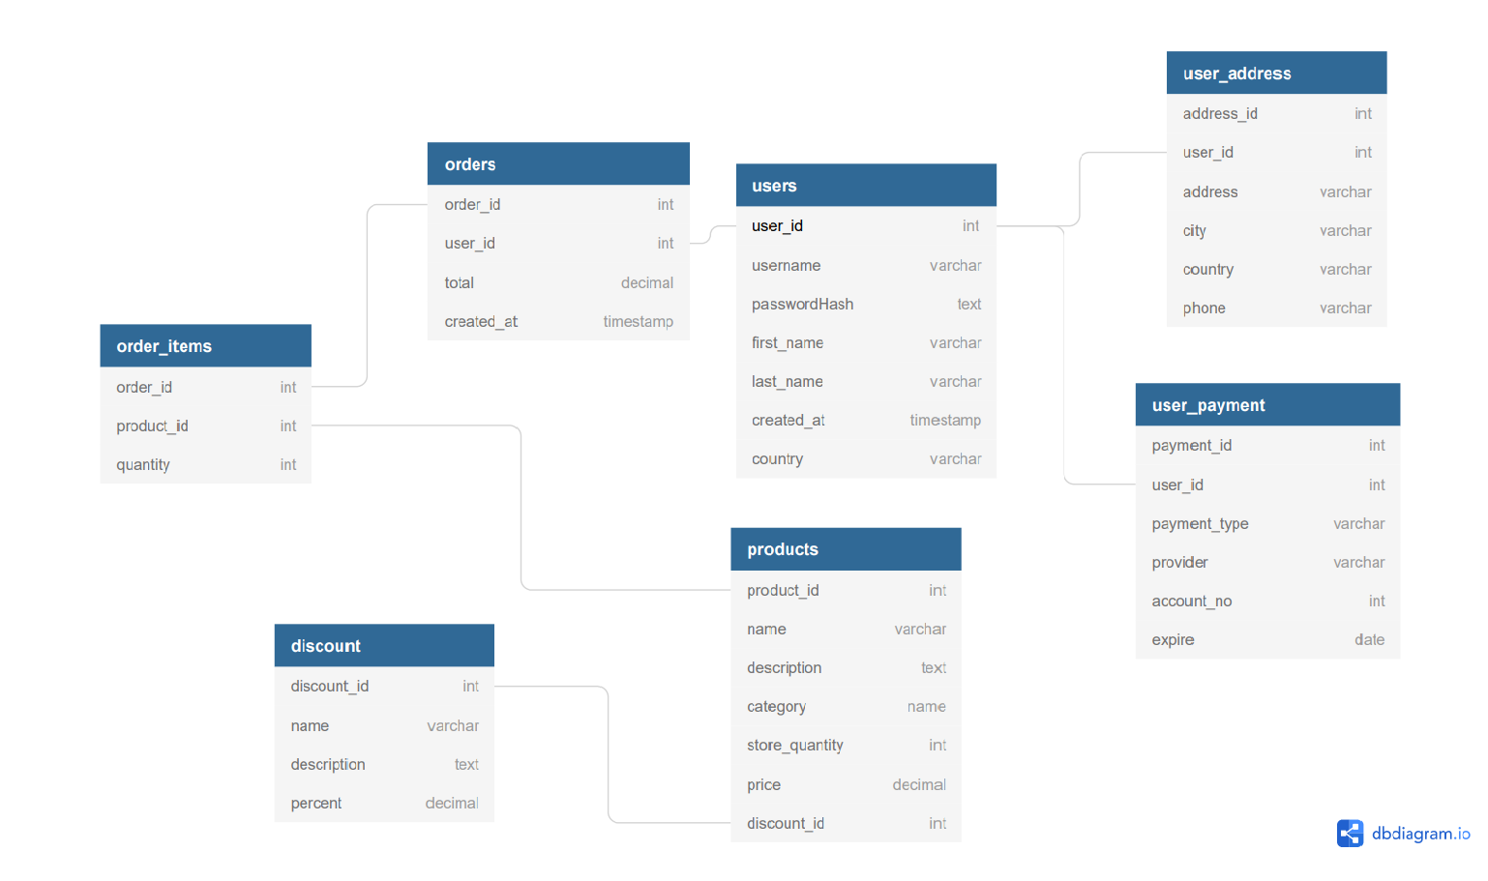
schema

Slide 7
Relationship sets
Users() FILLS address_book(), payment_book(), orders()
Address_book() STORES address()
Payment_book() STORES payment()
Orders() TRACKS order_items()
Products() STORES price()
Price() STORES discount()

Slide 8
Functional dependencies
Users (user_id, username, passwordHash, first_name, last_name, created_at, country):
User_id -> username, passwordHash, first_name, last_name, created_at, country
User_Address (address_id, user_id, address, city, country, phone):
Address_id, user_id -> address, city, country, phone
User_payment (payment_id, user_id, payment_type, provider, account_no, expire):
Payment_id, user_id -> payment_type, provider, account_no, expire
Orders (order_id, user_id, total, created_at):
Order_id, user_id -> total, created_at
Order_items (order_id, product_id, quantity):
Order_id, product_id -> quantity

Slide 9
Functional dependencies cont.
Products (product_id, name, description, category, store_quantity, price, discount_id):
Product_id -> name, description, category, store_quantity, price, discount_id
Discount (discount_id, name, description, percent):
Discount_id -> name, description, percent

Slide 10
Normalization and decomposition
All the given relations are in first normal form (1NF), since all their values have been stored as atomic and single-valued.
A relation is in 2NF if it is in 1NF, and every non-key attribute is fully dependent on primary key. This is not the case for "user_address" relation, since, for example, the attribute "address_id" can determine the "address" attribute on its own. In other words, the "address" attribute is a non-key attribute, and it is not fully dependent on the primary key "user_id, address_id".
We can have the following lossless decomposition:
{user_id, address_id, address, city, country, phone} ==>
{user_id, address_id} + {address_id, address, city, country, phone}

Slide 11
Normalization and decomposition Cont.
The same 2NF normalization applied to "user_payment" relation:
{user_id, payment_id, payment_type, provider, account_info, expire} ==>
{user_id, payment_id} + {payment_id, payment_type, provider, account_info, expire}
No further normalization is required as all the remaining relations are in BCNF.

Slide 12
Revised dependencies
User_Address (address_id, user_id, address, city, country, phone) =
Address_book(user_id, address_id):
User_id -> address_id
Address(address_id, address, city, country, phone):
Address_id -> address, city, country, phone
User_payment (payment_id, user_id, payment_type, provider, account_no, expire) =
Payment_book(user_id, payment_id):
User_id -> payment_id
Payment (payment_id, payment_type, provider, account_no, expire):
Payment_id -> payment_type, provider, account_no, expire

Slide 13

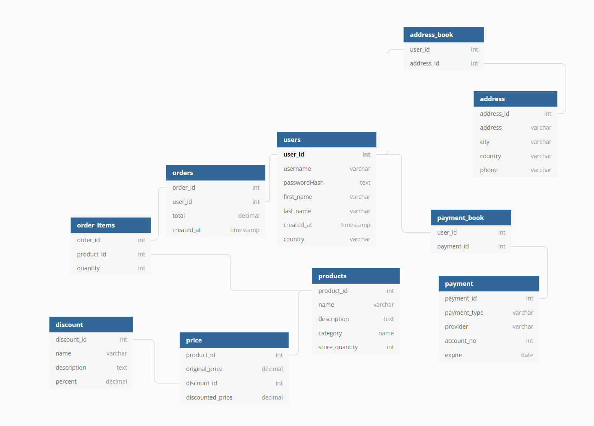
Revised schema

Slide 14
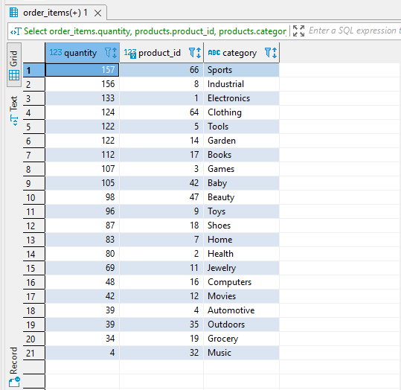
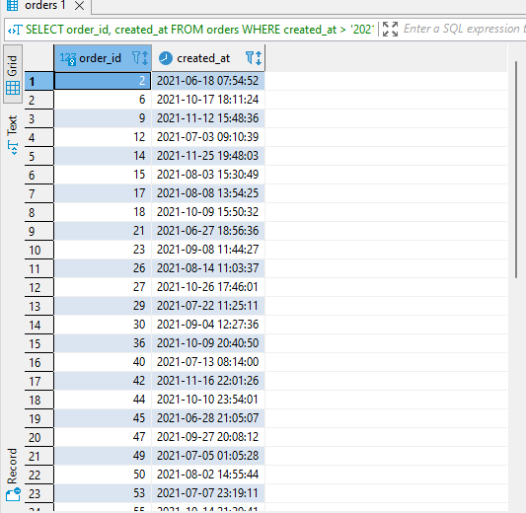
Queries
Best selling item category
• Select order_items.quantity, products.product_id,
products.category
FROM order_items
INNER JOINproducts ON
order_items.product_id = products.product_id
GROUP BY products.category
ORDER BY order_items.quantity DESC;
Orders after June 18, 2021
SELECT order_id
FROM orders
WHERE created_at >
'2021-06-18 00:00:00'

Slide 15
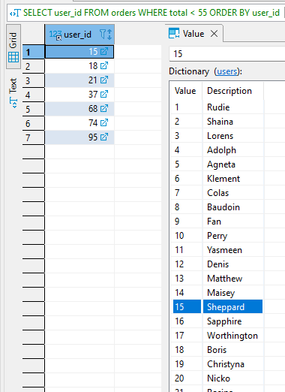
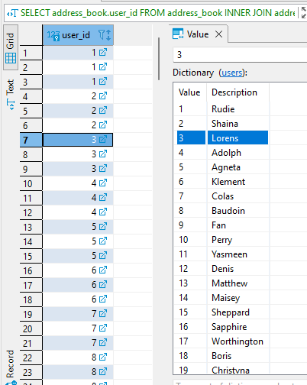
Queries Cont.
Find users with country 'United States'
SELECT address_book.user_id
FROM address_book
INNER JOIN address
WHERE country =
'United States';
Users with orders less than 55,
Ordered by user_id
SELECT user_id FROM orders
WHERE total < 55
ORDER BY user_id;

Slide 16
conclusion
Proper database design and management allows for information to be communicated efficiently
Decreases redundancies and inconsistencies
Crucial when applications begin to scale exponentially, and userbase/information gathered increases

Slide 17
Thank you!
Questions?

