Slide 1
Using Python to Explore Binder Composition Effects on Stress HVOF-Sprayed Cermets
Donald McMahon

Slide 2
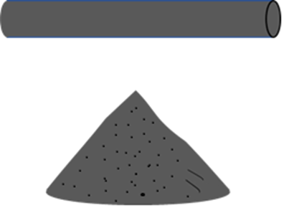




A Quick Overview on Thermal Spray
Thermal Spray: A coating technique that heats up a material, known as feedstock, and then accelerates it at a substrate, generating a coating that is 10s to 100s of µm thick.
Depending on the process, feedstock starts as a wire or a powder.
A heat source melts (or partially melts) the feedstock.
Molten particles are accelerated toward a roughened substrate.
Particle impacts substrate and forms a splat.
Multiple layers of splats form a coating.

Slide 3
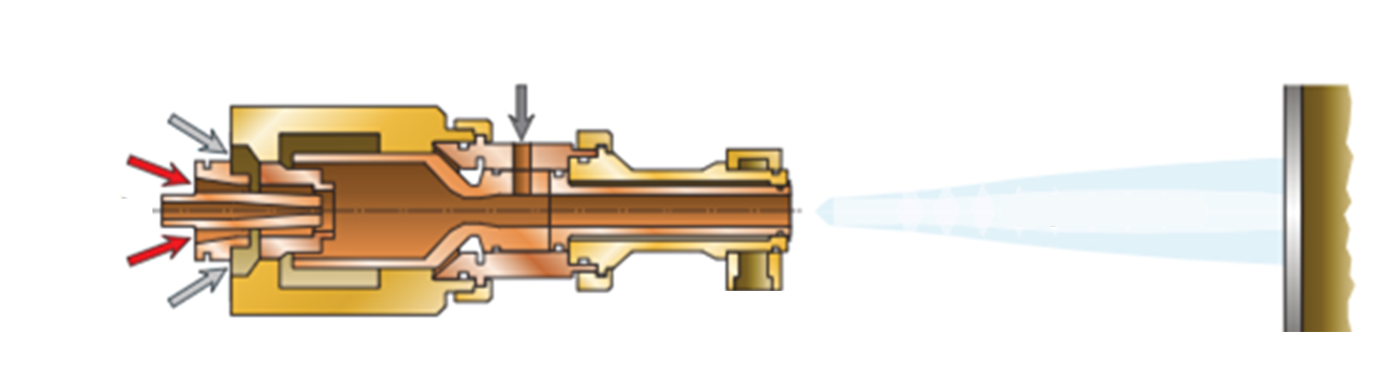

High Velocity Oxy Fuel (HVOF)
A high –velocity, relatively low temperature technique used for thermal spray.
Oxygen and some type of fuel (I use kerosene) are input into the gun.
The fuel and oxygen are ignited in the combustion chamber, forcing hot gas out through the barrel.
Powder is inserted after the combustion chamber and carried at high velocity through the barrel toward the substrate
Molten particles hit the substrate and generate a coating.
Oxygen
Kerosene
Kerosene
Oxygen

Slide 4
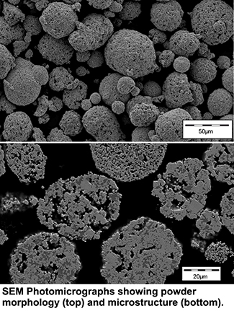
One last thing: Cermets
WC Particles
Cobalt Matrix
A cermet is a ceramic-metal (hence the name) composite where ceramic particles are sintered to a metal matrix, or binder.
These materials combine the hardness, wear resistance, and thermal resistance of hard materials like tungsten carbide (WC) and chromium carbide (Cr₃C₂) with the flexibility of the metal matrix, which is typically nickel, cobalt, chromium, or a combination of the three.
Matrix usually make up between 9 and 25 mass% of a single cermet particle.
This powder is Tungsten Carbide with a 12% Cobalt Matrix
SEM image of Metco 5143 particles (top) and cross-section (bottom),
credit Oerlikon Metco

Slide 5

HVOF is Perfect for Coating Carbides
Carbides have extremely high melting temperatures (1900°C for Cr₃C₂ and 2900°C for WC) and will commonly sublimate or decarburize when you approach these temperatures anyway.
However, an HVOF torch provides just enough thermal energy to melt the matrix of a cermet particle and generates high enough velocities that these particles deform and adhere to the substrate.
Without the matrix, unmelted carbide particles bounce off substrate
Matrix is sintered onto carbide particles, which melts and is able to adhere to substrate, capturing carbide particles
With the addition of the matrix, the particle partially melts and is able to adhere.

Slide 6
Here Comes the Code
I want to understand how changing the matrix of a cermet particle and the particle’s momentum affect the stresses that it generates when it hits a substrate.
Stress is calculated during a spray using an In-situ Coating Property sensor (ICP) that uses a laser to measure displacement of a beam.
The stress values I am interested in are those that are deposited while a part is being sprayed, known as evolving stress, σ_{E}.
3 Different sprays were done for each powder that resulted in 3 different particle velocities.
My goal is to create a code that will graph evolving stress values against a parameter that I create and then tell me how good the correlation is.

Slide 7
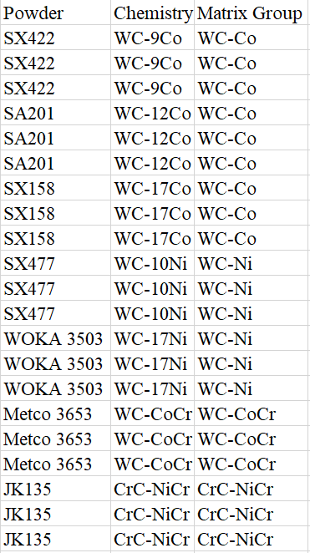
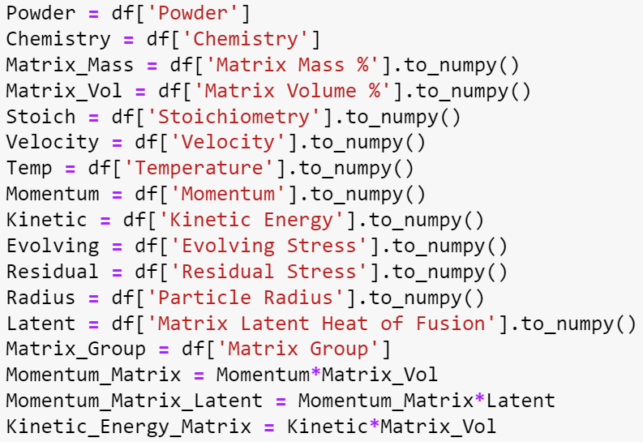
The Beginning
I created a .csv file that contained each HVOF spray for all my powders in order of powder chemistry and matrix composition.
A column entitled “Matrix Group” was created to differentiate between the type of matrix metal, i.e. WC-Co powders were put together, then the two WC-Ni powders, then WC-CoCr and Cr₃C₂.
The .csv was first read using pandas and turned into a dataframe.
Each relevant column in the .csv was made into a variable.
Columns with numerical values were converted to a numpy array.

Slide 8

Preparing the Graphs
Because a graph was to be made for each powder, each graph would need to be formatted with different colors.
To remedy this, an array was created for the markers and colors to be used by each different powder.
An array was also created to dynamically append units to the axis titles of the graphs.
A blank array with size = # columns – 4 was created. Then a new array was created for the 4 columns that needed units. Velocity was column 14, so index 14 in the unit array was changed to “m/s”.

Slide 9

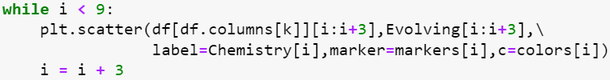

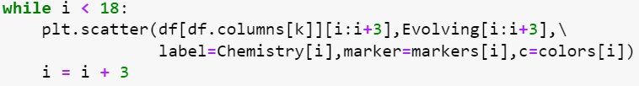
Loop-the-Loop
Variable “i” was used to call individual rows in the .csv file.
WC-Co was contained in rows 0 through 8, so a while loop was used to graph just this matrix group
The parameters that I wanted to graph were in columns 14 and 24 through 28. So an array was created to loop through the columns that I needed in the graphs.
Then I created a for loop to loop through the y-axis values I wanted.
i = i + 3 because there were three different velocities for each powder
The same was done for every other matrix group

Slide 10

Calculating Line of Best Fit
From what I could tell, there appeared to be a linear regression forming with some of the parameters.
So, I defined a linear regression for scipy.optimize’s curve_fit() function.
a is the slope, x is the parameter, and b is the intercept.
Variables “constants” and “pcov” was made to grab the output of curve_fit, which is two arrays. The first contains the desired constants, and the second is a 2-D array of the covariance of the data.

Slide 11


Graphing Line of Best Fit
Variables “a_fit” and “b_fit” were created to store the coefficients for the fit-line
Variable “t” stored the x values when the fit-line was graphed.
np.linspace was used with limits of the minimum and maximum parameter value based on the indexed dataframe columns
An empty array called “fit” was created and appended with calculated values for each value of t using the created “linear” function.
Then the line was plotted.

Slide 12
Calculating and Displaying Variance
I wanted to know the R² value for each graph:
Calculate sum of residuals.
Calculate residual sum of squares.
Calculate total sum of squares.
Calculate R².
Then R² and the equation of the line were added as text to the graph.

Slide 13
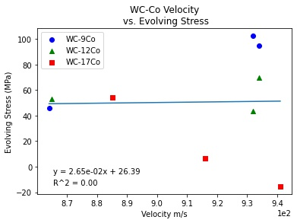
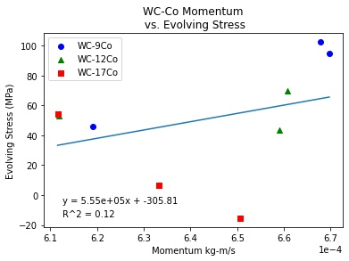
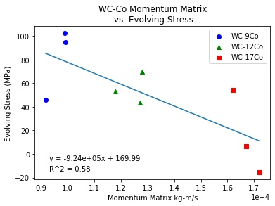
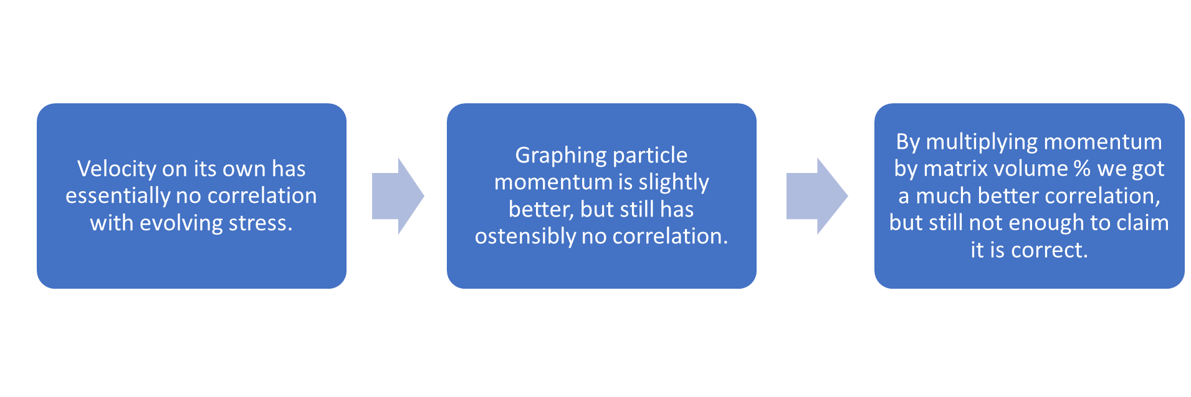
Finished Graphs

Slide 14
Thanks for listening!
Donny McMahon
Executive Producer
Lead Writer
Director
Donald McMahon
Donald McMahon
Donald McMahon
Donald McMahon

