Slide 1


Slide 2

ABOUT THIS PROJECT
We have used sql queries to make sales report in “ pizzain” . We have answered some questions based on the data that we were provided regarding the sales of pizza . We went from basic level queries to advanced level queries in this project which are shown in the preceding slides

Slide 3
QUESTIONS ANSWERED IN THIS PROJECT
Basic:
Retrieve the total number of orders placed.
Calculate the total revenue generated from pizza sales.
Identify the highest-priced pizza.
Identify the most common pizza size ordered.
List the top 5 most ordered pizza types along with their quantities.
Intermediate:
Join the necessary tables to find the total quantity of each pizza category ordered.
Determine the distribution of orders by hour of the day.
Join relevant tables to find the category-wise distribution of pizzas.
Group the orders by date and calculate the average number of pizzas ordered per day.
Determine the top 3 most ordered pizza types based on revenue.
Advanced:
Calculate the percentage contribution of each pizza type to total revenue.
Analyze the cumulative revenue generated over time.
Determine the top 3 most ordered pizza types based on revenue for each pizza category.

Slide 4
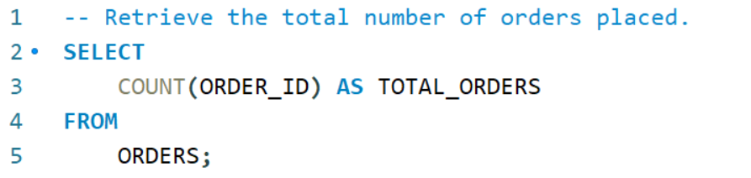


Slide 5
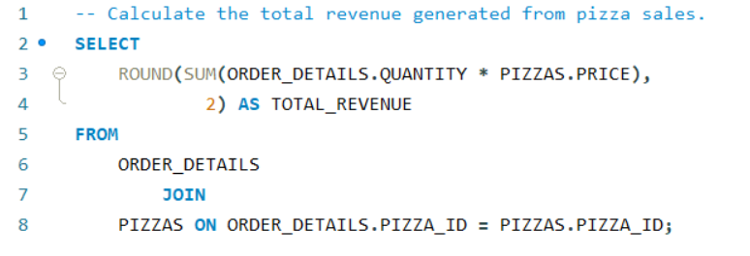
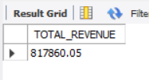

Slide 6
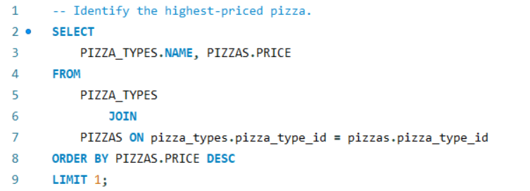
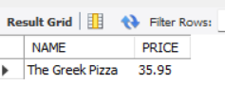

Slide 7
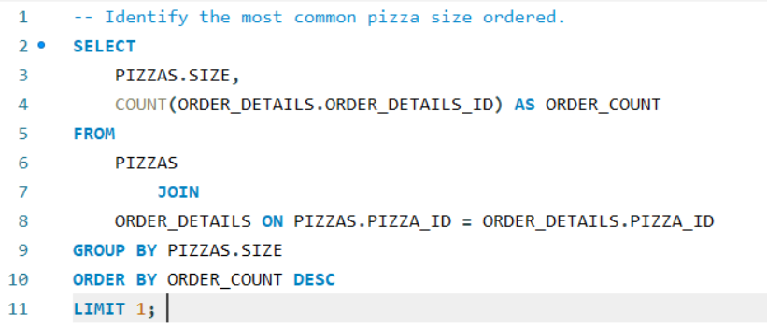
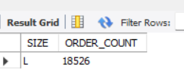

Slide 8
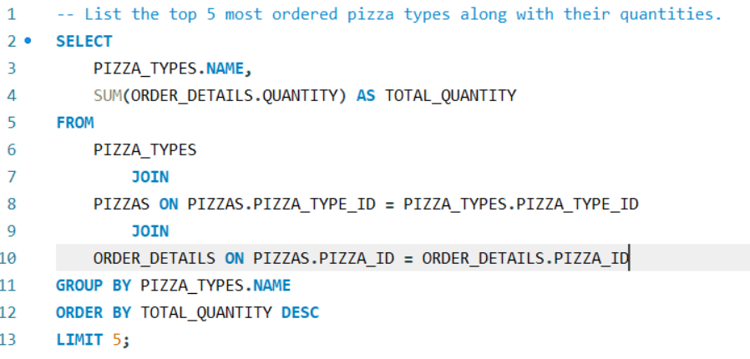
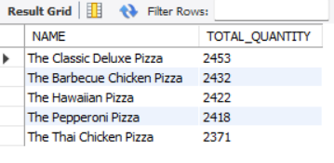

Slide 9
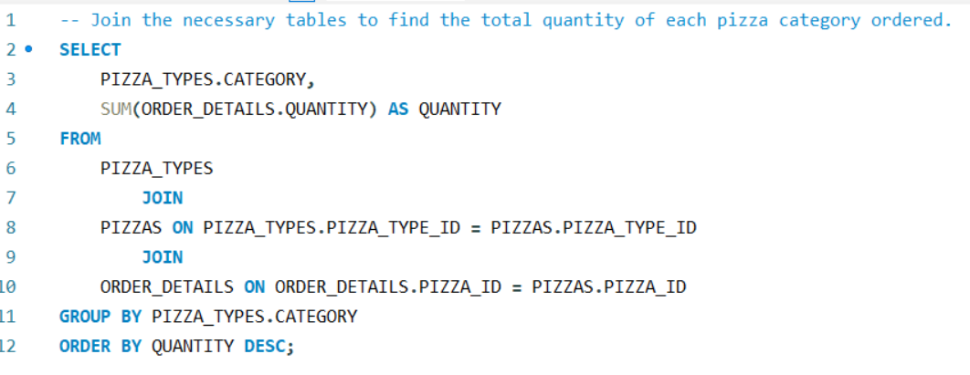
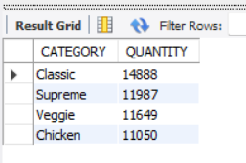

Slide 10
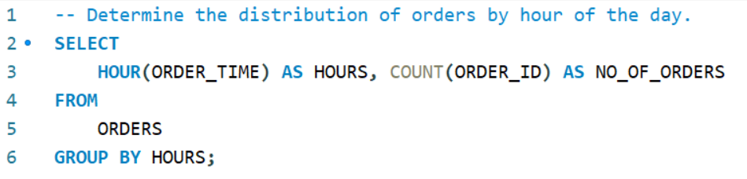
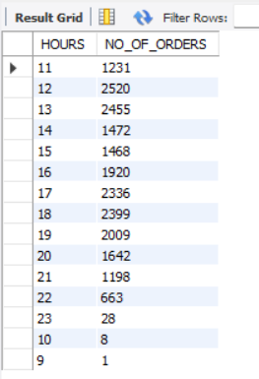

Slide 11
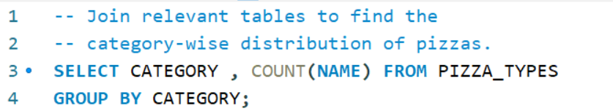
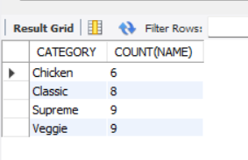

Slide 12
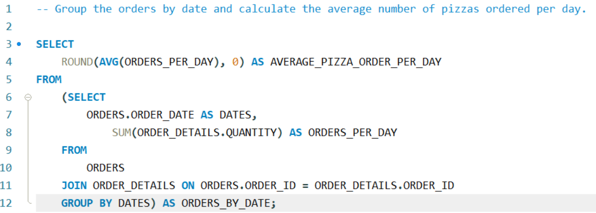
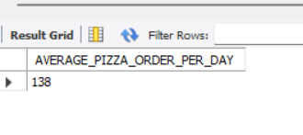

Slide 13
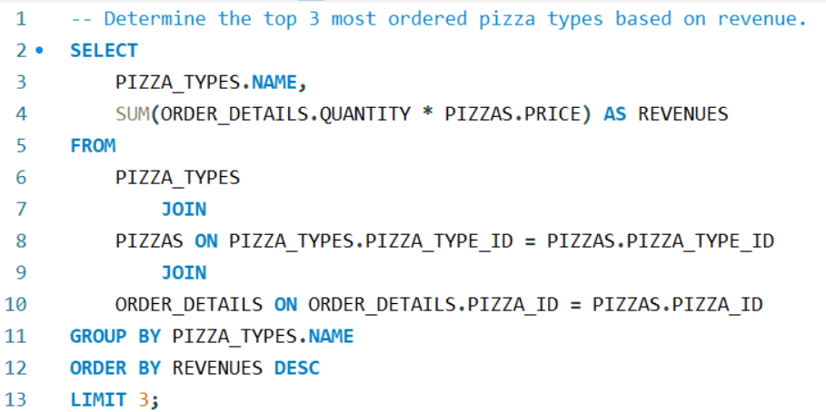
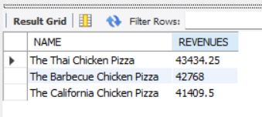

Slide 14
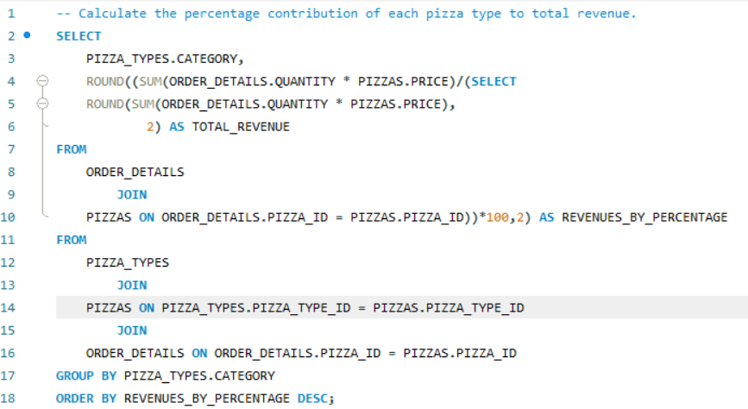
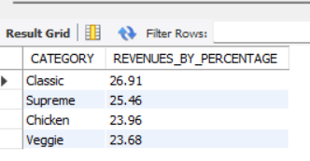

Slide 15
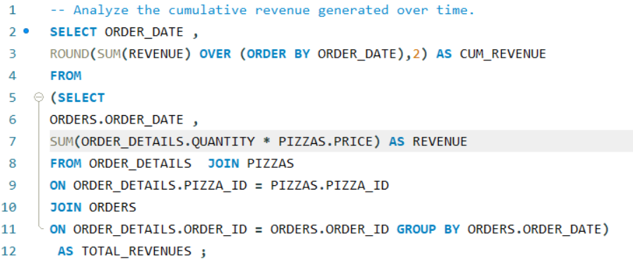
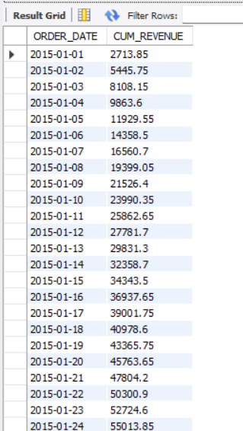

Slide 16
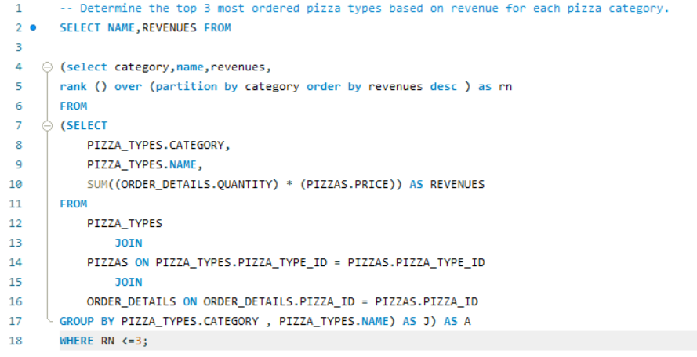
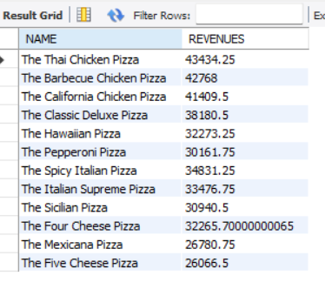

Slide 17

thank you
JANHAVI SHUKLA
8933986562
Janhaviatshukla@gmail.com

