Slide 1
ASMR-tistry
Topic Modeling ASMR YouTube Videos
Presented By: BlackLotus
Notes:
Welcome, my name (BlackLotus for YouTube). Today I will be presenting my findings for my YouTube ASMR topic-modeling project.

Slide 2

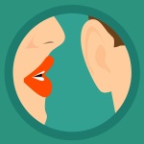
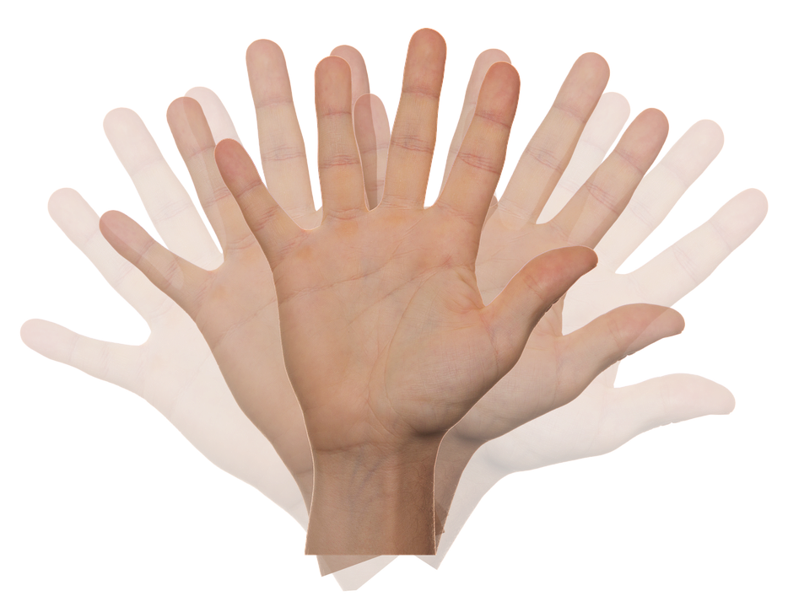
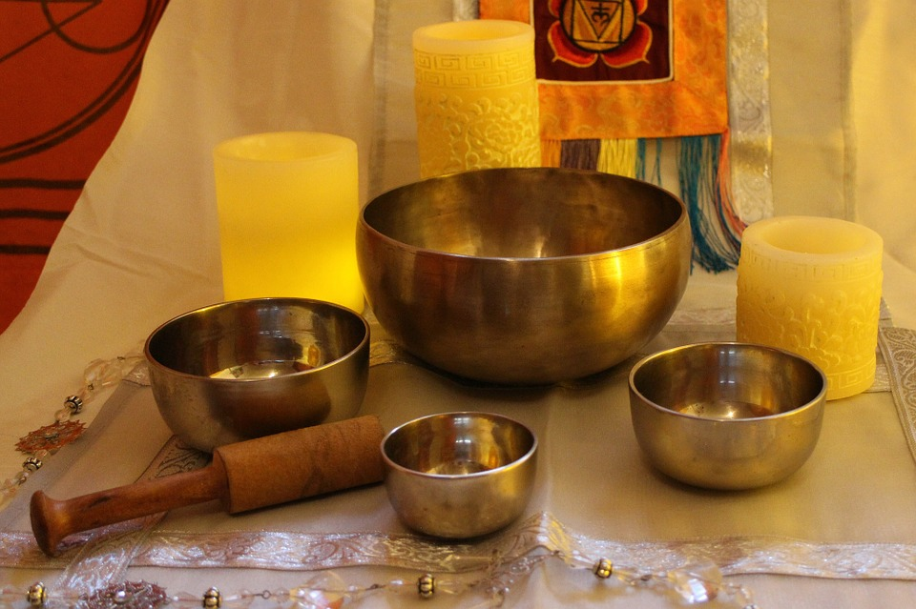
YouTube ASMR
What is ASMR?
  ASMR – Autonomous Sensory Meridian Response
The ASMRtist try to produce this sensation via triggers. Triggers are typically auditory and/or visual such as :
  Tapping sounds
  Whispering
  Hand movements (think hypnosis)
  Tibetan singing bowls (think meditation)
Notes:
I have a YouTube Channel and I am picky when it comes to subscribing to another channel; and I subscribe to many different types of channels.
So first off, how many know what ASMR is? Who has heard of AMSR?
According to Wikipedia, ASMR is a low-grade euphoria characterized by a combination of positive feeling and a distinct static-like tingling sensation on the skin.
This is often referred to as “the tingles” by the ASMR YouTubers and the consumers such as myself.
The ASMRtist try to produce this sensation via triggers. Triggers are typically auditory but can be visual such as :
Tapping sounds
Whispering
Hand movements (think hypnosis)
Tibetan singing bowls

Slide 3
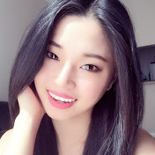
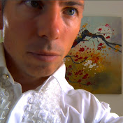
Subscriptions And
Two Questions
Why is it that I like these ASMR YouTubers so much that I would subscribe?
Are there any other ASMR YouTubers I would like as much so as to subscribe?
Notes:
With that being said, I am subscribed to two ASMR channels;
I am subscribed to a channel called TingTing ASMR and another called MassageASMR
I specifically subscribed to Tingting because she has many hair brushing videos, and I subscribed to MassageASMR because he created a series call crinkle heaven which I find to be very relaxing.
So what am I looking to accomplish with this topic modeling?
I am looking to answer the following two questions:
Why is it that I like the ASMR YouTubers I am subscribed to?
Are there any other ASMR YouTubers I would also like?

Slide 4
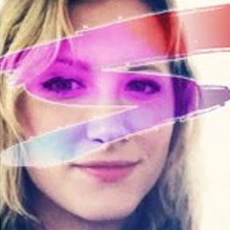
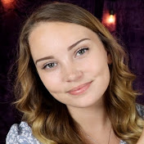

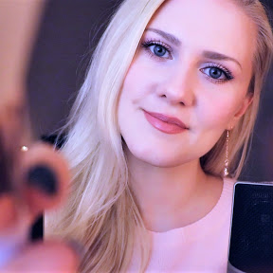
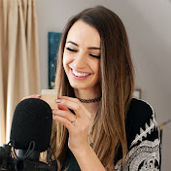
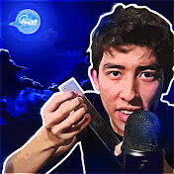
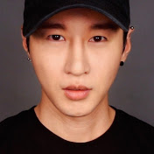

The Candidates
Notes:
To aid in my search I performed a Google search for the top ASMRtist on YouTube, and while there are different ASMRtist listed on the various blog sites on the internet, I chose eight other YouTubers to make comparisons.
Starting from the top left going across then bottom left and going across is how I will announce them; the first two are my subscriptions Tingting, and MassageASMR.
Then we have ASMR Requests, ASMR Darling, ASMR Surge, Gentle Whispering, Gibi ASMR, JOJO’s ASMR, Zach Choi ASMR, and WhisperRed ASMR
Now that I had the YouTubers I wanted to compare, I now needed to answer another question.
How was I going to answer my questions (on the previous slide);
Was there any (hidden) reason I subscribed to Tingting and MassageASMR; Would I like any of these other popular YouTubers just as much?
In order to make my comparisons I decided to perform topic modeling on each YouTubers top 10 most popular videos.

Slide 5
Webscraping
Tools
urllib (Python Standard Library)
BeautifulSoup
pytube
Regular Expressions
Notes:
To answer these questions I decided to perform topic modeling on the descriptions of each of the 100 videos. (Remember, top 10 most popular videos per YouTuber chosen)
I created two webscapers that made use of urllib library in the Python Standard library, as well as BeautifulSoup and a python package called pytube.
I gathered the urls of the top ten videos of each of these YouTubers, took the descriptions stored them in a dictionary and used regular expressions to extract the actual descriptions from the text and then combined the ten descriptions into a body of text for each YouTuber giving me a corpus.

Slide 6
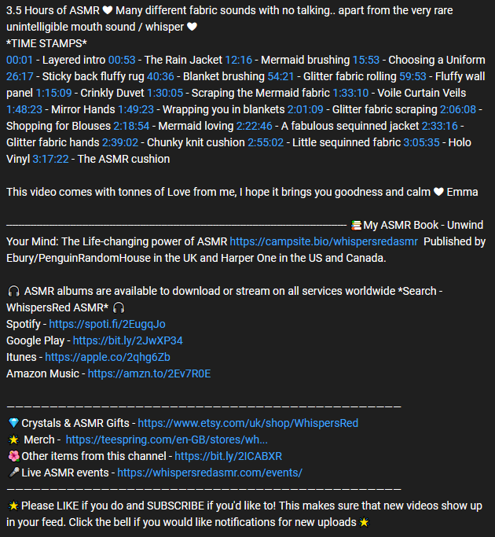
Webscraping
Notes:
This was easier said than done. As this screenshot of one of the descriptions show, the descriptions can be quite messy. In addition to the list of triggers that were included in the videos, many included links to social media sites and often times brief dialogs. While this screenshot from WhisperRed ASMR is fairly structured, many were not. As a result, I had to create ten functions (one for each ASMRtist) that used a series of regular expressions to get exactly what I wanted.

Slide 7
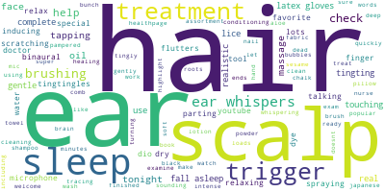
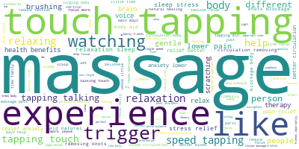
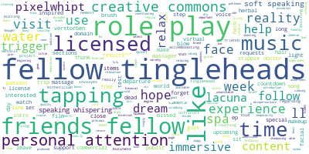
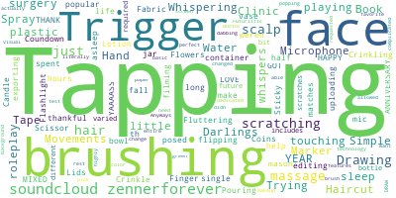
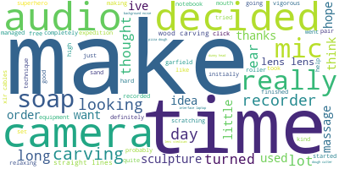
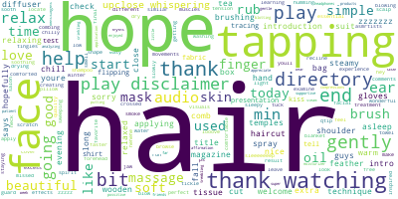
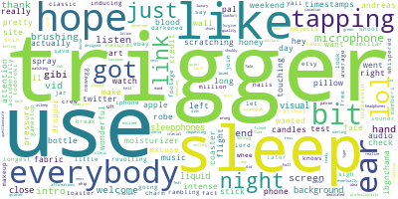
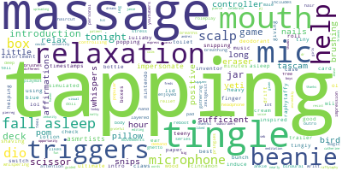
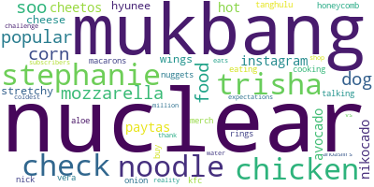
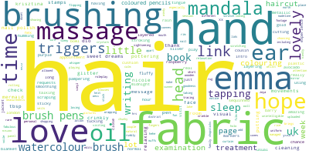
Word Clouds
Tingting ASMR
Massage ASMR
ASMRrequests
ASMR Darling
Gentle Whispering ASMR
Jojo’s ASMR
ASMRSurge
Gibi ASMR
WhispersRed ASMR
Zach Choi ASMR
Notes:
Once I had all the descriptions cleaned and stored, I took the corpora and created a document term matrix to perform the modeling. With the help of pandas, scikitlearn, and the python package appropriately named wordcloud, I was able to create these ten word clouds.
From the word clouds I immediately picked out a couple of triggers that are popular, that being tapping as a trigger and hair related triggers.

Slide 8
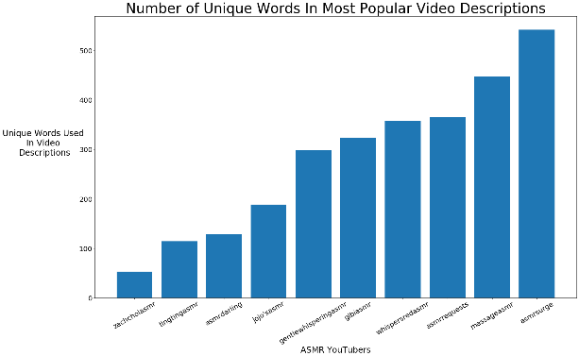
Length Of Descriptions
Notes:
I also decided to take a look at the number of words used in the descriptions as it relates to the videos. Perhaps the more or less I am explained as to what is going on in the videos the more I might be swayed to like an ASMRtist more. I don’t believe this to be the case as Tingting is on the lower end of words used for her descriptions and ASMRMassage is on the higher end.

Slide 9
The Topic Modeling
Topic Modeling Tools
pandas
scikit-learn (for stop words)
Natural Language Toolkit (NLTK)
gensim (LDA)
Notes:
To find any similarities among the small group of ASMRtist I chose, I started with a bag of words approach. This involved taking the corpuses I previously and creating a document term maktrix through the use of pandas and using stop words in scikit-learn.
I then used the natural language toolkit to filter verbs, nouns, and adverbs from the document term maxtrix as those parts of speech appeared most frequently when descripbing triggers related to videos.
Finally, I used the python library genism, to perform Latent Dirlchlet Allocation (LDA). LDA is a works by using probability distribution to group topics together until the topics presented make sense.
How does LDA work?
It’s all about probability distributions ( a mix of different things)
Choose the number of topics I think are
LDA will look at all words in the corpus and randomly assign a word to one of the topics.
Go through every word and its topic assignment in each document. Look at how often the topic occurs in the document and how often the word occurs in the topic overall. Based on this info assign the word a new topic.

Slide 10
The Topic Modeling
Topics
1) Positive Affirmations( thank, hope, help, gently)
2) Food/Eating Sounds
3) Tapping and Hair/Face Treatment
4) Many Brushing Triggers
5) Insomnia Help (commands such as relax and relief)
6) Vicarious Massages
7) Carpentry/Arts and Crafts and Props
ASMRtist Groupings
Topic 1 - Gentle Whispering ASMR
Topic 2 - Zach Choi ASMR
Topic 3 – Tingting ASMR, Gibi ASMR,
Topic 4 – WhisperRed ASMR
Topic 5 – Jojo’s ASMR
Topic 6 – MassageASMR
Topic 7 – ASMRRequests, ASMR Surge
Topic 3 and Topic 7 – ASMR Darling
Notes:
So the topics titles that I labeled after performing LDA are as follows:
1) Positive Affirmations( thank, hope, help, gently)
2) Food/Eating Sounds
3) Tapping and Hair/Face Treatment
4) Many Brushing Triggers
5) Insomnia Help (commands such as relax and relief)
6) Vicarious Massages
7) Carpentry/Arts and Crafts and Props
And the corresponding ASMRtist Groupings are…
If you disagree or are skeptical about these groupings please remember that these analyses are on the top ten most popular videos for each asmrtist, not on all the videos produced by each asmrtist.
As a side note I double checked all ten of the creators youtube channels to see how I did.
For the most part, I think that the modeling went well. Tingting was as expected and while crinkle heaven was not part of the top videos for MassageASMR, it does make sense that many of his top videos do In fact include massages.
The only issue I had was placing ASMR Requests into Topic 7. After looking through her channel, I probably would have placed her into either Topic 3, Topic 4, or a combination of the two. So the model itself I would say isn’t perfect, but still fairly accurate.

Slide 11
Answers
Why is it that I like these ASMR YouTubers so much that I would subscribe?
  Tingting ASMR is as expected
  ASMRMassage perhaps I also enjoy Vicarious Massages
Are there any other ASMR YouTubers I would like as much so as to subscribe?
  Gibi ASMR and ASMR Darling

Slide 12
Credits
Open Source Software
  Python3
  Scikit-learn, matplotlib, scipy, nltk, genism, and wordcloud
PyOhio 2018 – Alice Zhao
https://youtu.be/xvqsFTUsOmc
https://www.youtube.com/channel/UCyv-PL-QgkAXEfDRcKrYMeA
Bing Image Search
ASMRtist/YouTuber Thumbnails
Notes:
So this concludes my topic modeling for ASMR videos.
I would like to have some credits for this project. Again to complete this project I used several open source software. I used Python3, and the python libraries pandas, scikit learn, matplotlib, scipy, nltk, gensim and wordcloud.
The methods for the actual topic modeling were performed by Alice Zhao at pyOhio 2018 and on her youtube channel. Check out the links posted here.
The non-thumbnail photos were taken from the free for commercial use bing image search.
Finally , the thumbnails were used from each of the ASMRtists youtube channels, please take a look at them if you like ASMR. I believe ASMRtist, in addition to maving fun making the videos, are genially trying to help people relax and distress in a very stressful world, so please take a look at their channels.

