Slide 1
Matrix Multiplication & Cache Optimizations
By Jacob Cordano
September 22 2026

Slide 2
Overview
Measure the performance of three different matrix multiplication algorithms
Create two matrix multiplication algorithms; one with caching and another without
Evaluate their performance based on resulting benchmarks
Compare each algorithm against one another

Slide 3
Problem Statement
Given multiple sizes of matrices, how can we optimize them to make calculations faster
If we can already multiply two matrices with one algorithm, is there a way to rearrange it in a way that is more efficient, without sacrificing performance

Slide 4
Approach
Given three algorithms that compute the multiplication of identical matrix sizes, identify their performance
First evaluate a basic matrix multiplication implementation, then another with caching, and finally evaluate an implementation from OpenBLAS

Slide 5
DGEMM Basic
void square_dgemm(int n, double* A, double* B, double* C) {
for (int i = 0; i < n; i++) {
for (int j = 0; j < n; j++) {
for (int k = 0; k < n; k++) {
C[n * i + j] += A[n * i + k] * B[n * k + j];
}
}
}
}
The DGEMM Basic algorithm is a triple nested loop that iterates through the rows and columns of the input matricies.
The outer loop iterates through the rows of the first matrix, the middle loop iterates through the columns of the second matrix, and the inner loop iterates through the columns of the first matrix and rows of the second matrix.
The inner loop performs the multiplication and addition to store the output in the output array.

Slide 6
DGEMM Blocked
dgemm_blocked(n, block_size, A, B, C)
num_blocks = n / block_size
for i from 0 to num_blocks -1:
for j from 0 to num_blocks - 1:
C_cache = C[i, j]
for k from 0 to num_blocks - 1:
A_cache = A[i, k]
B_cache = B[k, j]
C_cache = C_cache + (A_cache * B_cache)
C[i, j] = C_cache
Reduces N * N into N_b * N_b blocks
Number of blocks is calculated as N / block size, where N is the size of the matrix and block_size is the size of the blocks. The number of blocks is used to determine how many times to iterate through the outermost loops

Slide 7
DGEMM BLAS
Originates from OpenBLAS
Uses the BLAS libarary from the GotoBLAS2-1.13 BSD version
Disregard first N = 64 for cache warmup

Slide 8
Methodology
Given the three matrix multiplication algorithms evaluate them all with N sizes of 64, 128, 256, 512, 1024, and 2048.
Capture total FLOPs at 2N^3
  For N multiplications and N-1 additions
MFLOPS/s is calculated by dividing the FLOPs by the elapsed time in seconds and multiplying by 1,000,000 to convert to millions of FLOPs per second

Slide 9
Metrics
MFLOP/s = 2N^3/(seconds * 10^6)
Timing
  Used std::chrono to compute elapsed run time
Matrix Test Sizes
  N = 64, 128, 256, 512, 1024, and 2048
Block Sizes
  N_b = 2, 16, 32, and 64

Slide 10
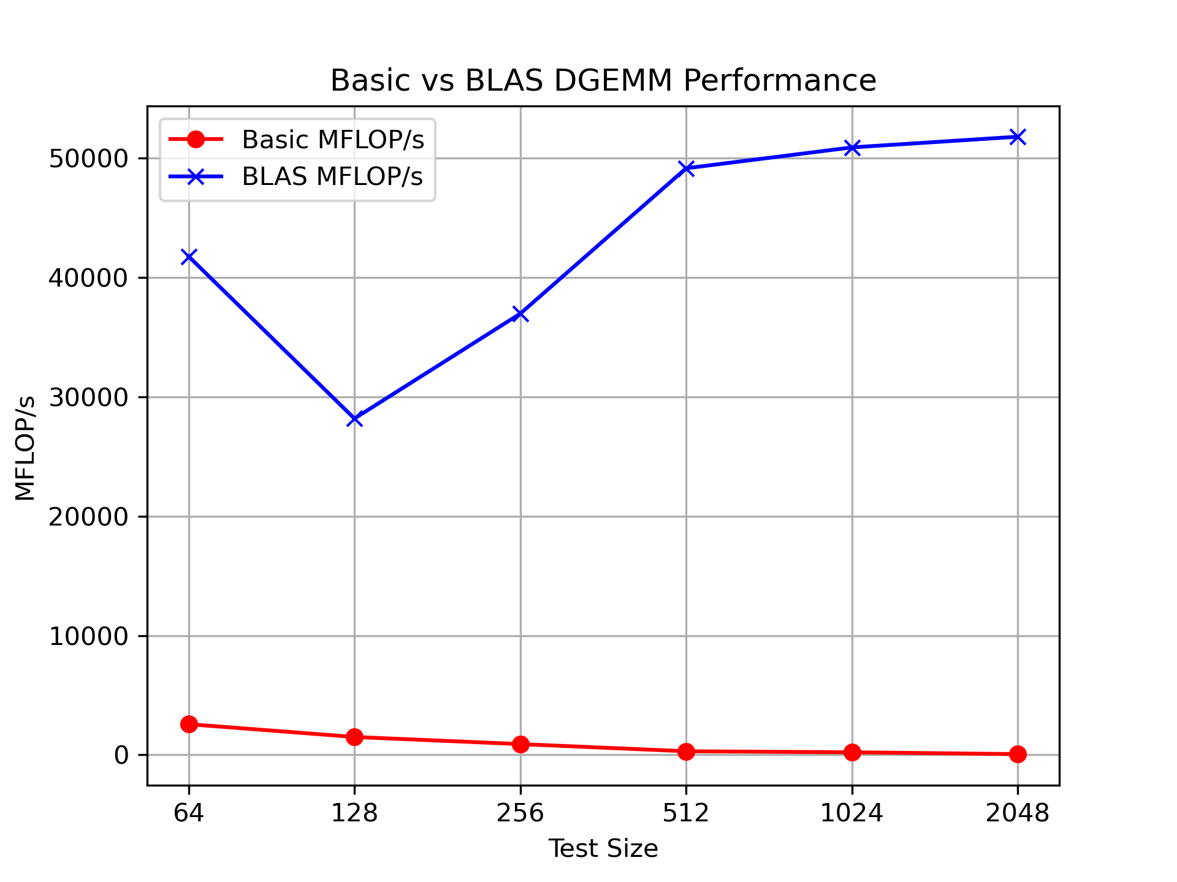
Basic Vs BLAS
BLAS outperforms basic in every test size
The highest performance in the Basic implementation is likely due to higher cache hit rate as the test size more closely aligns with cache size

Slide 11
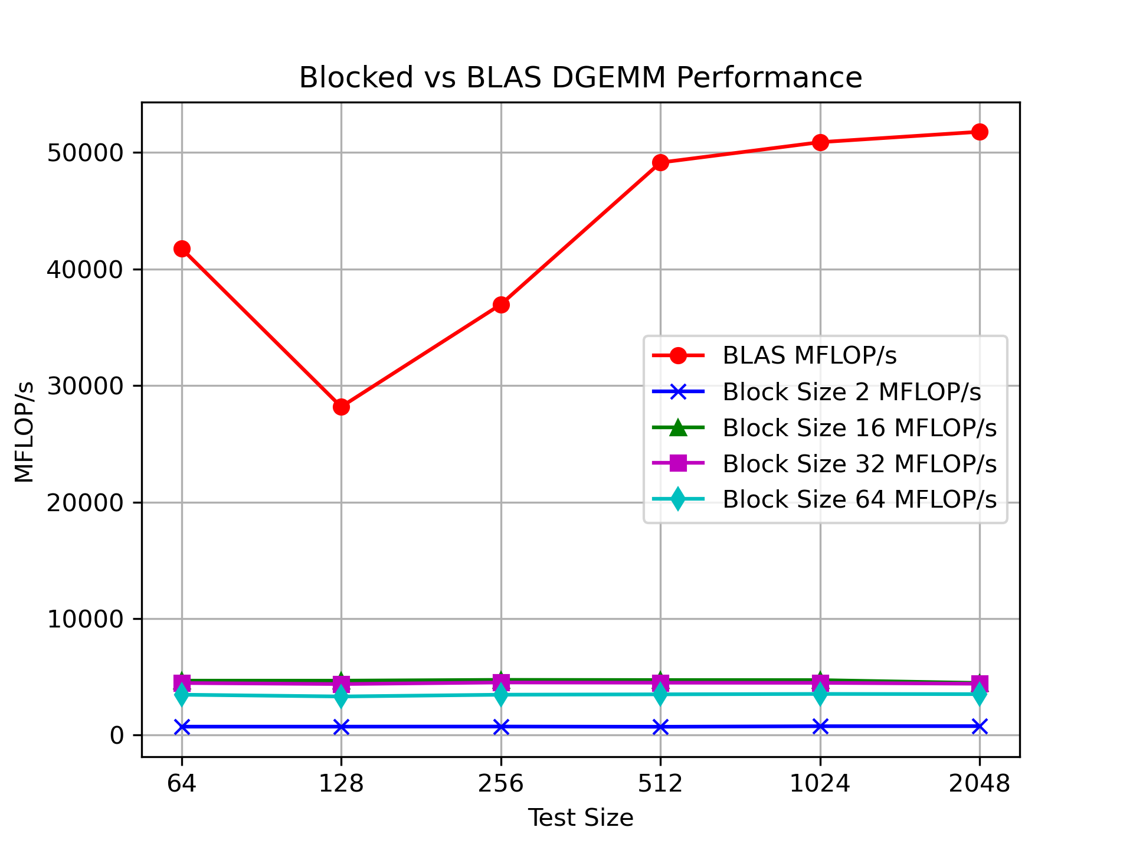
Blocked Vs BLAS
Once again BLAS optimizations outperform the Blocked implementation
We can notice block sizes 16 and 32 are the highest performers

Slide 12
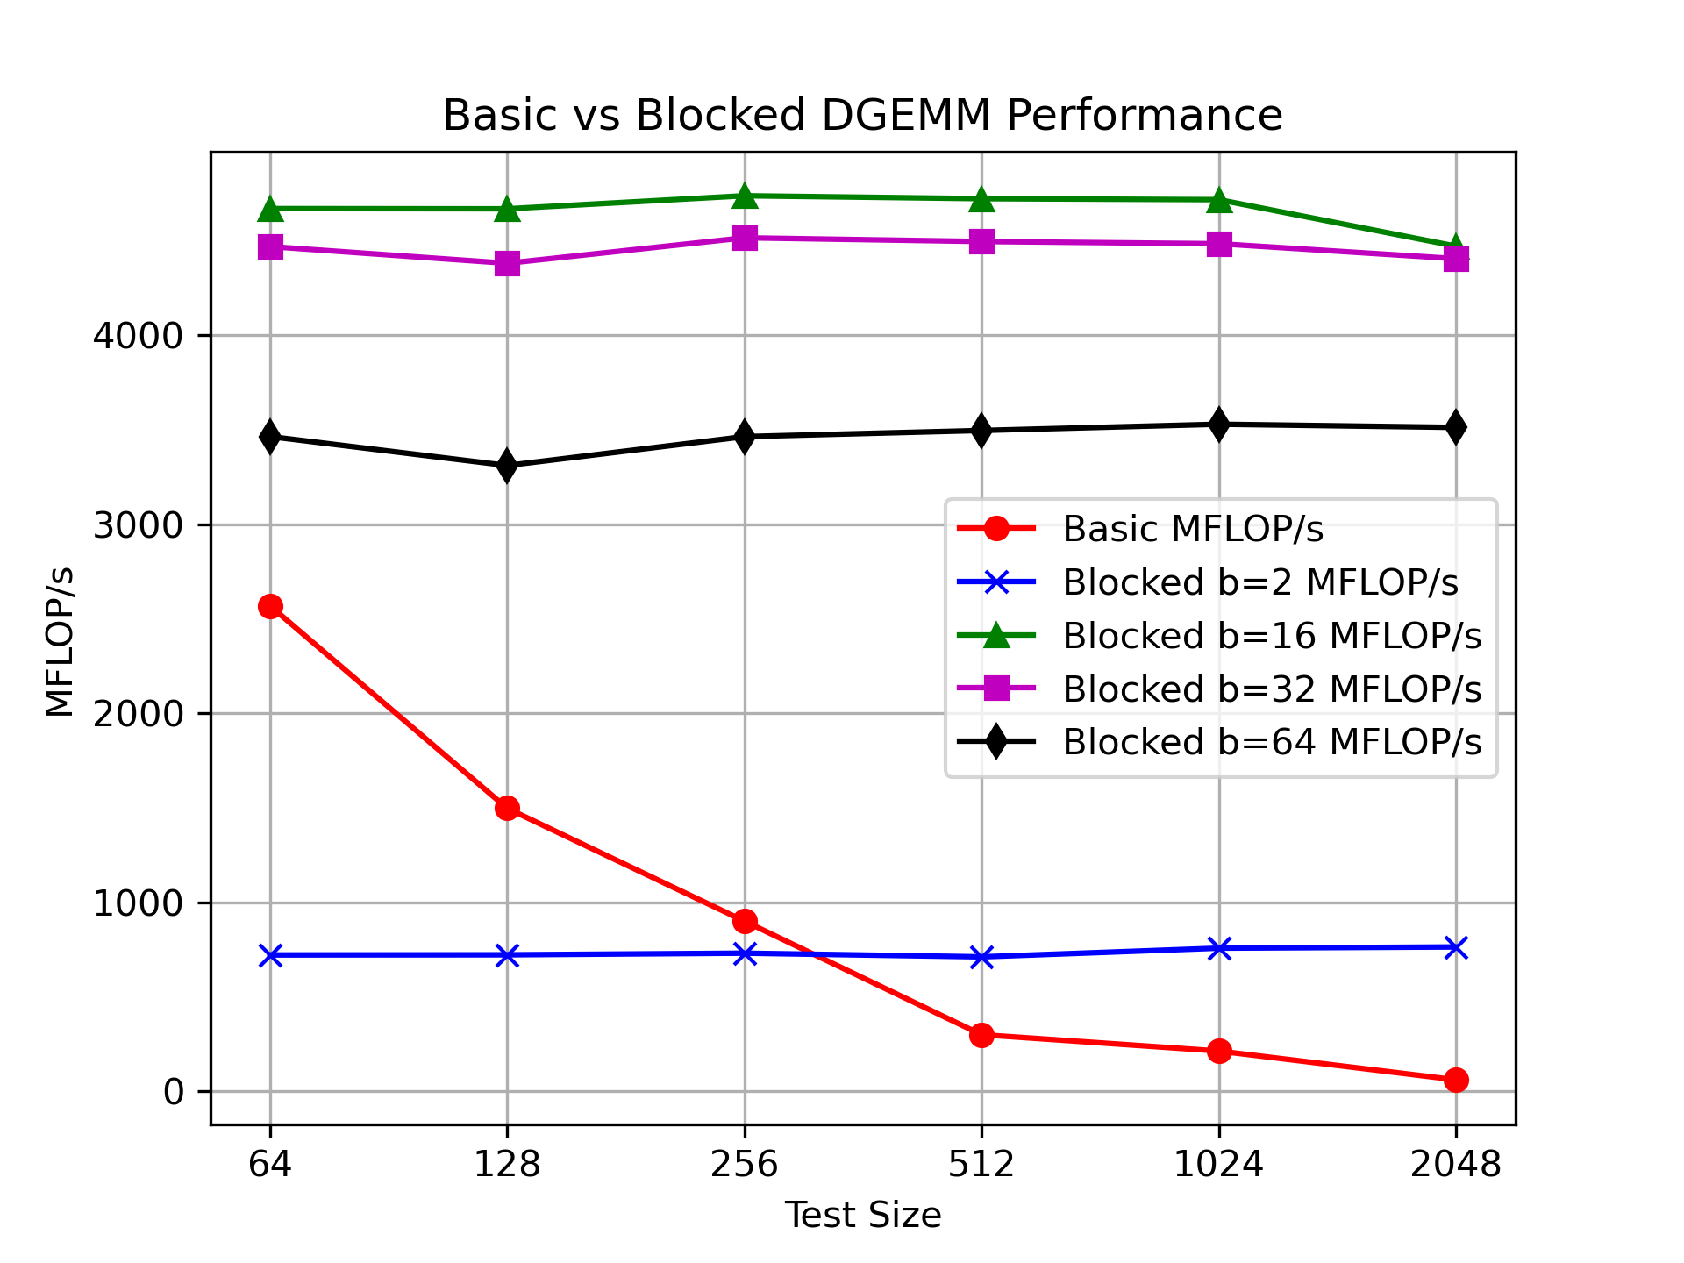
Basic v BLAS
L1 Cache Capacity: 32KB
Calculation: 3 * (B * B) * .008KB
  3 = A,B,C
  B = Block Size
B = 2: 0.1KB
B = 16: 6.14KB
B = 32: 24.58
B = 64: 98.3KB

Slide 13
Thank you

