Slide 1
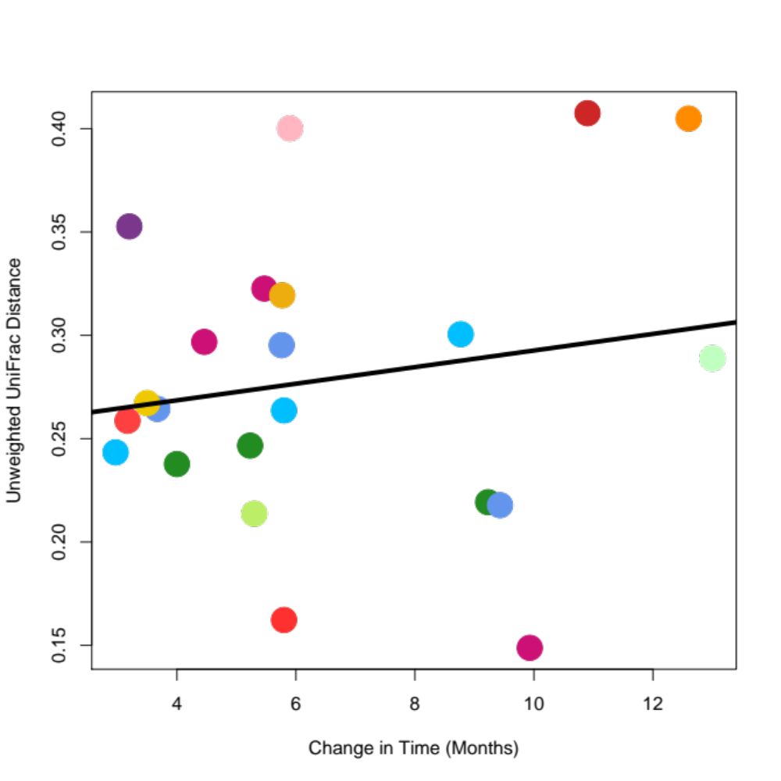
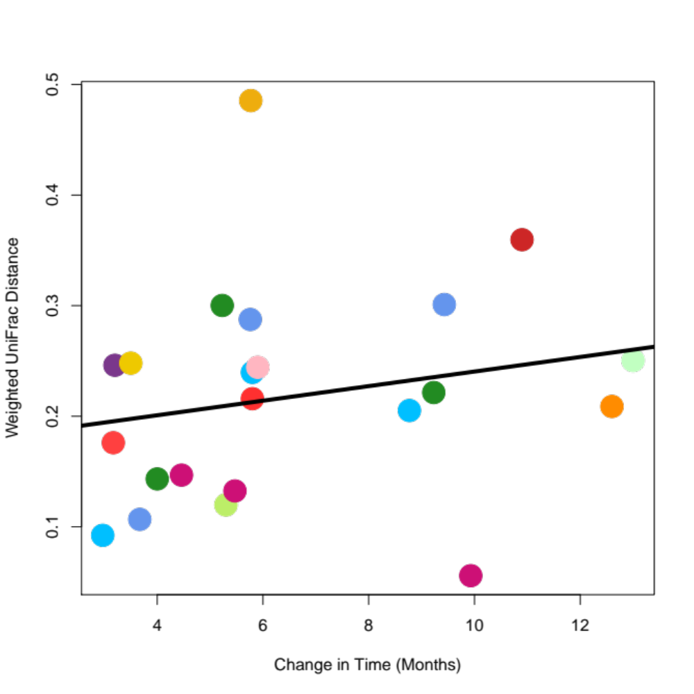
Unweighted UniFrac Distance
Weighted UniFrac Distance
Change in Time (Months)
Change in Time (Months)

