Slide 1
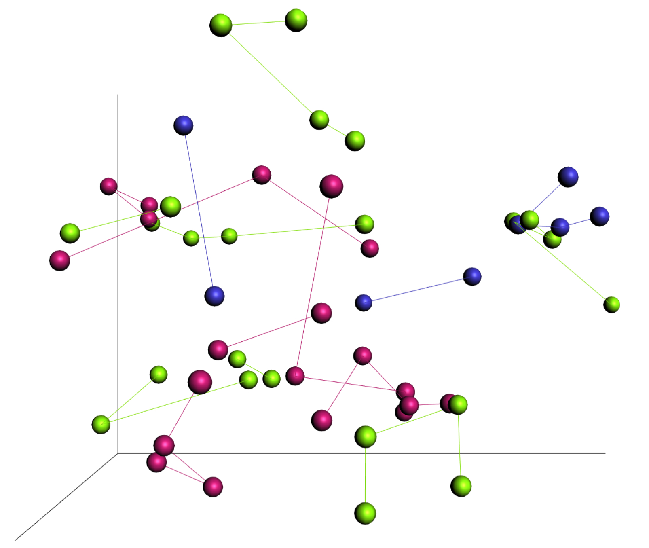
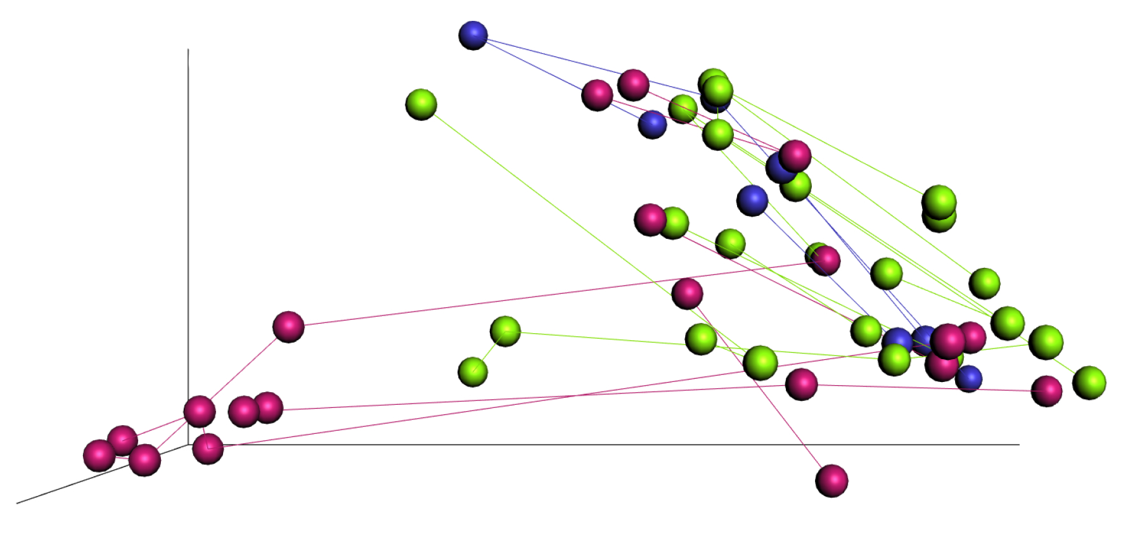
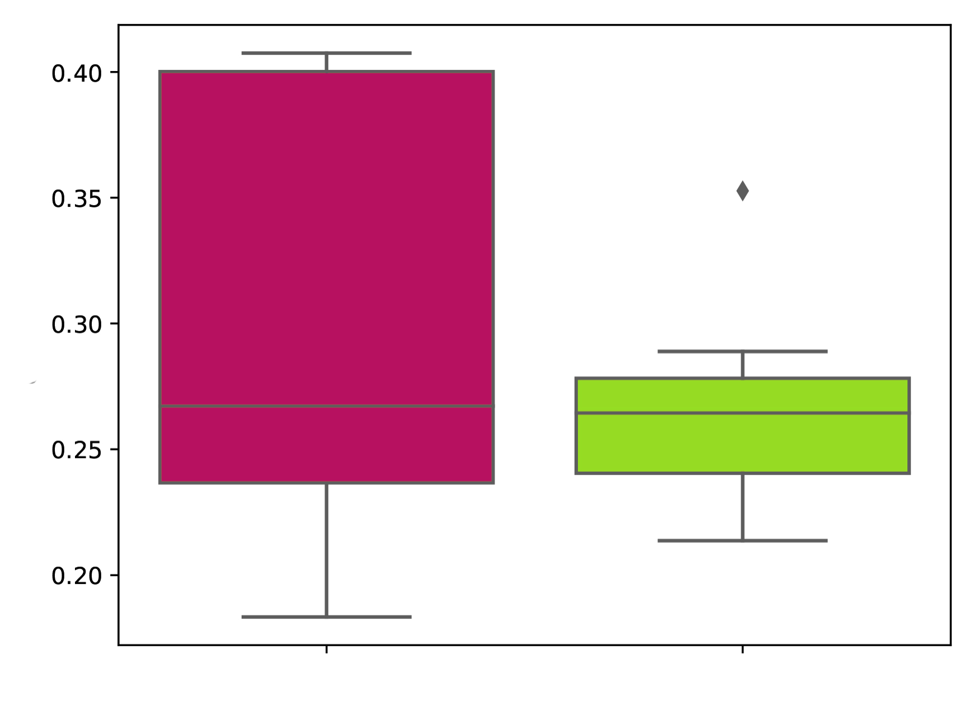
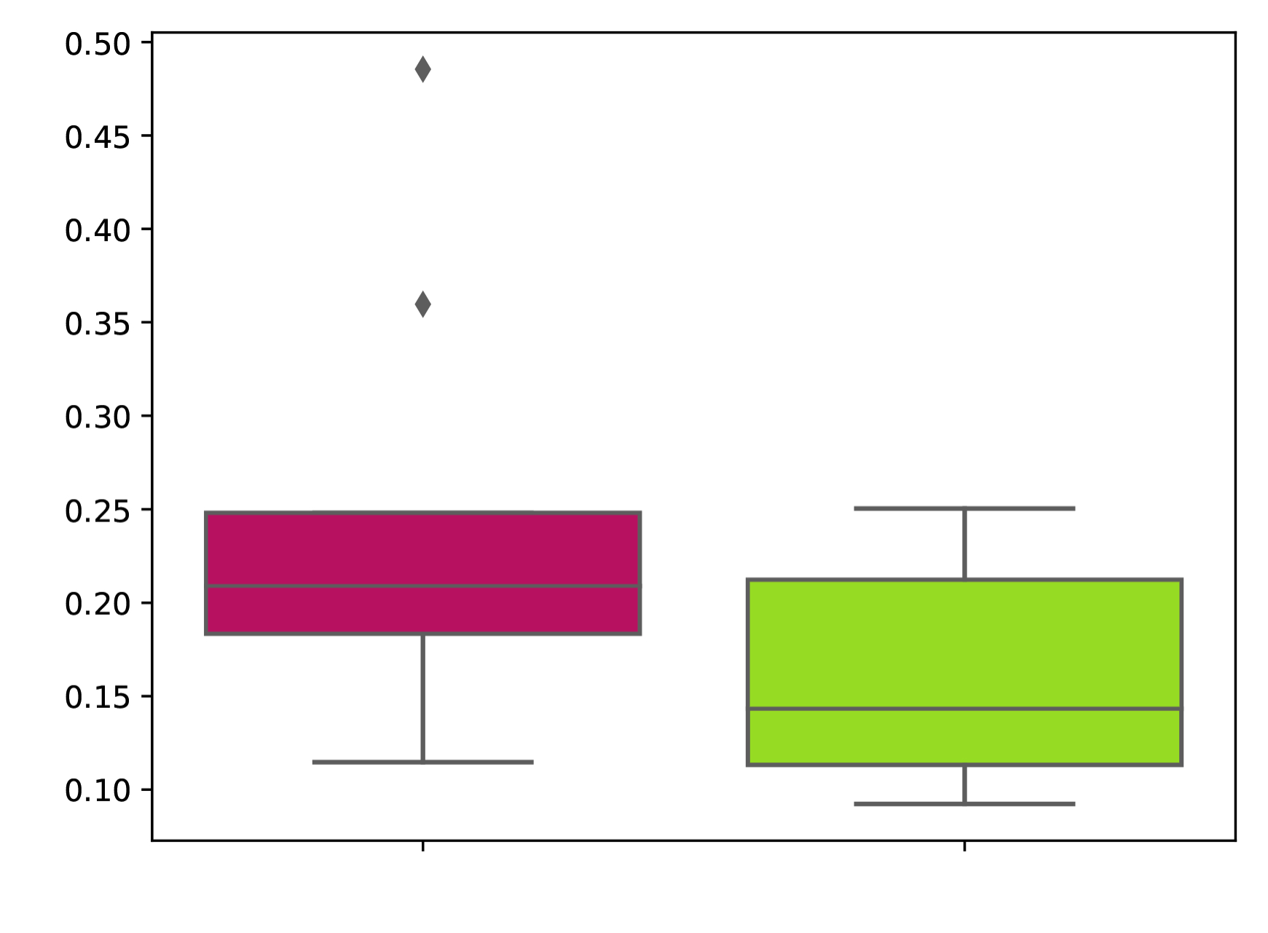
a)
ASD
NT
ASD Sibling
PC2 (9.7%)
b)
PC2 (12.1%)
PC1 (16.5%)
PC1 (45.9%)
PC3 (6.7%)
PC3 (10.0%)
c)
d)
NT (n=9)
ASD (n=7)
NT (n=9)
ASD (n=7)
Notes:
Figure X. Beta-diversity PCoA plots for ASD individuals, NT individuals, and ASD siblings and pairwise distance boxplots comparing beta-diversity changes for ASD and NT individuals. Beta-diversity analysis performed with a) the unweighted UniFrac metric and b) the weighted UniFrac metric where each individual’s samples are connected by vectors. Pairwise distance boxplots comparing beta-diversity changes for ASD and NT individuals between sampling days one and two using c) the unweighted UniFrac metric and d) the weighted UniFrac metric. PCoA = principal coordinates analysis.

