Slide 1

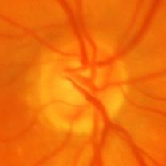
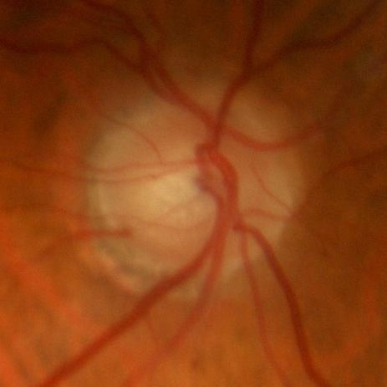
Machine Learning Models for Early Glaucoma Detection
Dawson Hillebrand, Bibin John, and Jonathon Machen
Computer Science, University of Houston
Abstract
Methods
Results
Glaucoma is an eye disease that can lead to vision loss, and even blindness, due to the damage of the optic nerve located at the back of the eye. The disease is the leading cause of blindness in people over the age of sixty. The good news is that glaucoma can be stopped, with early detection. This study aims to present a comprehensive analysis of glaucoma detection in retinal scans using a deep learning Convolutional Neural Network (CNN) and two machine learning algorithms: Support Vector Machines (SVMs) and Random Forests. This research will evaluate the performance of these models on a dataset of retinal scans comprising of both glaucoma and non-glaucoma cases.
For this research, 300X300 pixel retinal scans were used. The selected retinal scans came from the ACRIMA dataset, references to which can be found on the NIH National Library of Medicine’s website. Three different types of Machine Learning models were trained, validated, and tested on the dataset.
Random Forest:
Preprocessed images by applying rotation, shifts, and scaling, converted images into feature vectors and used PCA to reduce dimensionality. Finally, used GridSearchCV to find best parameters.
SVM:
Employed a linear kernel with the SVM, using flattened 128x128 grayscale images as features.
CNN:
Used the architectures InceptionV3, VGG16, VGG19, Xception, and a control hand-written Vanilla model with the optimizers Adam, Nadam, SGD, RMSProp, FTRL, Adadelta, and Adagrad.
SVM
Overall Accuracy: 73.53%
Random Forest
Overall Accuracy: 93.14%
CNN
(Average for all optimizers)
Vanilla
Overall Accuracy: 83.19%
VGG16
Overall Accuracy: 92.44%
VGG19
Overall Accuracy: 88.79%
InceptionV3
Overall Accuracy: 94.96%
Xception
Overall Accuracy: 96.78%
Conclusion
Previous Work
Based on the results of this research, the obvious best model was the Convolutional Neural Networks. From those, the best transfer learning architecture was the Xception architecture, which had an average accuracy of 96.78%, which is superior to the SVM and Random Forest models. Overall, 60% of all the transfer learning architectures and optimizers were a success (>= 93%).
Explainable Machine Learning for Glaucoma Diagnosis: This study developed a machine learning model for glaucoma diagnosis using clinical data and tests like RNFL OCT and fundus photography. The model, especially effective with the XGboost algorithm (92.4% accuracy), employed explainable AI techniques like SHAP for interpretation, marking a significant advancement in eye disease diagnosis.
Glaucoma Classification Using OCT Data:
Focusing on SD-OCT data, this research used clustering methods like k-means and hierarchical analysis to classify eyes as healthy or glaucomatous. The model-based clustering method proved most accurate (91.7%), demonstrating the effectiveness of clustering algorithms in understanding glaucoma through SD-OCT parameters.
Future Direction
Bouncing off from this research, the logical next steps would be to use OCT scans, which are taken from a different angle than retinal scans and use those to classify a wider array of diseases, including Diabetic Retinopathy, Age-related Macular Degeneration, Glaucoma and a whole list of others.
Acknowledgments
We thank Dr. Rizk for her insightful guidance in our Data Science 2 class, and the University of Houston for the supportive academic environment. Special appreciation goes to the staff and peers in the Department of Computer Science for their valuable contributions to our research.

