Slide 1
OBJECT ORIENTED WEB PROGRAMMING USING RUBY
Day 7: 25/May/2017
Merge the design

Slide 2
Let us introduce Chat Module
Reference:
http://guides.rubyonrails.org/action_cable_overview.html
Method:
Step 1: make another clone for you to trace the command.
Step 2: Introduce Chat Sample / gem update
Confirm that every member can run the server.
Step 3: Use Okane’s sample to merge design.
How to introduce?

Slide 3
Step 1: make another clone
Purpose:
When you clone the project master, you have no chance to modify the rails project by yourself. So, make another clone to try the rails command on the copy.
mkdir trial
cd trial
git clone https://github.com/webdbhosei/ScopsOwl.git

Slide 4
Gemfile update
Last week, I had added the following
# gem 'i18n-tasks'
This had caused another gem’s installation problem, so I had commented out.

Slide 5
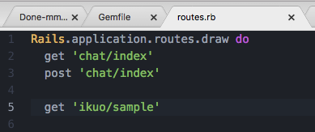
Step 2 : Chat introduction
Generate the chat controller
rails g controller chat index
rails g channel chat
Modify the routing Path
get 'chat/index'
post 'chat/index'

Slide 6
app/channels/chat_channel.rb
class ChatChannel < ApplicationCable::Channel
def subscribed
stream_from "chat:message"
end
def unsubscribed
# Any cleanup needed when channel is unsubscribed
end
def put_message (msg)
ChatChannel.broadcast_to('message', msg['data'] )
end
end

Slide 7
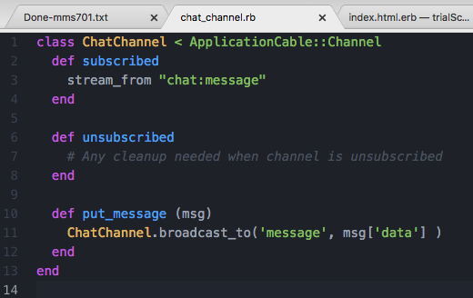
app/channels/chat_channel.rb

Slide 8
app/views/chat/index.html.erb
<h1>Chat#index</h1>
<p>Find me in app/views/chat/index.html.erb</p>
<%= form_tag 'index', id: 'message' do %>
<%= text_field_tag 'body' %>
<% end %>
<ul id="message-list">
</ul>

Slide 9
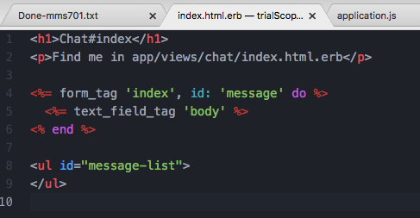
app/views/chat/index.html.erb

Slide 10
app/assets/javascripts/application.js
window.addEventListener('load', ()=> {
document.getElementById('message').onsubmit = () => {
App.chat.put_message(document.getElementById('body').value);
return false;
}
});

Slide 11
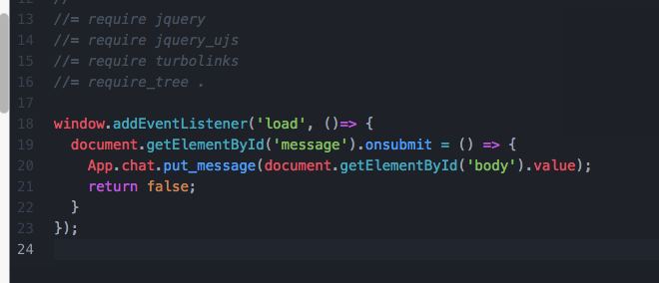
app/assets/javascripts/application.js

Slide 12
app/assets/javascriopts/channels/chat.coffee
App.chat = App.cable.subscriptions.create "ChatChannel",
connected: ->
# Called when the subscription is ready for use on the server
disconnected: ->
# Called when the subscription has been terminated by the server
received: (data) ->
li = document.createElement('li')
li.textContent = data
document.getElementById('message-list').appendChild(li)
# console.log(data)
# Called when there's incoming data on the websocket for this channel
put_message: (msg) ->
@perform('put_message', { data: msg })
return

Slide 13
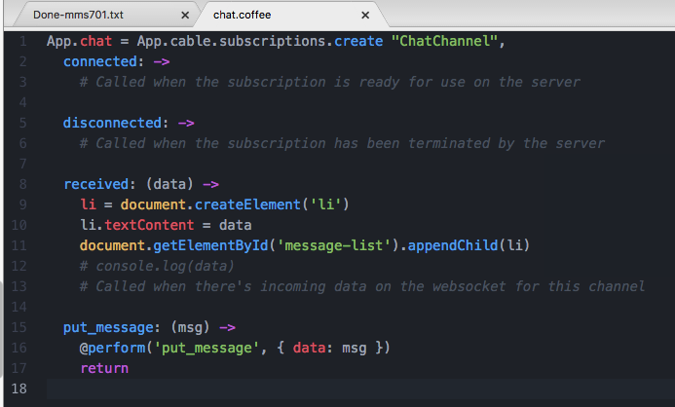
app/assets/javascriopts/channels/chat.coffee

Slide 14
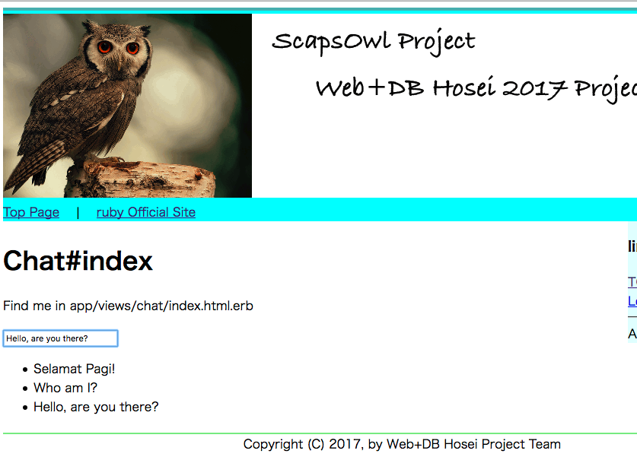
Test Run

Slide 15
Mission : Make this Chat a library
(1) Relocate this chat screen to the _right_bar if possible.
(2) Refacter this chat, to make this a library, so that other members can use.
Next week:
(1) Introduce login to identify the user.
(2) Bind the chat message to the speaker
(3) save the chat messages to database.

Slide 16
Step 3 : bind Okane’s sample
Everyone, generate the blank model, skeleton, and blank views in each project.
Do it one by one, to avoid the unnecessary conflict in our project.
Note: View designer will generate controller.
Hatuka-k will ‘pull’ those changes.

Slide 17
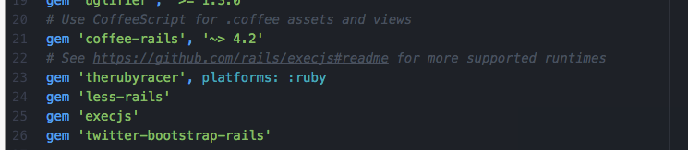
Bind bootstrap into rails
Update Gemfile
Add the following line;
gem 'less-rails'
gem 'execjs'
gem 'twitter-bootstrap-rails'
Then bundle install.

Slide 18
Install bootstrap
rails g bootstrap:install less
Now, check bootstrap classes
Also, check LESS, and SASS

Slide 19
Generate your own portal
rails g controller your_handle index
Then, submit pull request to me.
Let us try and see how it works.
Now I will(should) face with the routes.rb conflicts, if you successfully generated your own portal.

