Slide 1
Snake Solving AI
James Sipowicz, Val Puente
Texas State Software Engineering Project
Spring 2021, Dr. Rodion Podorozhny
5/6/2021

Slide 2
Snake AI Structure
Long Short-Term Memory:
Recurrent Neural Network with gates that train a short memory and long memory.
Learns when to use the short memory and when to use long memory.
Neural Network:
Input Layer = 11, Hidden Layer = 256, Output Layer = 3.
Input Layer: Danger left, Danger right, Danger Straight ahead, Snake Direction, and Food Position relative to snake.
Output Layer: Three possible actions: Turn Left, Turn Right, Keep Straight.
Q-Table (numpy.array)
utilized to manage the decision making process of considering inputs and making actions.

Slide 3
Important Variables Defined
Learning Rate (LR) :
often referred to as alpha or α, is the hyperparameter that controls how much to change the model in response to the estimated error each time the model weights are updated.
Discount Rate (Gamma) :
determines how much the learning agent cares about rewards in the distant future relative to those in the immediate future
Randomness (Epsilon)
value that determines how much we explore in an epsilon-greedy policy
Snake takes random actions at the beginning and start using learned behaviour later on.

Slide 4
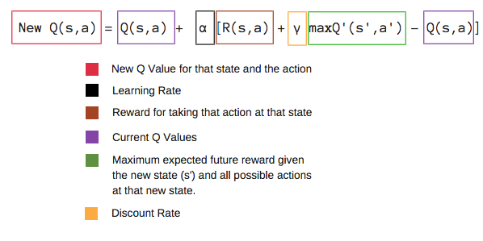
Equations : Bellmen Q-Learning

Slide 5
OOP and Encapsulation
Four main components :
Snake Game
Main Menu (TkInter interface)
Neural Network
Scoreboard
The components were separated into different classes because that assisted in individual testing for features down the line.

Slide 6
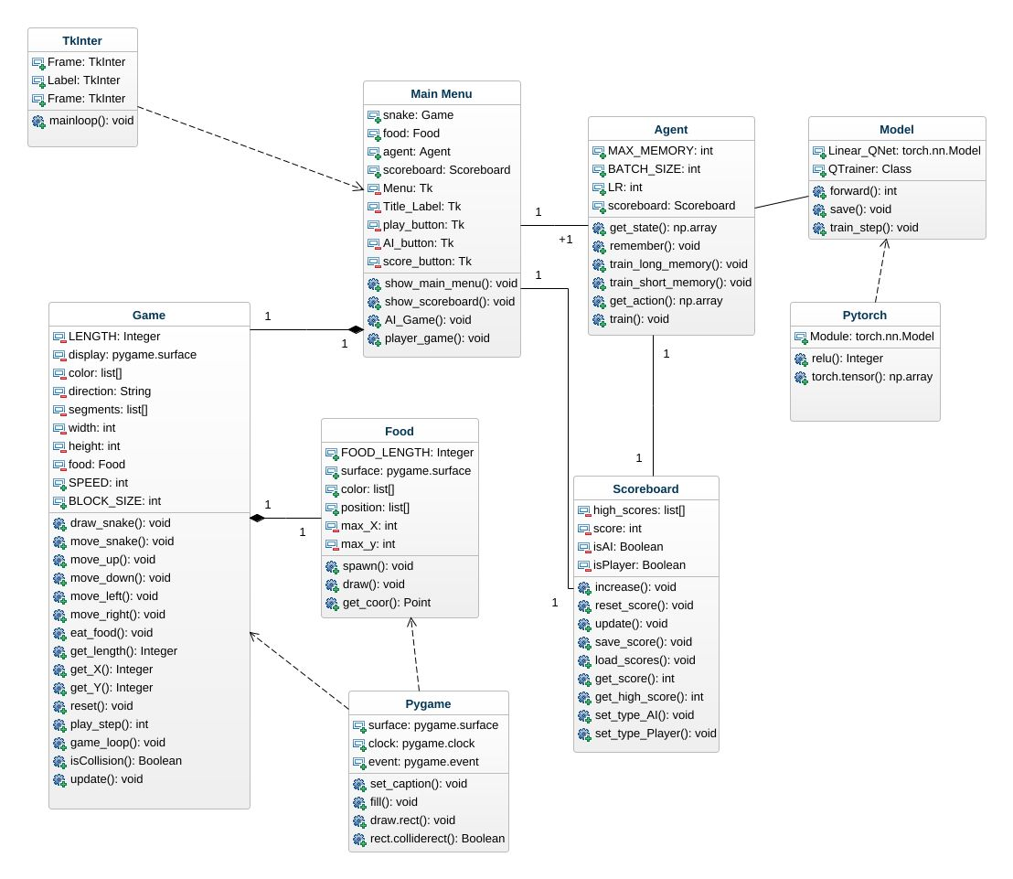
Application Structure
Main Menu uses TkInter for the interface and has a Game object, Agent (AI) object and Scoreboard Object.
Agent has a private model object hidden to all other classes. The model itself uses PyTorch’s neural network functionality.
The Game object has an instance of Food and depends on Pygame for drawing and collision. Receives Scoreboard from Menu to use public methods.

Slide 7
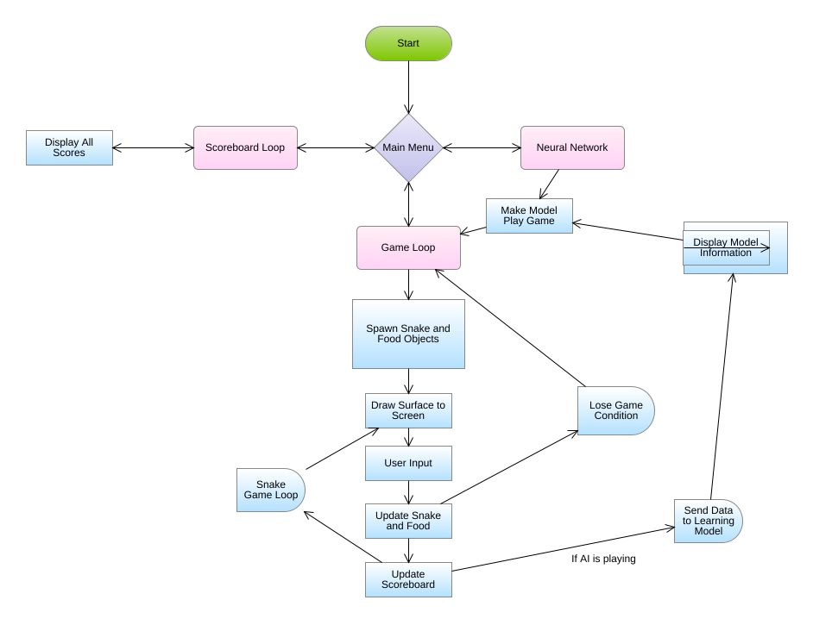
Statechart
Fairly simple loop.
AI will keep playing and learning until the game is manually stopped.
Users can play the snake game themselves.

Slide 8
Main Game State Pitfalls:
Snake traversing into its own loop
During testing and supervision, we noticed that the largest pitfall our snake AI experiences is a game state where the snake decides to turn towards the direction of a spawned food, even though it’s body is in between.
In turning this direction / orientation, it inadvertently traps itself by changing direction in a loop of its own body which is most times impossible to traverse out of.

Slide 9
Trying to solve the Pitfall:
We were unable to devise a solution to tackle the game state issue.
If a solution was found, our AI would be more efficient in learning, would gain higher scores , and would survive for longer.
We tried to implement a solution to tackle this pitfall where we tracked the tail and middle of the snake, along with how many turns the snake body has so that it could detect escape a potential body trap.
This approach proved to be extremely resource expensive, causing the performance of our snake to decrease drastically.

Slide 10
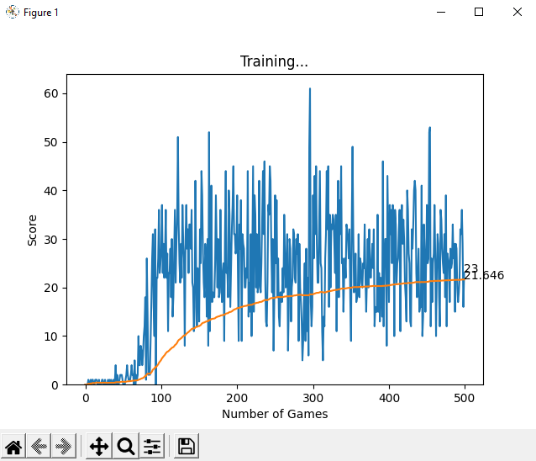
Example Game Run # 1
Gameframe size : 400 x 400
# of Games Ran : 500
Learning Rate : 0.001
Discount Rate : 0.9
Epsilon (Randomness) : 0
RESULTS
High Score : 61
Mean Game Score : 21.6
Displays O = log ( n ) Average Score Improvement

Slide 11
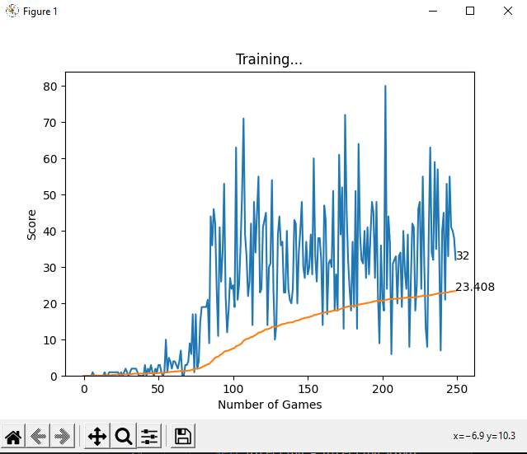
Example Game Run #2
Gameframe size : 600 x 600
# of Games Ran : 250
Learning Rate : 0.001
Discount Rate : 0.9
Epsilon (Randomness) : 0
RESULTS
High Score : 80
Mean Game Score : 23.4

Slide 12
Effects of changing the Game Frame size
After juxtaposing the results of our two example trials:
We see that the larger the game frame, we are able to achieve higher record scores, with higher average mean score improvement, with half of the number of games played
The pitfall of the Snake traversing into its own loop occurs more in games with a smaller frame because the snake is more congested, and has less options of escape than it would if the frame was larger.
Games with larger frames take much longer to complete compared to games with a smaller frame.

Slide 13
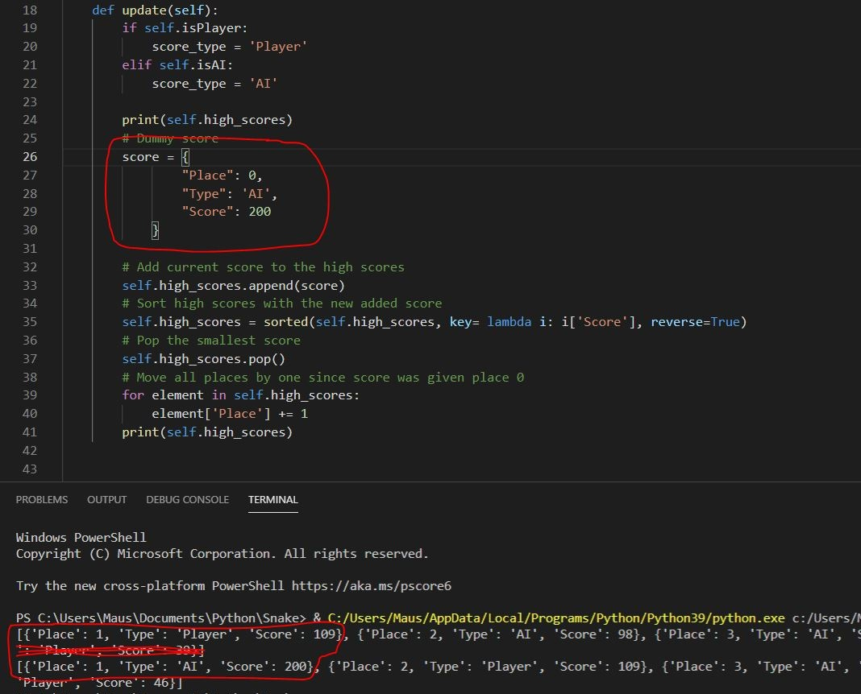
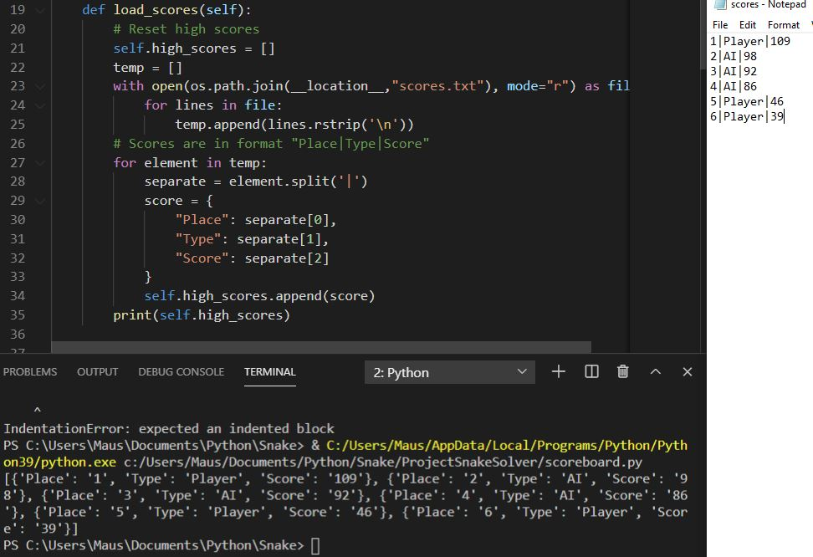
Scoreboard testing
Testing that the scoreboard loads and formats scores properly.
AI not implemented yet. Dummy variables used for testing.

Slide 14
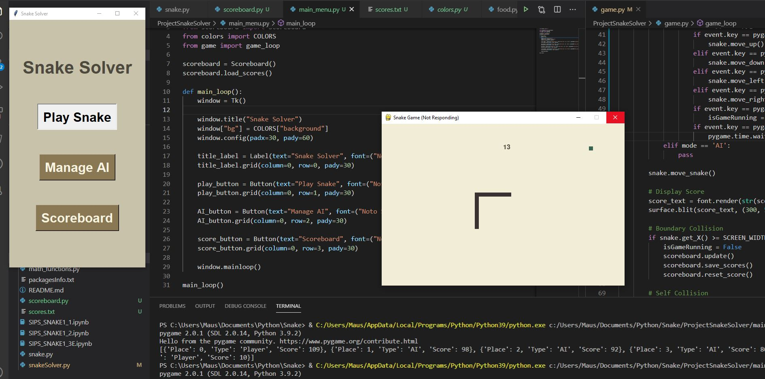
Interface testing
Minimal testing required; with TkInter you get what you see on the screen.

Slide 15
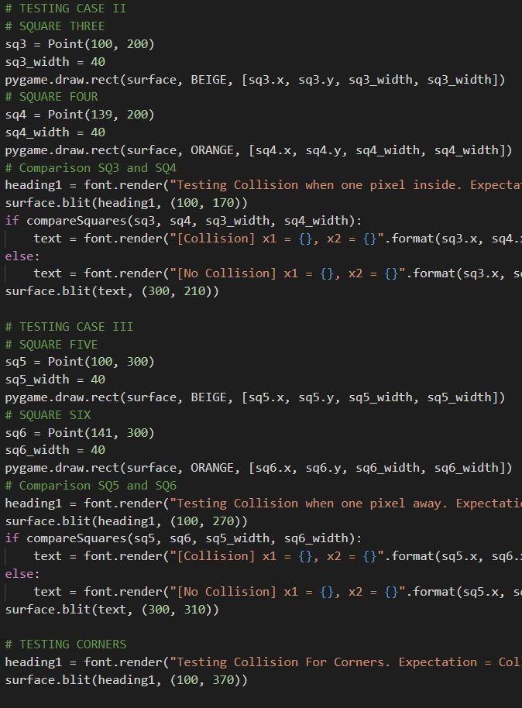
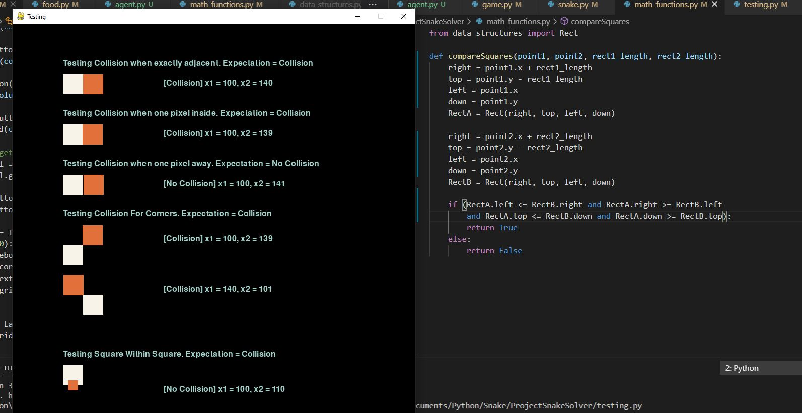
Snake Game Testing
At first created collision test ourselves. Due to the way PyGame lays out y coordinates ( 0 at top, MAX_RES at bottom, a strange bug appeared.
After reading PyGame’s documentation we found a dedicated collision test function.

Slide 16
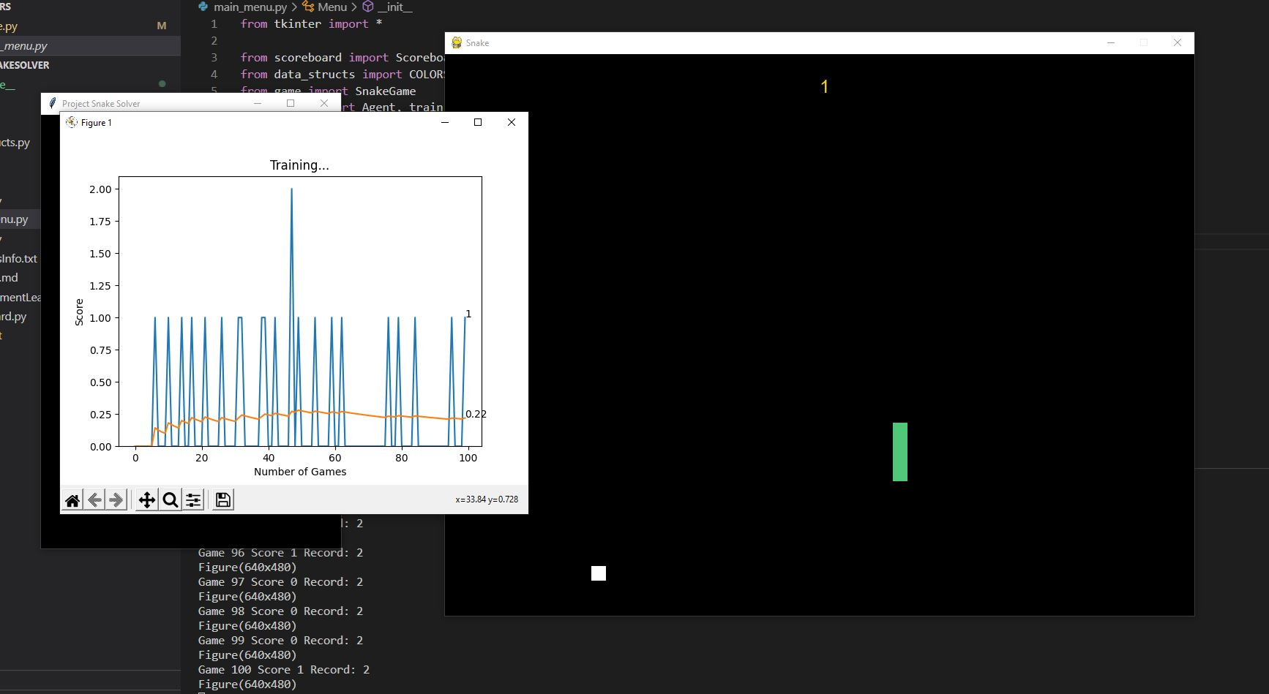
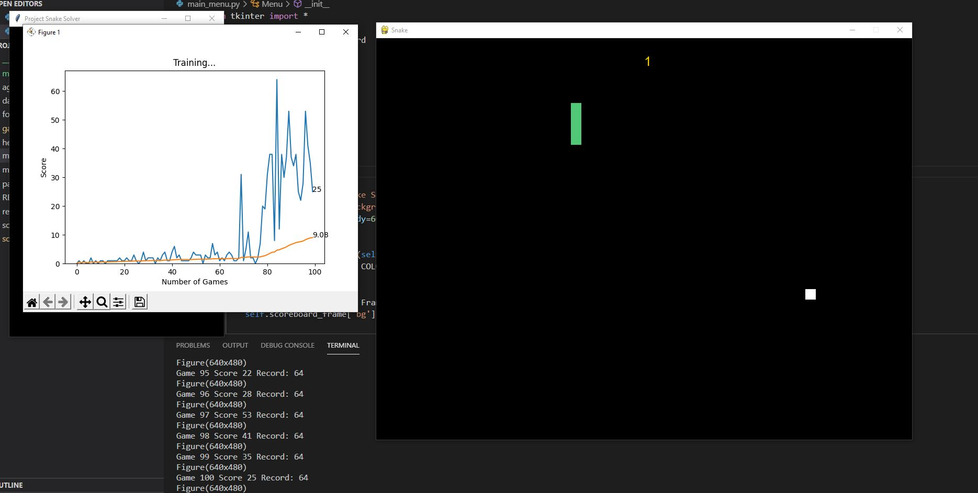
AI Testing
After feedback came up with improved reward system: positive reward if the snake is closer to the food, negative reward otherwise.
Minimal performance increase in small spaces with less exploration; massive performance increase in large spaces where with more exploration.
First reward system. In 1024x768 res performed with mean of 0.22 over 100 iterations.
Second reward system. In 1024x768 res performed with mean of 9.03 over 100 iterations.

Slide 17
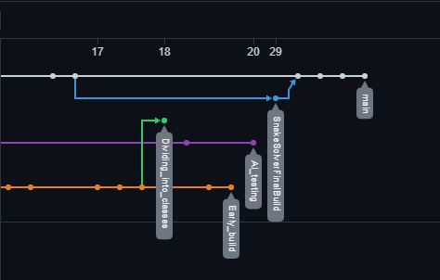
Github contributions
Additional branches focused either on the AI system, the snake game, or the interface.

