Slide 1
Impact of COVID-19 on
ABC Company's Parcel Business
Executive Presentation | Programming for Data Science Final Project
James Tampanga & Wilfred Nnamuchi S. | Saskatchewan Polytechnic | 2026

Slide 2
Study Objectives
📦 Main Question
📅 COVID Timeline
How did COVID-19 impact ABC Company's parcel delivery volumes and revenue?
When were volumes first impacted? What Canadian events drove the changes?
📈 Peak Season
🏢 Customer Segments
How did the unprecedented 2020 peak season compare to 2019?
How were Enterprise, Large, Medium, and Small clients affected differently?
ABC Company Parcel Business Analysis
2

Slide 3
Executive Summary
Impact of COVID-19 on ABC Company Parcel Business | 2018–2020
COVID-19 Triggered an Unprecedented Volume Surge
Revenue Grew by $368M During the COVID Period
Total 2020 parcel volume reached 73.5M parcels; up 39.1% over 2019. The surge began at Week 12 (March 16, 2020) when Canadian lockdowns took effect and peaked at +127.9% YoY by Week 16. Volumes never returned to 2019 levels for the rest of the year, confirming a permanent structural shift to e-commerce.
ABC Company generated $1.135B in revenue during the COVID observation period (W12–W53, 2020), a 48.0% increase over the $767M earned in the same 2019 period. Small customers recorded the highest growth rate at +62.3%, while Enterprise customers drove the largest absolute revenue gain.
Customer Retention Was Near Perfect Across All Segments
2020 Peak Season Delivered a Record 19.4M Parcels
55.4% of all customers were classified as High Growth during COVID. Only 26 of 1,061 customers stopped shipping entirely, a 97.5% retention rate. Enterprise and Large segments retained 100% of their accounts. Notably, zero new customers were acquired, confirming COVID deepened existing relationships rather than attracting new ones.
The 2020 holiday peak season (November to January) shipped 19.4M parcels — 26.5% more than the 15.4M recorded in the 2019 peak season. Every single week of the 2020 peak outpaced its 2019 equivalent. Week 49 alone recorded nearly 3M parcels, the highest single-week volume in the dataset.
ABC Company Parcel Business Analysis | James Tampanga & Wilfred Nnamuchi | Saskatchewan Polytechnic | 2026
3

Slide 4
Dataset & Customer Segmentation
190,719
1,061
2018–2021
$22.00
Total Records
Unique Customers
Years Covered
Base Parcel Price
Customer Groups — Classified by 2019 Annual Volume
Customer Group | 2019 Volume Definition | Discount | Price/Parcel | # Customers
Enterprise | > 500,000 pieces | 22% | $17.16 | 12
Large | 200,000 – 500,000 | 17% | $18.26 | 15
Medium | 10,000 – 200,000 | 10% | $19.80 | 174
Small | 1,000 – 10,000 | 4% | $21.12 | 860
📌 We classify customers using their 2019 volume only — using 2020 figures would mix the classification with the impact we are trying to measure. Enterprise customers (12 in total) account for most of the volume despite being the smallest group in number.
ABC Company Parcel Business Analysis
4

Slide 5
Customer Segmentation — 2019 vs 2020 Classification
📌 Applying the same classification thresholds to 2020 volumes reveals that COVID pushed many customers into higher tiers. This has real implications — contracts signed pre-COVID may need renegotiation to reflect the new volume reality heading into 2021.
ABC Company Parcel Business Analysis
5

Slide 6
Question — How did COVID-19 impact ABC Company's parcel business?
Annual Volume: The 2020 Surge
2019
52.8M
+7.6% YoY
2020
73.5M
+39.1% YoY
-33.7% YoY
📌 2020 stands out immediately — a 39% jump in a single year is unprecedented. The pre-COVID growth trend from 2018 to 2019 was a steady 7.6%.
ABC Company Parcel Business Analysis
6

Slide 7
Question - When were customer volumes first impacted?
Weekly Volume 2019 vs 2020
⚑ W12: COVID
Lockdowns Begin
📌 The two lines track almost identically until Week 12. The divergence is sharp and immediate — by Week 16 we are at +128% YoY. This is not gradual; it is a structural shift. Notice also that 2020 never returns to 2019 levels for the rest of the year, confirming that e-commerce adoption was permanent, not temporary.
ABC Company Parcel Business Analysis
7

Slide 8
Question - How did COVID impact peak season in 2020?
Peak Season 2019 vs 2020
2019 Peak Season
(Nov 4, 2019 – Jan 20, 2020)
2020 Peak Season
(Nov 2, 2020 – Jan 17, 2021)
15.4M
19.4M
+26.5%
Parcels Shipped
Parcels Shipped
📌 Every single week of the 2020 peak season outpaced 2019. The biggest gap is at W49, nearly 3M parcels in a single week versus 2.5M the year before. This is the direct result of consumers shifting holiday shopping entirely online during lockdowns.
8

Slide 9
Question - What events within the COVID timeline contributed to the change?
COVID Timeline: Key Events COVID Timeline: Key Events & Volume Impact
W11 · Mar 11
W14 · Mar 30
W45 · Nov 2
WHO
Pandemic
Declaration
CERB
Introduced
(Income Support)
2020 Peak
Season
Begins
Vol: +0.9%
Vol: +64.6%
Vol: +17.2%
W12 · Mar 16
W16 · Apr 13
Canadian
Provincial
Lockdowns
Essential
Services
Only Orders
Vol: +11.9%
Vol: +127.9%
YoY volume changes shown relative to the same week in 2019. ISGR (pre-COVID baseline) = +11.4%
9

Slide 10
Question - How has COVID affected companies in the different customer groups? (1/2)
Volume by Customer Segment: 2019 vs 2020
Full-year volume growth 2019 → 2020:
Enterprise: +38.3%
Large: +34.2%
Medium: +41.8%
Small: +51.9%
📌 Enterprise customers ship 73% of all parcels despite being just 12 accounts. Small customers grew the fastest at +51.9% — a sign that many SMBs launched or expanded e-commerce for the first time during COVID. Every segment grew, confirming this was a market-wide shift, not an individual account effect.
ABC Company Parcel Business Analysis
10

Slide 11
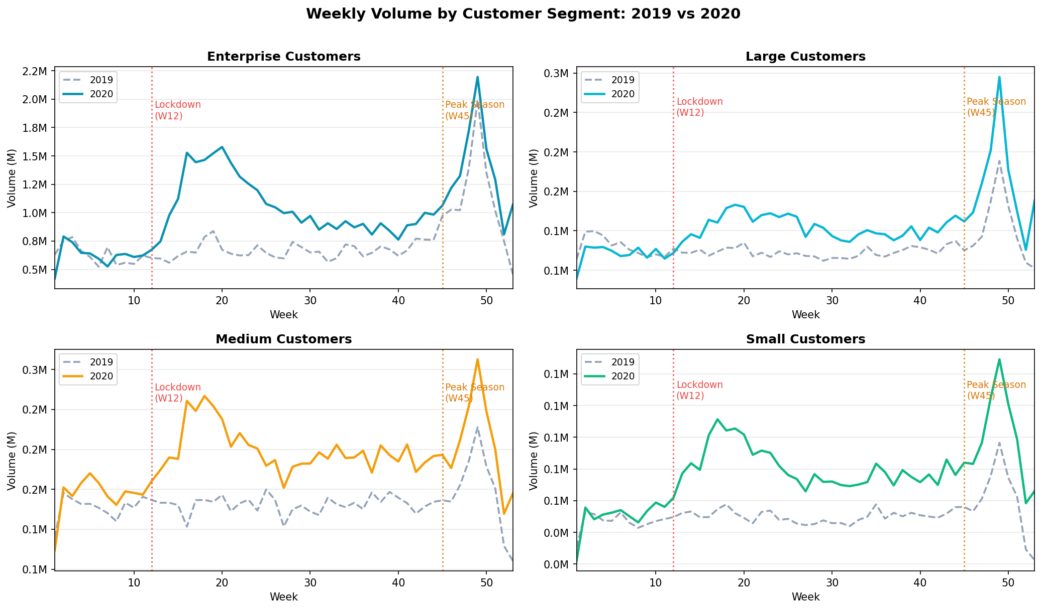
Question - How has COVID affected companies in the different customer groups? (2/2)
Weekly Volume Trends by Segment
📌 Breaking down by segment reveals different surge profiles. Enterprise volumes spiked earliest and hardest. Small customers had a slower initial response but achieved the strongest sustained percentage gains — likely reflecting the time it took smaller businesses to stand up online operations.
ABC Company Parcel Business Analysis
11

Slide 12
Question - What percent of each group is growing, stable, and declining?
Customer Health During COVID Observation Period (1/2)
ISGR: +11.4%
📌 The left chart shows proportions, the right shows actual numbers. Over half of every segment was High Growth — the pandemic was broadly positive for parcel volumes. The declining customers in Small and Medium (34–38%) are worth investigating: these are likely service-sector businesses such as restaurants or salons that saw demand collapse during lockdowns.
ABC Company Parcel Business Analysis
12

Slide 13
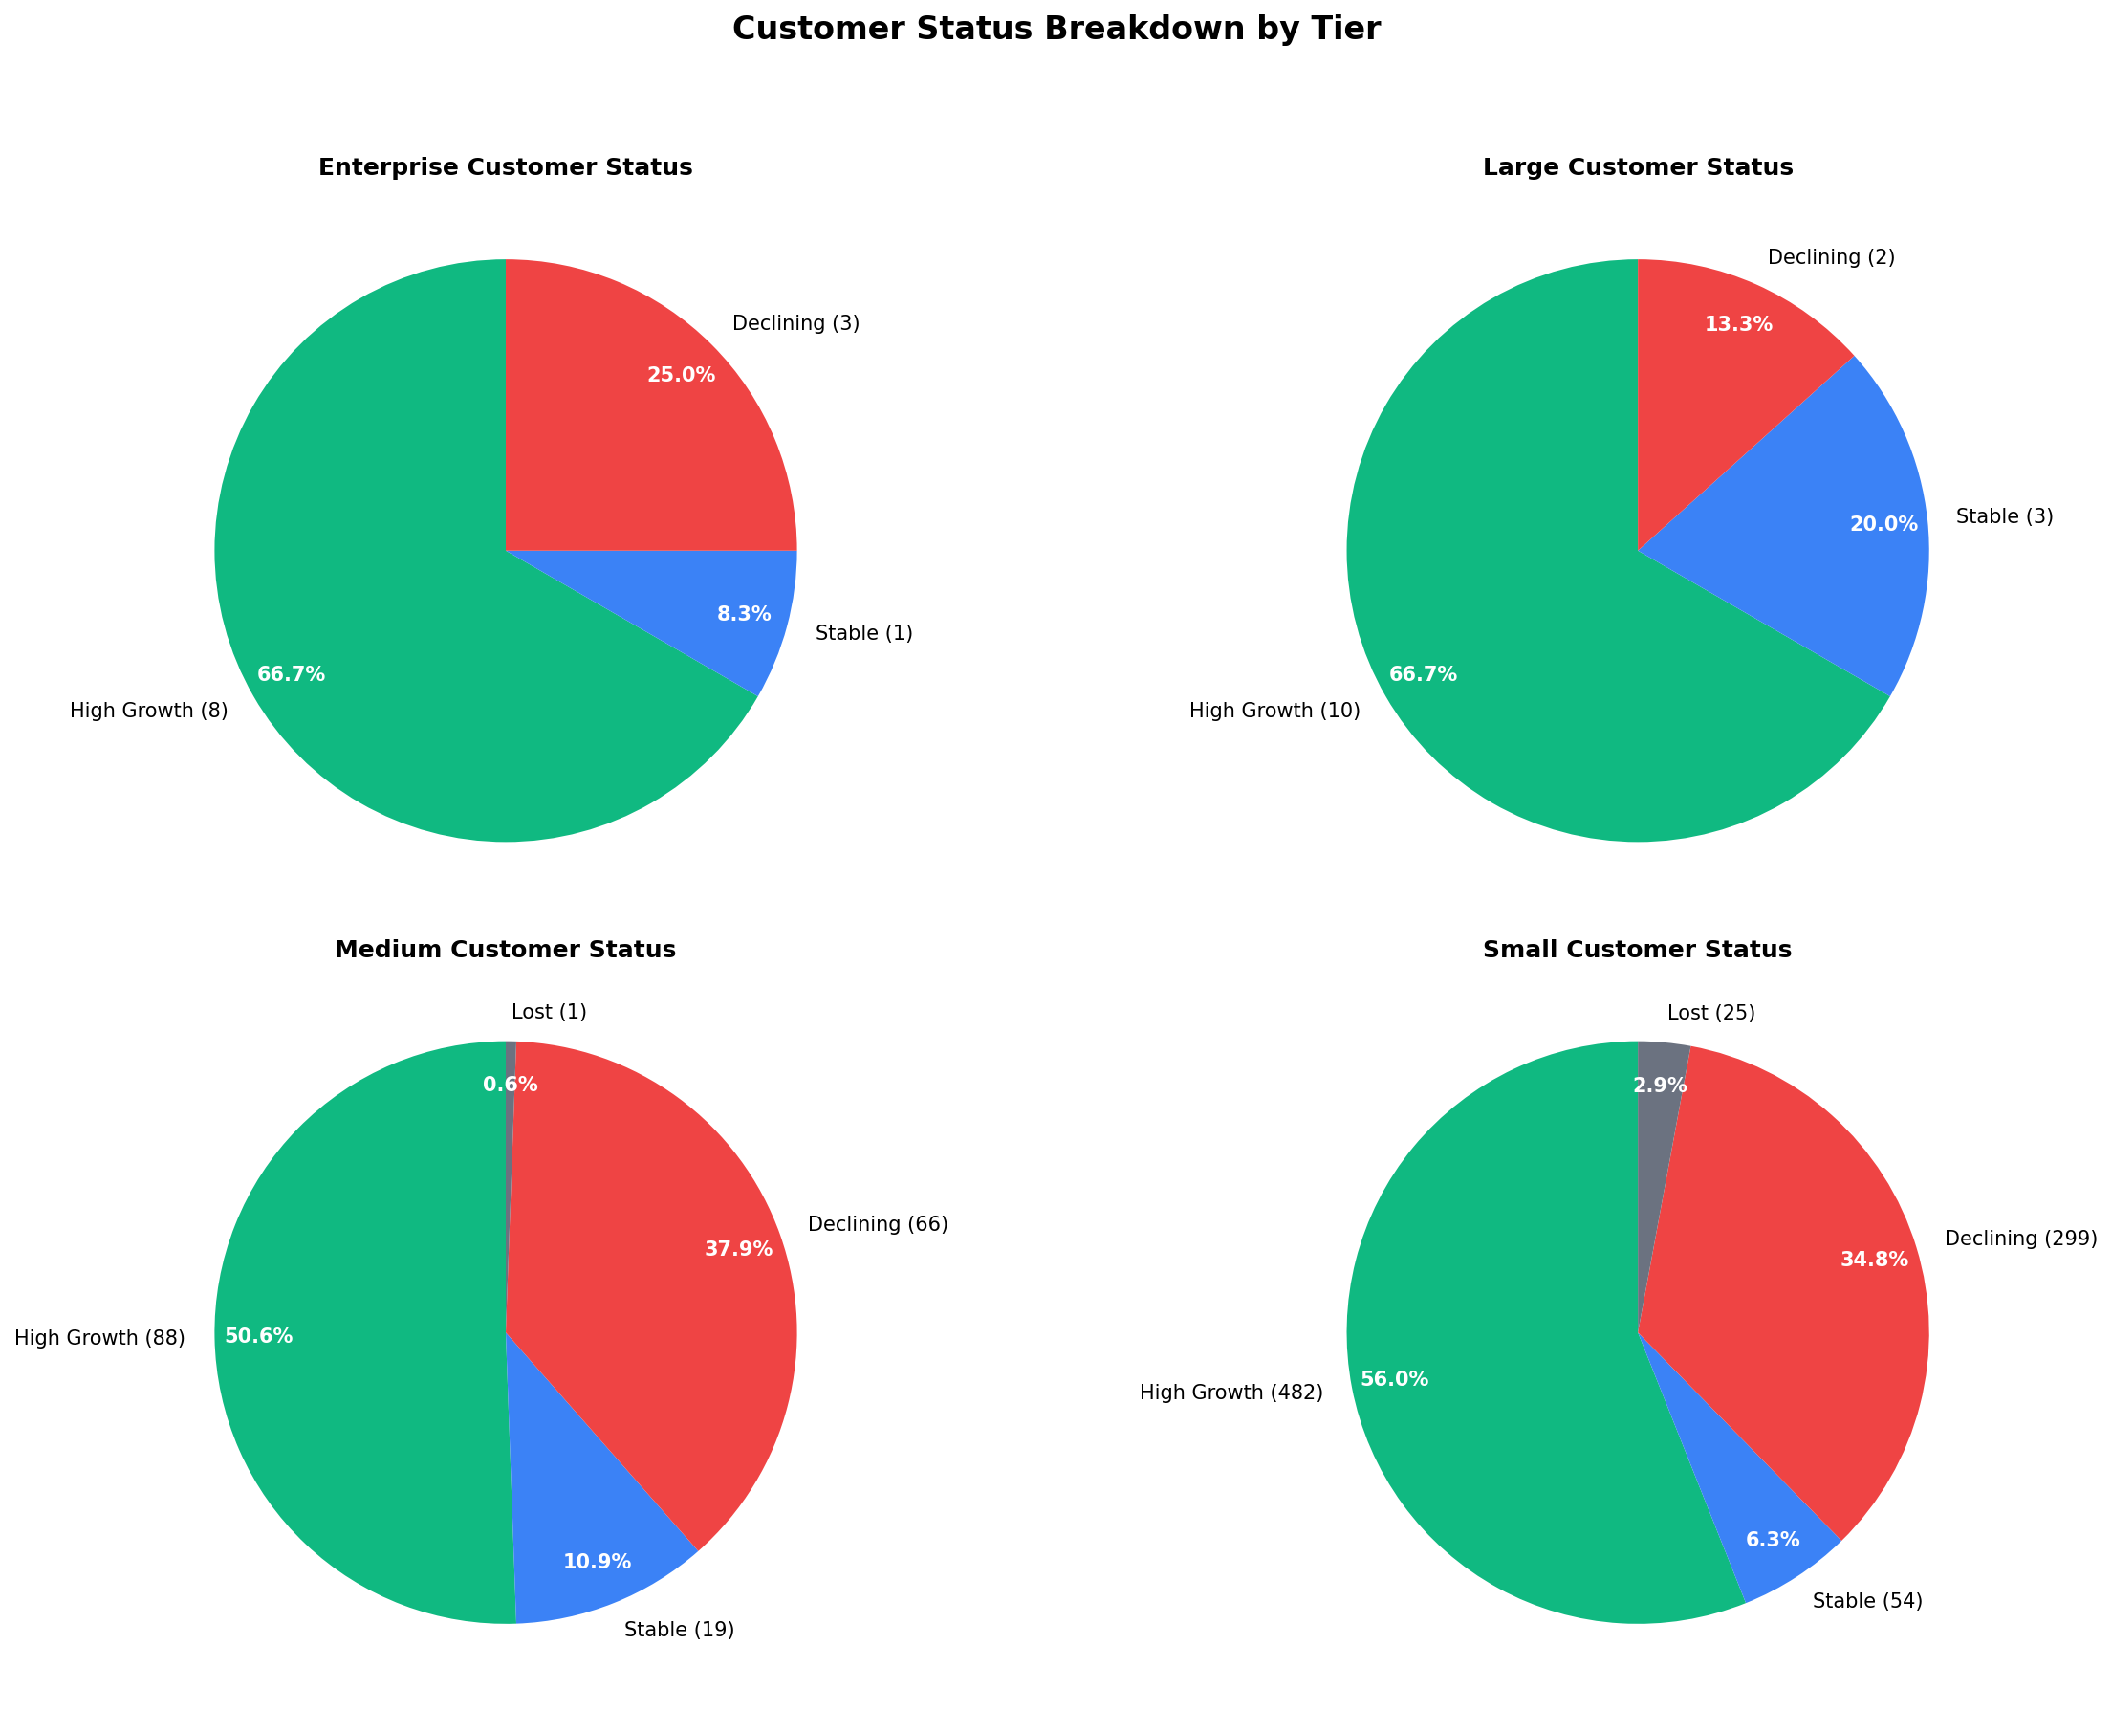
Question - What percent of each group is growing, stable, and declining? (2/2)
Customer Health During COVID Observation Period (2/2)
ISGR: +11.4%
🔎 New Customers During COVID: 0% across all segments. Every customer active during the COVID observation period (W12–W53, 2020) was already an existing ABC Company account from 2019. COVID did not attract new clients; it deepened and accelerated existing relationships across all four segments.
13

Slide 14
Question - What percent of 2019 customers did we lose during COVID?
Customer Retention Analysis
Enterprise
100% retained
12 kept · 0 lost
Large
100% retained
15 kept · 0 lost
Medium
99.4% retained
173 kept · 1 lost
Small
97.1% retained
835 kept · 25 lost
📌 Enterprise and Large had perfect retention — not a single account was lost. Even Small customers, our most at-risk segment, retained 97.1% of their 2019 base. This tells us that while some customers declined in volume, very few stopped shipping entirely. ABC Company's client relationships held up well through the pandemic.
ABC Company Parcel Business Analysis
14

Slide 15
Question - What was the overall impact on volumes and revenue by customer group?
Revenue Impact by Customer Group (COVID Period)
Total Revenue
(COVID Period)
$1.135B
vs $767M in 2019 (+48.0%)
Enterprise
+46.8%
$548.8M → $805.5M
Large
+46.2%
$60.6M → $88.6M
Medium
+49.2%
$111.5M → $166.4M
Small
+62.3%
$46.1M → $74.8M
📌 Total revenue grew by $368M — a 48% increase — in the COVID period alone. Small customers showed the highest growth rate at +62.3%, but in dollar terms Enterprise still accounts for the vast majority of that gain. This concentration means ABC's revenue is closely tied to the health of its 12 Enterprise accounts.
ABC Company Parcel Business Analysis
15

Slide 16
Conclusions & Recommendations
01
02
COVID Accelerated E-Commerce
Record-Breaking Peak Season
2020 total volume surged +39% to 73.5M parcels. The surge began Week 12.
2020 peak season delivered 19.4M parcels — a +26.5% increase over 2019's 15.4M. Every week outpaced the prior year.
03
04
Strong Revenue Growth
Most Customers Thrived
Total COVID-period revenue reached $1.135B — up +48% vs the same 2019 period.
50–67% of customers in all segments were High Growth.
Recommendations: ① Increase capacity to support higher post-COVID volumes. ② Retention programs for declining Small/Medium clients ③ Continue monitoring 2021 trends as volumes normalized.
16

