Slide 1
Customer Support System: An email to the customer
by Jubaida Tasnim

Slide 2
Table of Content
Introduction
Design
Problem Identification
Investigation of Solutions
Theoretical Comparison of Solutions
Implementation
Test
Enhancement Ideas
Result
Conclusion

Slide 3
Introduction
The "Customer Support System: An Email to the Customer" project focuses on automating customer communication in an electronics store using ChatGPT. The objective is to generate customer comments, analyze sentiments, create subject lines for emails, and respond to the customers efficiently by leveraging AI.

Slide 4
Design
a. Problem Identification
Managing a high volume of customer inquiries in an electronics store is time-consuming and resource-intensive. Automating this process allows customer support to be more efficient, saving time and improving response accuracy.
b. Investigation of Solutions
Solutions were investigated with a focus on using AI tools such as ChatGPT to handle common customer service tasks:
Generating customer comments based on product descriptions.
Using NLP techniques to create email subject lines.
Summarizing customer feedback.
Conducting sentiment analysis to detect positive or negative tones.
c. Theoretical Comparison of Solutions
Multiple AI-based solutions were considered, and ChatGPT's comprehensive natural language processing abilities made it the best fit for this project. Its capacity for context understanding and sentiment analysis provided an edge over more static rule-based systems.

Slide 5
Implementation
Step 1: Generate a Customer's Comment
Input: Provide ChatGPT with detailed product descriptions.
Output: ChatGPT generates a 100-word comment based on the products. This is used as input for further steps.
Automation: The system automates the process of generating customer comments using predefined prompts for each product.
Step 2: Generate Email Subject
Input: The customer's comment from Step 1.
Output: ChatGPT generates a relevant email subject using an inferring technique based on the comment.
Step 3: Generate the Summary of the Customer's Comment
Input: The customer's comment from Step 1.
Output: ChatGPT summarizes the customer’s feedback using a summarizing technique.

Slide 6
Step 4: Sentiment Analysis of the Customer's Comment
Input: The customer's comment from Step 1.
Output: ChatGPT performs sentiment analysis to determine if the feedback is positive or negative.
Step 5: Generate an Email
Input: The customer’s comment, summary, sentiment analysis, and email subject.
Output: ChatGPT generates a customer-facing email in the selected language using an expanding technique. The email includes the comment summary and an appropriate response.
Step 6: Send the Email
The email generated in Step 5 is sent to the customer programmatically using Google APIs or Python code for testing purposes.

Slide 7
Test
The system was tested using a variety of customer comments related to different electronics products. Test cases included:
Generating comments for multiple products.
Verifying email subject accuracy based on the comments.
Checking the sentiment analysis results against known feedback types.
Confirming email delivery through Google API integration.

Slide 8
Enhancement Ideas
Multilingual Support: Extend the system to handle customer comments and emails in multiple languages for international customers.
Customization: Allow customers to provide real-time feedback and tailor email responses based on customer preferences.
Machine Learning: Implement machine learning algorithms to continuously improve email subject generation based on customer interaction data.

Slide 9
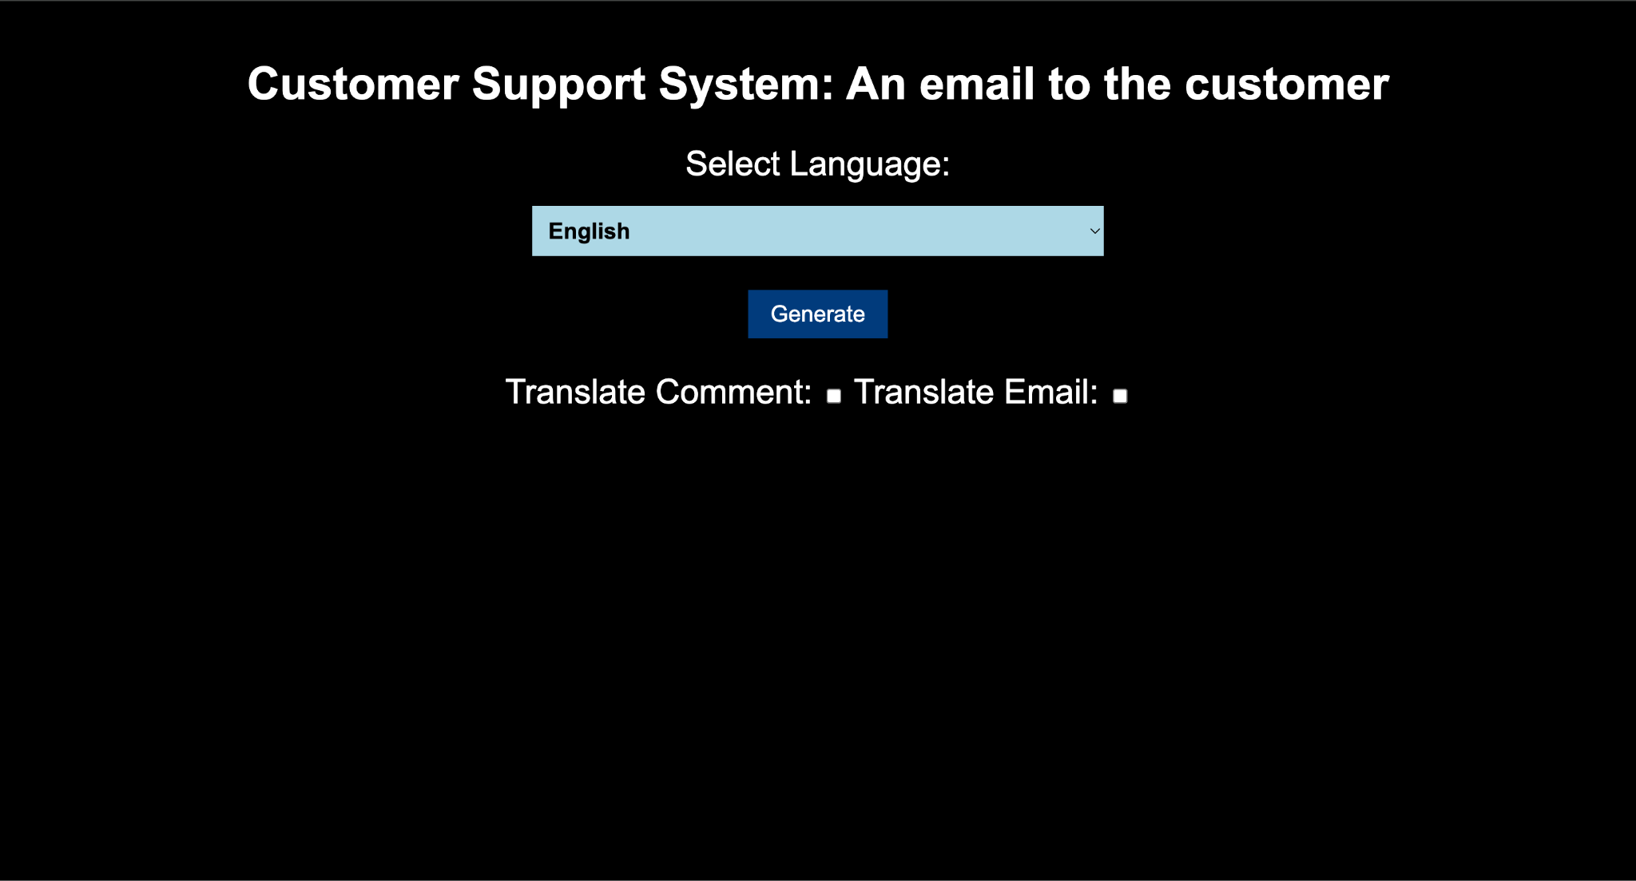
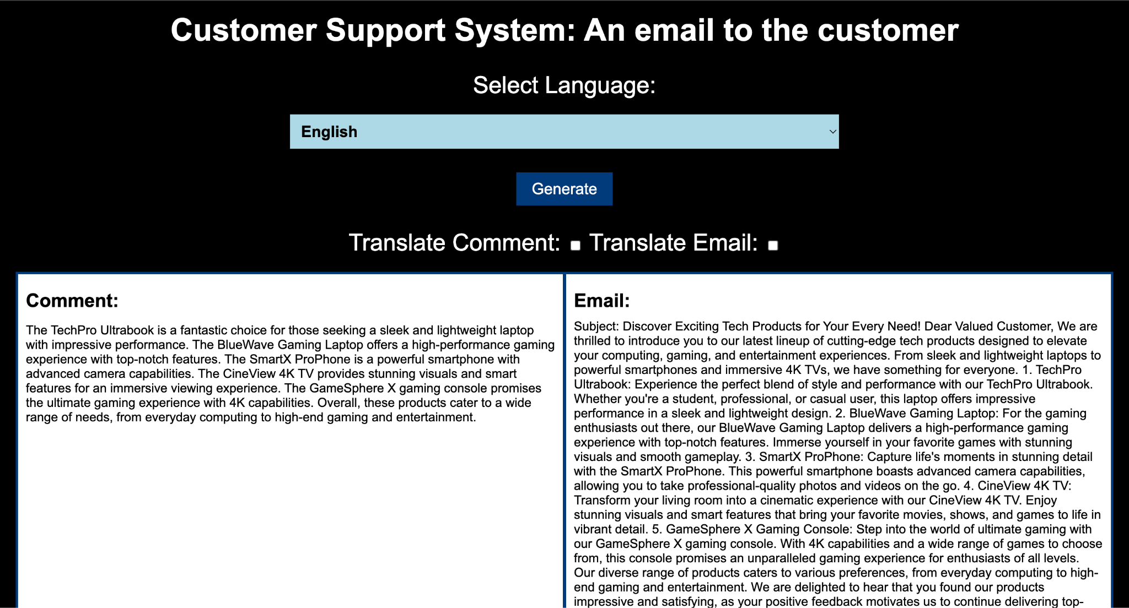
ScreenShot of execution results

Slide 10
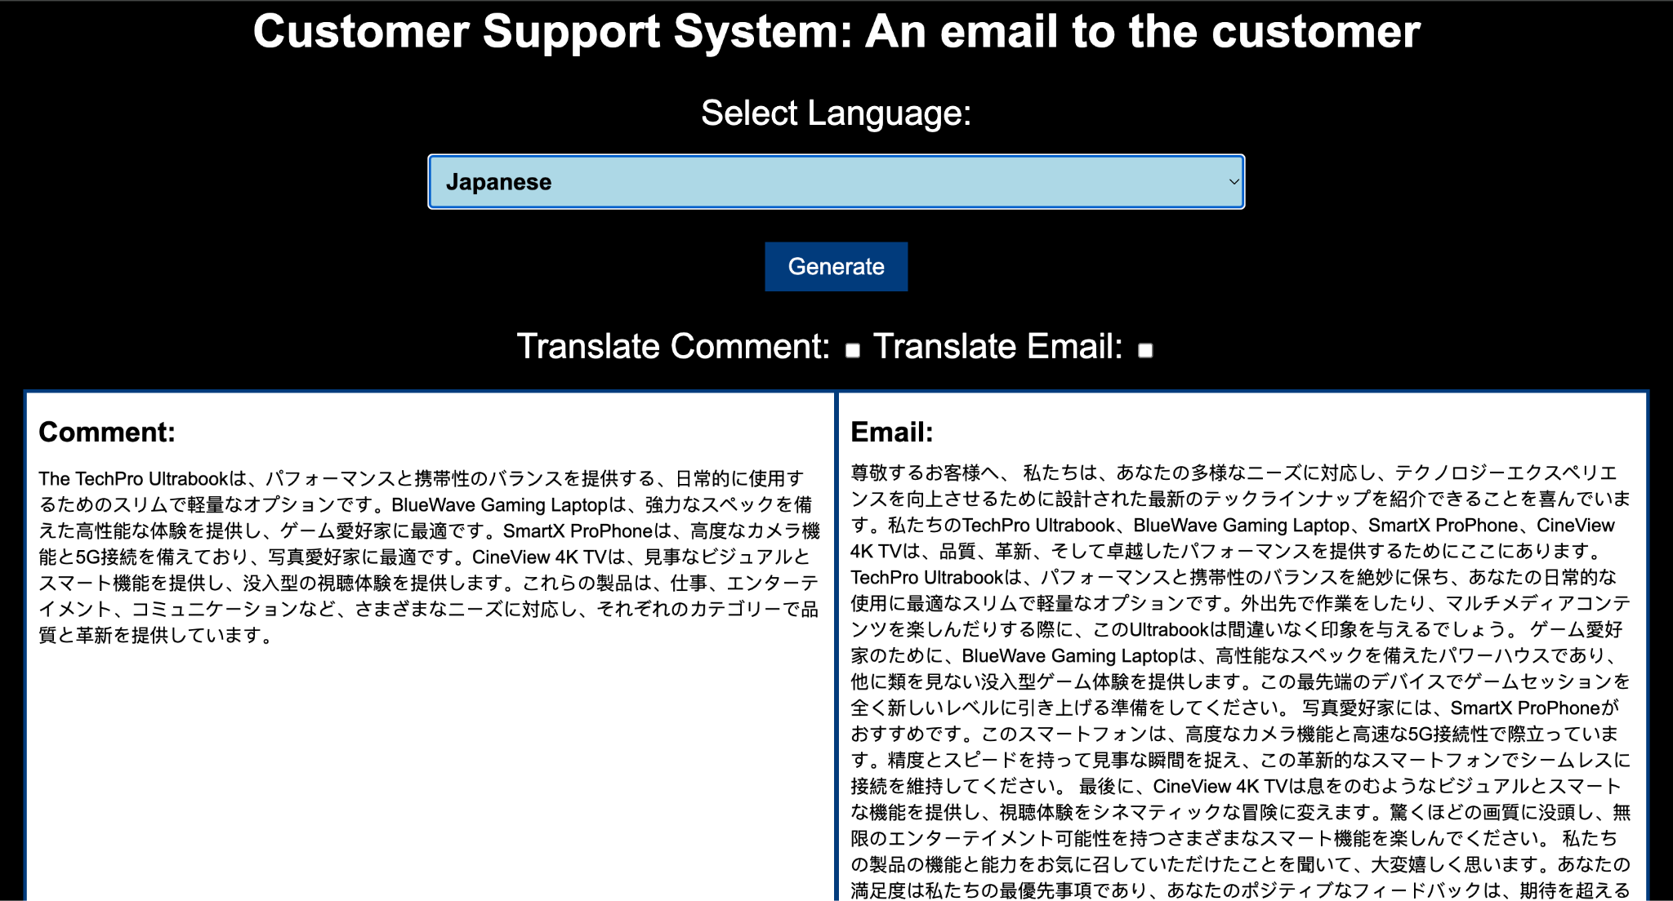

Slide 11
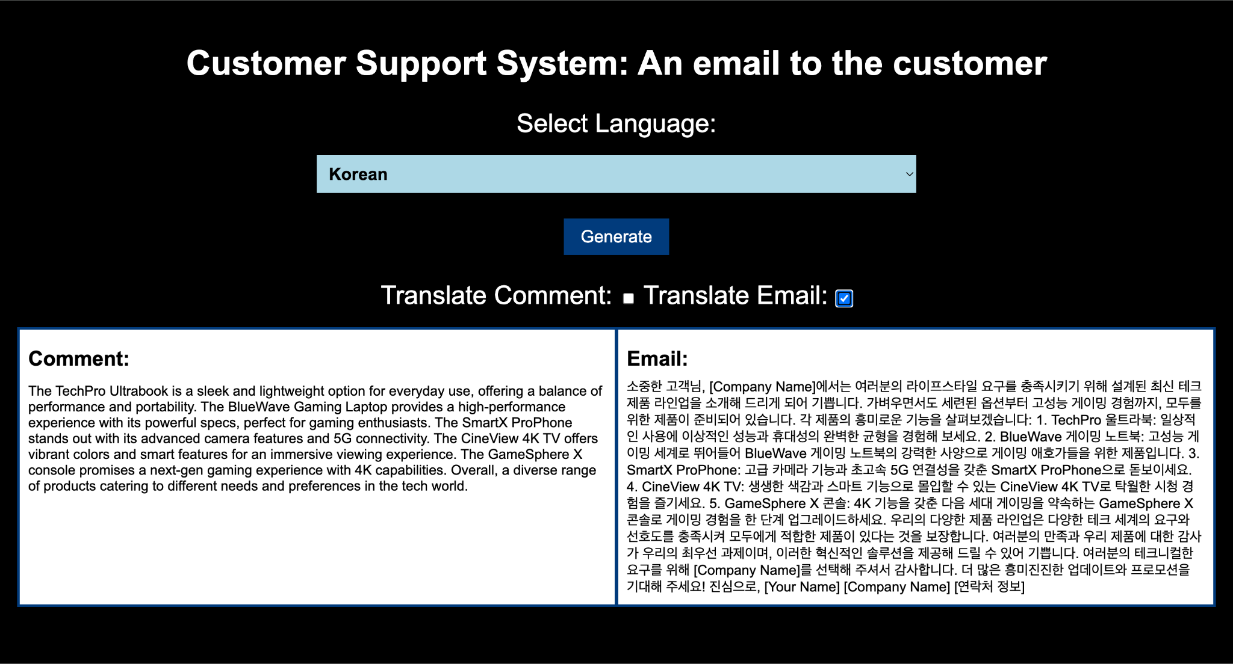

Slide 12
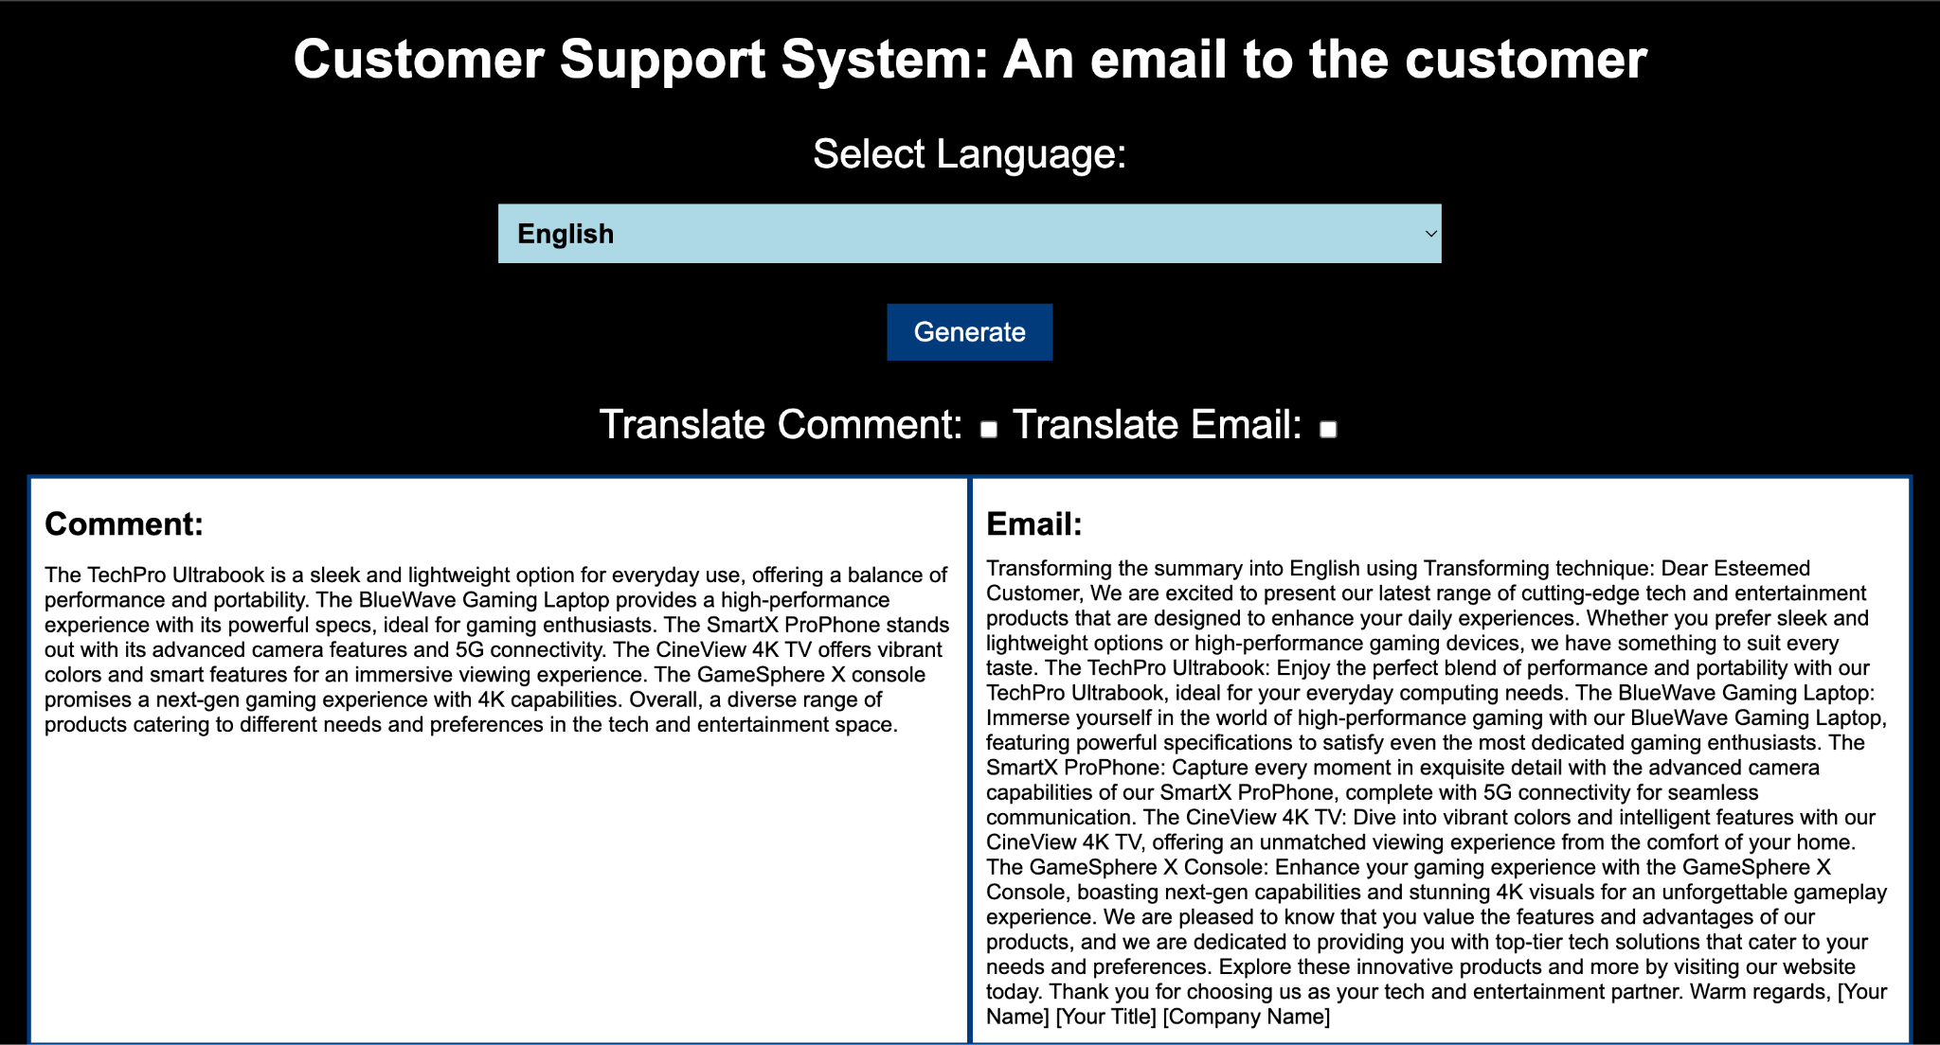

Slide 13
Conclusion
The "Customer Support System: An Email to the Customer" project successfully automates the process of generating customer comments, conducting sentiment analysis, and sending personalized emails using AI. By integrating this system, companies can efficiently manage customer inquiries and improve communication without manual intervention.

