Slide 1
OpenAI API ChatBot GPT-4o with Streamlit
Jubaida Tasnim

Slide 2
Subjects
Introduction
Overview of GPT-4o
OpenAI API
Building the ChatBot
Streamlit Integration
Testing and Deployment
Result
Conclusion
References

Slide 3
Introduction
Objective: Introduce the project to build a chatbot using OpenAI’s GPT-4o with the help of Streamlit for the front-end interface.
Context: Highlight the importance of AI and NLP in building chatbots for real-time communication.

Slide 4
Overview of GPT-4o
GPT-4o: Introduce the GPT-4 model and its capabilities.
Key Features:
Natural language understanding
Conversational capabilities
Large-scale language model
Usage in Chatbots: Explain why GPT-4o is ideal for chatbots due to its human-like conversational skills.

Slide 5
OpenAI API
What is OpenAI API?: Explain how to access GPT-4o through the OpenAI API.
Key API Features:
Easy integration
Scalable requests
Support for various tasks (text generation, Q&A, etc.)
Usage: Provide an example of how API calls are made to OpenAI to get responses.

Slide 6
Building the ChatBot
Step-by-Step Process:
Install necessary libraries (openai, streamlit).
Authenticate with OpenAI using an API key.
Write a function to make API requests to GPT-4o.
Code Example:
Provide a basic example of Python code that communicates with the GPT-4 API.

Slide 7
Streamlit Integration
What is Streamlit?: Introduce Streamlit as an easy-to-use framework for building web applications.
Integration Steps:
Install Streamlit.
Set up the chatbot interface with Streamlit widgets (text input, submit button).
Display chatbot responses in real-time.
Code Example:
Provide a simple example of how to set up a chatbot interface using Streamlit.

Slide 8
Testing and Deployment
Testing: Walk through the process of testing the chatbot.
Deployment Options:
Streamlit Cloud for easy sharing.
Alternative hosting solutions for scaling the application.

Slide 9
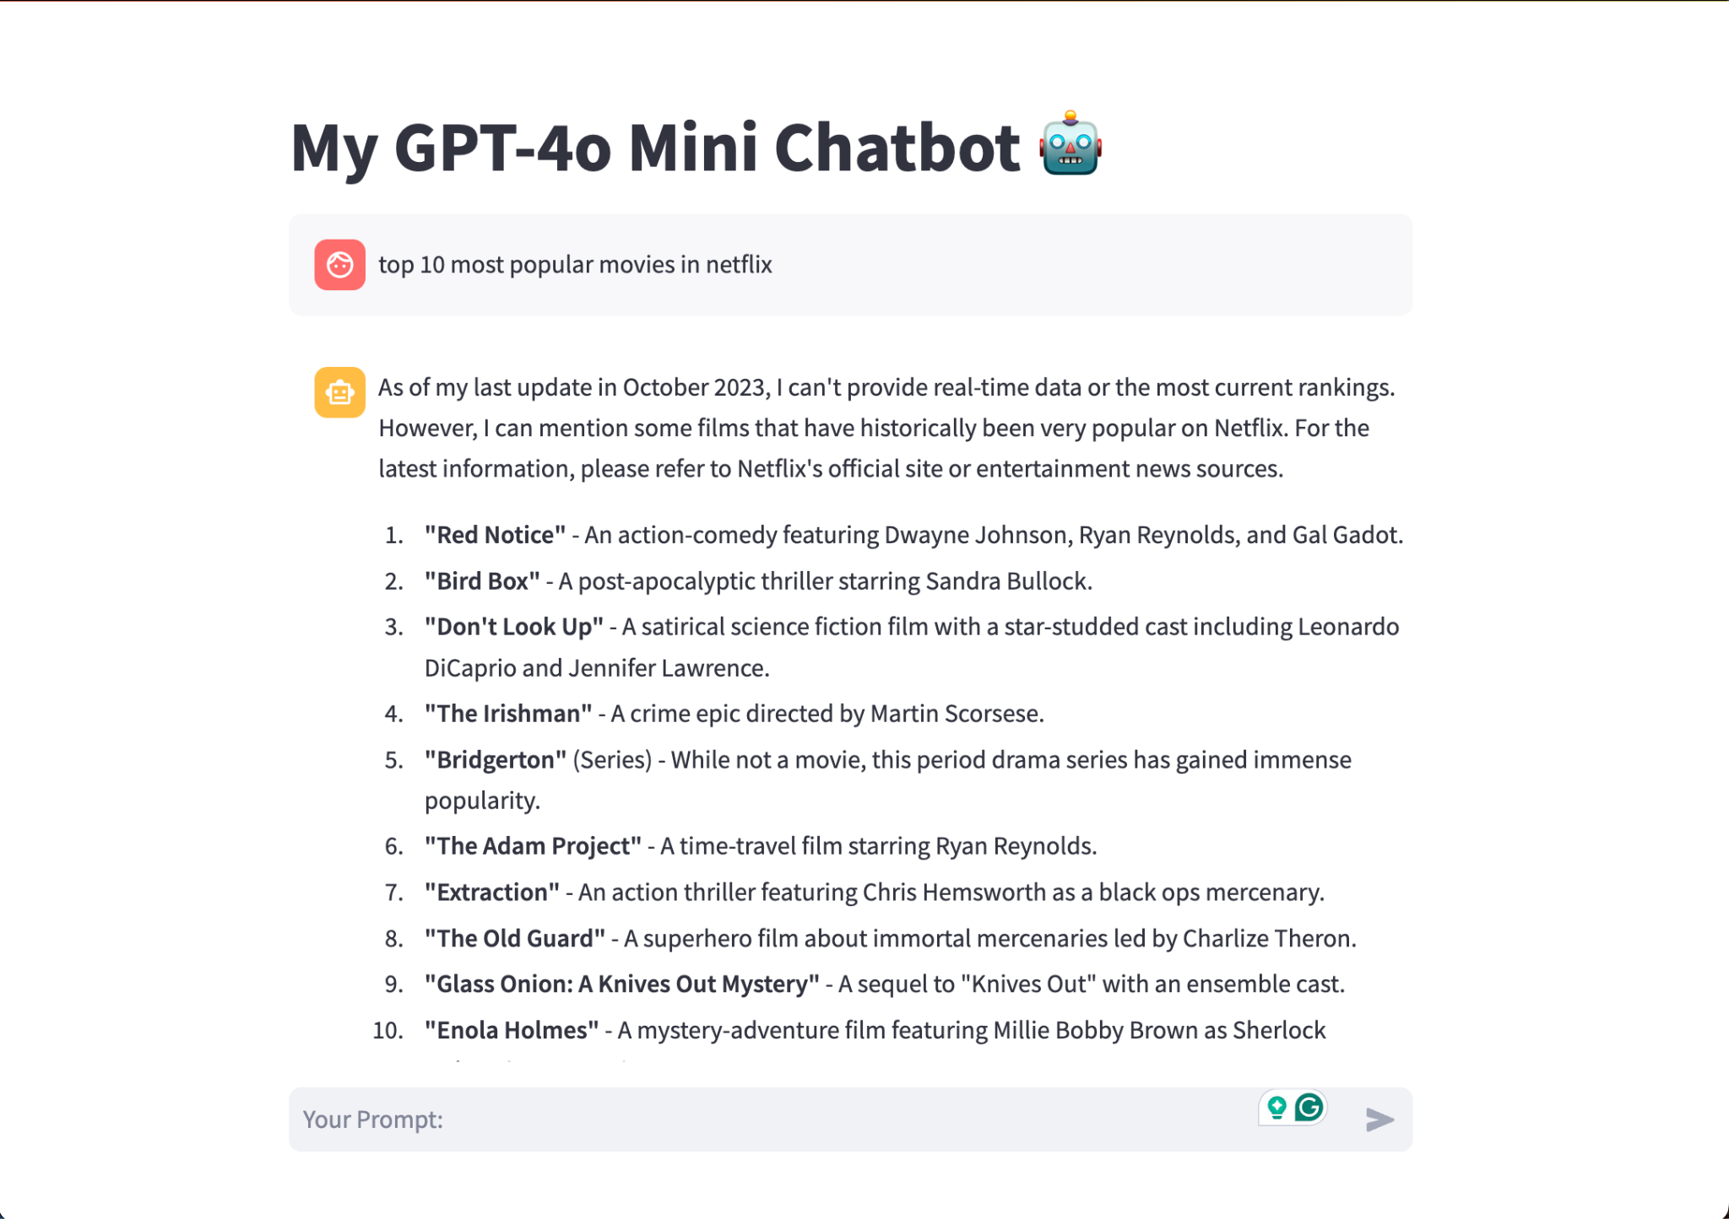
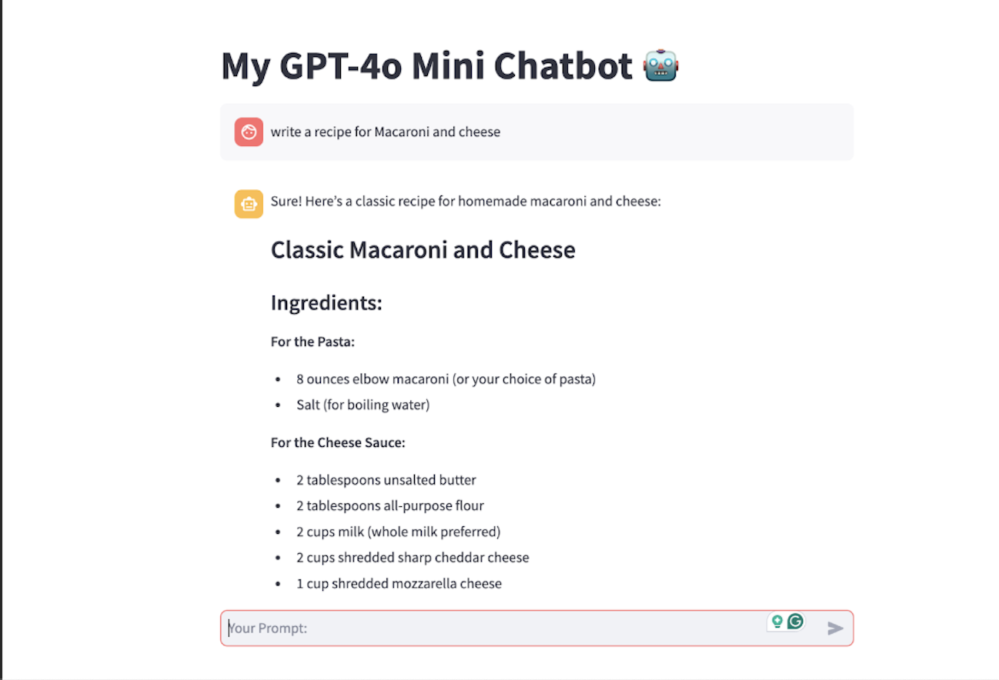
ScreenShot of execution results

Slide 10
Conclusion
Summary: Review the main steps of building a chatbot with GPT-4o and Streamlit.
Future Enhancements: Mention ideas for improving the chatbot, like adding more conversational features or integrating with other APIs.

Slide 11
References
OpenAI API: From Basics to Chatbot Implementation with GPT-4o Mini & Streamlit

