Slide 1
AI-Powered Answer Generator with Semantic Search
Jubaida Tasnim

Slide 2
Table of Contents
Introduction
Design
Preprocessing Input Texts
Creating Embeddings and Search Index
Searching for Articles
Generating Answers
Implementation
Test Cases
Code and Results
Enhancement Ideas
Conclusion

Slide 3
Introduction
Generating Answers focuses on leveraging embeddings and semantic search to retrieve and provide answers to user queries. This approach combines:
Preprocessing large bodies of text.
Building search indexes.
Using advanced language models to generate accurate and context-specific answers.

Slide 4
Design
Preprocessing Input Texts
Step 1.1: Split text into a list of paragraphs.
Step 1.2: Clean data by removing empty spaces and newlines.
Creating Embeddings and Search Index
Step 2.1: Convert paragraphs into embeddings using Cohere API.
Step 2.2: Build a search index with AnnoyIndex for quick retrieval.
Searching for Articles
Query embeddings are compared with the search index to retrieve relevant articles.
Generating Answers
Use retrieved articles as context to generate precise answers to the given question.

Slide 5
Implementation
Code Highlights:
Preprocessing input text for cleaner data handling.
Using Cohere for embeddings and AnnoyIndex for indexing.
Generating answers using Cohere's language generation capabilities.
Process Workflow:
Preprocess the input data.
Embed the data into numerical vectors.
Search for relevant articles.
Generate an answer using Cohere's LLM.

Slide 6
Test Cases
Test Case 1:
Input: "Are side projects important when you are starting to learn about AI?"
Output: Generated answer from the relevant article excerpt:
"Side projects are important as they allow you to explore practical applications, enhance your learning, and build a portfolio that demonstrates your skills."
Test Case 2:
Input: Same query: "Are side projects important when you are starting to learn about AI?"
Output: Multiple contextual and varied responses to explore diverse perspectives:
"Yes, side projects help in mastering technical skills and provide hands-on experience essential for building a career in AI."
"Engaging in side projects offers opportunities to deepen skills and learn project management challenges in AI."
"While starting out, side projects provide a stepping stone to larger opportunities by showcasing your practical knowledge."

Slide 7
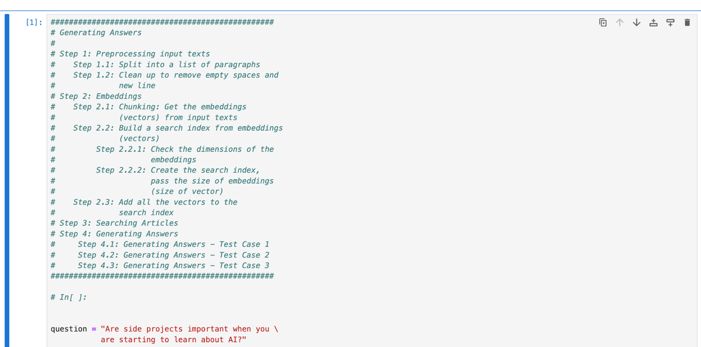
Code and Results

Slide 8


Slide 9
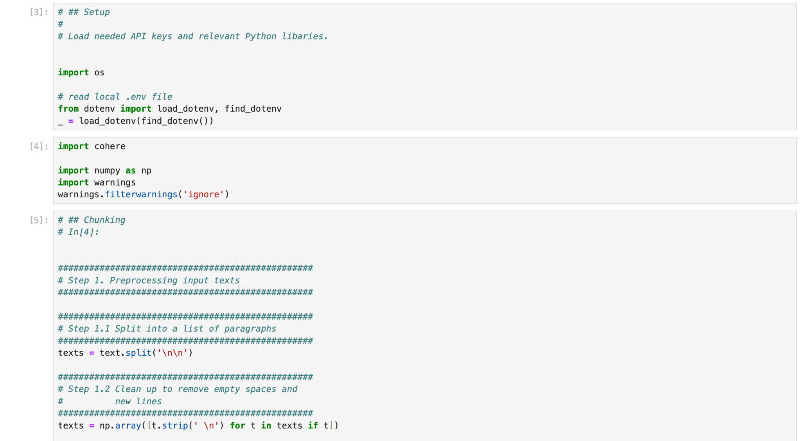

Slide 10
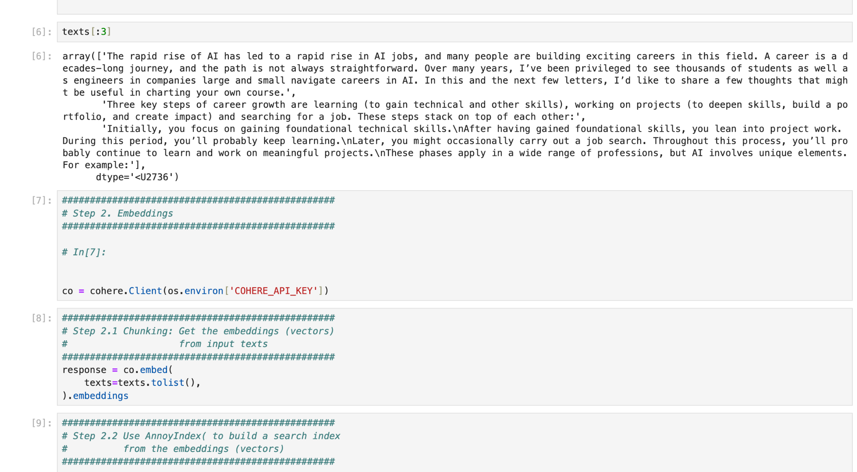

Slide 11
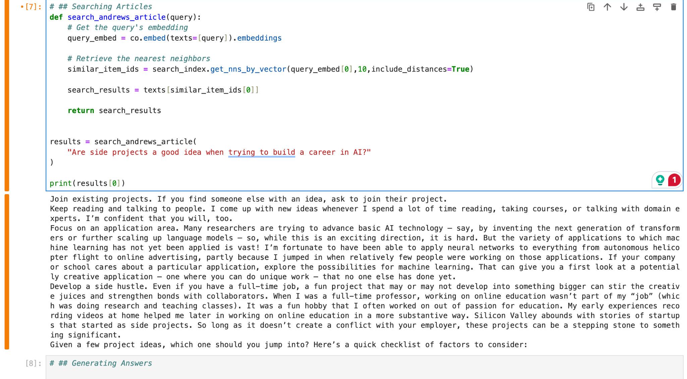

Slide 12
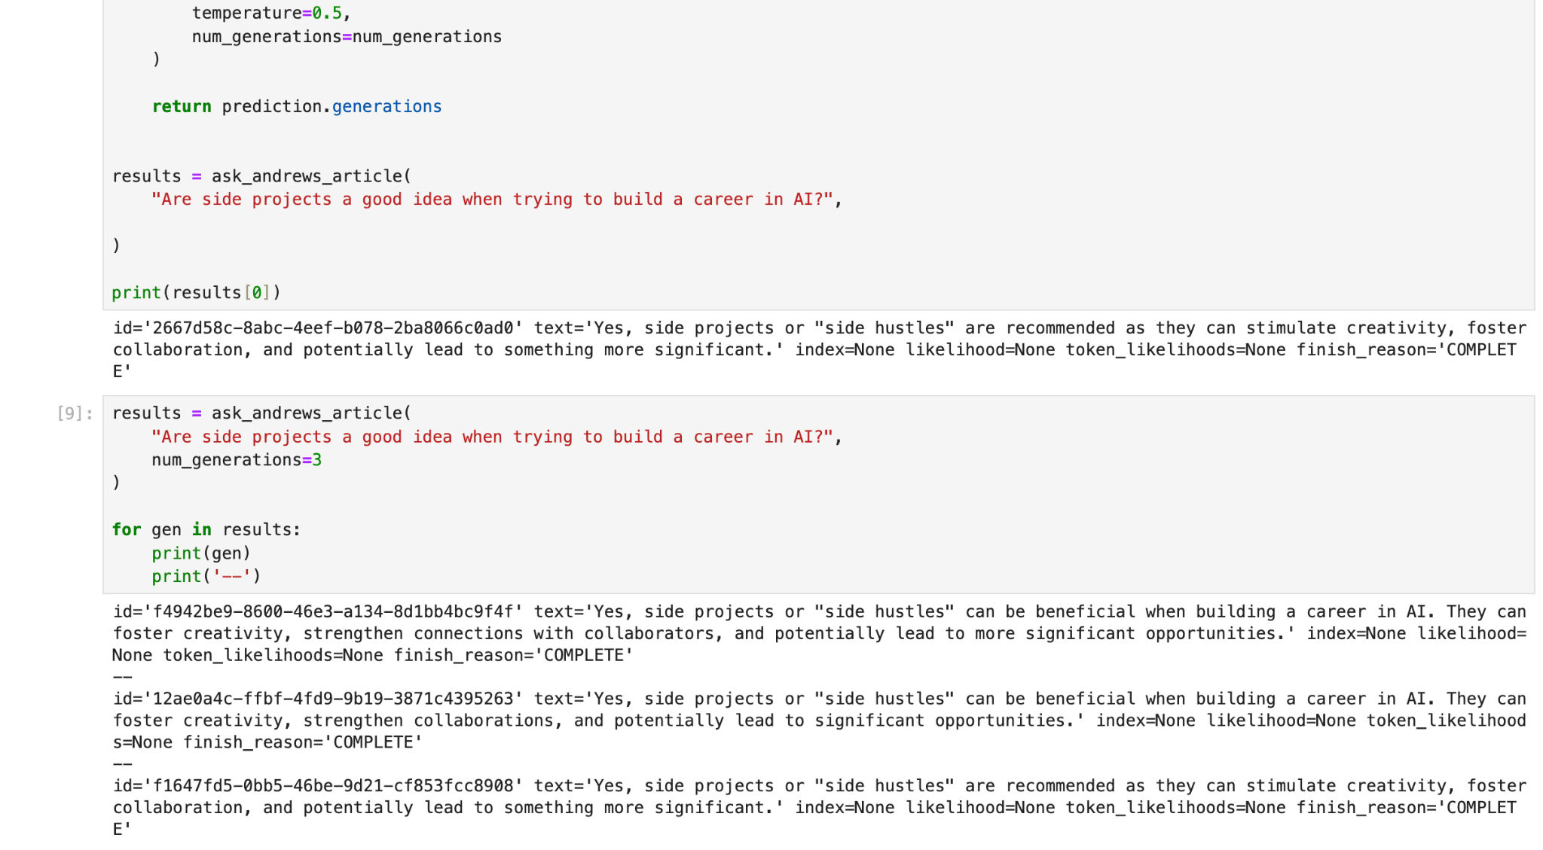

Slide 13
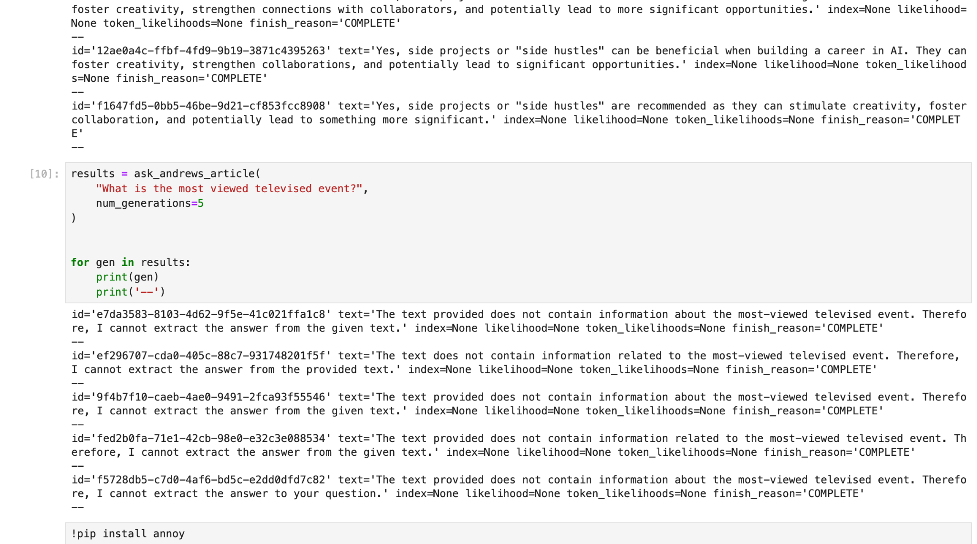

Slide 14
Enhancement Ideas
Multi-document Retrieval: Expand to multiple document sources for richer context.
Dynamic Chunk Sizes: Optimize chunking for better embedding representation.
Fine-tuned Models: Use fine-tuned Cohere models for domain-specific queries.
Scalability: Improve the indexing and search system for larger datasets.

Slide 15
Conclusion
This project showcases the power of embeddings and semantic search to generate answers with context. By combining advanced preprocessing, embedding, and indexing techniques, this approach delivers precise and relevant answers to complex queries.

