Slide 1
Keyword and Semantic Searches with ReRank
Jubaida Tasnim

Slide 2
Table of Content
Introduction
Design
Identify and understand the problems
Investigate possible solutions
Compare solutions and select the best one.
Implementation
Test
Code and Results
Enhancement Ideas
Conclusion

Slide 3
Introduction
Objective: To improve semantic search results using the ReRank methodology.
Scope: Applying dense retrieval and keyword search techniques with ReRank to reorder results based on relevance.
Why ReRank? ReRank leverages advanced NLP models to enhance both dense retrieval and keyword-based searches by evaluating query-document relevance.

Slide 4
Design
Step 1: Identify and Understand the Problems
Keyword search often retrieves irrelevant results because it focuses solely on term matches.
Dense retrieval captures semantic meaning but can still include irrelevant results due to embedding proximity.
Step 2: Investigate Possible Solutions
Keyword Search: Enhance by re-ranking results for higher precision.
Dense Retrieval: Integrate relevance scoring to highlight accurate responses.
Explore integration of Cohere's ReRank API for relevance scoring.
Step 3: Compare Solutions and Select the Best One
Evaluated methods: Direct dense retrieval, hybrid retrieval, and re-ranking.
Selected ReRank as it provides query-document relevance scoring to reorder results effectively.

Slide 5
Implementation
Setup:
Import libraries: Cohere and Weaviate.
Load environment variables and API keys.
Keyword Search:
Perform a keyword search for queries with 3 and 500 results.
Apply ReRank to reorder results by relevance.
Dense Retrieval:
Use dense retrieval to extract semantically relevant results.
Apply ReRank to enhance ranking precision.
ReRank Integration:
Use rerank API from Cohere to reorder query responses.
Implement custom logic to process and display results.

Slide 6
Test
Evaluation Metrics:
Precision: Measure accuracy of retrieved results.
Recall: Determine relevance coverage.
Mean Reciprocal Rank (MRR): Assess ranking quality.
Testing Queries:
“What is the capital of Canada?”
“Who is the tallest person in history?”
Results:
Keyword search without ReRank: High noise in results.
Keyword search with ReRank: Improved precision and relevance.
Dense retrieval with ReRank: Balanced precision and recall with accurate top results.

Slide 7
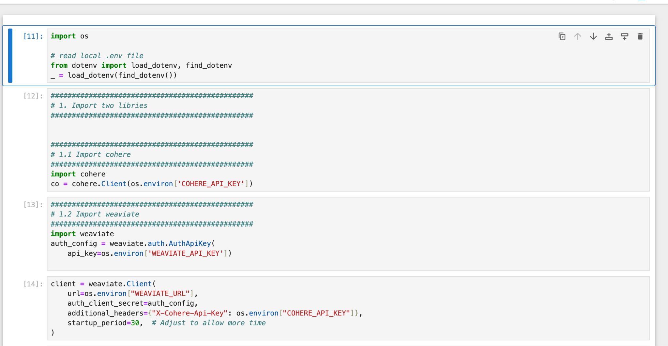
Code and Results

Slide 8
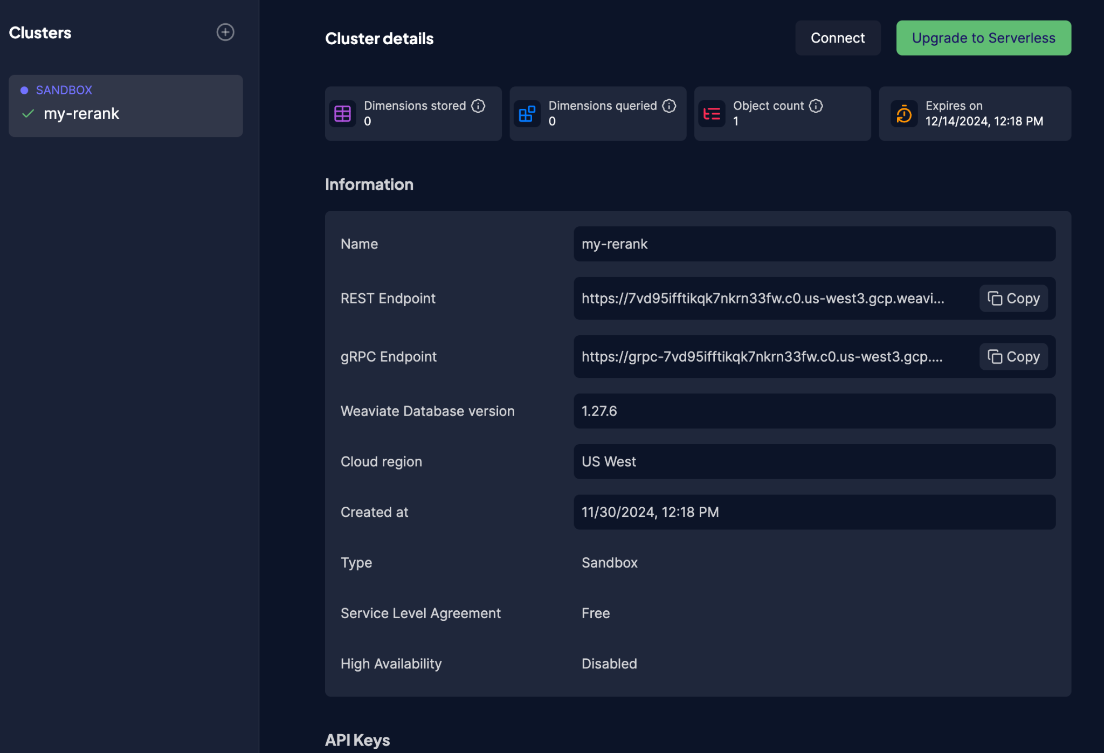
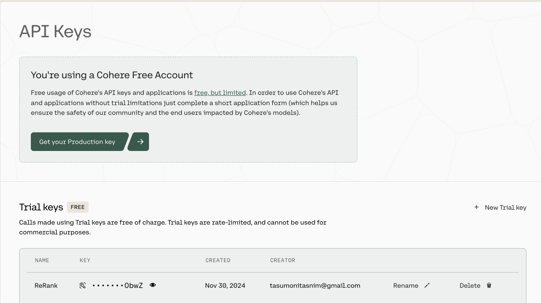

Slide 9
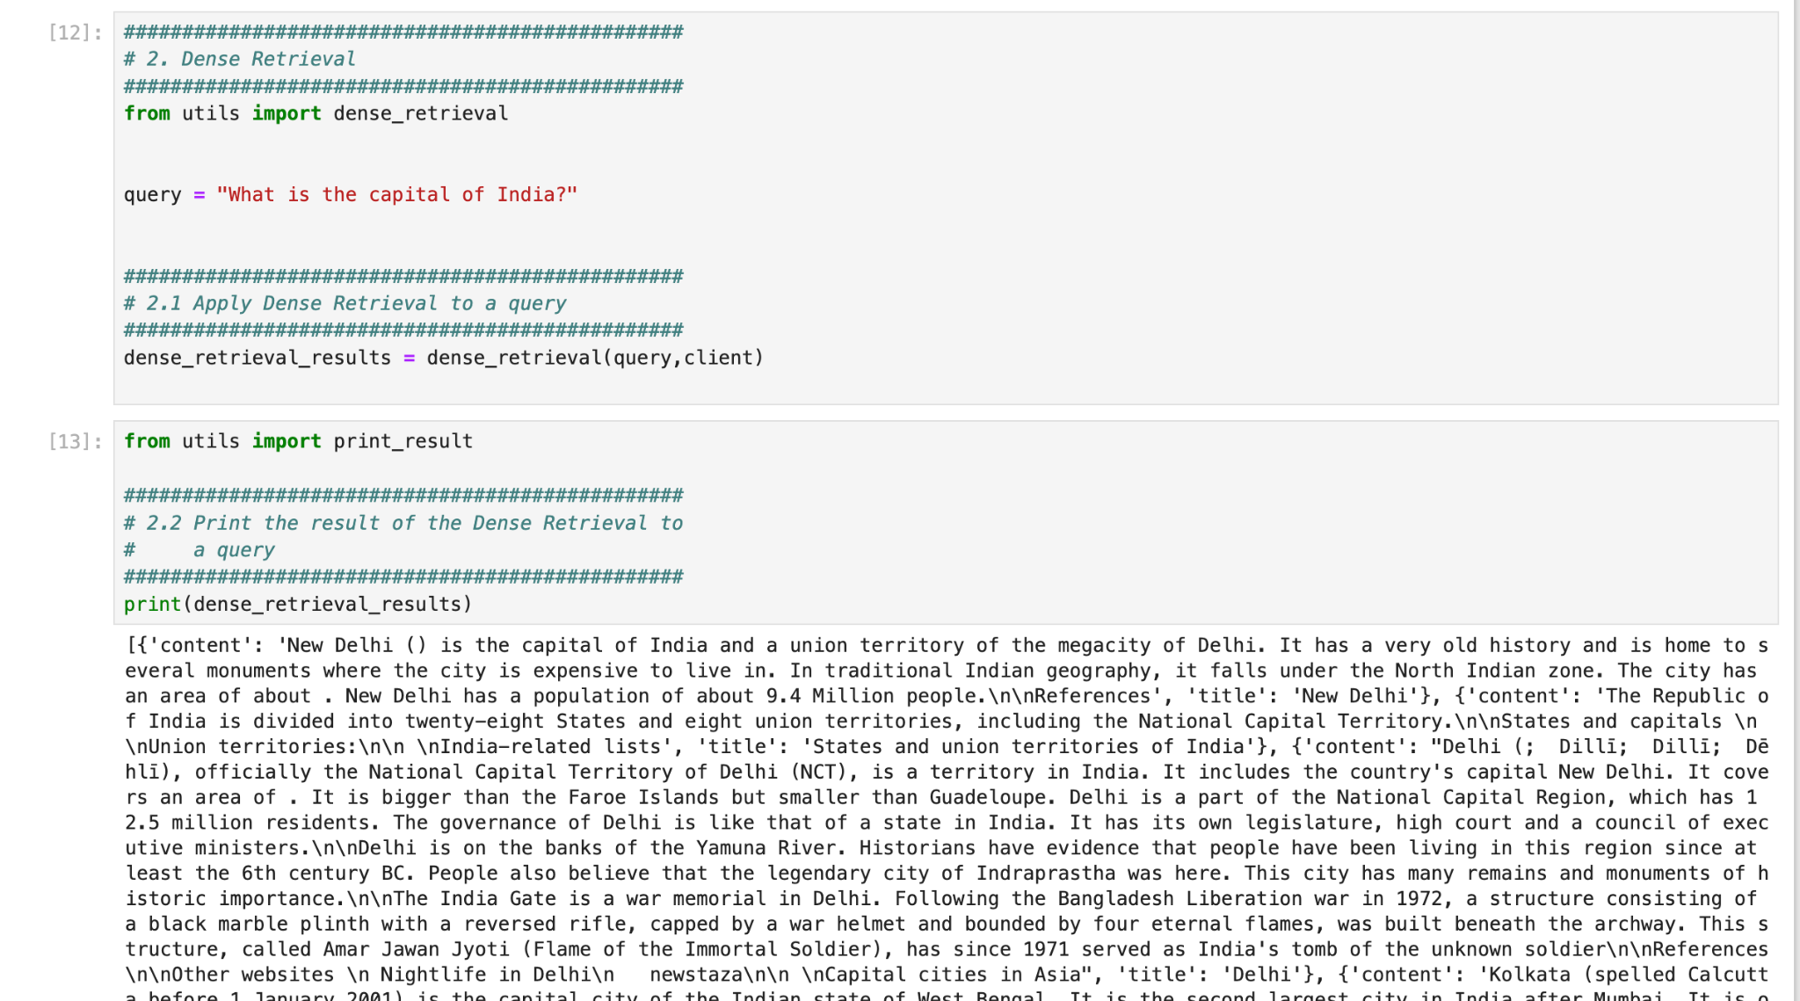

Slide 10
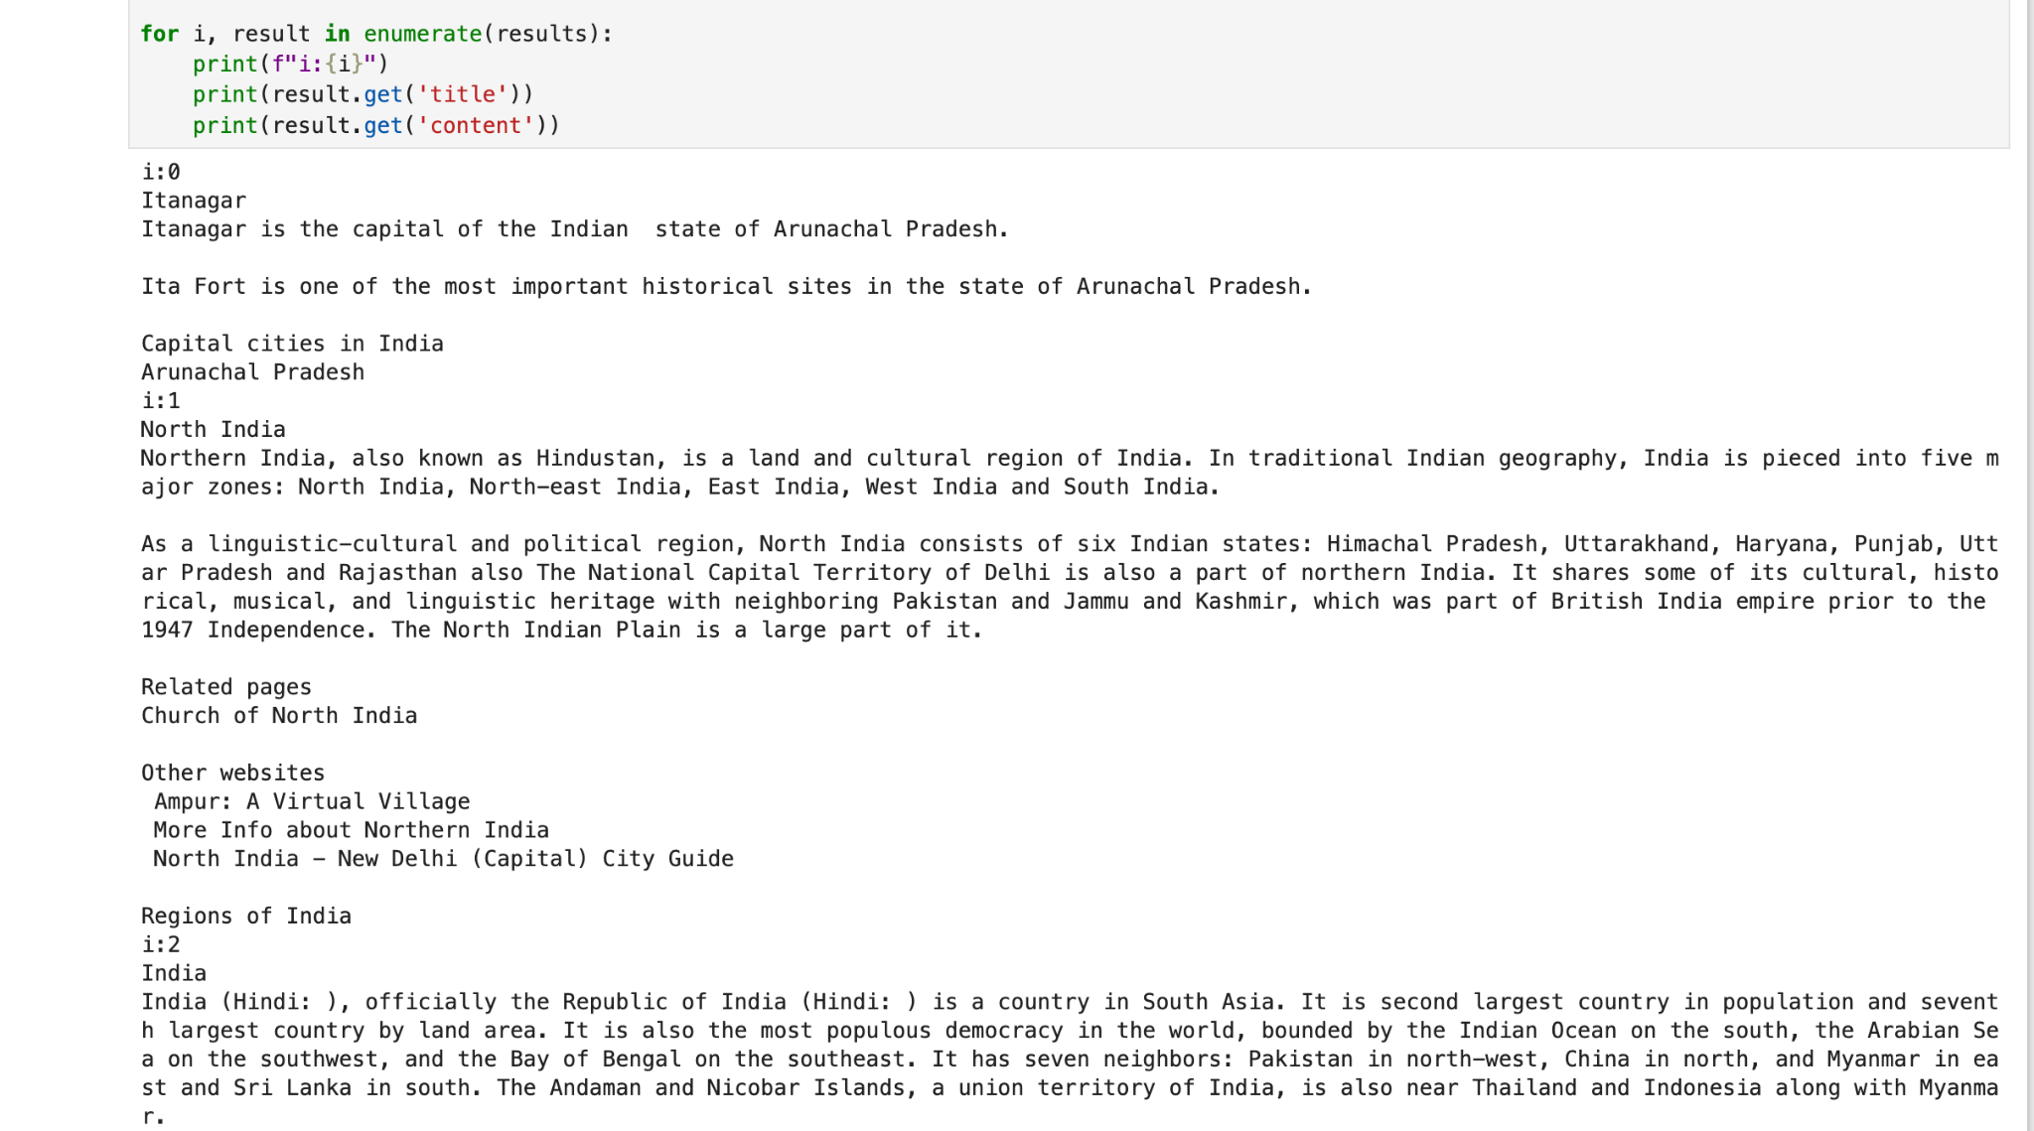

Slide 11
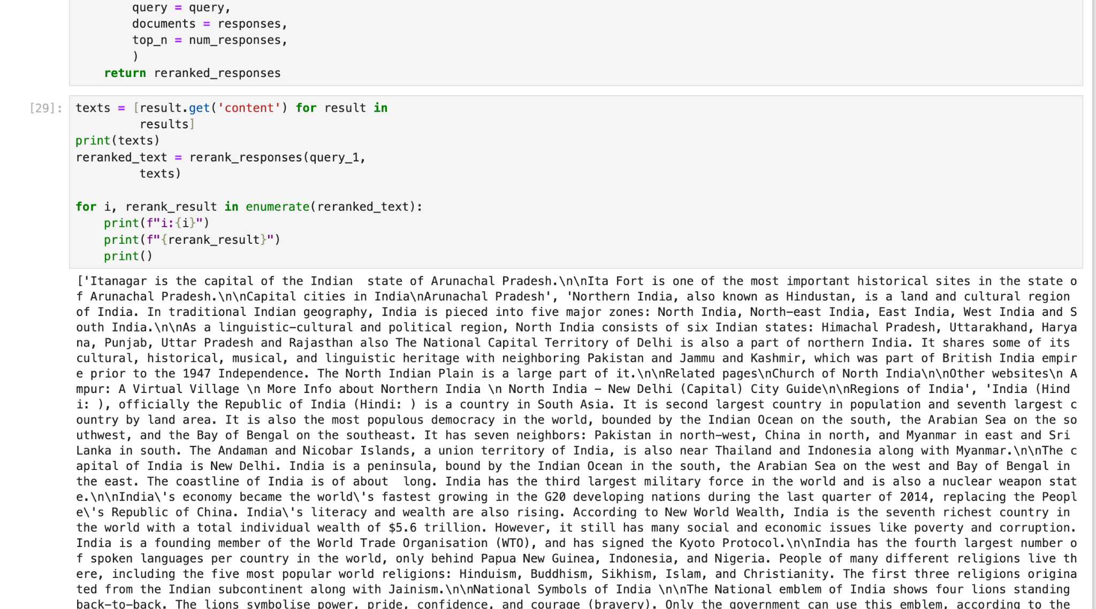

Slide 12
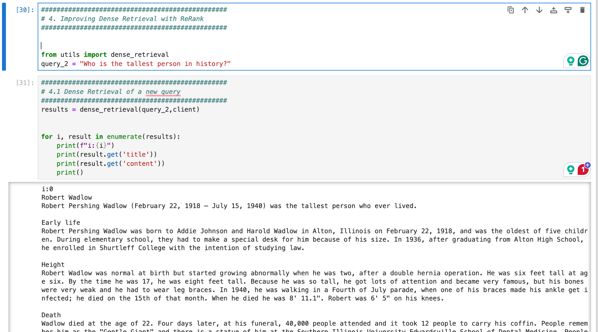

Slide 13
Enhancement Ideas
Model Improvements:
Experiment with different embedding models (e.g., GPT-based embeddings).
Fine-tune ReRank for domain-specific queries.
Hybrid Search:
Combine keyword-based and dense retrieval approaches with ReRank.
Scalability:
Evaluate performance for larger datasets and complex queries.
Evaluation Metrics:
Implement additional metrics like NDCG (Normalized Discounted Cumulative Gain).

Slide 14
Conclusion
Key Takeaways:
ReRank significantly improves retrieval relevance for both dense retrieval and keyword-based searches.
Leveraging Cohere's NLP capabilities ensures accurate and context-aware results.
Future Scope:
Integrate ReRank with conversational AI models for better question answering.
Deploy for domain-specific applications like healthcare and legal search engines.

