Slide 1
LangChain Chat with Data
Jubaida Tasnim

Slide 2
Table of Contents
Introduction
Design
Implementation
Testing
Result
Enhancement Ideas
Conclusion

Slide 3
Introduction
The project goal - building a customer support system using LangChain and ChatGPT for answering questions from various documents.

Slide 4
Design - Problem Identification
Objective: Identify and understand the problems.
Challenges:
Managing and retrieving information from different document types (PDFs, YouTube videos, URLs).
Ensuring accurate and relevant responses from a large document set.

Slide 5
Design - Solution Investigation
Solutions Considered:
Vectorstores and Embeddings: Using embeddings for storing document chunks.
Similarity Search: Implementing similarity-based retrieval for relevant document chunks.
Key Idea: Retrieval Augmented Generation (RAG) using vectorized document retrieval.

Slide 6
Design - Solution Selection
Best Solution: Selected RetrievalQA Chain and ConversationalRetrievalChain in LangChain for effective document retrieval and conversational AI.
Why: Provides accurate and contextually relevant responses by combining embeddings and vector storage with a conversational memory.

Slide 7
Implementation - Workflow Overview
Process:
Step 1: Document Loading
Step 2: Content Splitting into Chunks
Step 3: Embedding and Indexing
Step 4: Storage in Vectorstore
Step 5: Retrieval of Relevant Chunks

Slide 8
Implementation - Detailed Steps
Step-by-Step:
Create vector embeddings for each document chunk.
Store embeddings in a vector database (e.g., Chroma).
Use similarity search to retrieve relevant content based on user queries.
Implement conversational memory to handle multi-turn conversations.

Slide 9
Testing
Test Plan:
Check accuracy of document retrieval for various questions.
Verify conversational memory with follow-up questions.
Example Queries: “Is scholarship available?” and follow-up questions.

Slide 10
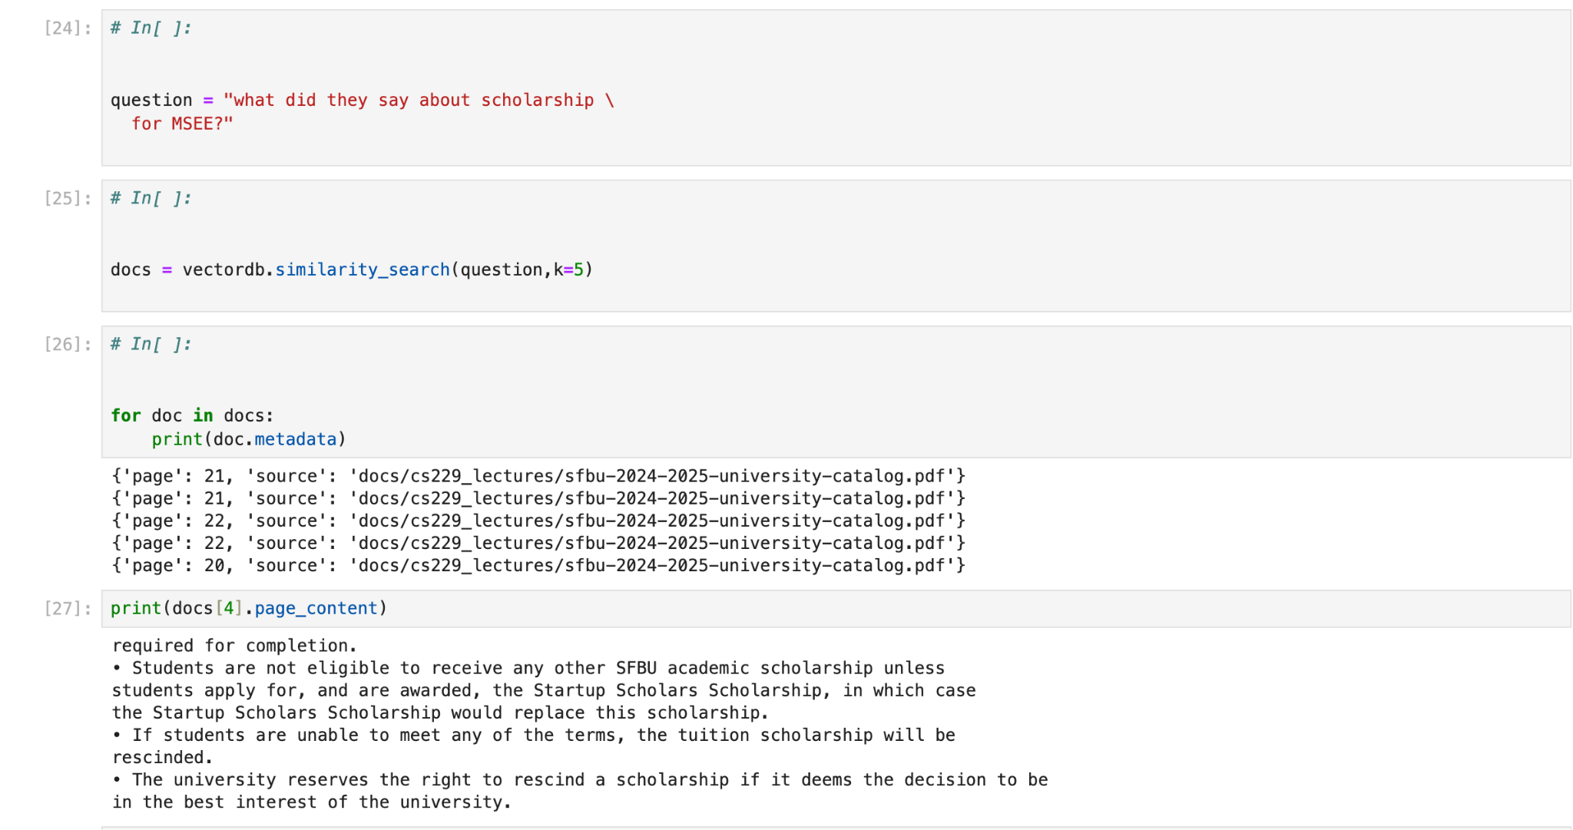
Result

Slide 11
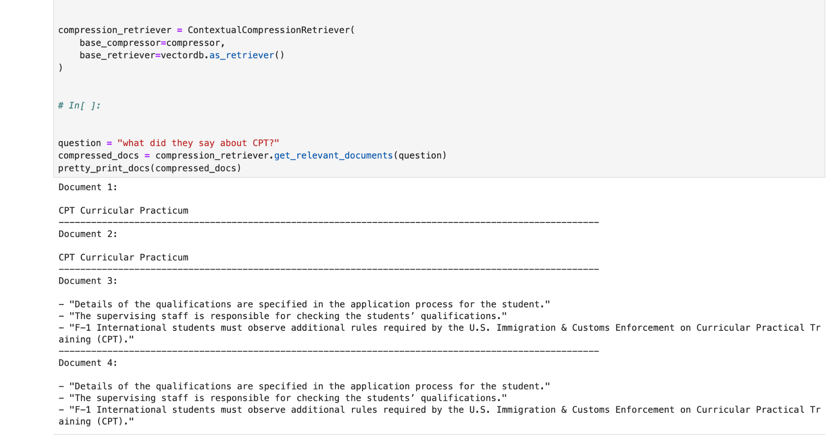

Slide 12
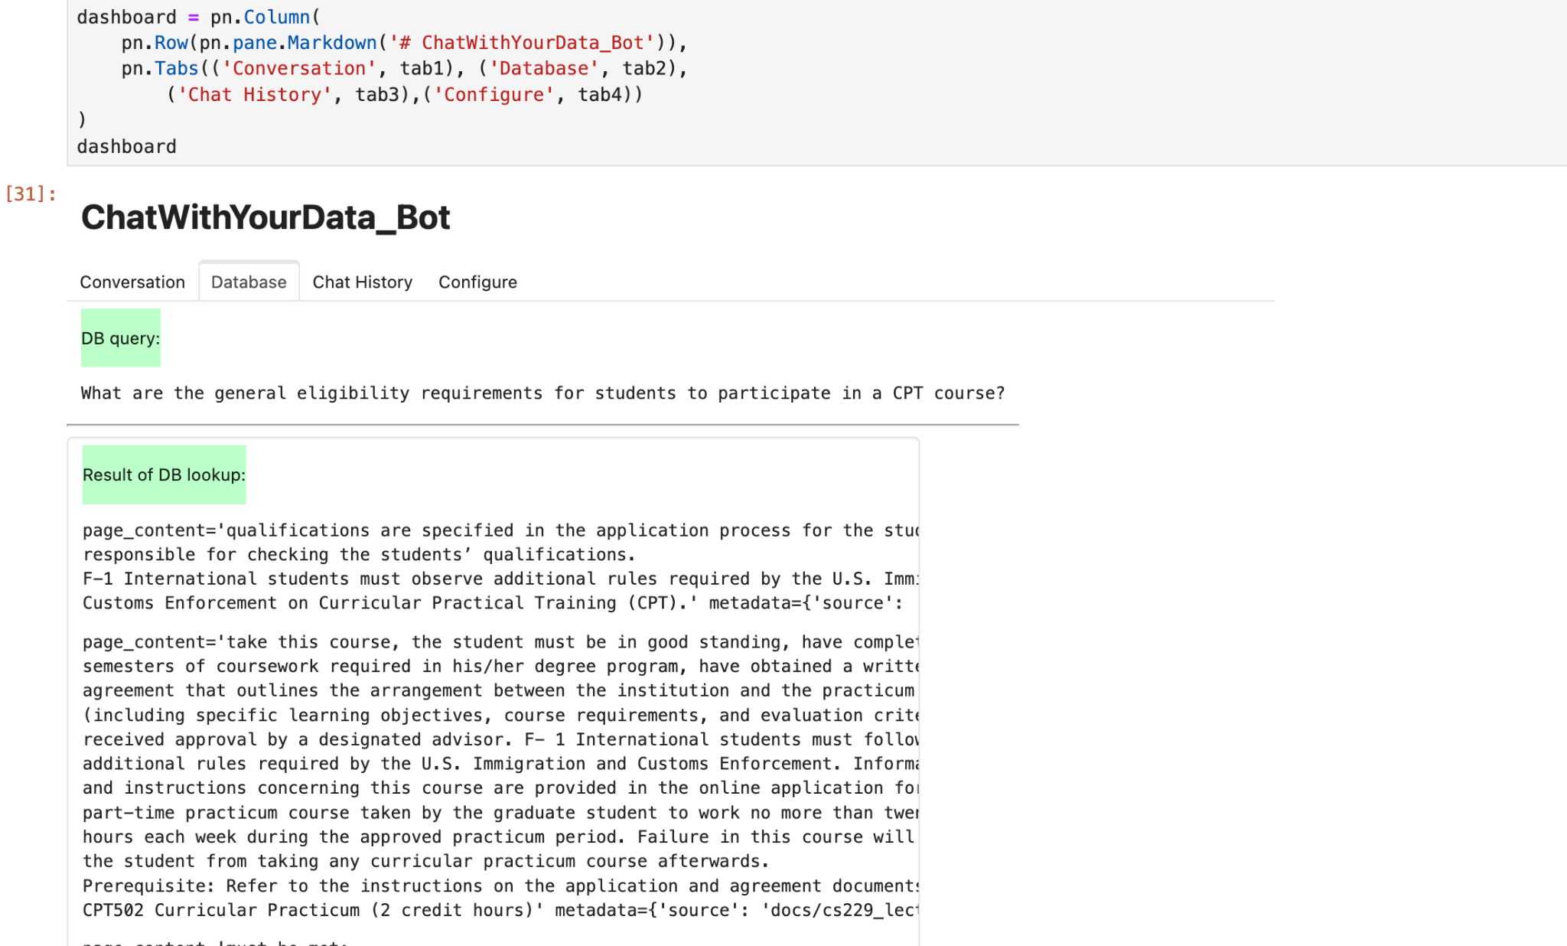

Slide 13
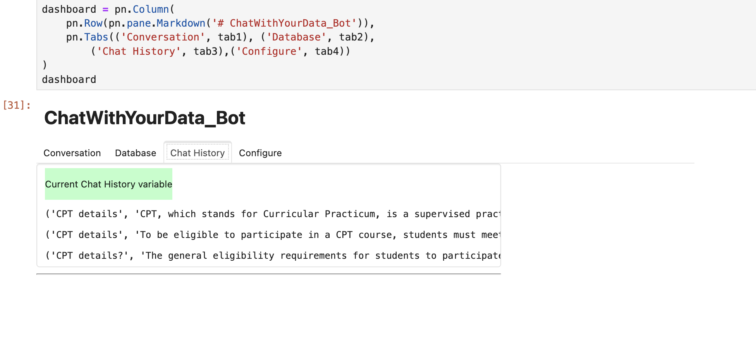

Slide 14
Enhancement Ideas
Future Improvements:
Integrate advanced retrieval techniques to address diversity and specificity in retrieval results.
Expand support to more data types (e.g., audio files, databases).
Improve user interface for better user experience.

Slide 15
Conclusion
Summary: The project successfully demonstrates a LangChain-based customer support system that can retrieve relevant answers from a variety of document types.
Impact: Provides a foundation for building complex, data-driven chatbots using retrieval-based generation.

