Slide 1

Magic the Gathering Card Browser
Metis Engineering
John Tazioli
5OCT2022

Slide 2
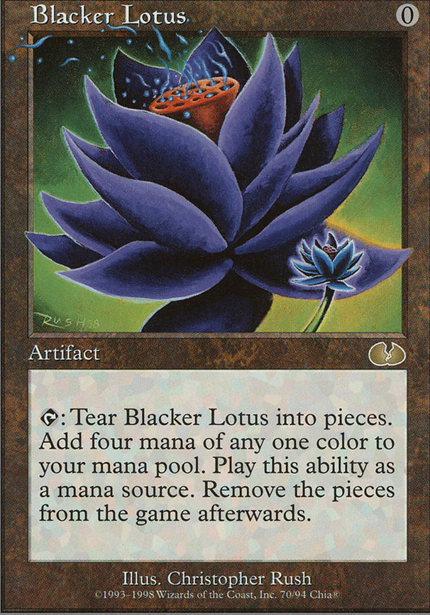
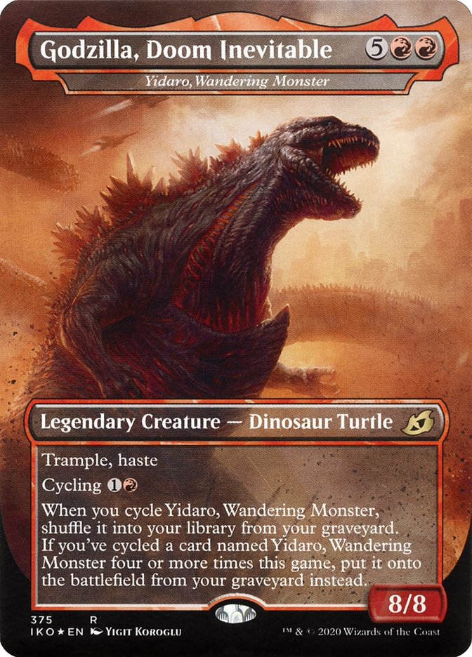


Introduction
Motivation:
Hugely Popular deck building game with thousands of cards
40-60-100 cards per deck
?
What cards exist that I can put in my deck?
Build data pipeline to allow users to interact with and explore MTG Cards

Slide 3
Methodology
Data Ingestion
Data Storage
Processing
Deployment
Webscraping scryfall.com
JSON with 64+ features
~300MB
mongoDB Atlas
PyMongo
Pandas
Streamlit
Streamlit Cloud
Github

Slide 4
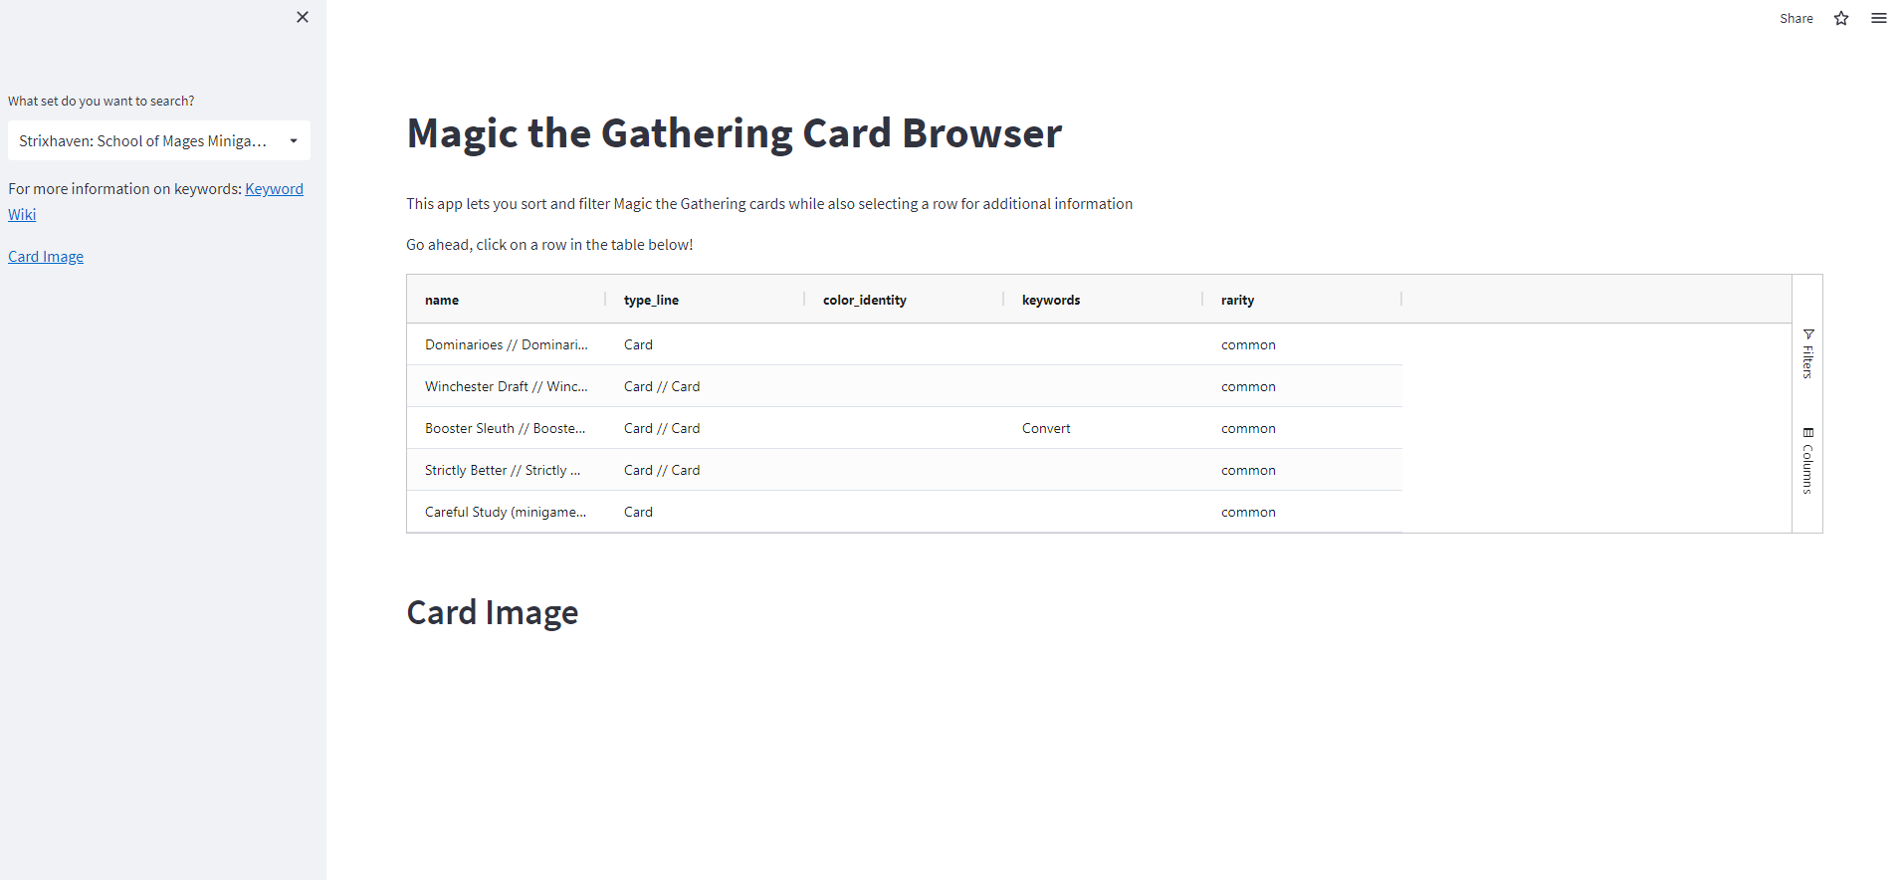
Home Page
https://jtazi-metis-engineering-test-st-t6kf3o.streamlitapp.com
Input for Query
Interactive Table
Query Output

Slide 5
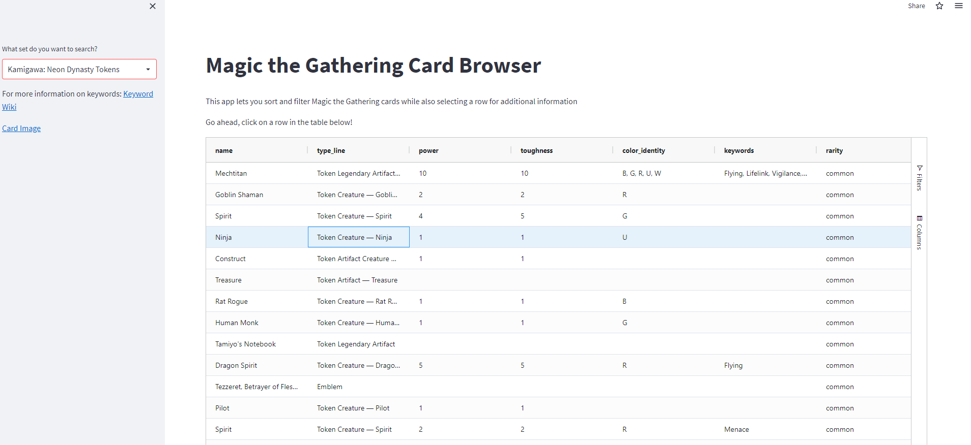
Use name for URI Query

Slide 6
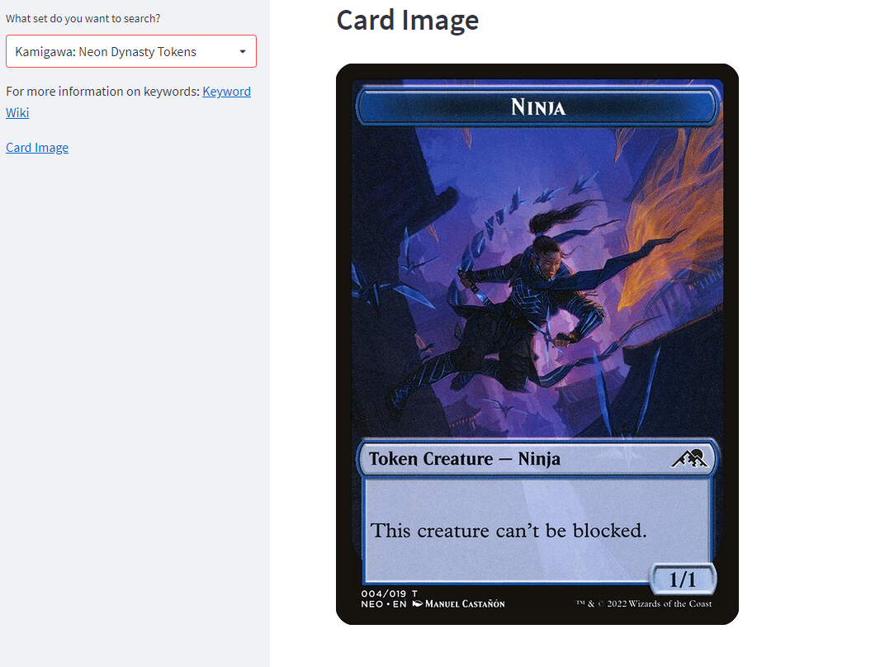

Slide 7

Future Work
Recommender System with Content based filtering system for like cards
Use Spark

Slide 8
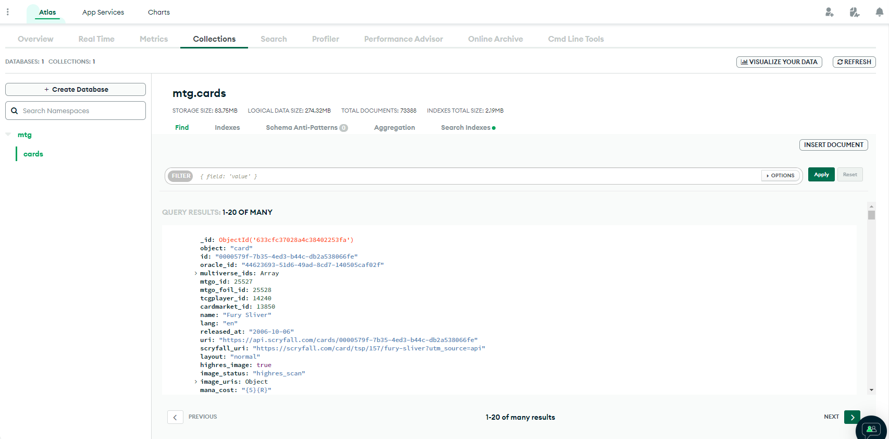
MongoDB Atlas

