Slide 1


Apache Spark
Author
Jesse T. Espinoza

Slide 2

What is Apache Spark?
Open-source, distributed computing engine.
Developed at UC Berkeley, now under the Apache Software Foundation (2009,2010, 2013)
Handles large scale data processing.
Faster than older tools like Hadoop due to in-memory computing.
Fig. Spark Cluster

Slide 3
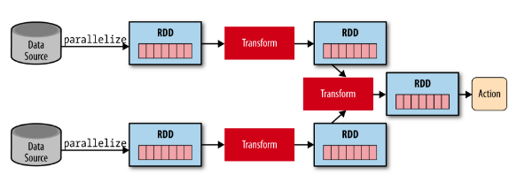
How Apache Spark Works
RDDs (Resilient Distributed Datasets) - Core data structure, fault-tolerant (lineage).
Figure.
Computation Model- Transformations vs. Actions – Lazy vs. Triggered operations
In-memory Processing – Fast because data stays in RAM
DAG (Directed Acyclic Graph) Scheduler - Creates a plan before execution for optimization.

Slide 4
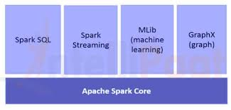
Apache Spark Ecosystem
Spark Core – The engine
Spark SQL – SQL queries on large datasets
Spark Streaming – Handle live data streams
MLib – Built-in machine learning tools
GraphX – Analize graphs/networks.

Slide 5
Why Apache Spark?
Increasing need for fast data analysis.
Big data grows rapidly. Need fast and scalable processing.
Apache Spark is one of the most popular tools for handling big data.
Thousands of companies utilize for data analytics (significant Fortune 500), active community with over 2000 contributors.
Used in diverse industries. Software development, banking, medicine, telecommunications, Apple, IBM, Meta, Microsoft.

Slide 6
Advantages of Apache Spark
Speed – In-memory(RAM) computing makes it fast (rather than to disk)
Flexibility- Works with large volumes of data at once(batch processing), streaming(real-time), SQL(SELECT, JOIN), machine learning(train models)
Ease of Use- Multi-language support, simple APIs
Scalability- Can run on laptops or massive clusters

Slide 7
Disadvantages of Apache Spark
Memory Usage– Expensive on large memory nodes. (more RAM, more cost)
No native Storage – Relies on external storage like HDFS(Hadoop Distributed Filing System) or Amazon S3 (Amazon Simple Storage Service)
Overkill for small jobs. Why?
Tuning – Complex optimization for performance (numerous settings and configuration options)

Slide 8
Real-World Applications
Netflix – Personalized recommendations
Uber – Real-time dynamic pricing
eBay – User behavior analysis
Fraud Detection – Real-time alerting
Marketing analytics – Customer segmentation

Slide 9
Final Points
Companies need fast insights from large data, Apache Spark gives them tools to make real-time decisions, also beneficial for large and small businesses.
Fast, scalable, flexible and supports many data processing tasks from analytics to AI.

Slide 10
Bibliography
https://spark.apache.org/
https://www.databricks.com/glossary/what-is-apache-spark
https://www.ibm.com/think/topics/apache-spark
https://aws.amazon.com/what-is/apache-spark/
https://towardsdatascience.com/tag/apache-spark/ (Multiple)
Apache Spark in 100 seconds
What is Apache Spark?

