Slide 1

Flight Tracker Q And A
James Tew

Slide 2
What it does
Live Dynamic Flight map – Real time aircraft positionson an interavctive Gmap interface refreshed every 10 seconds with Opensky REST API
Flight paths – Historical trajectoey of each selected flight drawn on the map using an Opensky endpoint
Airport Data – Return arrivals and departures for specific airports in the last 24 hours
Fuel Consumption metrics – Instantaneous fuel burn in kg/sec for each flight using EASA engine fuel coefficients mapped by each aircrafts ICAO24 identifier

Slide 3
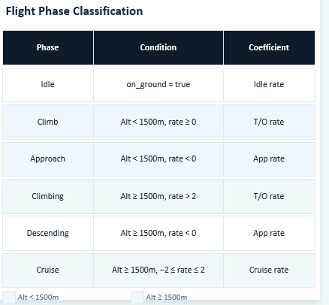
USP – Fuel Consumption Estimation
ICAO24 for aircraft is searched in Opensky database
Database returns Typecode
Typecode is used to identify EASA engine fuel coefficients
Vertical Rate is used to determine flight phase
Fuel flow in kg/sec is returned multiplied by engine count

Slide 4
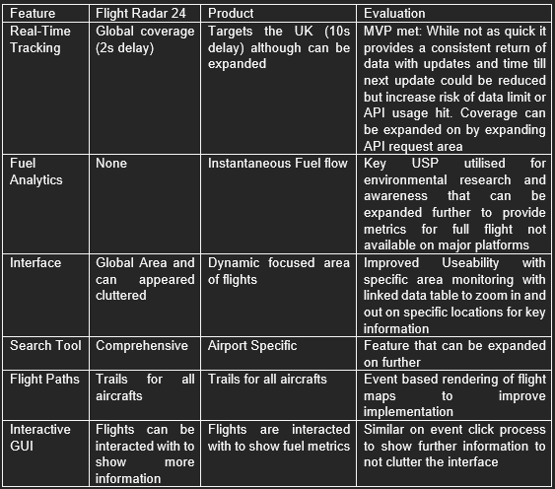
Product Evaluation
Real Time map updates every 10 seconds
Full state vectors of flight information
24-hour window of airport arrivals and departures
Historical Flight Paths
Fuel Consumption returned for each flight phase

Slide 5
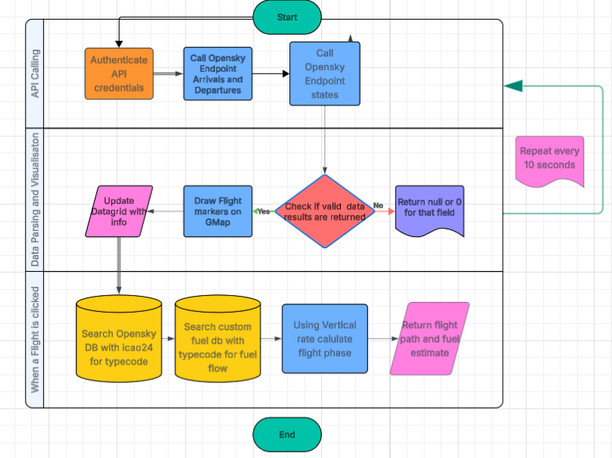

Slide 6
Future Work
Interval fuel consumption – Combine flight path endpoint data to calculate total fuel burn across a full flight not just small instant snapshots
Personal ADS-B receiver to reduce API dependency leading to more frequent updates
Expand engine fuel coefficient database to cover more commercial flights and not just the main aircraft types
Cross platform support with the use of .NET MAUI or React Native

Slide 7
Graphical User Interface
Interface is dynamic and prioritises readability with separate data grids
Real time interaction improves useability compared to static tables
Was designed around the MoSCoW requirements to prioritise functionality
Split container layout allowed for useability with users being able to resize the map and data grid to their preference so they can prioritise tables or the map
Windows forms provided fast prototyping in a familiar environment with easy to use drag and drop properties
Windows forms limits scalability and the se of React or .NET MAUI would expand the app with modern gui and cross platform
Colour code markers by category
Add filtering for specific aircrafts or airlines

Slide 8
Fuel Consumption metric
Fuel metric is the USP where it is not present in any other commercial flight tracker
Provides insight at different flight phases
Reliable using real fuel coefficient values instead of speed estimate calculations
Real time estimation allows for reall time comparionsd
A B737 at cruise returns 1.221 kg sec which is consistent with the official EASA source
Icao – typecode – engine – fuel coefficient
All values are estimates and not exact operational measurements
Limited by data where there Is default values and doesn’t use parameters like aircraft mass or engine thrust
Instantaneous fuel flow is only a snapshot fo the flight as a whole
Open AP was a python library and also required thrust metrics which I couldn’t get from ADSB data
Future work would add interval fuel consumption
Expand aircraft coeffcient database
Vertical rate – rate of altitude change in m/s with positive being climbing and negative being descending

Slide 9
Opensky API
Free and accessible for research based projects
Real time state vectors with main parameters reliable
Allowed for rapid prototyping
Opensky was free and a community driven source for research which better fit an environmental project
The last known information stays on screen
Rate limits would eventually affect the app
Data quality issues with fields like the category
Null values and inconsistent field required more data handling
Use local adsb receiver with a raspberry pi
Cache previous returned results

Slide 10
Database Design
Faster to implement than full database fit for project scope
Still met requirements
Simple look up process for both with CSV helper
Was a trade off to implement a working look up table system
CSV helper was faster to set up than sql lite
Performance slows on a larger scale
Difficult to maintain larger datasets
Missing aircraft types reduce reliability
CSV helper is a row by row look up chain
Lack of category field

Slide 11
Project Evaluation
MVP requirements were met
Unique feature works as intended within scope
Intergrates both real time and historic data
Review API endpoints earlier and further test data quality
Interval fuel consumption was a bit more difficult than I thought
Accuracy is dependent on data quality
Limited by time scope
Some features remained prototypes
Full flight emission calculation
Mobile deployment
Analysis and comparisons overview

Slide 12
Agile methodology
Allowed for rapid prototyping
Requirements didn’t need to be fully outlined
More flexible
Spint based approach allowed for improvements
Issues were caught through live testing
Couldve benefitted from peer review more maybe or a stakeholder

