Slide 1




Team 1
Bastien Baret
Lou Kramer
Cristoffer Sarevall
Jennifer Tipecska

Slide 2
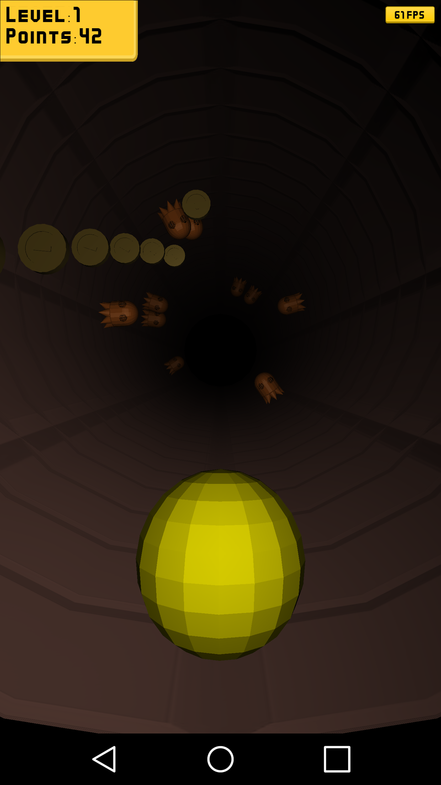
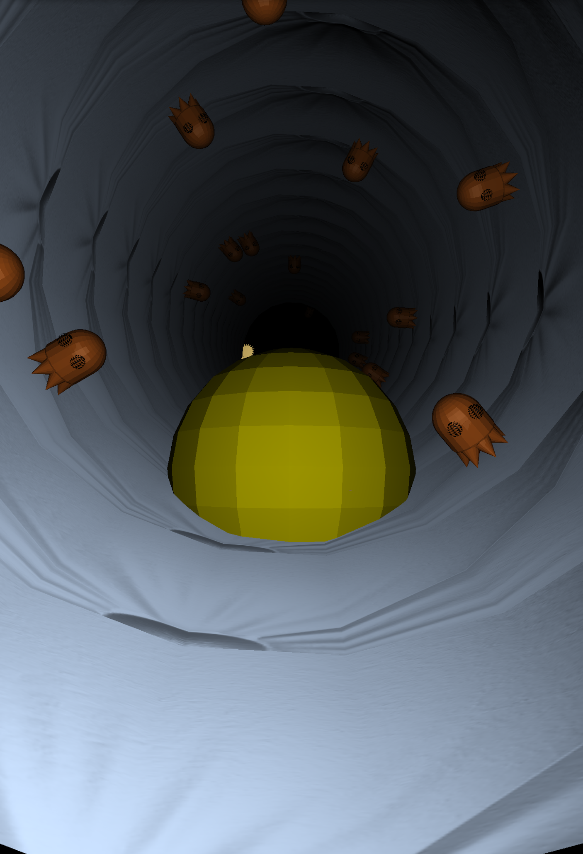

Normal Mapping
To achieve a more interesting pattern for the tunnel,
normal mapping is applied

Slide 3
Clean-up shaders
Furthermore …
clean-up the shader stuff:
remove unnecessary variables from shader
adjust materials, remove redundant variables

Slide 4
Performance improvement
Texture is now loaded only one time
Can now use all textures slots: 32*32 different textures
Fixed some memory leak with Bitmap java object

Slide 5
Levelmanager
When the scene is created all objects are preloaded, meaning we have a set number of ghosts, coins etc. to work with.
Objects are stored as children to a non-rendered node.

Slide 6
Levelmanager
Ghosts are spawned randomly
Coins spawn in groups, with random size of the group.
First coin spawn at random location, following coins
spawn behind the previous coin at an angle.
Bonus and malus are spawned randomly.

Slide 7
Collision
Euclidean to calculate if there is collision.
When an object is created a radius is set depending on it’s size.
Used to see when pacman hits objects but also to make sure new objects don’t spawn on top of existing objects.

Slide 8
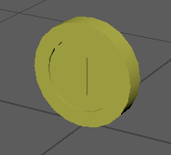
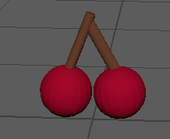
New 3D Models
Different Collectible Coin Object: - Gold shader will be applied in game
Second Bonus Object Cherry: - Doubles the Coins collected, while active. - Textured with Uv Mapping

Slide 9
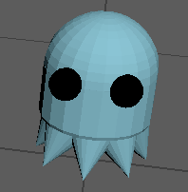
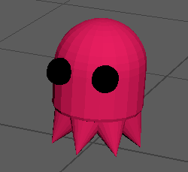
3D Model Improvements
Pacman UV Mapping and Texturing with Eyes
(4 different colored Versions)
Vertice Count Reduction, to optimize the loading of more Ghosts
In Game optimized model size changes, to improve the 3d models proportions
to each other

Slide 10
Last sprint
Add bonus and malus functions.
Some way to lose the game, KILL THE PACMAN!!!!
User testing, improve feel of game.
Fully integrate leaderboard with the game.

