Slide 1
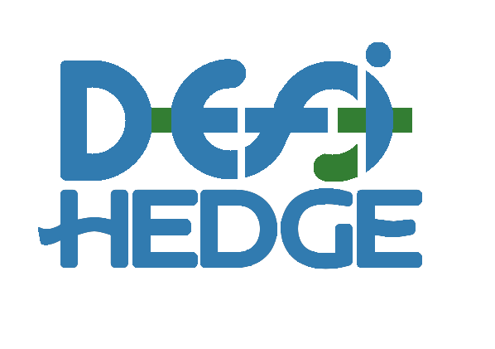
The DefiHedge Protocol & Exchange
Fixed Rate Lending & Interest-Rate Swaps

Slide 2
Traditional Interest Rate Swap Markets
The Bank for International Settlements currently estimates the notional value of all OTC interest rate derivates to be ~ $524 Trillion in their most recent annual economic report.[2]
All swaps are subject to counterparty risk and each party must evaluate the likelihood of counterparty default.

Slide 3
Decentralized Financial Markets
Today, nearly $5 Billion is locked in various DeFi protocols providing users the ability to utilize the “time-value” of their assets.
Unlike traditional finance, DeFi severely lacks the infrastructure necessary to provide leveraged positions on these protocols.
Users that wish to hedge against rate variability are forced to utilize centralized services.

Slide 4
Solution:
The DefiHedge protocol offers users the ability to hedge against DeFi interest-rate volatility through fixed-side swaps.
The DefiHedge protocol offers users the unique ability to leverage their capital with floating-side swaps.
The DefiHedge protocol ensures there is no counterparty risk and in doing so can guarantee a previously unenforceable, “trustless” swap venue.

Slide 5









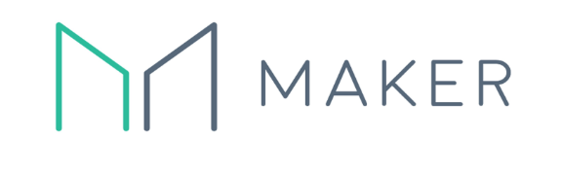












Competitive Environment
Crypto-Lending
Crypto Derivatives
Fixed
Variable
Interest-Rates
Futures/Leverage
DeFi
Central
DeFi
Central
Theoretical:
*
*Aave provides “stable” rates which are arbitrated centrally under certain circumstances but claim to be “decentralized”.

Slide 6
Obtainable Market
Given DefiHedge requires a demand for both leveraged positions and fixed-rate lending, protocol adoption is limited by whichever garners least demand.
Accepting this thesis, we estimate that the currently obtainable market is likely in the range of ~$3B/year with fixed-rate lending as the limiting factor.

Slide 7
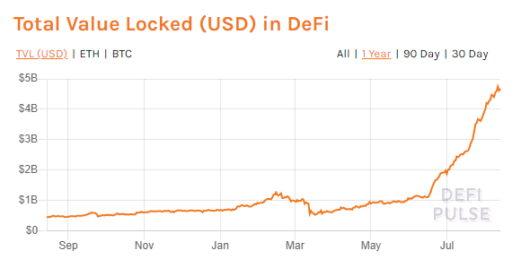
Market Timing
The rapid adoption and growth of decentralized finance has only recently facilitated the development of additional derivative markets.
As adoption has increased, production testing resulted in clear candidates for further derivative development, namely Compound Finance.

Slide 8
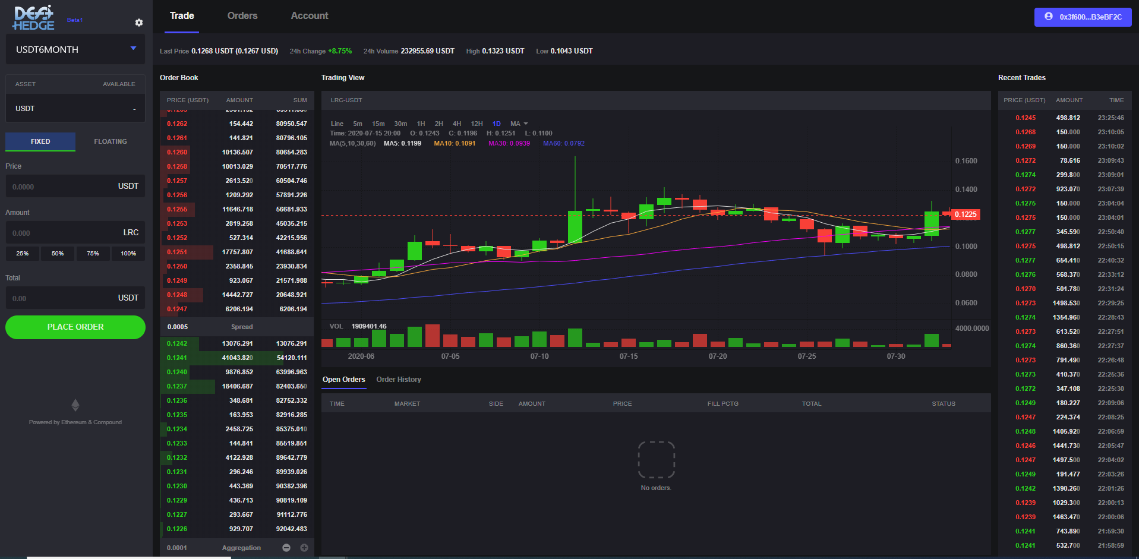
Current Progress:
Contracts:
Siloed On & Off-Chain Order Books
EIP-712 signature validation
DEX:
Major UI development complete
Backend framework established
Contract integration in progress

Slide 9
A Decentralized Marketplace for Interest-Rate Swaps

