Slide 1
Team Dank : Reengineering – Structure Analysis
Steven Hartnett, Kyle Hoffhein, Kyle Kwasniewski, Jonah Tollefson

Slide 2
Background: Mechanics
Copyrighted by IBM Corporation in 1991
Single and Two player
Destructible Environment
Winner hits the other player [loser] with an exploding banana
AI adjust difficulty depending on the actions of the player
Physics based shots
Gravity
Wind
Speed
Angle and initial power

Slide 3
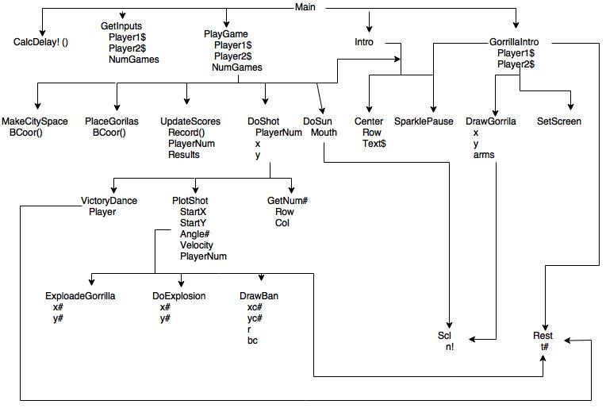
Structured Chart
Designed using Draw.io; online application

Slide 4
Data Dictionary

Slide 5
P-Spec

Slide 6
Software Metrics
Metric | Numerical Result
Lines of Code (without the space lines) | 979 ± 78
Commented lines | 198 ± 39
Executable lines | 781 ± 39
Functions/Subroutines | 24
Source Code Files | 1
External Data Files | 0

Slide 7
Questions?

