Slide 1
Indel profiling for CRISPR-Cpf1
Joanna Tumelty
15/09/17

Slide 2
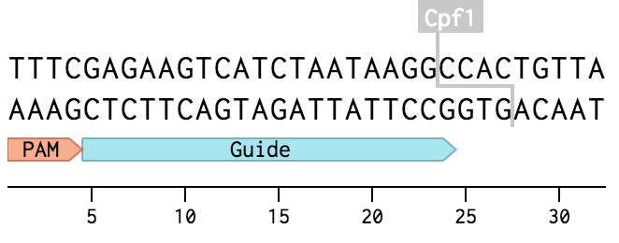
Cpf1
AsCpf1 (from Acidaminococcus) and LbCpf1 (from Lachnospiraceae bacterium)
T rich PAM
Staggered cut
Cut site distal to the PAM
Longer deletions observed than short indels
Low off-target activity
https://benchling.com/pub/cpf1

Slide 3
Process
Filtered data
Found indels
Looking at the distributions

Slide 4
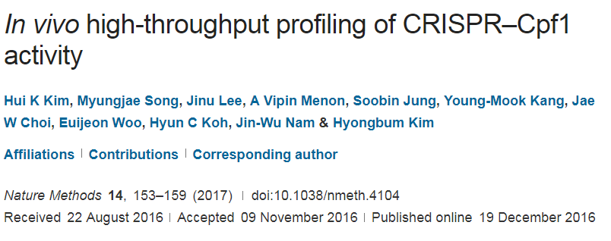
Process
Filtered data
Found indels
Looking at the distributions

Slide 5
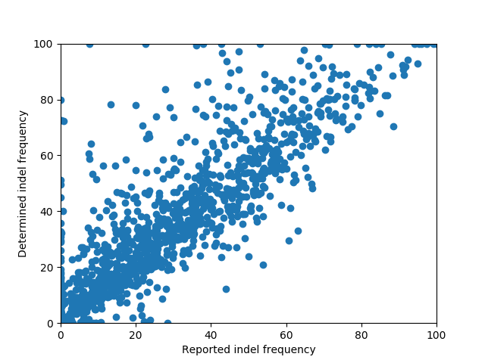
Process
Filtered data
Found indels
Looking at the distributions

Slide 6
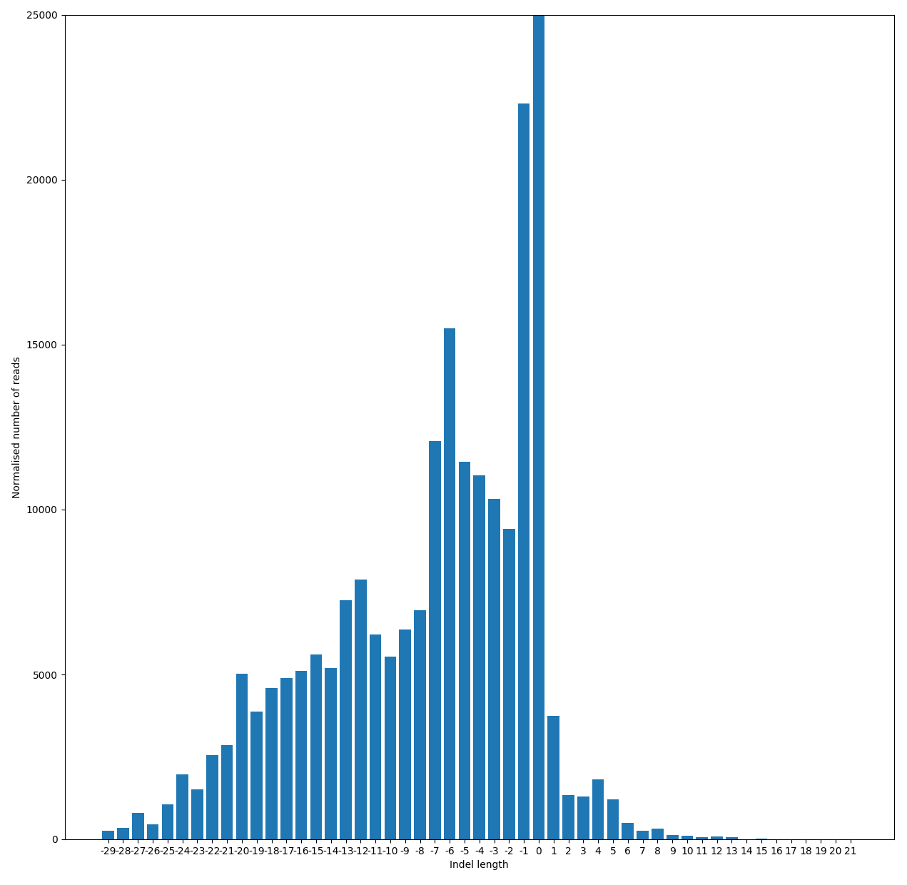
Indel lengths

Slide 7
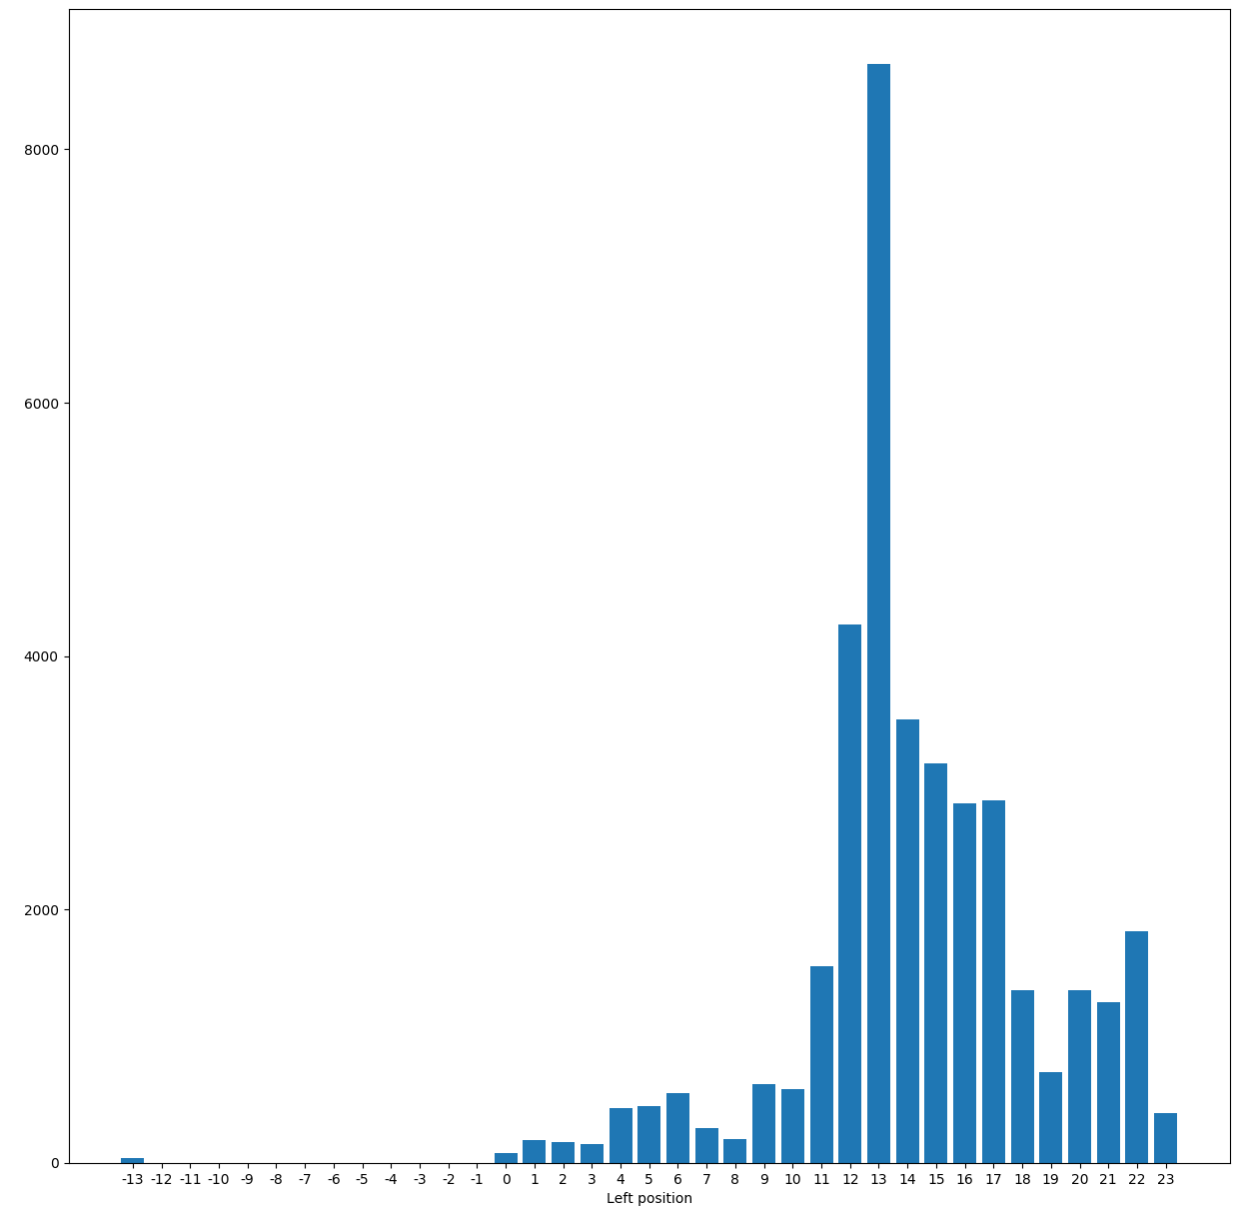
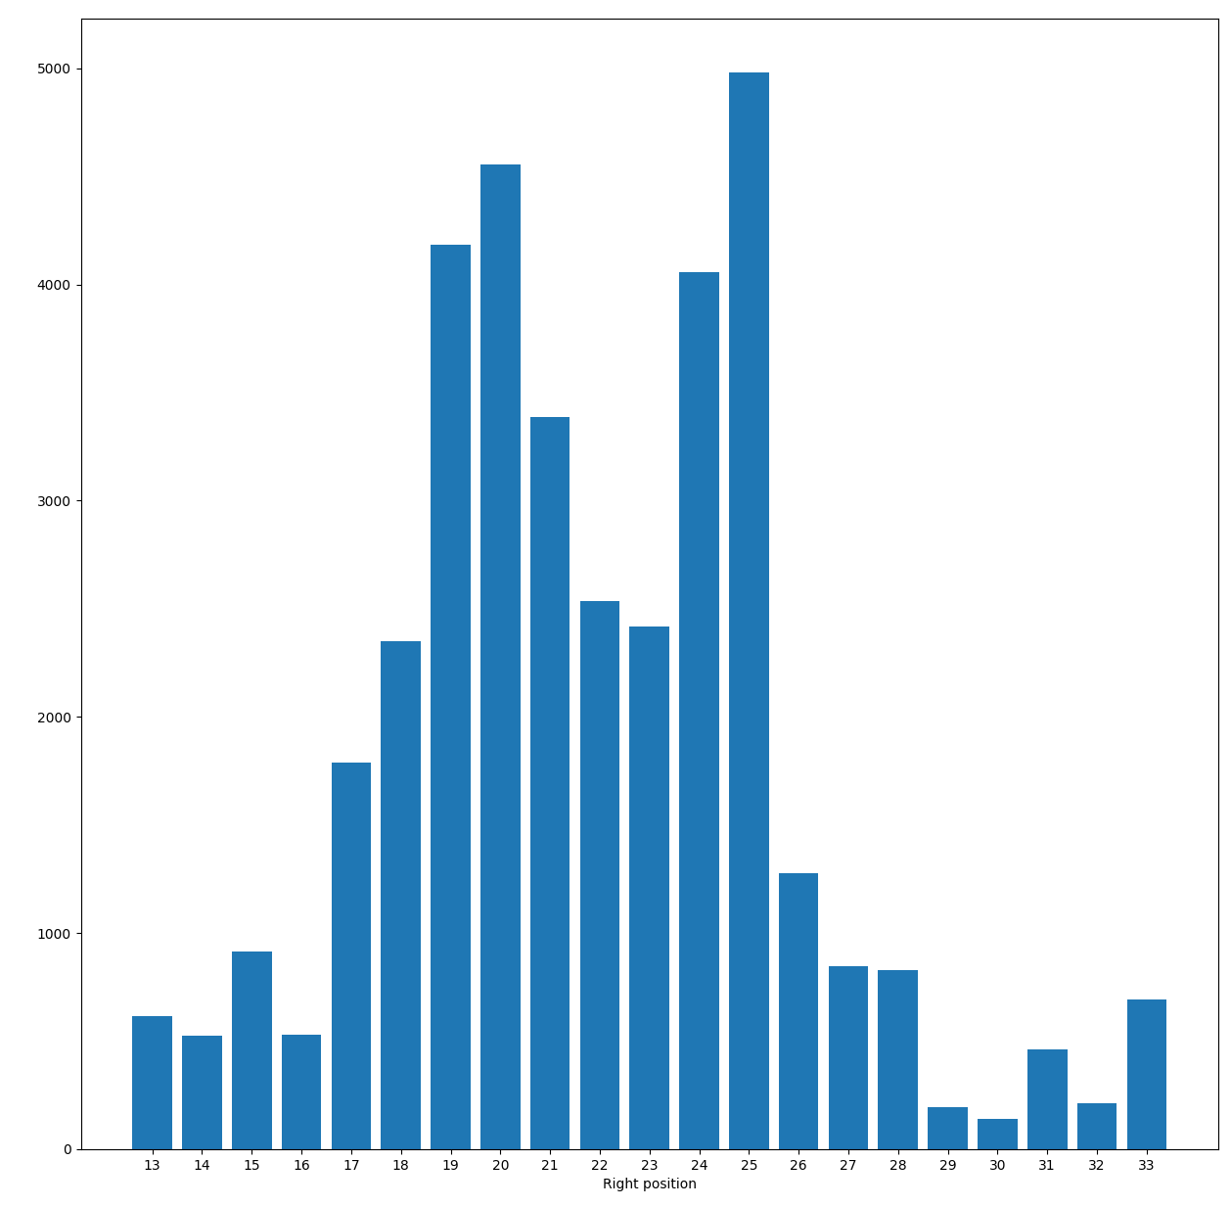
Deletion positions
TTTAGCGGGCGCCGAGTATAGAGCCTAAGCTTGGCGTAACTAGATCT
TTTAGCGGGCGCCGA CCTAAGCTTGGCGTAACTAGATCT
11
20

Slide 8
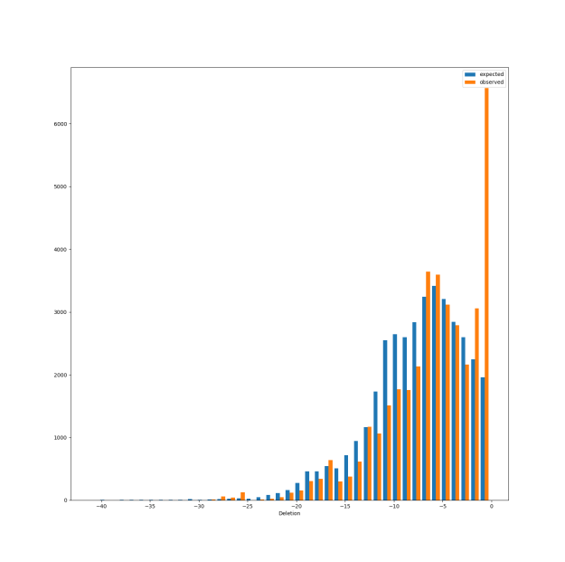
Deletion length profiles: Observed (orange) Expected if positions are independent (blue)

Slide 9
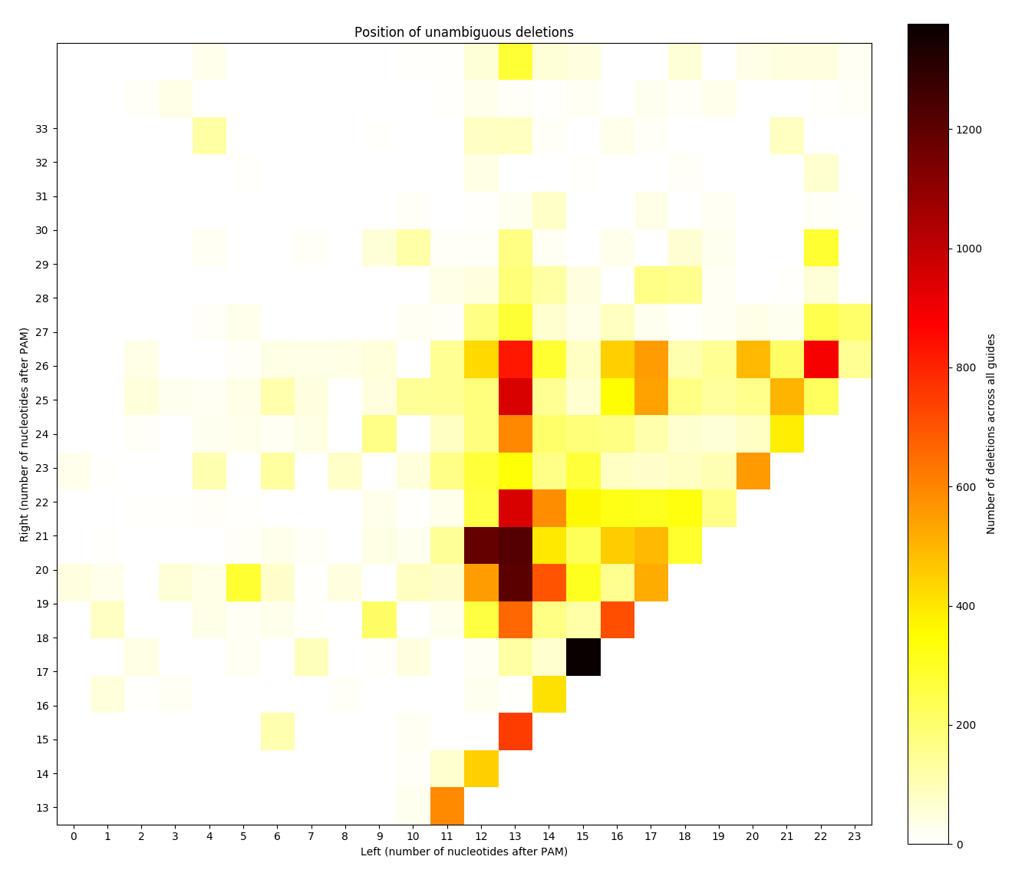
Deletion length profiles: Observed (orange) Expected if positions are independent (blue)
Deletion positions: Comparing the pairs of upstream and downstream positions of deletions

Slide 10
Insertions
a. TTTAACAGGAGGAGGTCGTCGTTGTT CAGCTTGGCGTAACTAGATCT
TTTAACAGGAGGAGGTCGTCGTTGTTTTGTTCAGCTTGGCGTAACTAGATCT
b. TTTAGCCCTCATCCTTGGTGGTGA AGTAGCTTGGCGTAACTAGATCT
TTTAGCCCTCATCCTTGGTGGTGATGAAGTAGCTTGGCGTAACTAGATCT
c. TTTAACAGGAGGAGGTCGTCGTT GTTCAGCTTGGCGTAACTAGATCT
TTTAACAGGAGGAGGTCGTCGTTCACGTTCAGCTTGGCGTAACTAGATCT

Slide 11
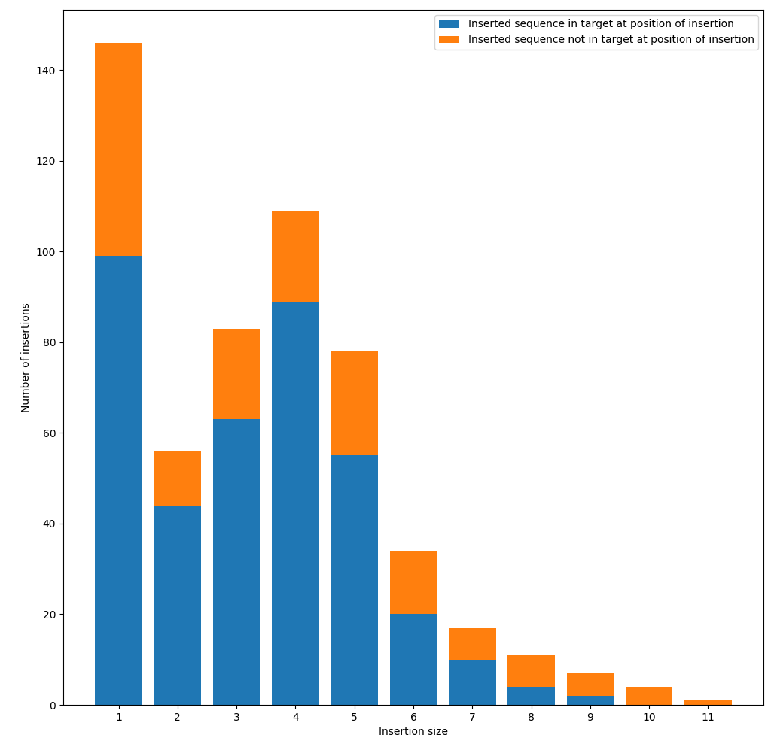
Insertions
a. TTTAACAGGAGGAGGTCGTCGTTGTT CAGCTTGGCGTAACTAGATCT
TTTAACAGGAGGAGGTCGTCGTTGTTTTGTTCAGCTTGGCGTAACTAGATCT
b. TTTAGCCCTCATCCTTGGTGGTGA AGTAGCTTGGCGTAACTAGATCT
TTTAGCCCTCATCCTTGGTGGTGATGAAGTAGCTTGGCGTAACTAGATCT
c. TTTAACAGGAGGAGGTCGTCGTT GTTCAGCTTGGCGTAACTAGATCT
TTTAACAGGAGGAGGTCGTCGTTCACGTTCAGCTTGGCGTAACTAGATCT

Slide 12
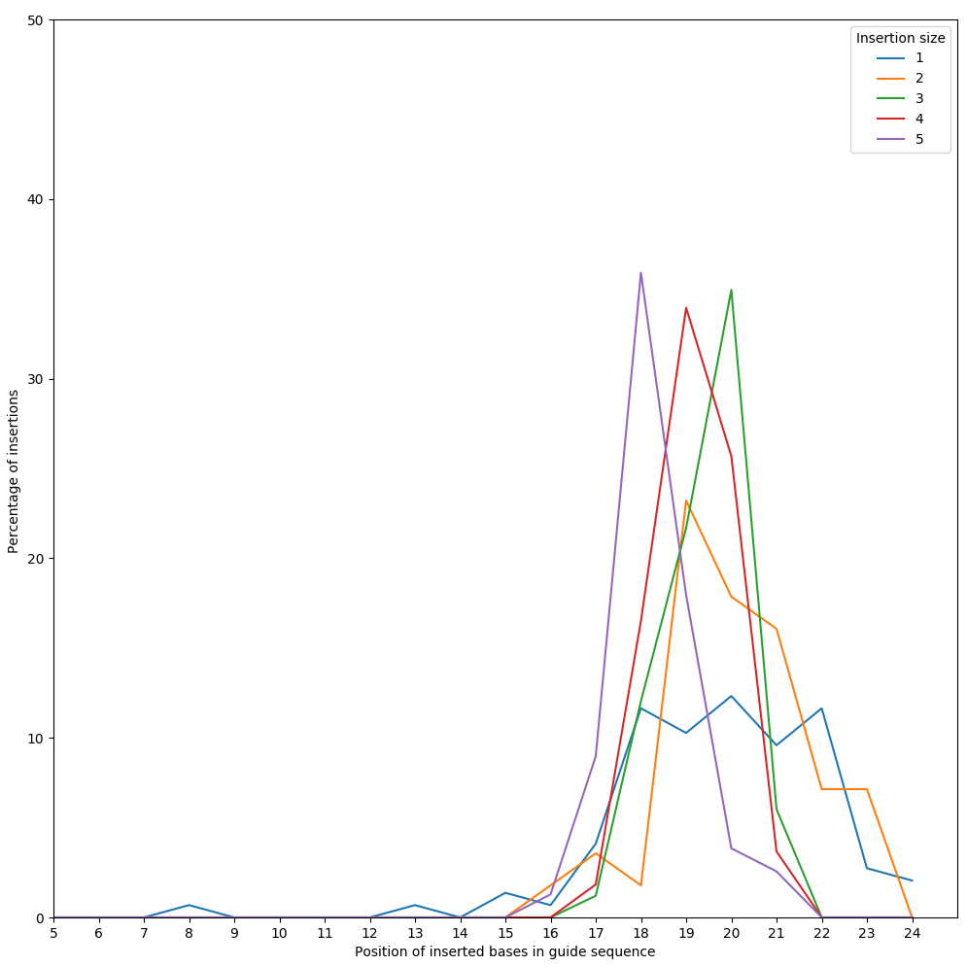
Insertions
a. TTTAACAGGAGGAGGTCGTCGTTGTT CAGCTTGGCGTAACTAGATCT
TTTAACAGGAGGAGGTCGTCGTTGTTTTGTTCAGCTTGGCGTAACTAGATCT
b. TTTAGCCCTCATCCTTGGTGGTGA AGTAGCTTGGCGTAACTAGATCT
TTTAGCCCTCATCCTTGGTGGTGATGAAGTAGCTTGGCGTAACTAGATCT
c. TTTAACAGGAGGAGGTCGTCGTT GTTCAGCTTGGCGTAACTAGATCT
TTTAACAGGAGGAGGTCGTCGTTCACGTTCAGCTTGGCGTAACTAGATCT

Slide 13
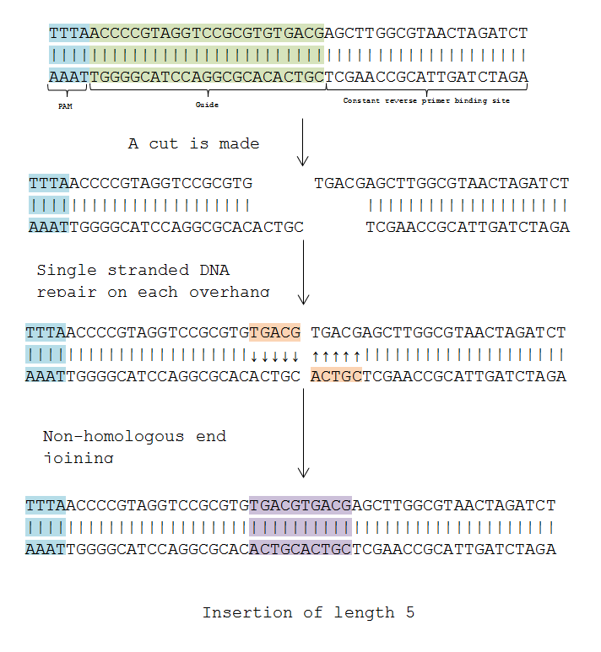

Slide 14
Possible further work
Did indels corresponding to a deletion followed by an insertion of a smaller number of bases occur in similar positions to straight deletions?
To what extent can the cleavage position on either strand be deduced from the sequenced reads?
If this is possible how often was the cleavage position around each position?

Slide 15
Conclusions
Cpf1 cleavage results in indels and there were a range of activity levels across the guides.
Deletions were far more frequent than insertions.
Distinct profiles for the left and right positions of deletions.
Insertions tended to be a direct repeat of sections in the target sequence and often towards the end of the target sequence.
Cleavage on the non-target strand occurred around both the 14th and 18th bases.

Slide 16
Acknowledgements
Felicity Allen
Leopold Parts

