Slide 1
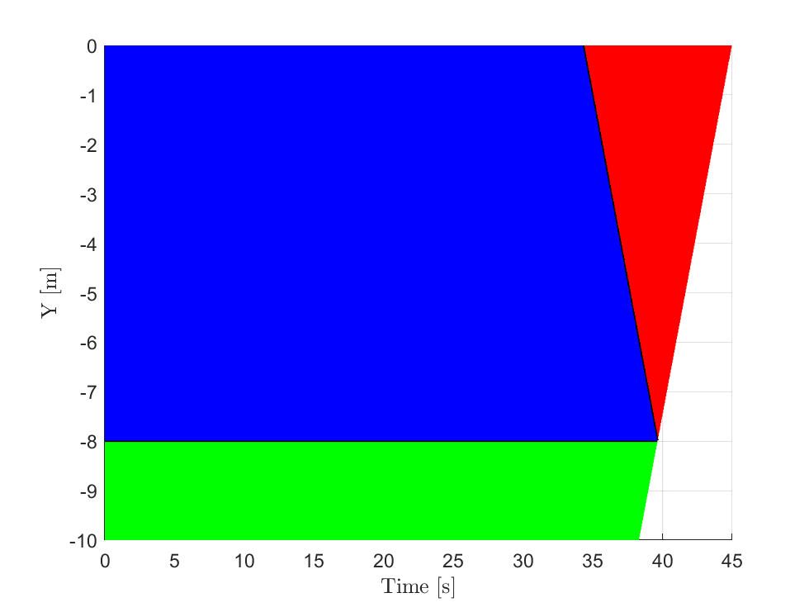
Dive-Surface
Dive-Hold-Surface
Surface-Hold-Surface
Invalid Region

